Slide 1
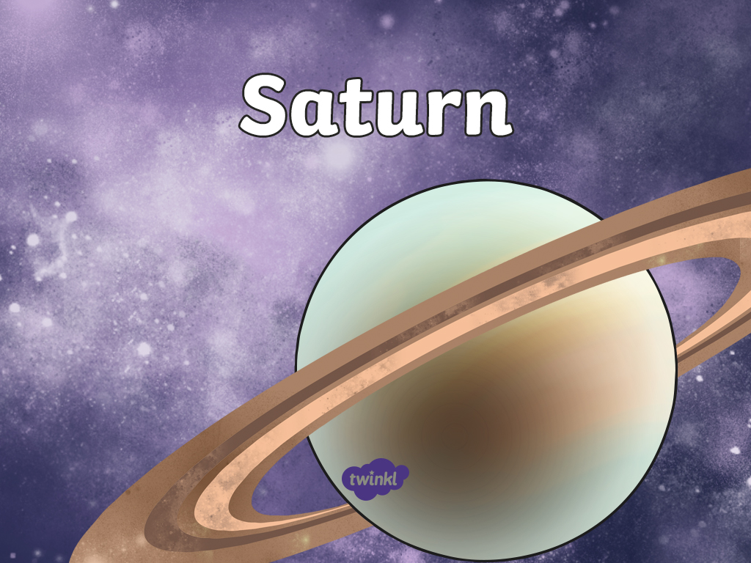

Slide 2

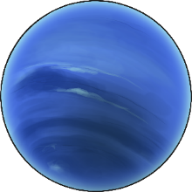
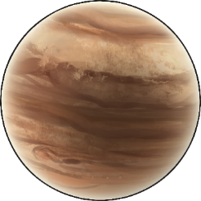
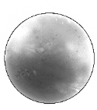
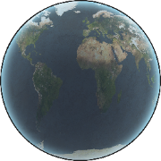
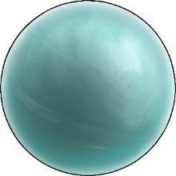
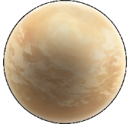
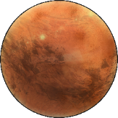
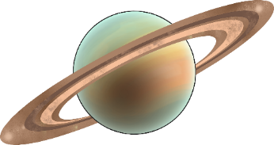
Earth is only one of the planets in our Solar System. There are seven other planets that also orbit our Sun.
Neptune
Jupiter
Mercury
Earth
Uranus
Venus
Mars
Saturn

Slide 3
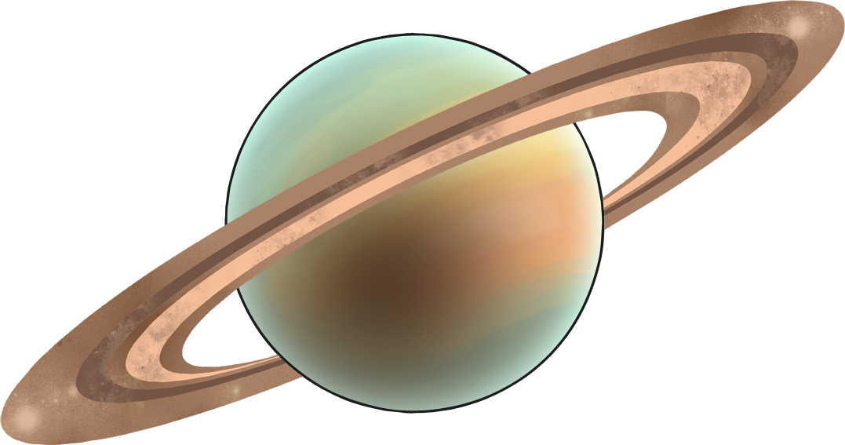
The Ringed Planet
The planet Saturn is the second largest planet in the Solar System. It is the sixth planet from the Sun and 1.2 billion kilometres away from Earth.

Slide 4
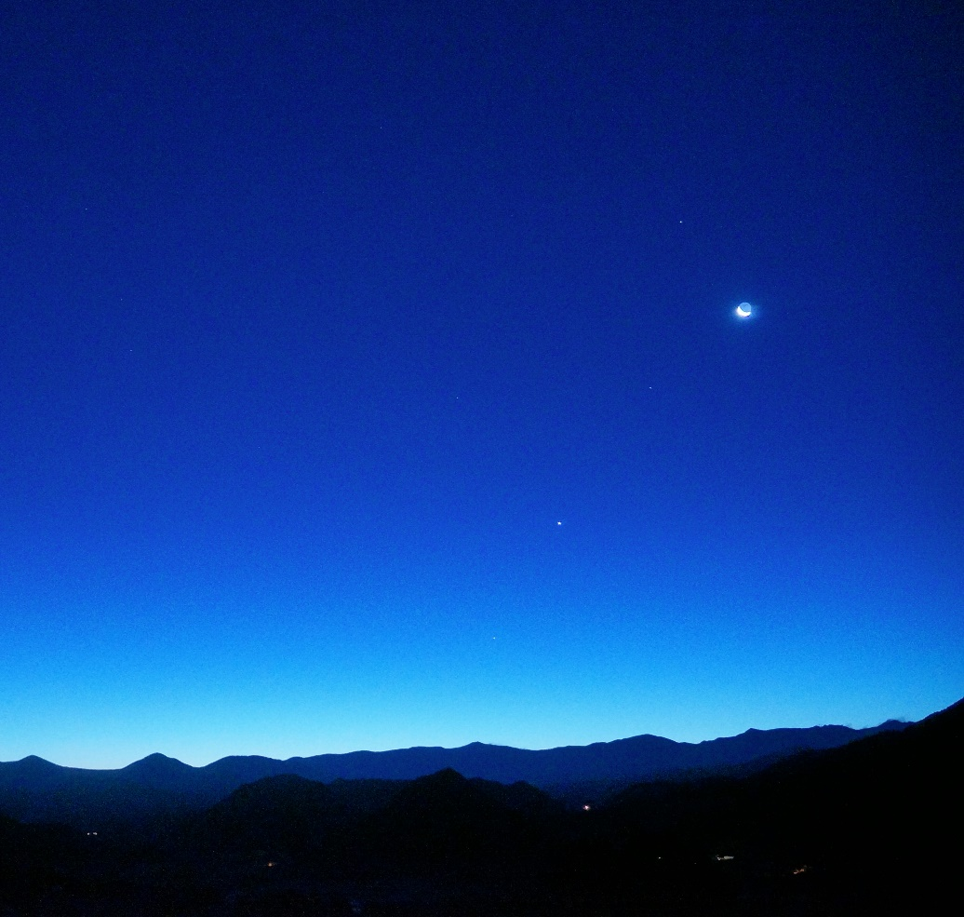
Even though it is so far away, Saturn can sometimes be seen in the night sky as a yellow point of light.
Saturn
“Saturn, Moon, Venus and Mercury at dawn” by Mike Lewinski is licensed under CC BY 2.0

Slide 5
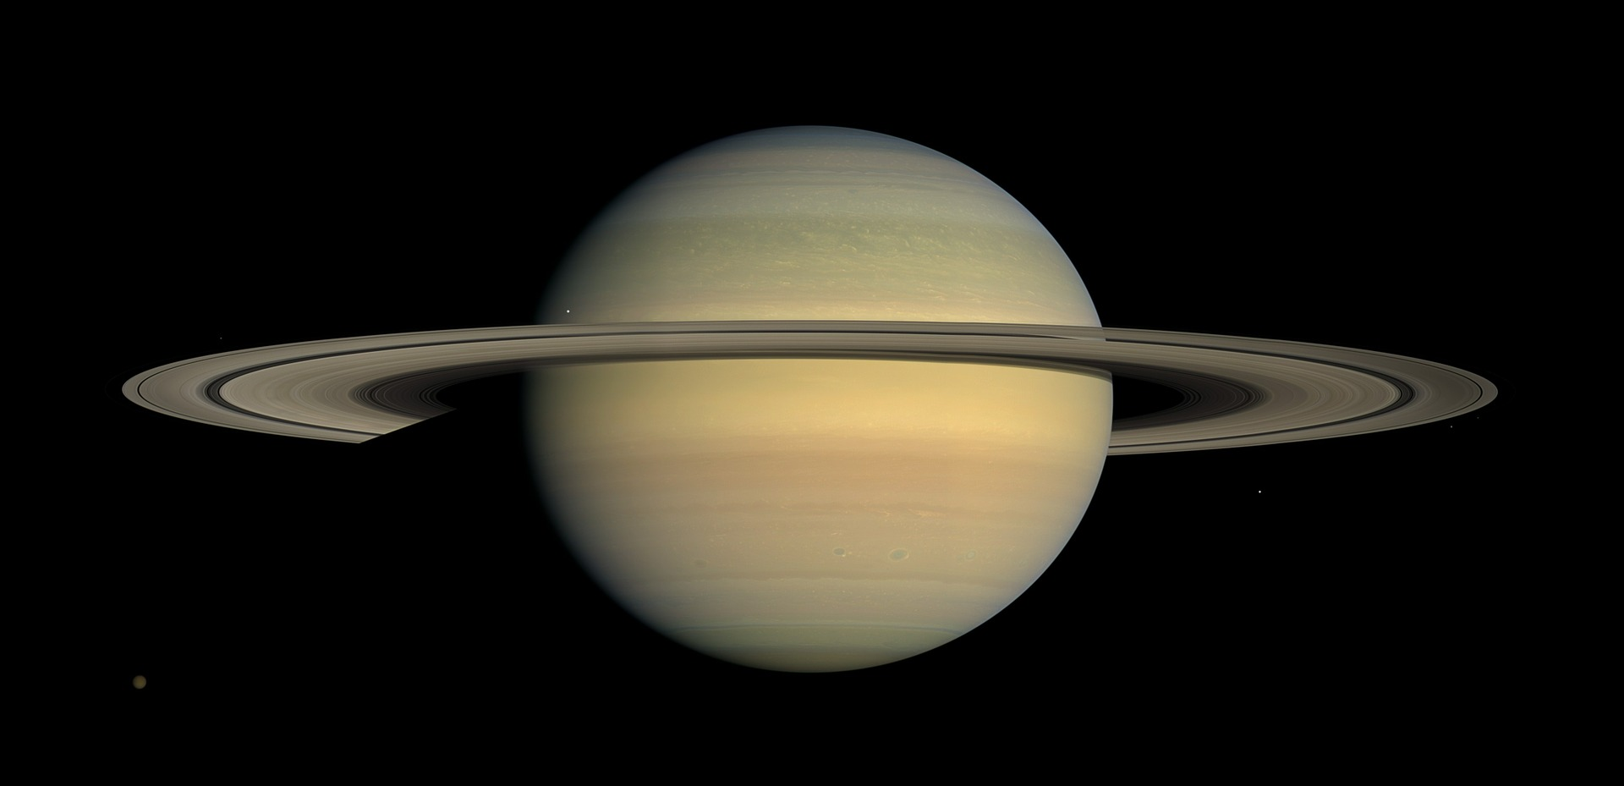
Saturn is a gas giant. It is an enormous ball of gas with no solid surface.
It is famous for its seven beautiful rings. These are made of chunks of rock and ice.
It is not the only planet in the Solar System with rings but none are as spectacular as the ones around Saturn.

Slide 6
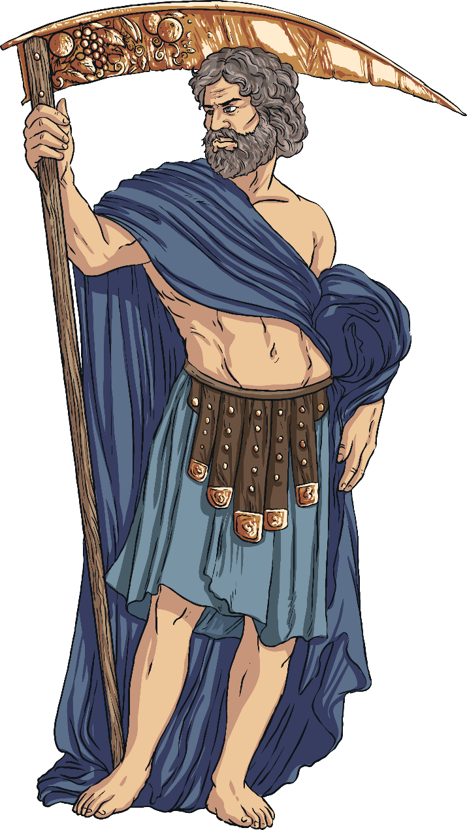
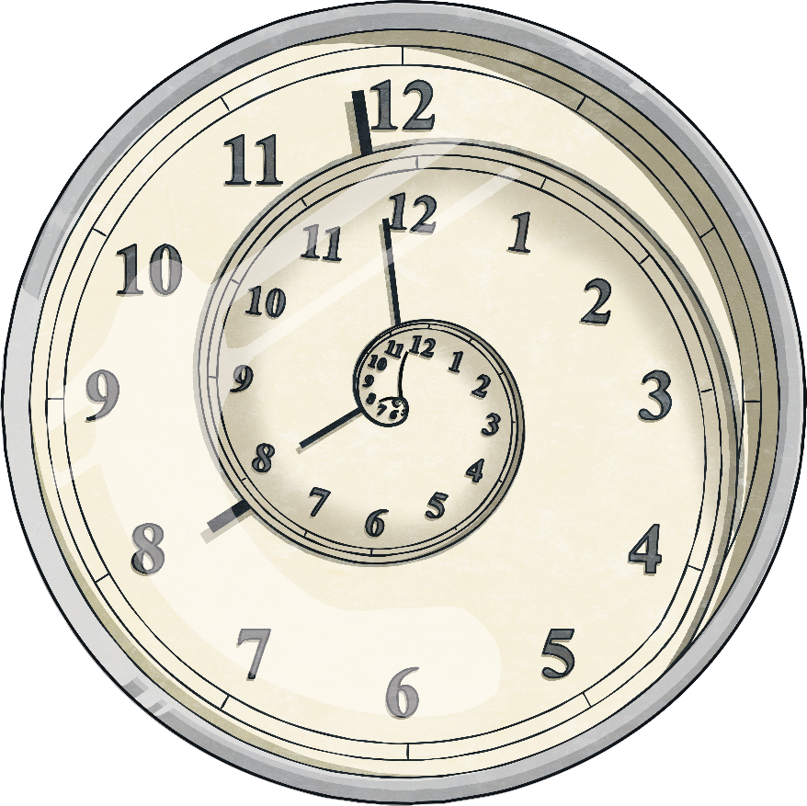
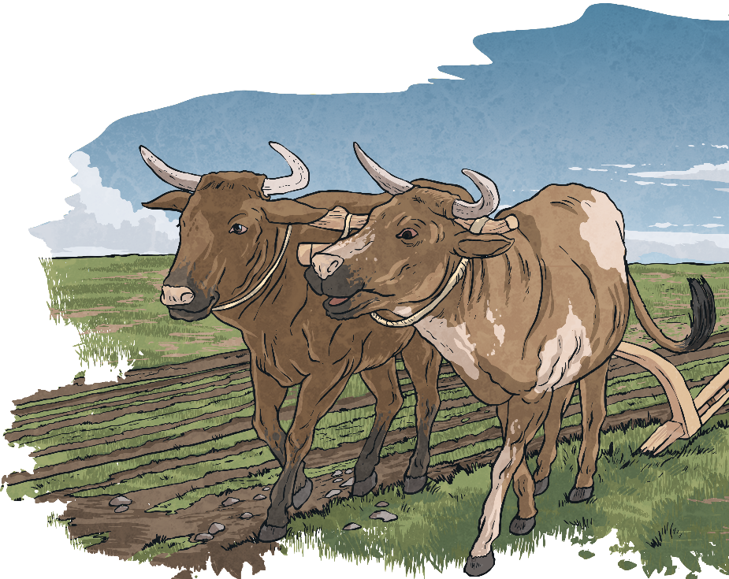
Saturn is named after the Roman god of agriculture and time. In Roman times, it was known as ‘the star of Saturn’ and believed to be sacred to the god Saturn.

Slide 7
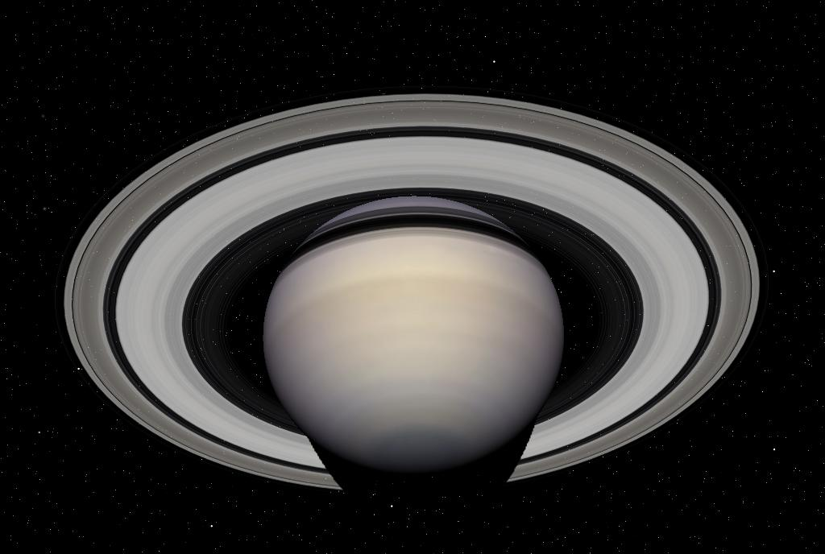
Saturn and Earth
Saturn is very different from Earth.
One day on Saturn is less than 11 hours long.
Saturn takes a long time to orbit the Sun. One year on Saturn is the same as 29 years on Earth.
Saturn has 82 moons, more than any other planet in the solar system. 53 of its moons are named.
“Saturn portrait” by Les Chatfield is licensed under CC BY 2.0

Slide 8
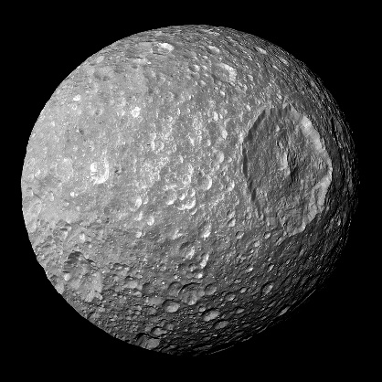
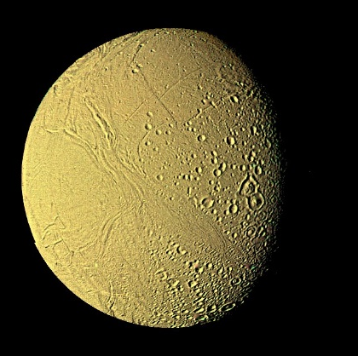
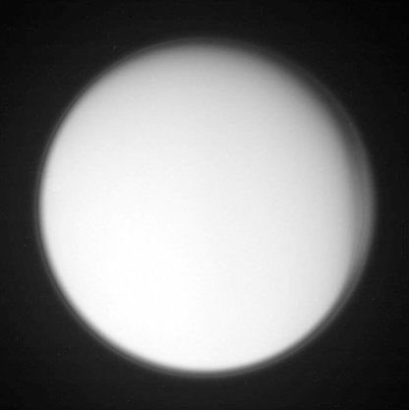
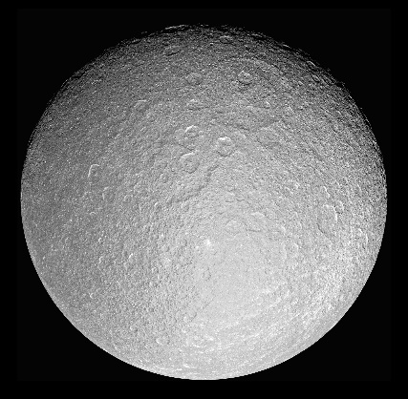
Saturn’s Moons
Out of Saturn’s 82 moons, the moons of Mimas, Enceladus, Titan and Rhea are of the most interest to scientists.
Click on each moon below to find out more information!
Mimas
Enceladus
Titan
Rhea
“Titan4” by alan taylor is licensed under CC BY 2.0

Slide 9

Mimas
Mimas is the closest moon to Saturn.
It is incredibly small. Its whole surface area would cover about the same amount of land as Spain.
It was discovered by the astronomer William Herschel in 1789.
The biggest feature of Mimas is its massive crater, named Herschel after Mimas’ discoverer. The crater is 81 miles across and about 3 miles deep.
Back

Slide 10
Enceladus
Enceladus is the sixth largest moon of Saturn.
It is also the sixth largest moon in the Solar System.
It was discovered by the scientist Galileo in 1610.
Enceladus is covered in a layer of fresh, clean ice, making it very reflective.
It also has geysers on its surface that shoot up hot water vapour into the sky.
Scientists are very interested in Enceladus as they think it has most of the chemical ingredients needed for life.
Back

Slide 11
Titan
Titan is the largest of Saturn’s moons and the second largest moon in the Solar System. It is even larger than the planet Mercury.
Titan is made mainly of ice and rock.
It is the only moon with its own atmosphere. It has clouds, rain, rivers, lakes and seas of liquid methane.
Scientists think that Titan might have a liquid water ocean below its surface.
“Titan4” by alan taylor is licensed under CC BY 2.0
Back

Slide 12

Rhea
Rhea is Saturn’s second largest moon and the ninth largest moon in the Solar System.
It was discovered by the astronomer Giovanni Cassini in 1672.
Rhea is an icy moon covered in craters and canyons. The canyons look like cracks on its surface.
As Rhea orbits Saturn, the same area of the moon faces the planet in the same way that Earth’s moon does.
Back

Slide 13
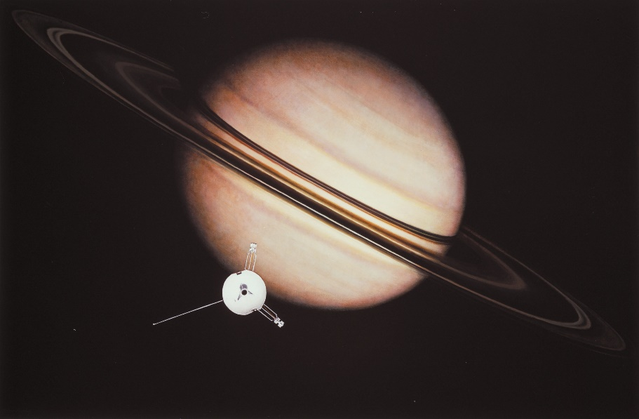
Exploring
Humans have known about Saturn for thousands of years. However, it is only recently that we have had the technology to study Saturn, its rings and its moons close up.
The Pioneer 11 spacecraft was the first to reach Saturn in 1979. It found out the number of rings Saturn has and it discovered a new moon.

Slide 14
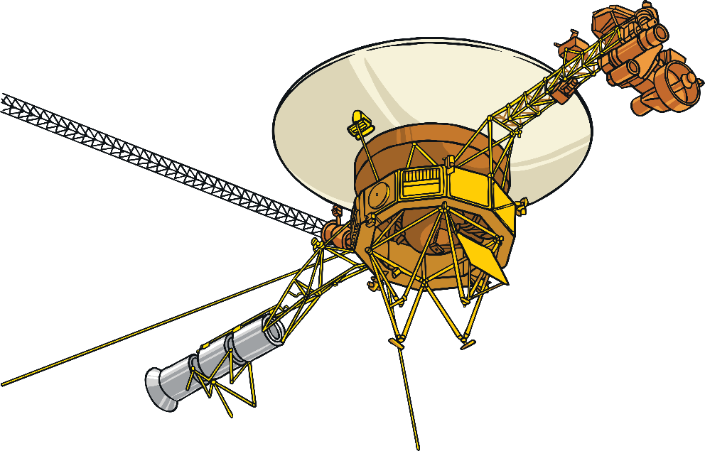
Exploring
In 1980, the Voyager 1 probe visited Saturn. It studied what the rings of Saturn were made from and found out that they are made up of tiny ringlets.
In 1981, the Voyager 2 probe took some even more detailed photos of Saturn’s rings and found out that they are quite thin compared to the size of the planet.

Slide 15

Exploring
In 2004, the Cassini spacecraft began to orbit Saturn. It found out lots of new information about the planet, its rings and its moons.
Cassini ended its mission in September 2017 when it flew into Saturn, sending information back to Earth about Saturn’s atmosphere before it crashed.
In 2005, the European Space Agency Huygens’ probe landed on Saturn’s moon Titan. It sent back information and images from Titan’s muddy surface.

Slide 16
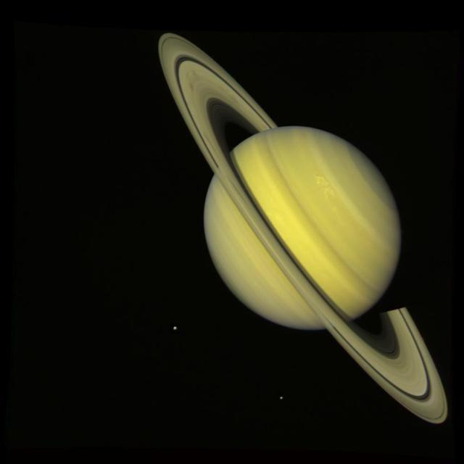
Photographs of Saturn
An image of Saturn taken by NASA’s Voyager 2 spacecraft in 1981.
You can see the moons Rhea and Dione as small dots below.
“Saturn With Rhea and Dione True Color” by National Aeronautics and Space Administration

Slide 17
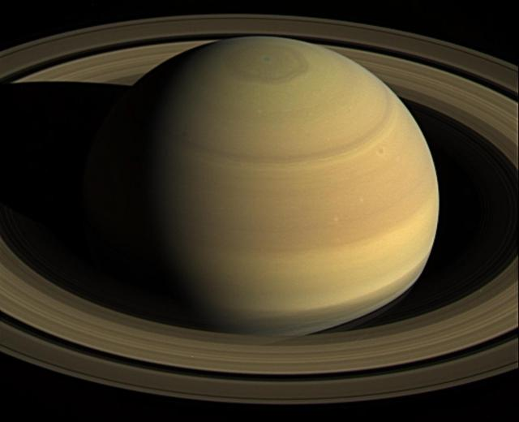
Photographs of Saturn
A beautiful image of Saturn taken by NASA’s Cassini spacecraft in 2016.
“Staring at Saturn” by National Aeronautics and Space Administration

Slide 18
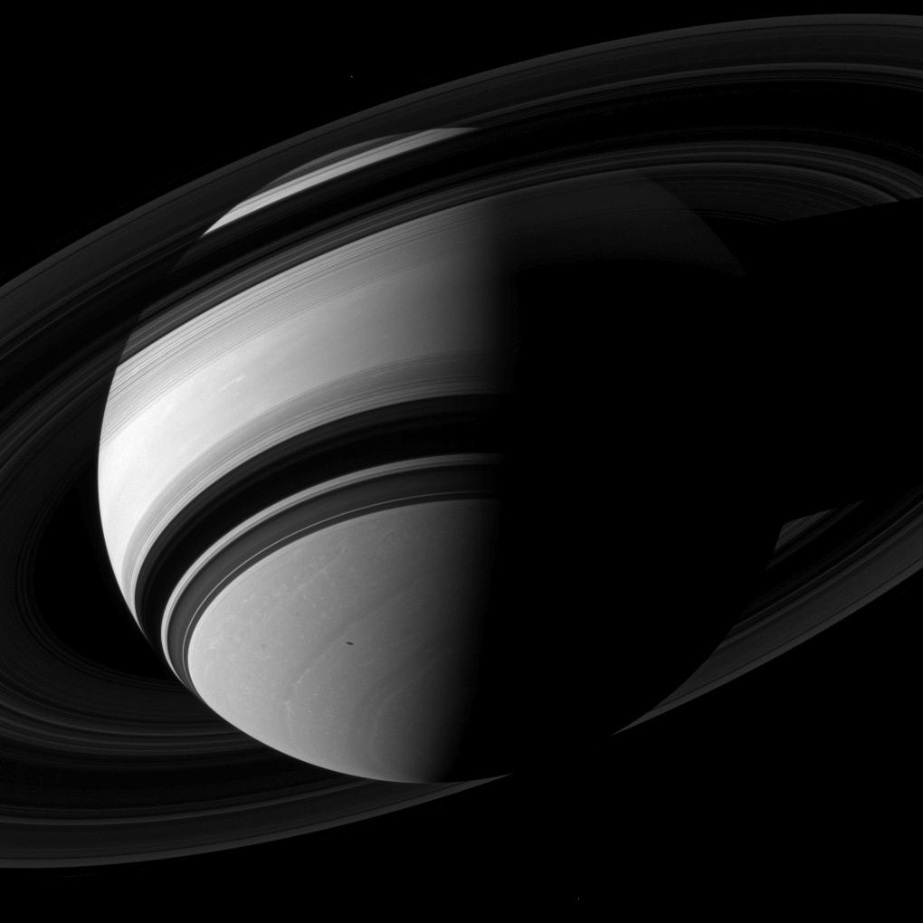
Photographs of Saturn
A beautiful black and white image of Saturn taken by Cassini, showing the shadows of the rings falling on the planet.
“Saturn Looms” by National Aeronautics and Space Administration

Slide 19


