Slide 1
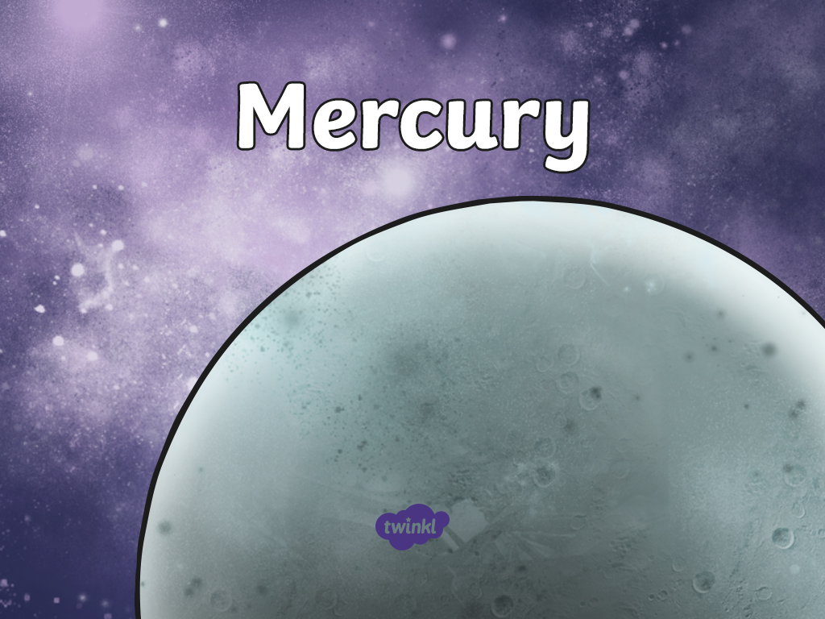

Slide 2

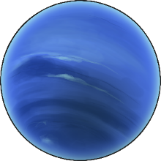
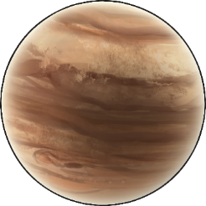
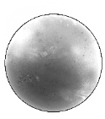
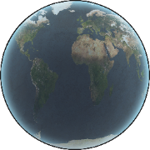

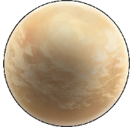
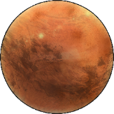
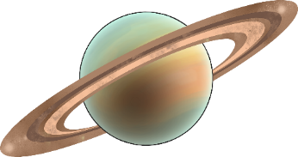
Earth is only one of the planets in our solar system. There are seven other planets that also orbit our Sun.
Neptune
Jupiter
Mercury
Earth
Uranus
Venus
Mars
Saturn

Slide 3
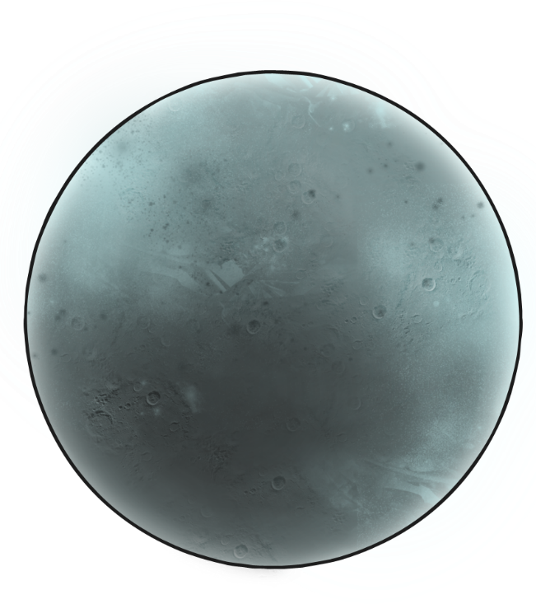
The Closest Planet
The planet Mercury is the closest planet to the Sun. It is also the smallest planet in our solar system. It is 77 million km (55 million miles) away from Earth.

Slide 4
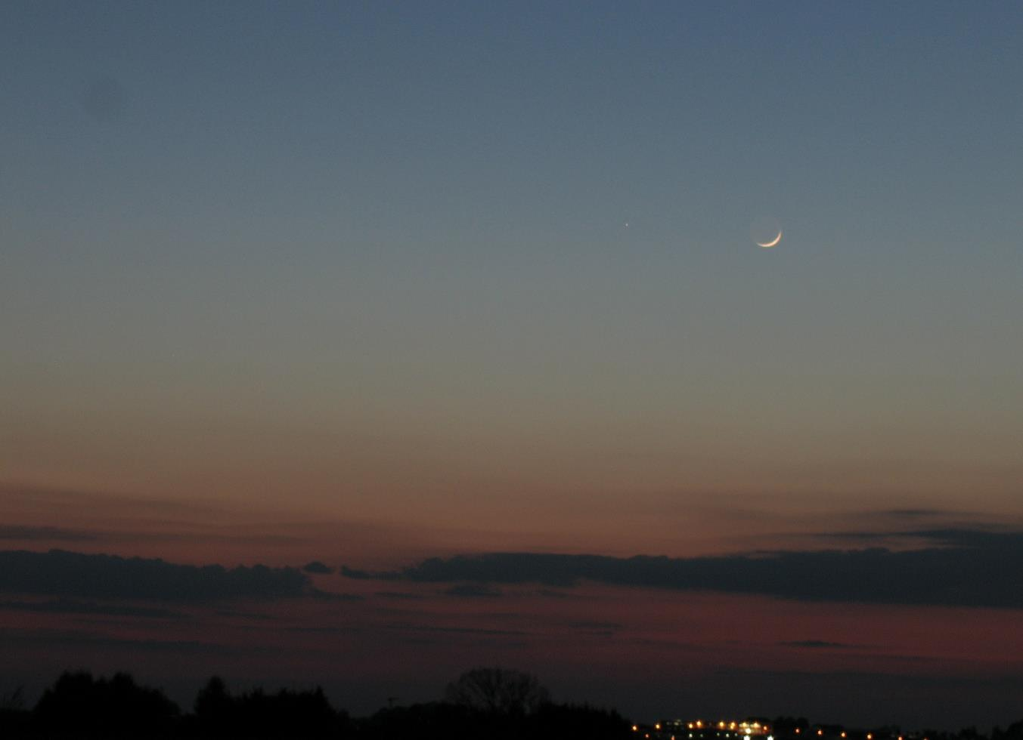
Mercury
It is sometimes possible to see Mercury in the sky at night, but it can be very hard to spot.

Slide 5
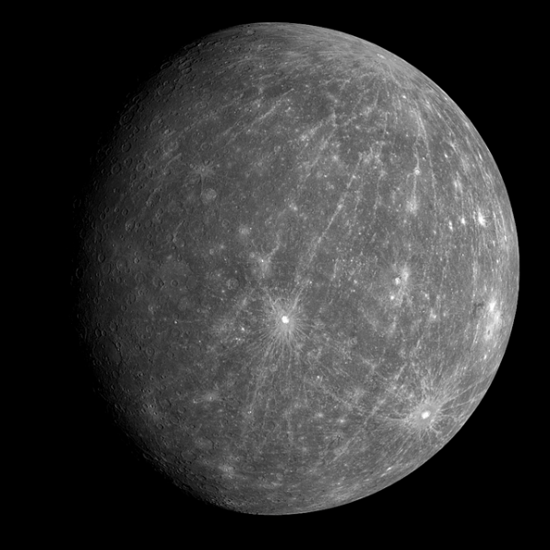
Mercury is a tiny planet, about the same size as the Moon!
It is rocky, dusty and covered in craters from being hit by objects floating through space.
It also has some volcanoes on its surface!

Slide 6
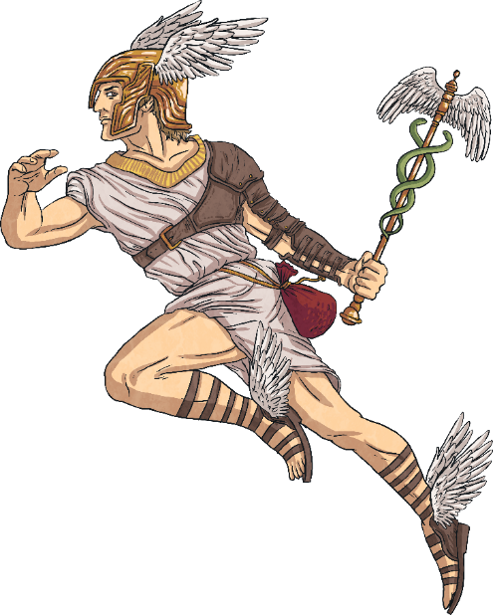
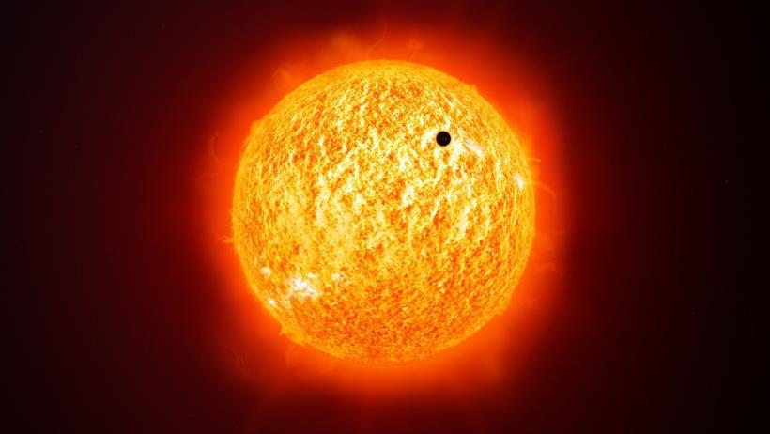
Mercury is the fastest moving planet in the solar system. It zooms around the Sun in only 88 days!
This is why it is named Mercury, after the swift Roman messenger god.

Slide 7
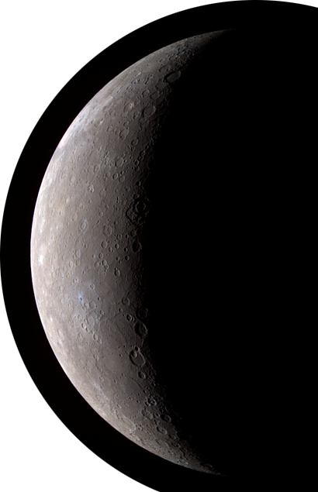
Mercury and Earth
Mercury is very different to Earth.
On Mercury, 1 day lasts the same as 59 days on Earth!
The surface of Mercury gets extremely hot when in sunlight, much hotter than anywhere on Earth. The parts of the surface out of the sunlight get extremely cold, much colder than anywhere on Earth!
Mercury does not have any moons.

Slide 8
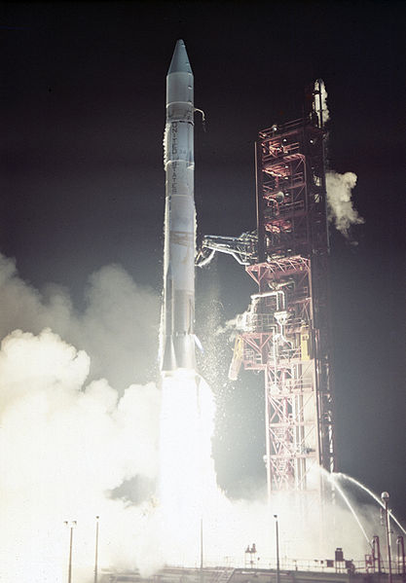
Exploring
Humans have known about Mercury for thousands of years. However, it was only recently that technology meant we could study Mercury more closely.
In 1974, the Mariner 10 spacecraft performed 3
fly-pasts of Mercury and took photographs of about half of its surface.

Slide 9
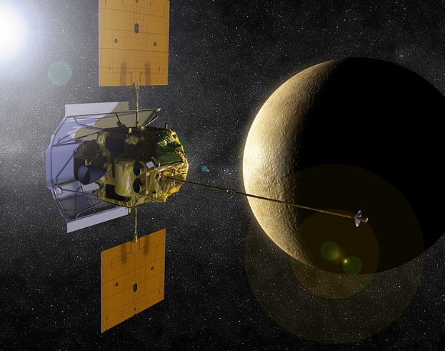
The MESSENGER Mission
In 2008, the MESSENGER probe performed 3 fly-pasts, taking photographs of Mercury.
In 2011, MESSENGER entered Mercury’s orbit. It took close-up photographs of the planet’s surface, including volcanoes, craters and valleys. It also collected information on what Mercury is made from.
It finished its mission in 2015 and crashed into the planet’s surface.

Slide 10
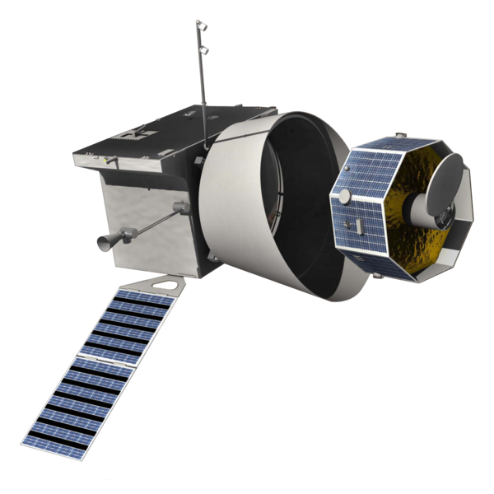
The BepiColombo Mission
In October 2018, the BepiColombo mission to Mercury launched. It is hoped that it will reach Mercury in 2025 in order to learn more about the planet.
BepiColombo is named after Guiseppe “Bepi” Colombo, an Italian scientist who worked on the Mariner 10 mission and died in 1984.

Slide 11
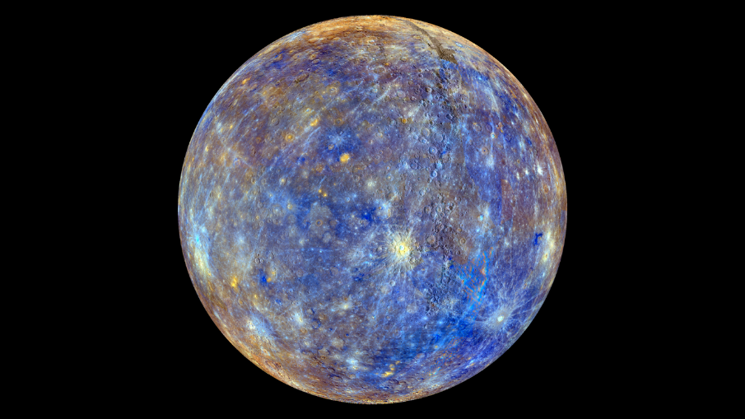
Photographs of Mercury
A photograph of Mercury taken by the MESSENGER probe in 2008. The colourful image is how the spacecraft sees Mercury before the colours are changed by scientists to show what our eyes would see.
“False Color View of Mercury” by NASA Goddard Space Flight Center is licensed under CC BY 2.0

Slide 12
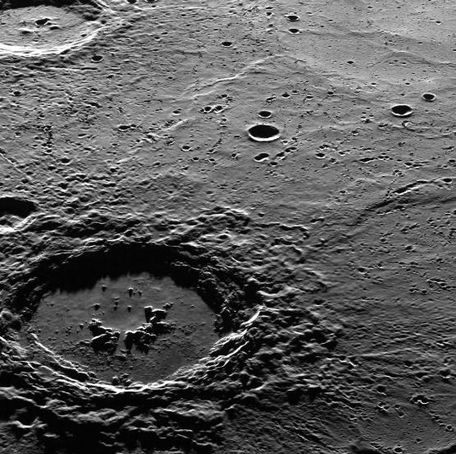
Photographs of Mercury
A close-up photograph of Mercury’s surface, showing lots of craters up close in detail. This image was taken by the MESSENGER probe in 2008.
“Hi, Hokusai!” by NASA Goddard Space Flight Center is licensed under CC BY 2.0

Slide 13
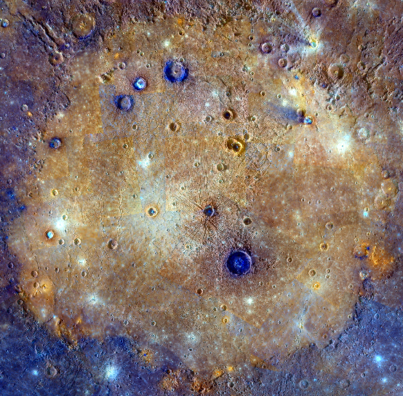
Photographs of Mercury
This image of Mercury captured by the MESSENGER spacecraft in 2008 shows ‘Cloris Planitia’, a huge impact site. This is the large orange area in the picture.
“It's All About That Basin” by NASA Goddard Space Flight Center is licensed under CC BY 2.0

Slide 14
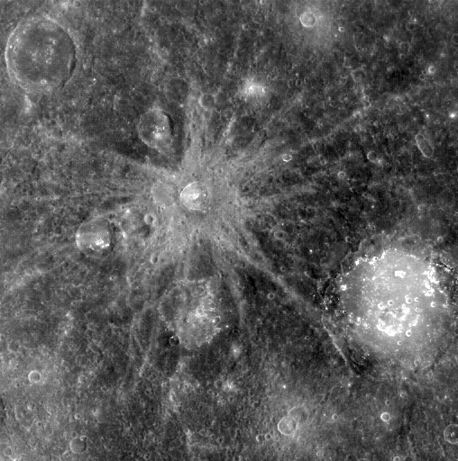
Photographs of Mercury
This photograph shows some of Mercury’s craters close up in detail. This image was taken by the MESSENGER probe in 2008.
“Bek and Lermontov” by NASA Goddard Space Flight Center is licensed under CC BY 2.0

Slide 15
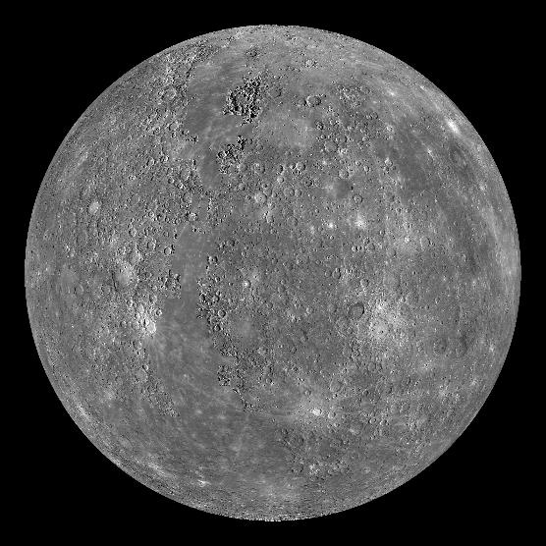
Photographs of Mercury
A detailed photograph of Mercury taken by the MESSENGER probe in 2011.

Slide 16
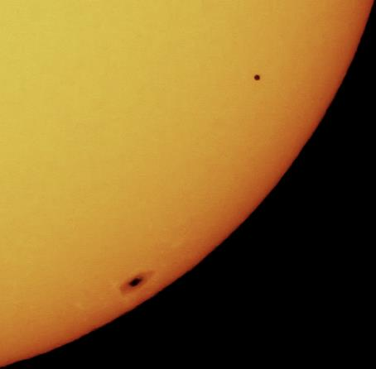
Photographs of Mercury
This photograph shows Mercury passing in front of the Sun. This is known as the ‘Transit of Mercury’.
Seeing Mercury travel across the Sun from Earth only happens 13 times every 100 years!
The next time this is due to happen is the 11th November 2019.
“A Rare Transit of Mercury - Mercury on Sun” by Ed is licensed under CC BY 2.0

Slide 17


