Slide 1
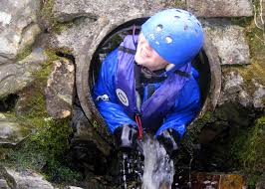
Delamont 2016

Slide 2
Delamont Outdoor Education Centre
Delamont Outdoor Education Centre is situated within Delamont Country Park, on the shores of Strangford Lough, 2 kilometres SW of the village of Killyleagh. It is approximately 45 minutes drive from school.

Slide 3
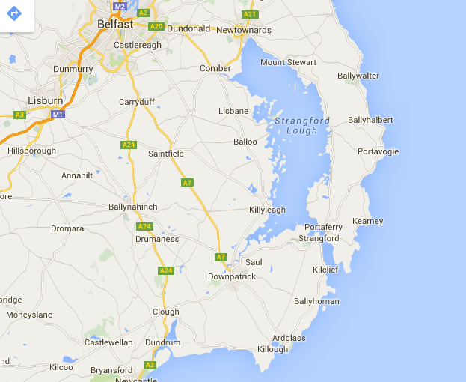

Slide 4
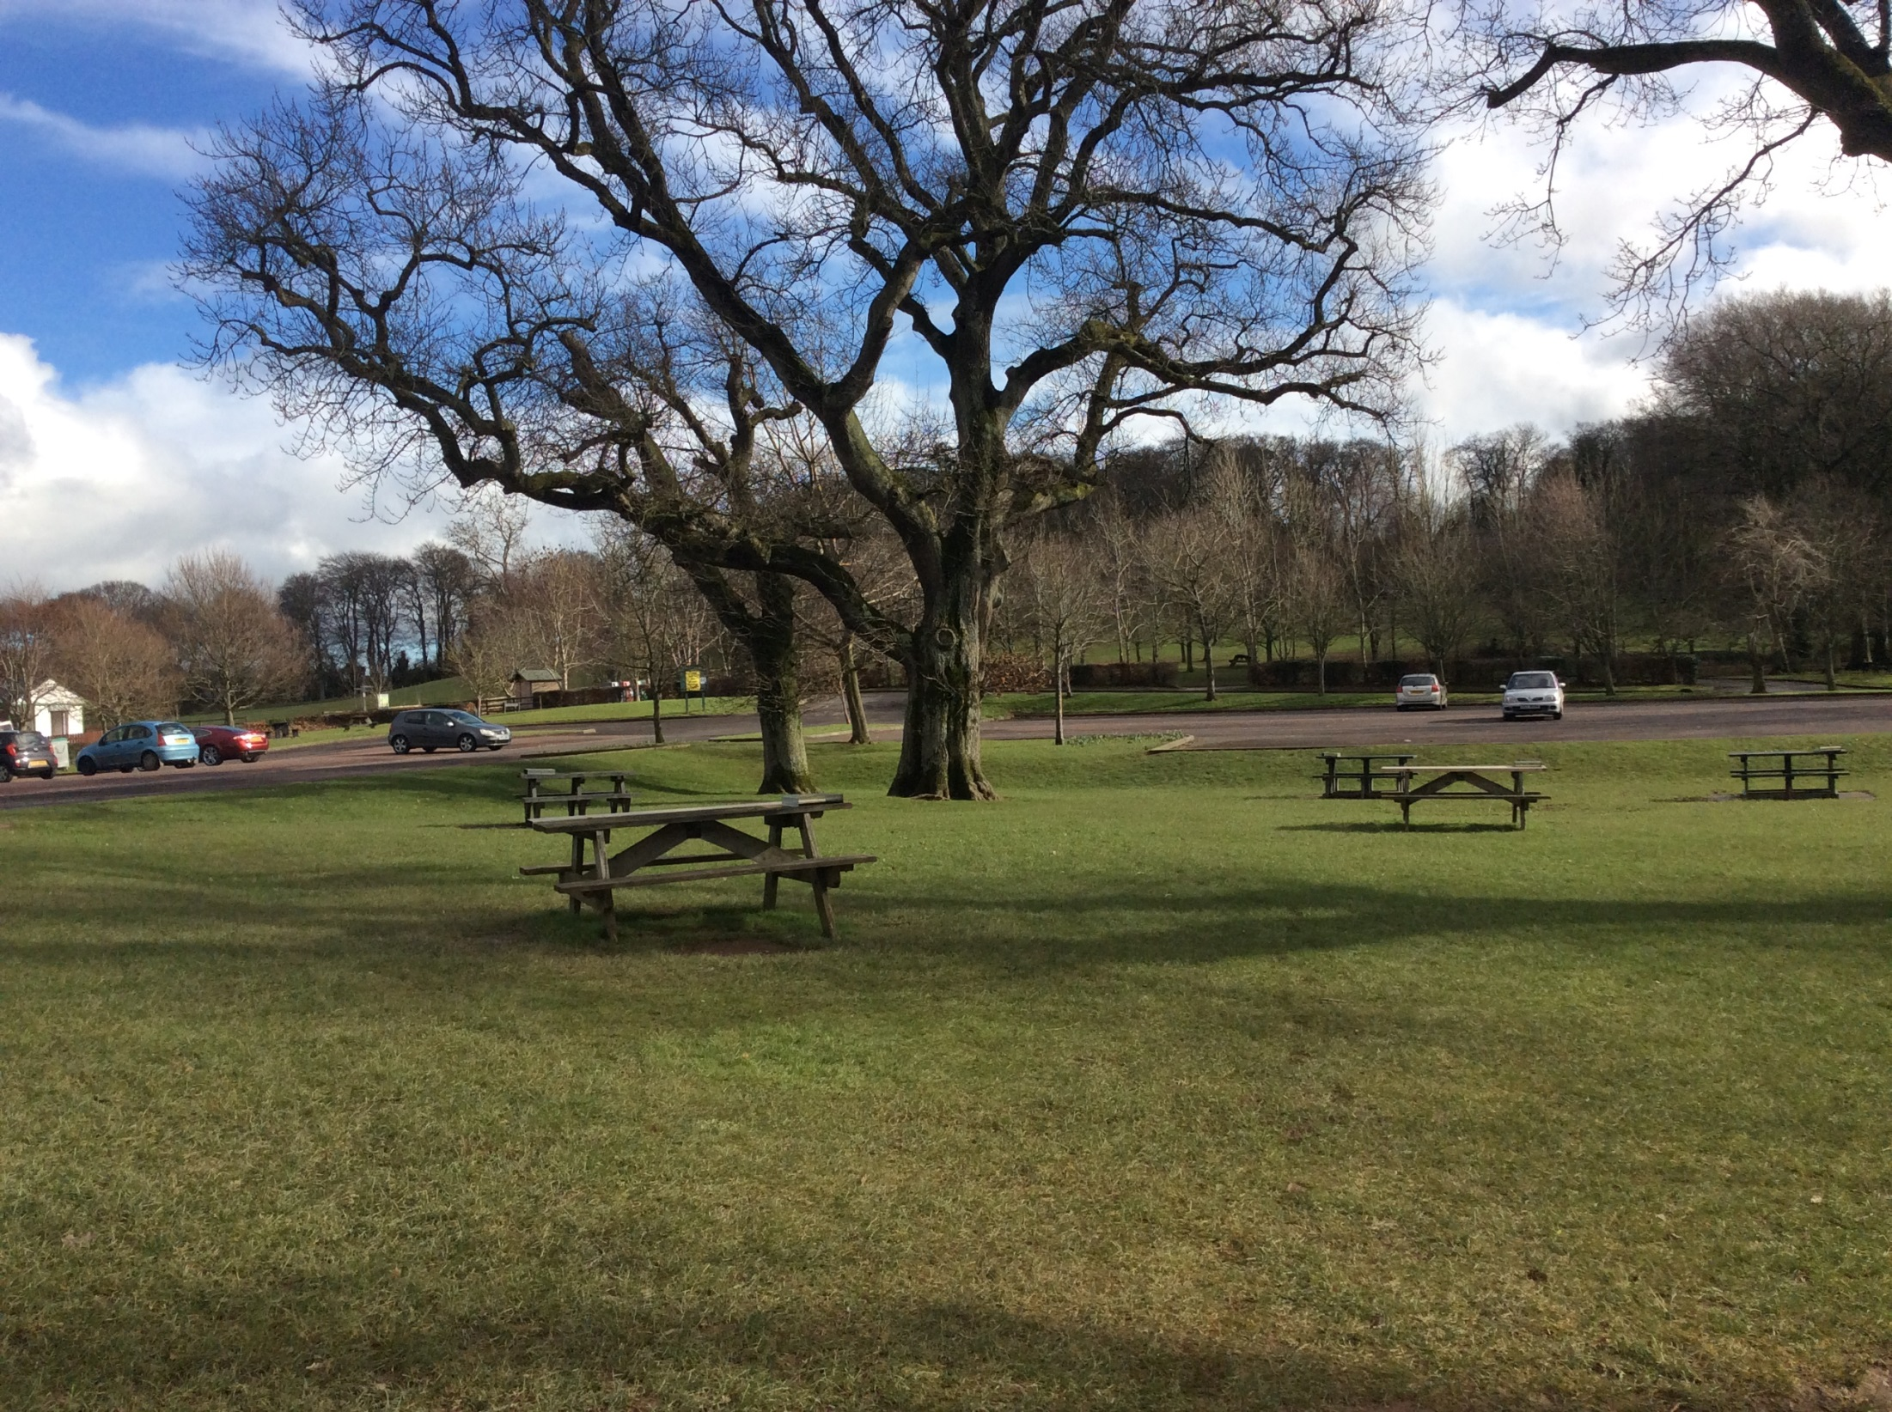

Slide 5
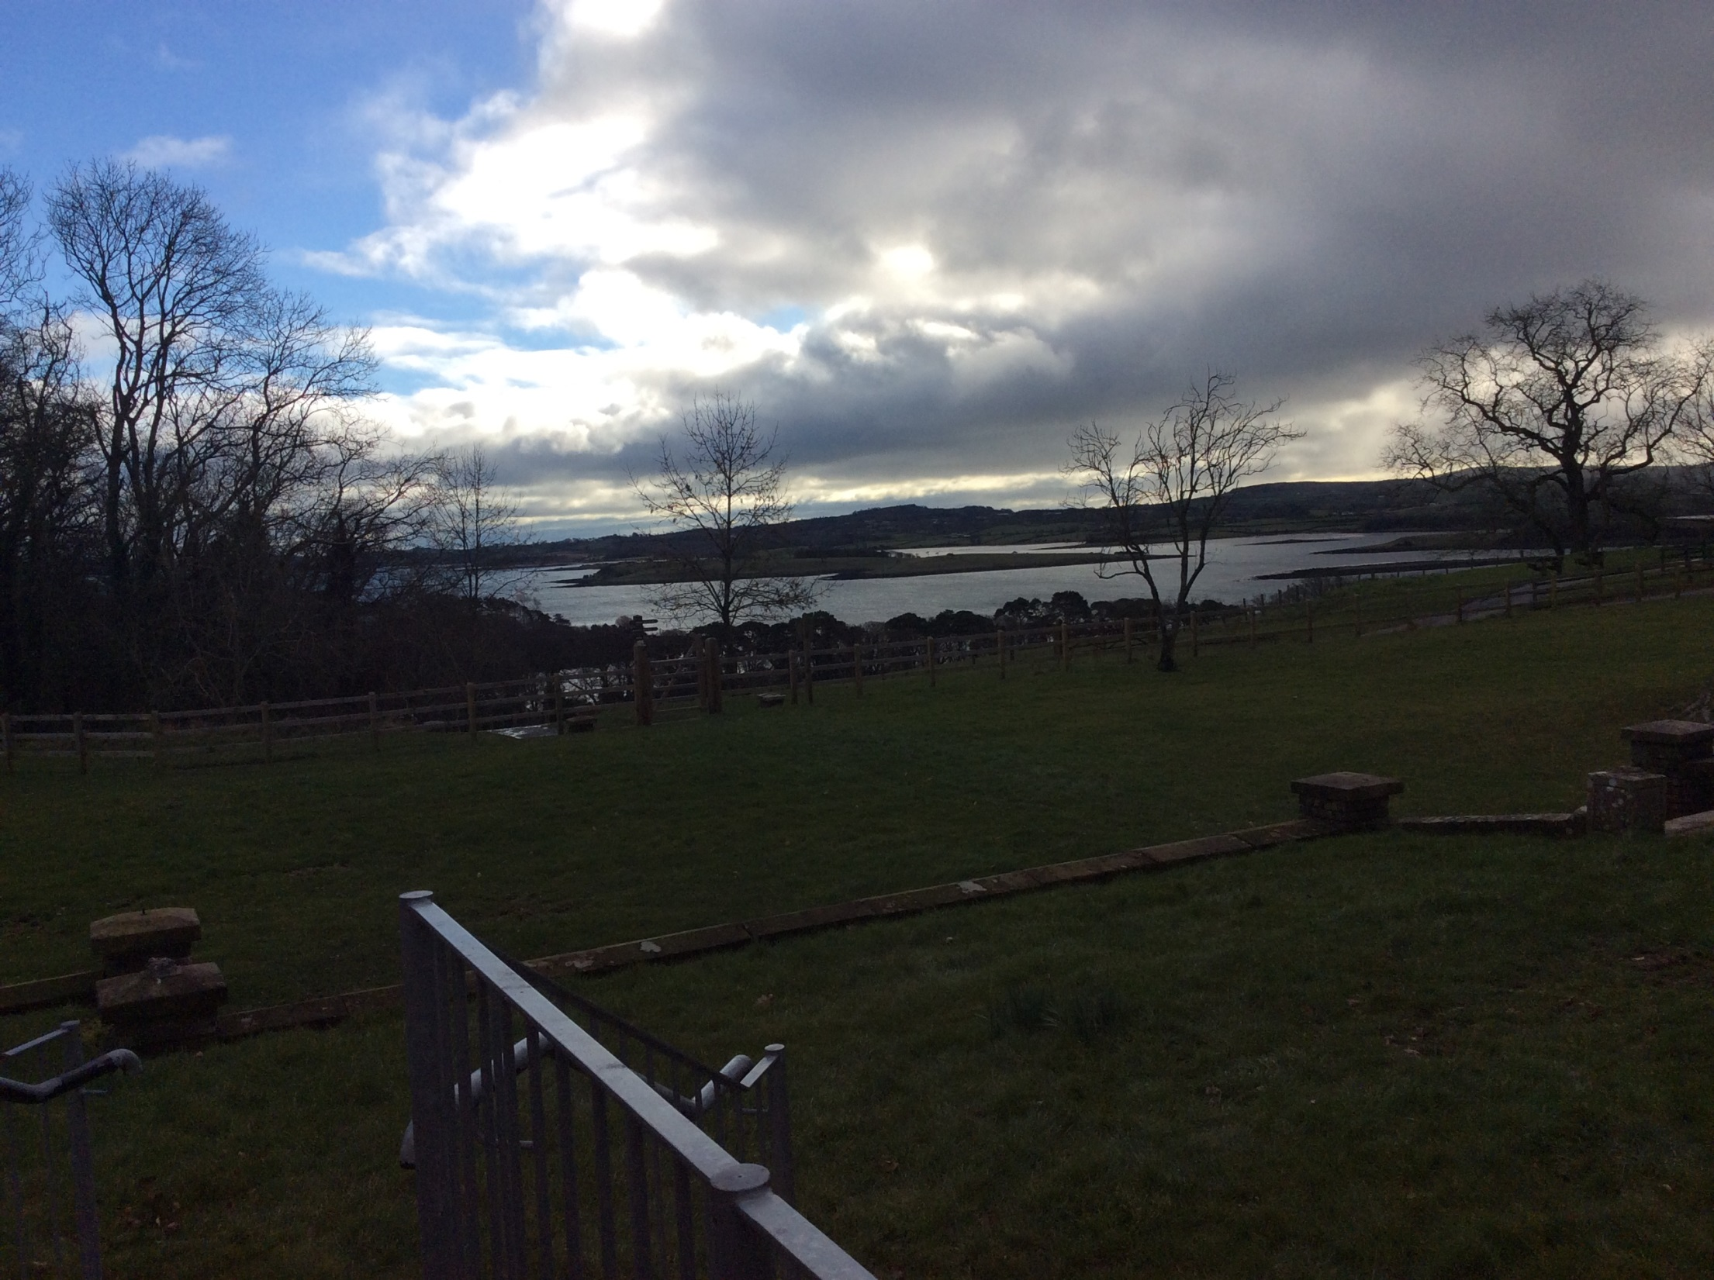

Slide 6
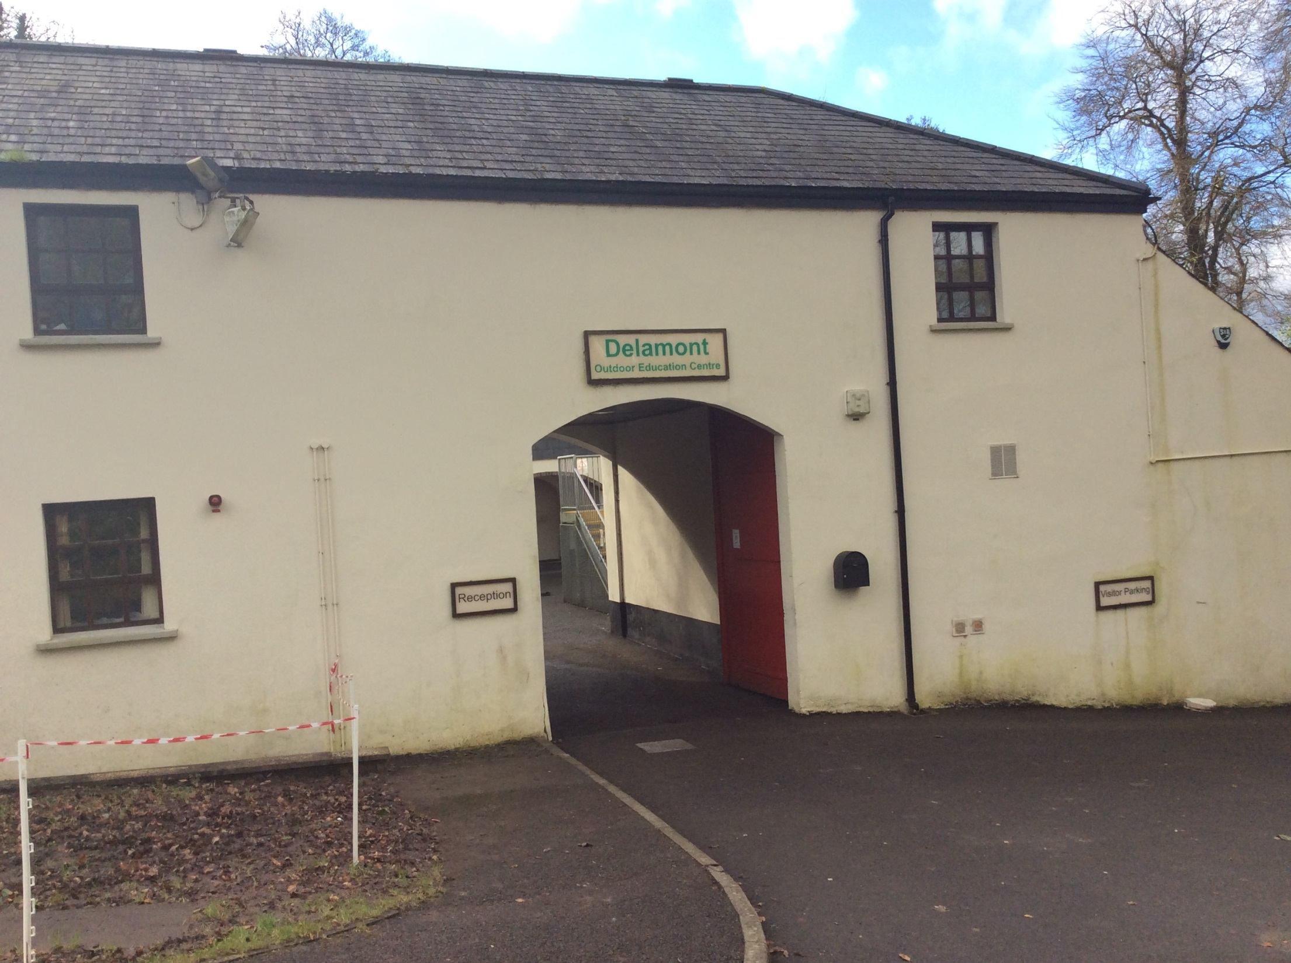

Slide 7
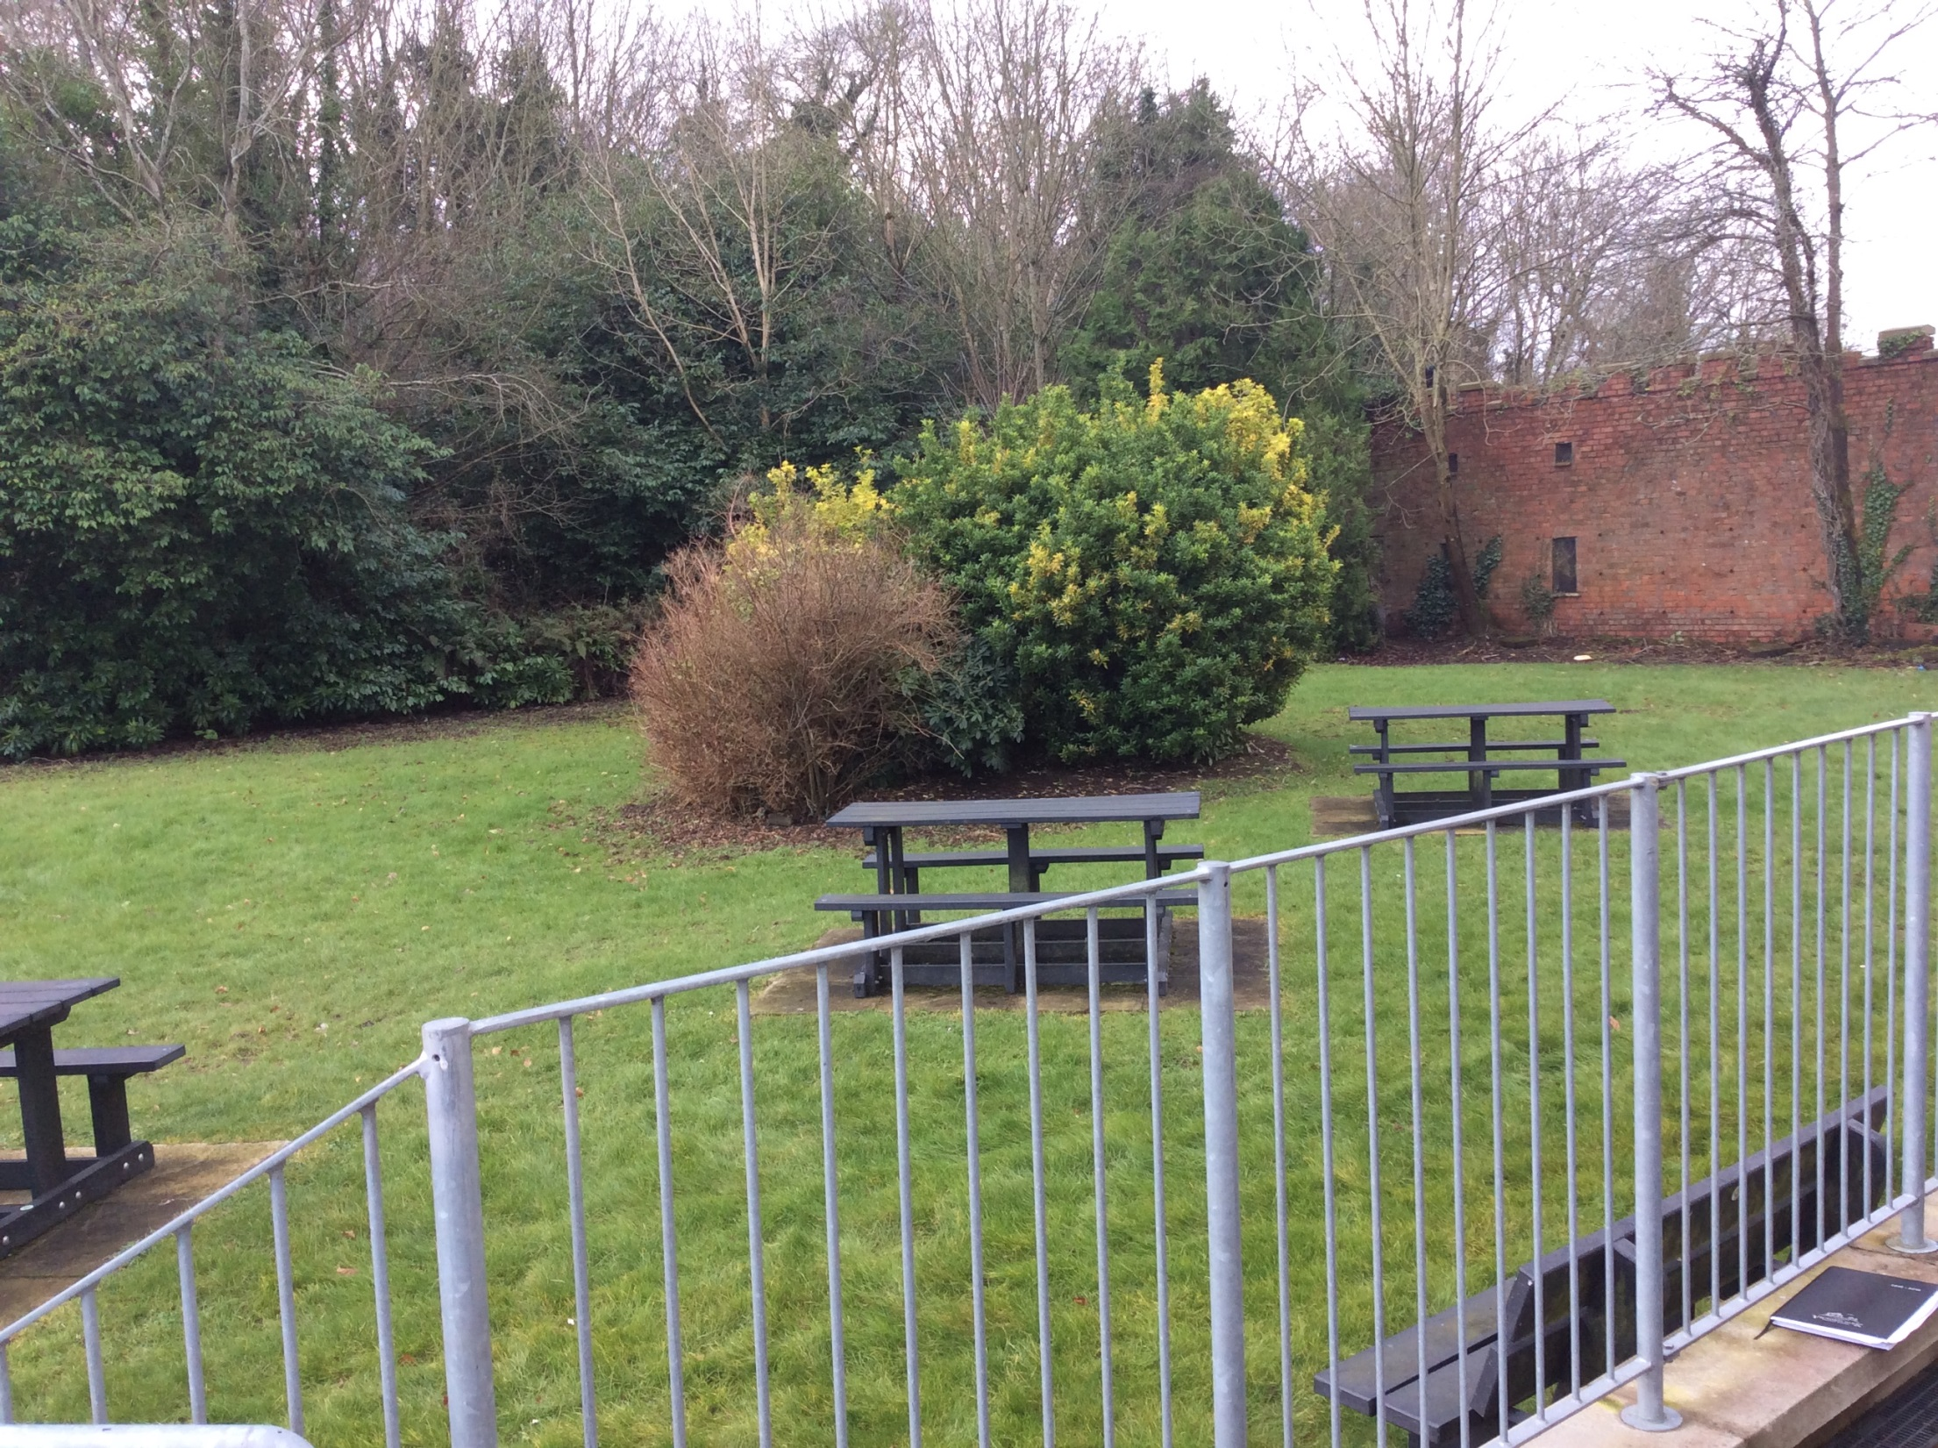

Slide 8
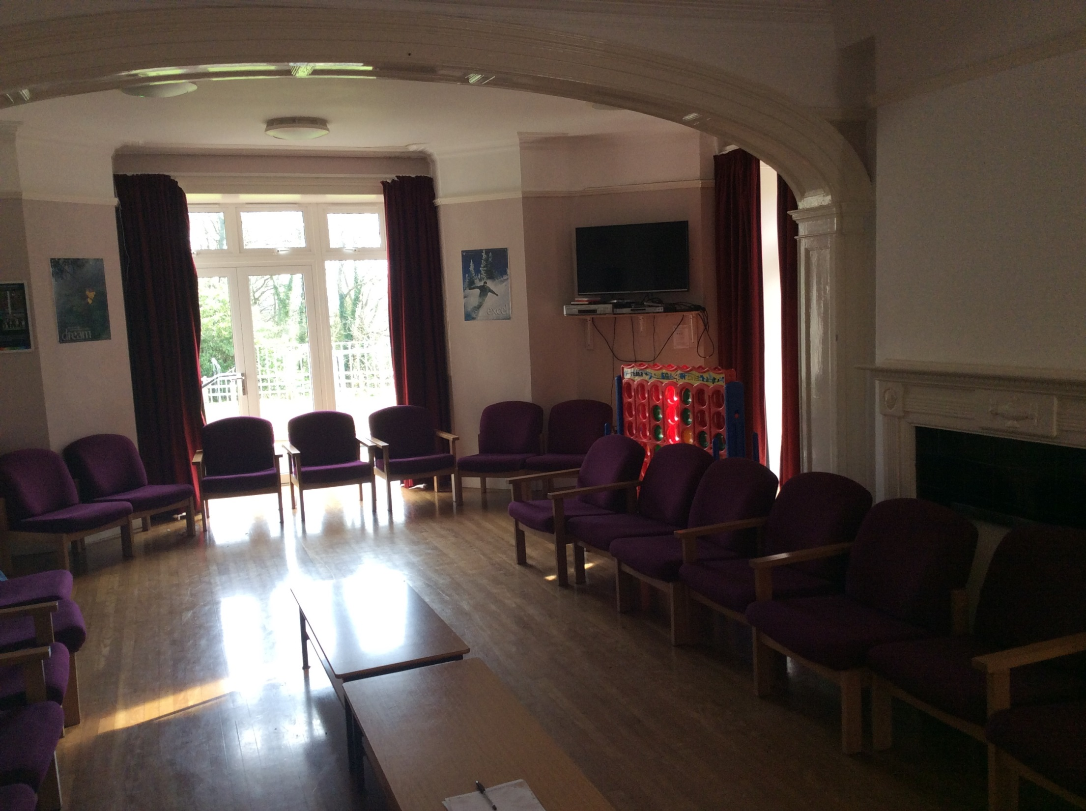

Slide 9
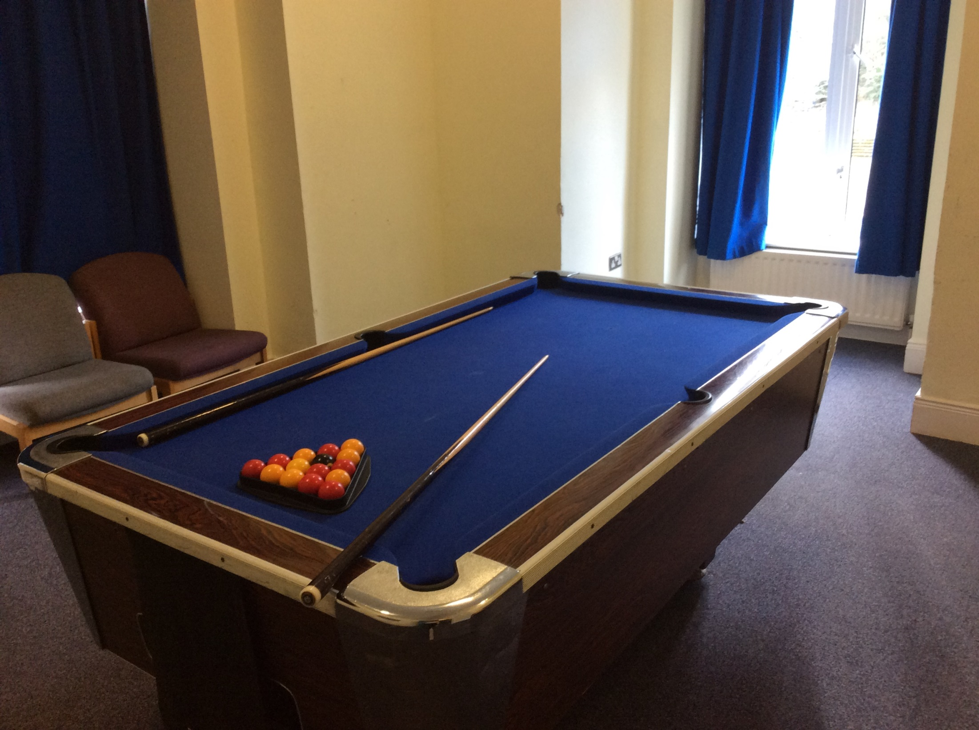

Slide 10
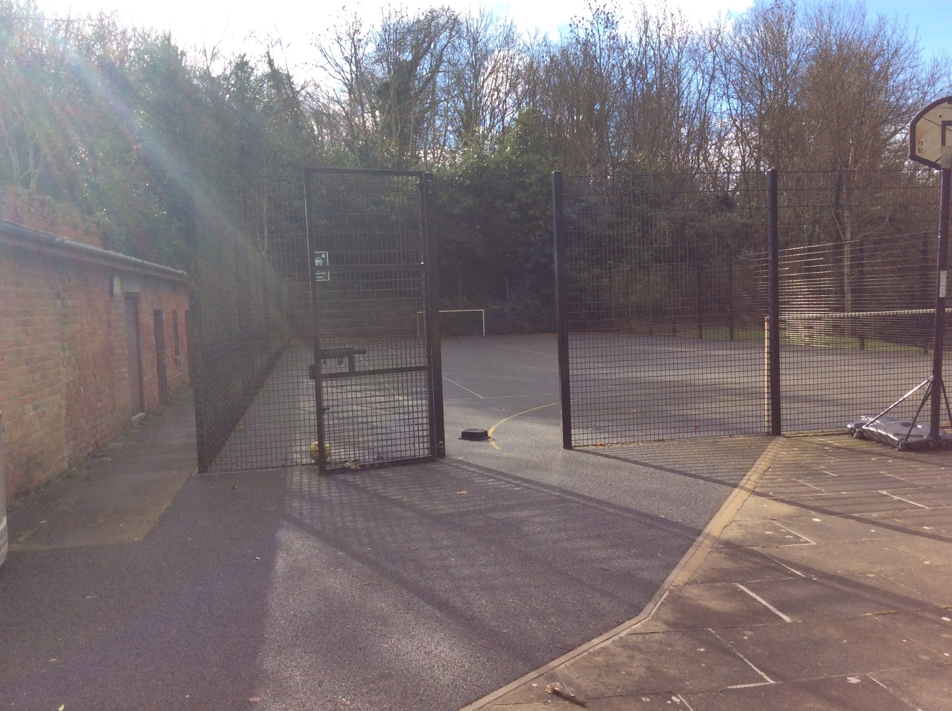

Slide 11
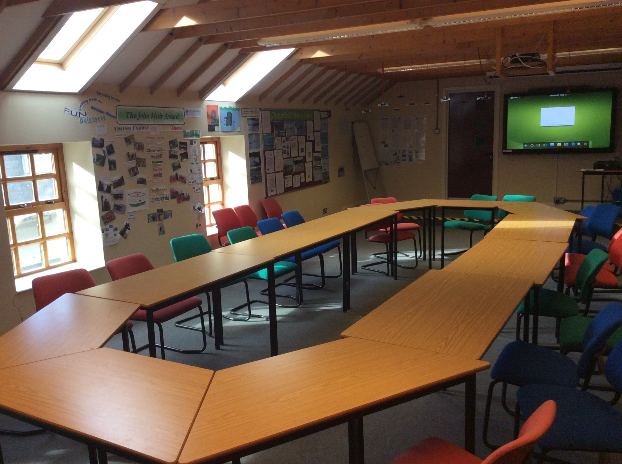

Slide 12
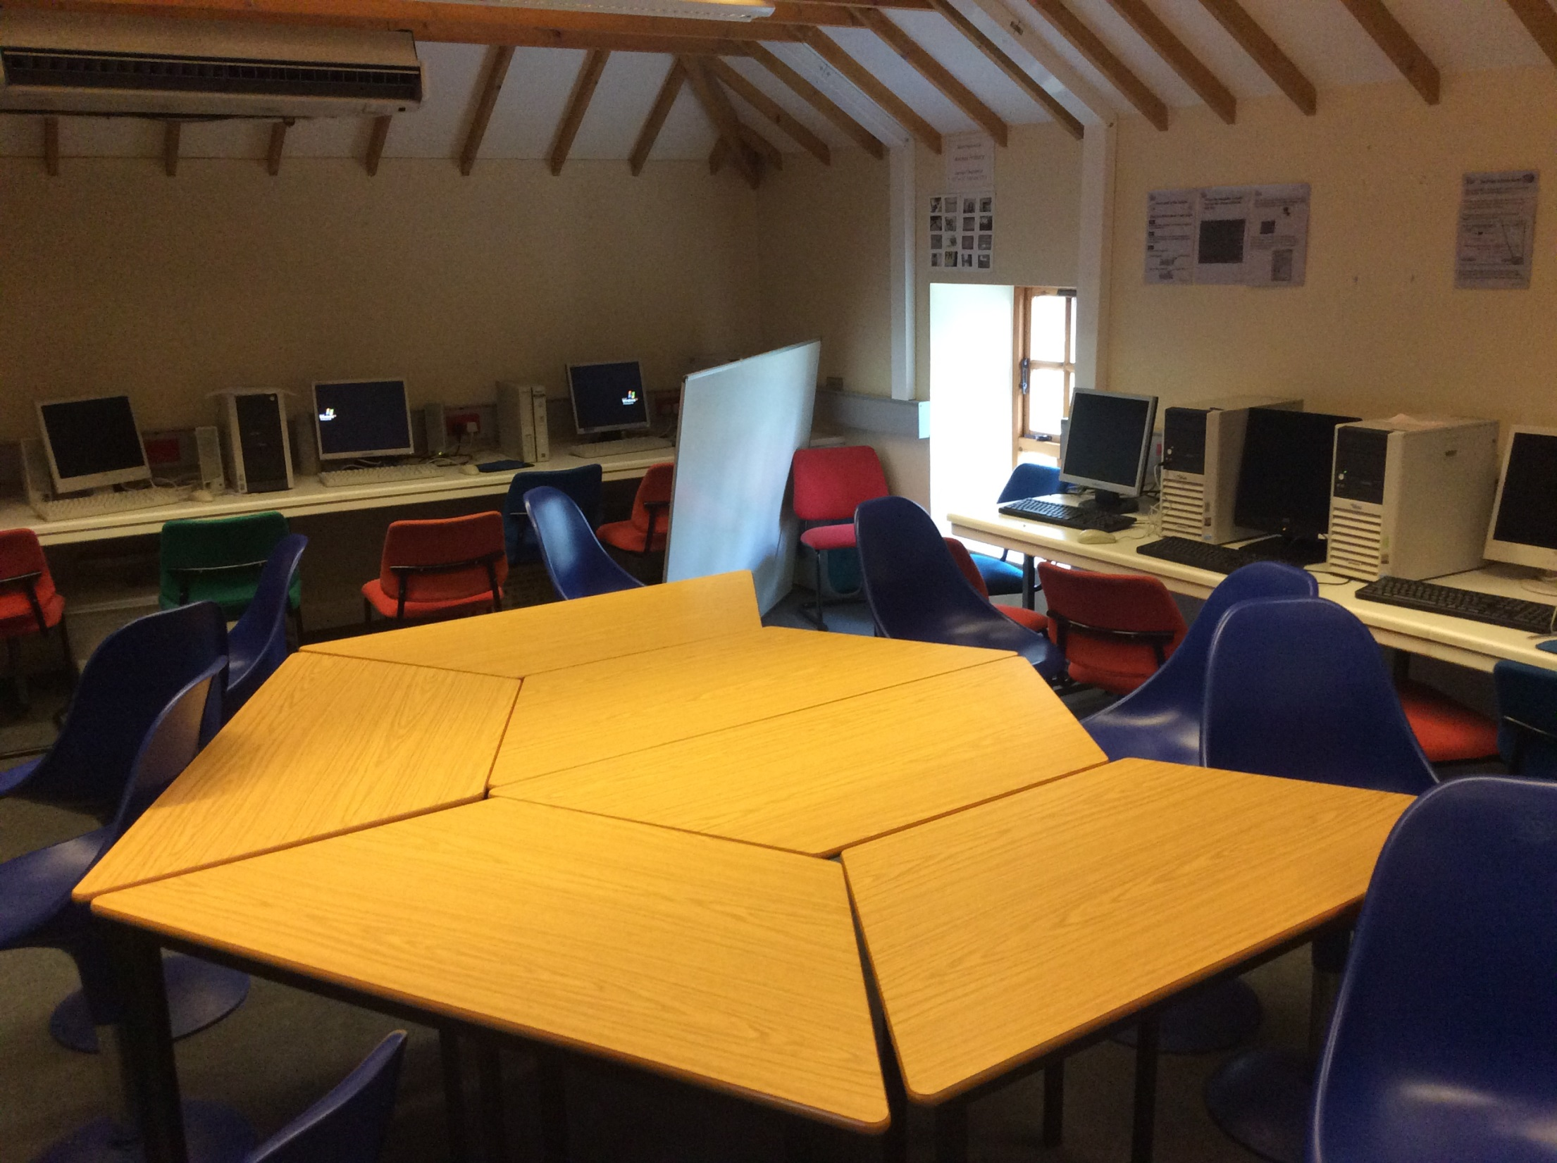

Slide 13
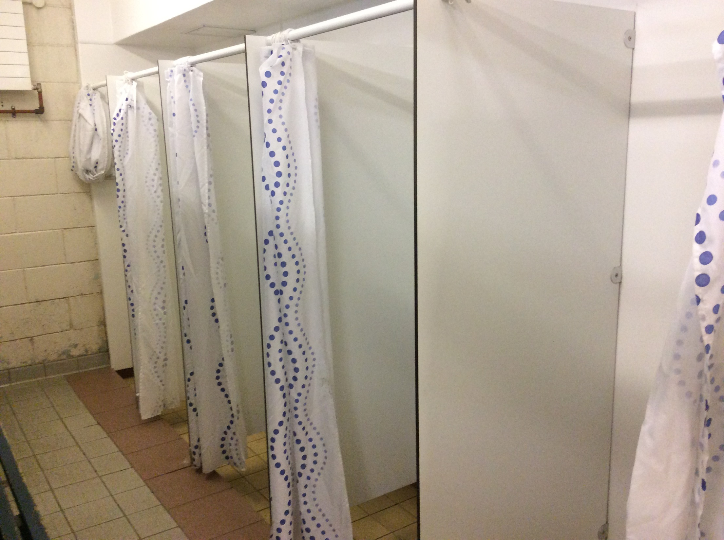

Slide 14
Accompanying Staff
Mr Ryden’s class
Mr Ryden
Mrs McDougall
Mrs Maguire’s class
Mr Dunlop
Mrs Beatty

Slide 15
Activities
‘Adventure Walk’ in Tollymore Forest
Climbing Wall
Archery
‘Night Line’
Adventure Park
Camp Fire
* activities are weather-dependent

Slide 16
Clothing
equipment list in pack
old clothing required for activities
all specialist equipment provided by the centre

Slide 17
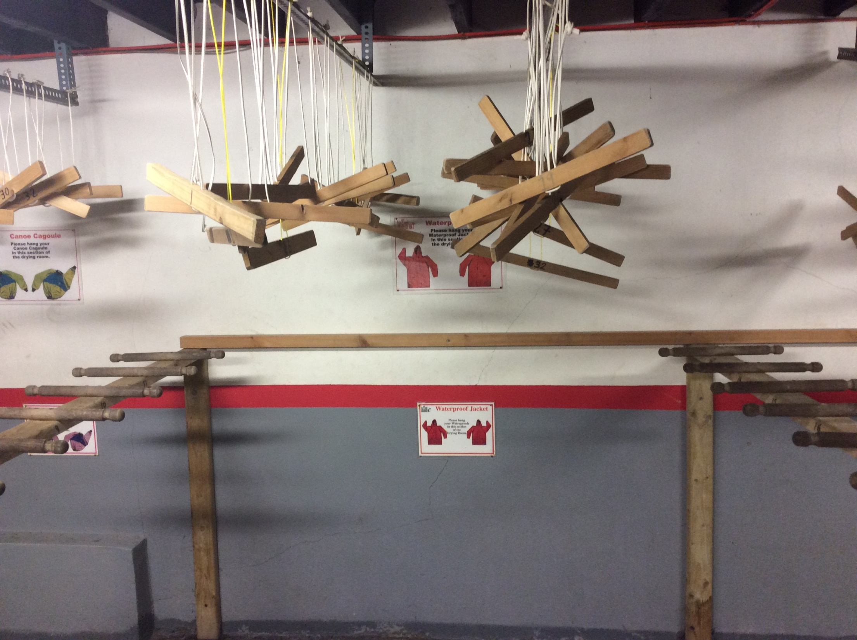

Slide 18
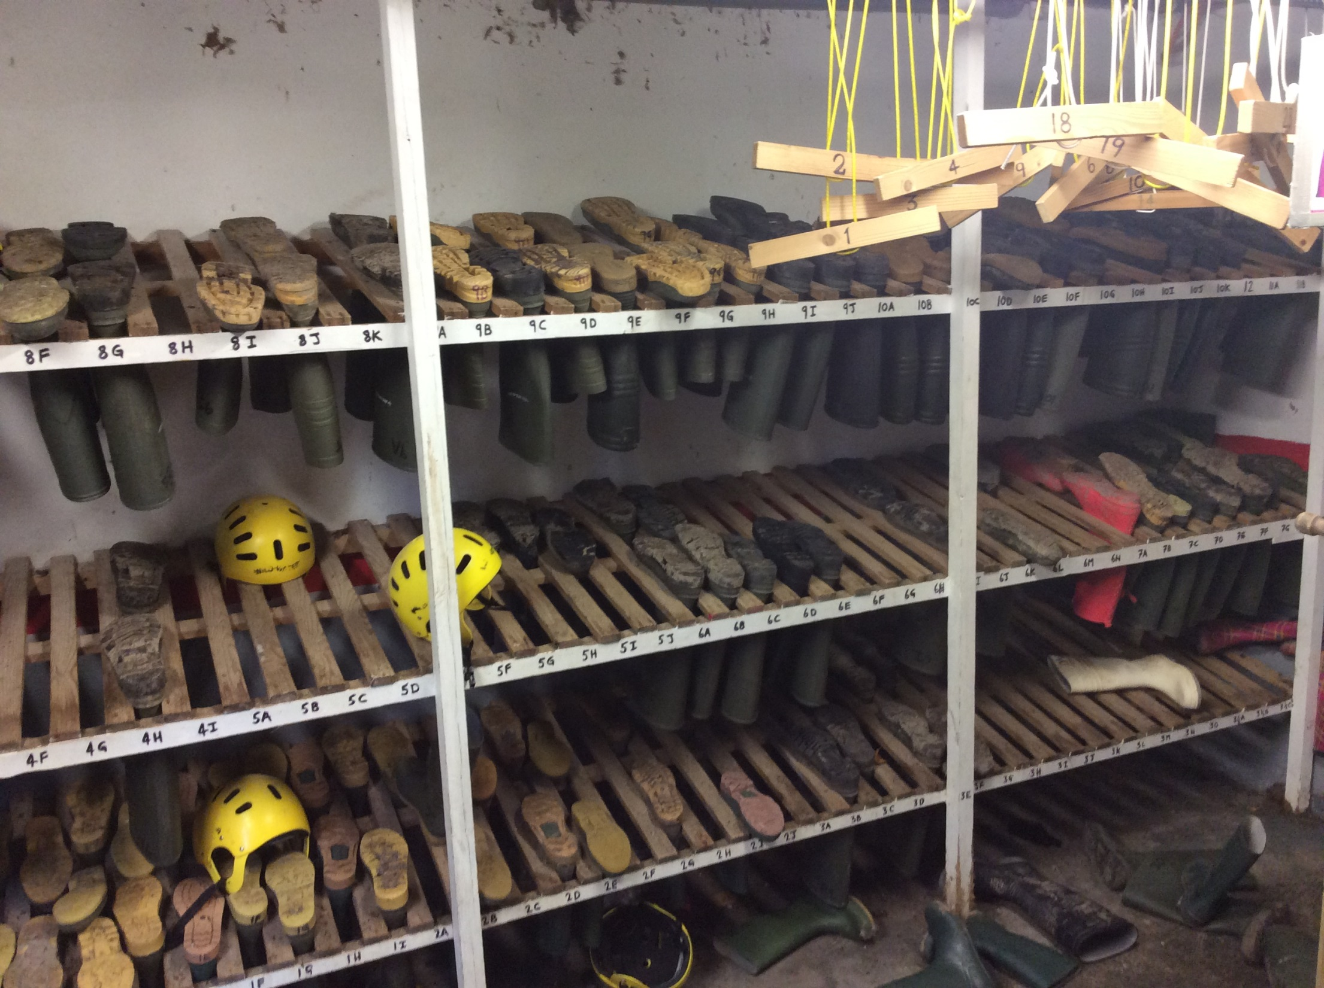

Slide 19
Bedrooms
girls on first floor; boys on second floor
teacher in their own room on each floor
only children assigned to each bedroom are allowed in that room

Slide 20
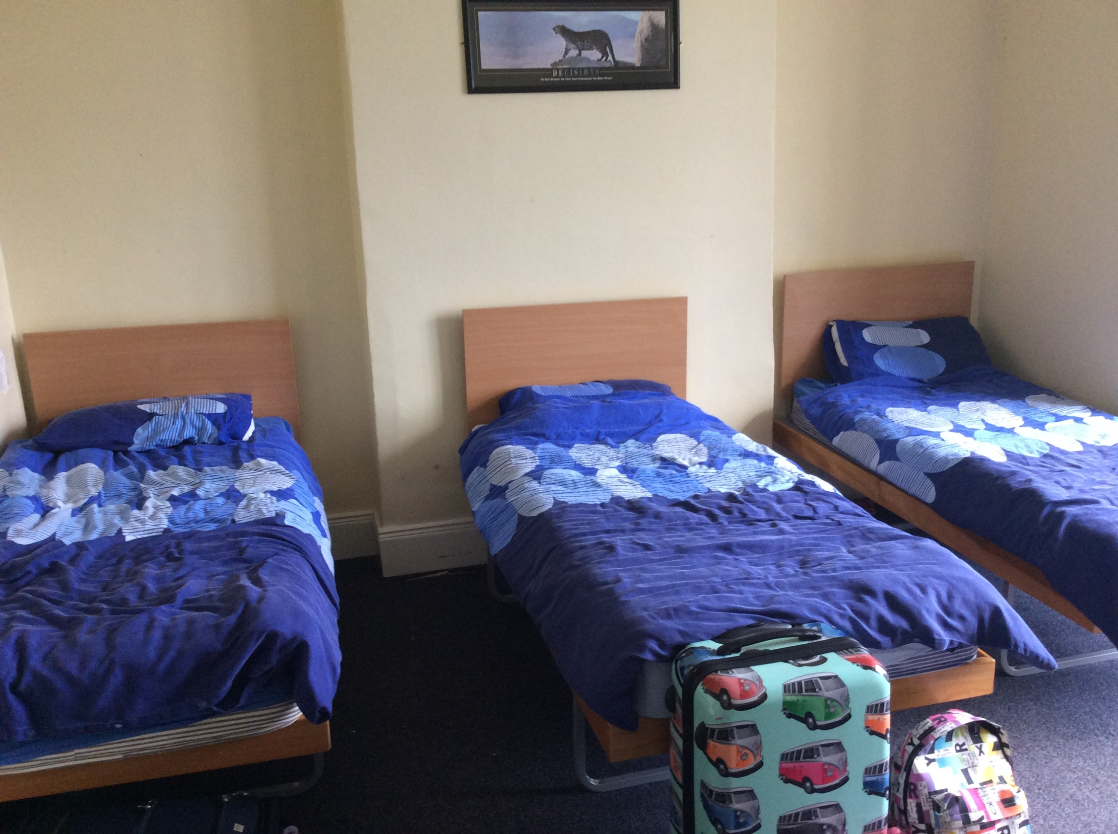

Slide 21
Food
lunch, dinner and supper provided first day
breakfast and lunch provided second day
there will always be ‘seconds’ if children want them – the centre wants them ‘well-fuelled’ for activities!

Slide 22
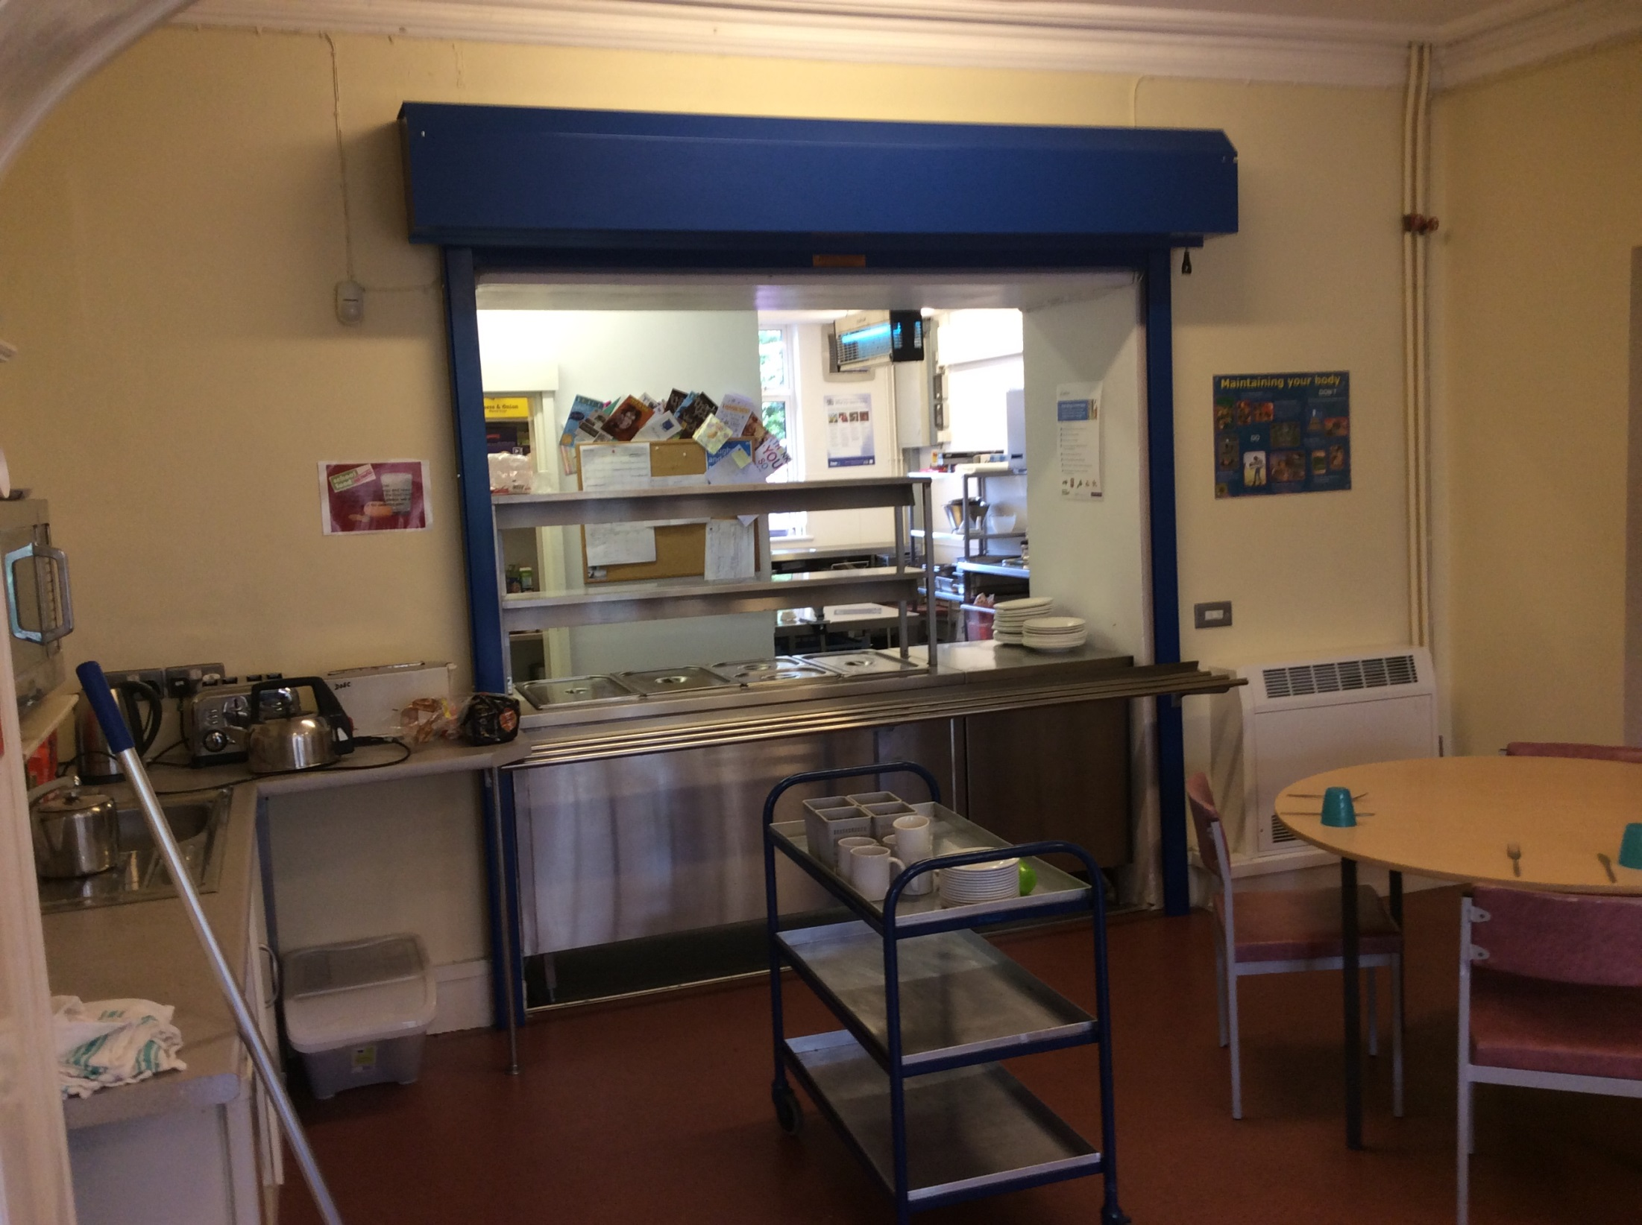

Slide 23
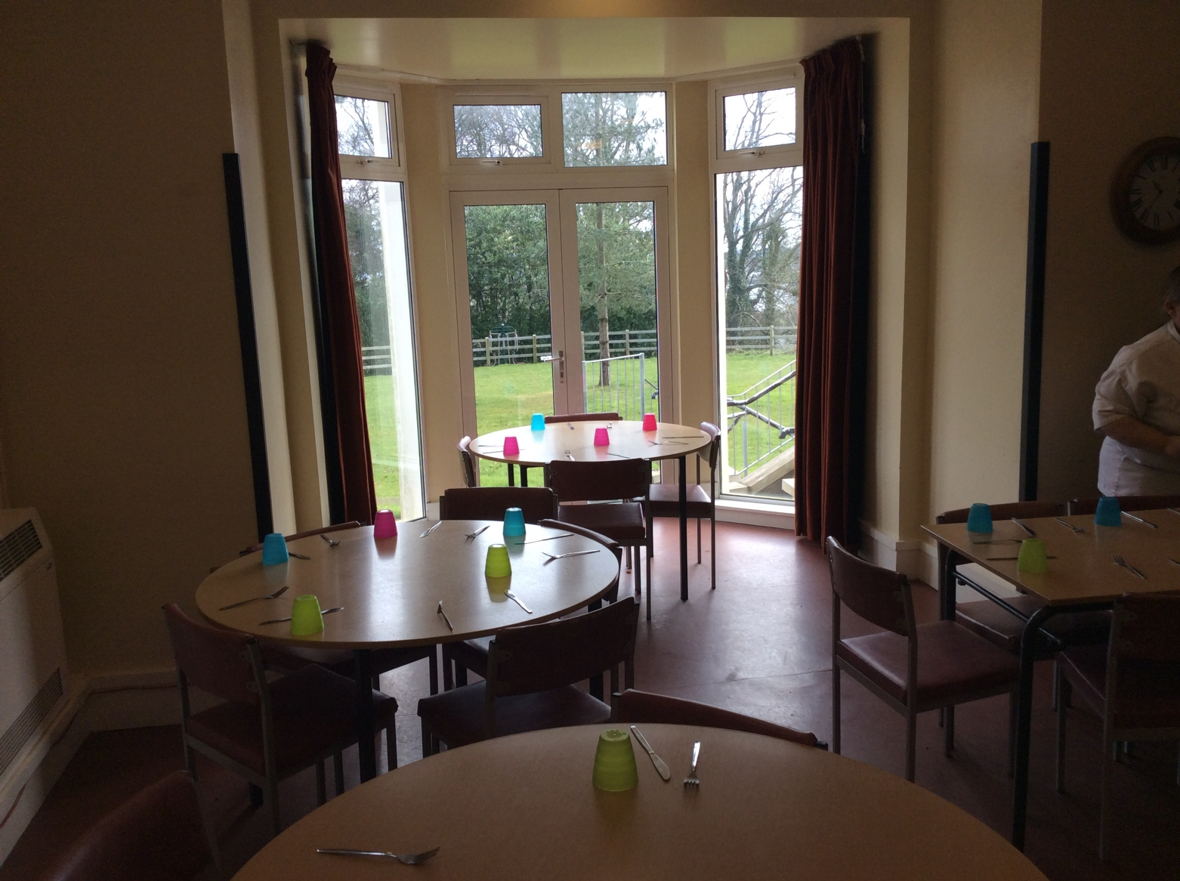

Slide 24
Sweets
children are allowed some sweets but can only be eaten after dinner so as not to spoil their meals
no chewing gum allowed

Slide 25
Mobile Phones
no mobile phones or other electronic devices allowed
please make sure these are left at home
contact details for Delamont in pack in case of emergency

Slide 26

Any Questions?

