Slide 1
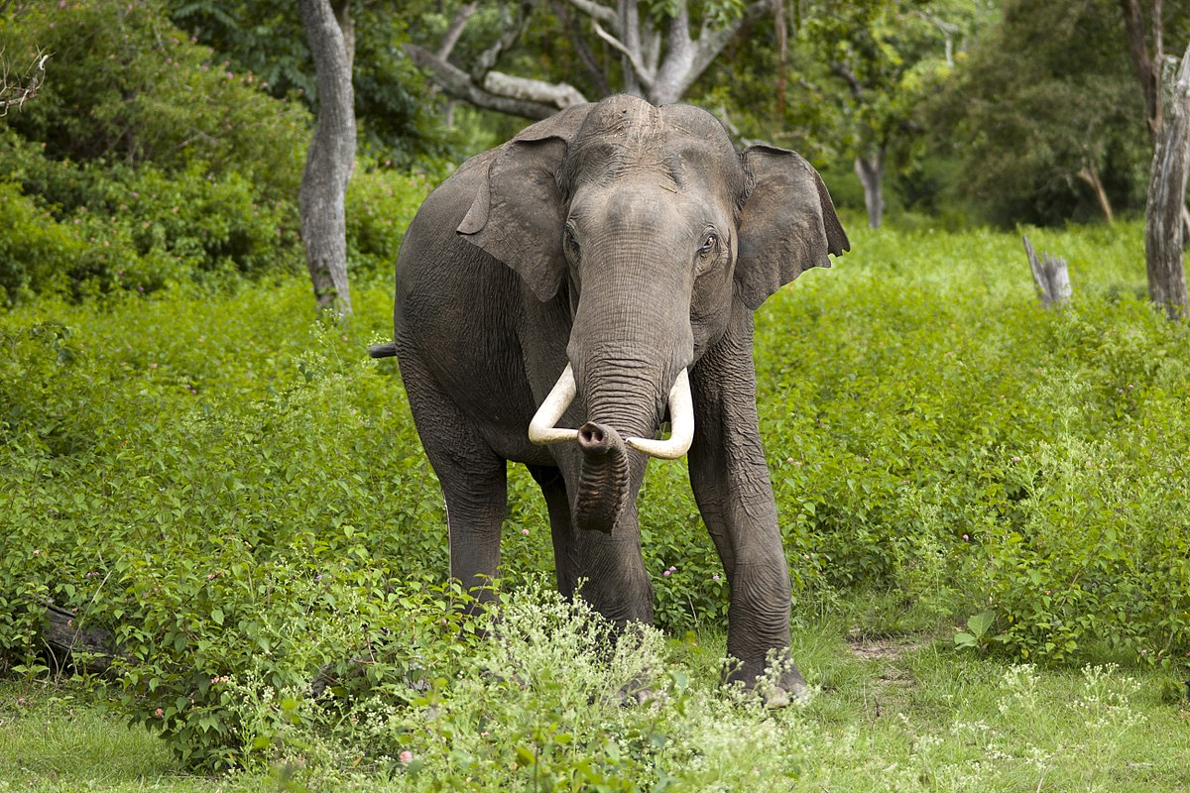
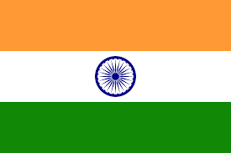

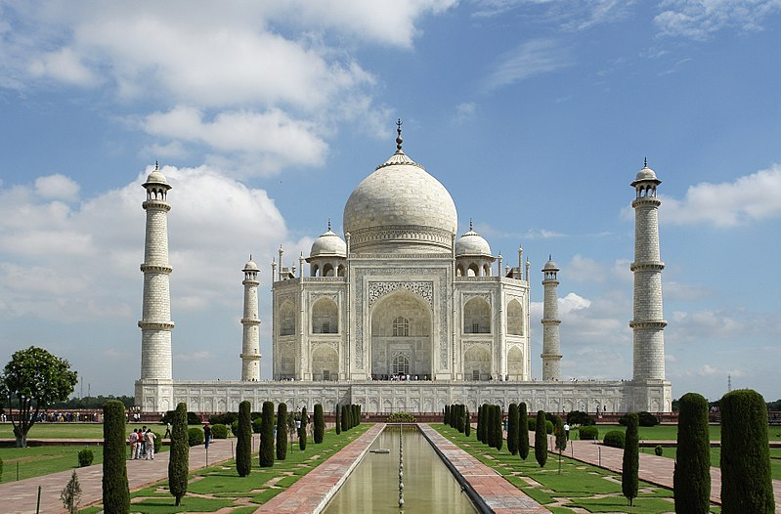
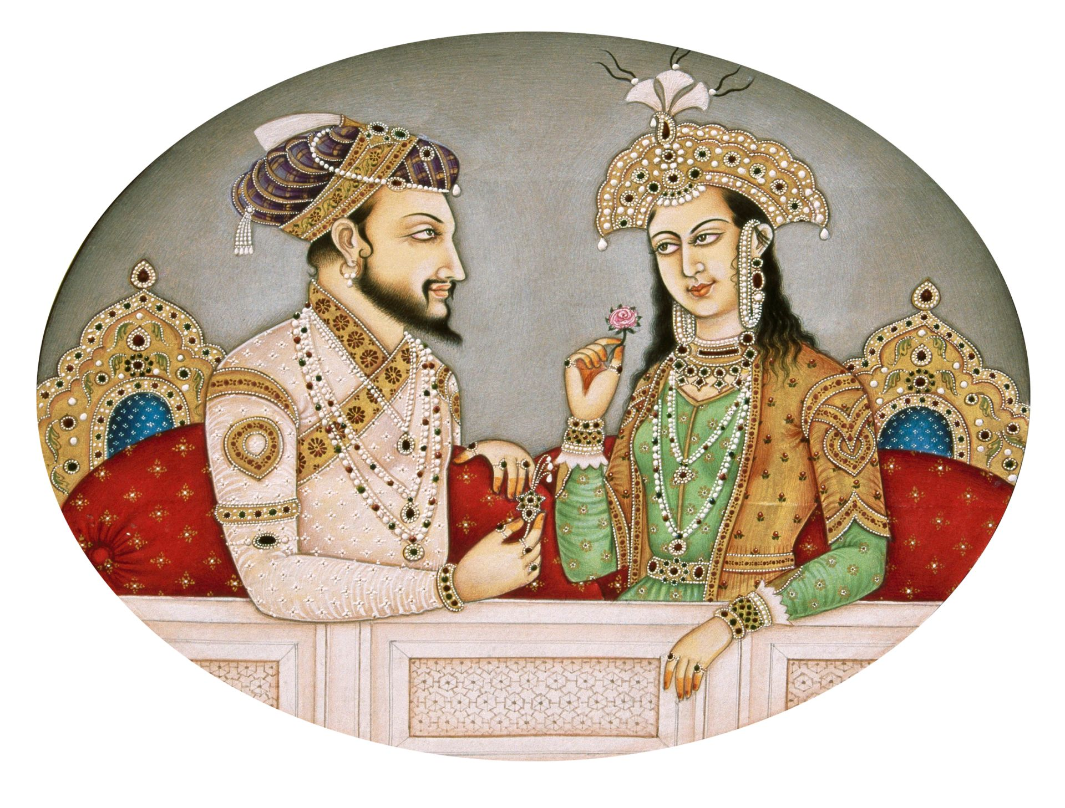
ALL ABOUT INDIA
BY KAI COWDEN

Slide 2
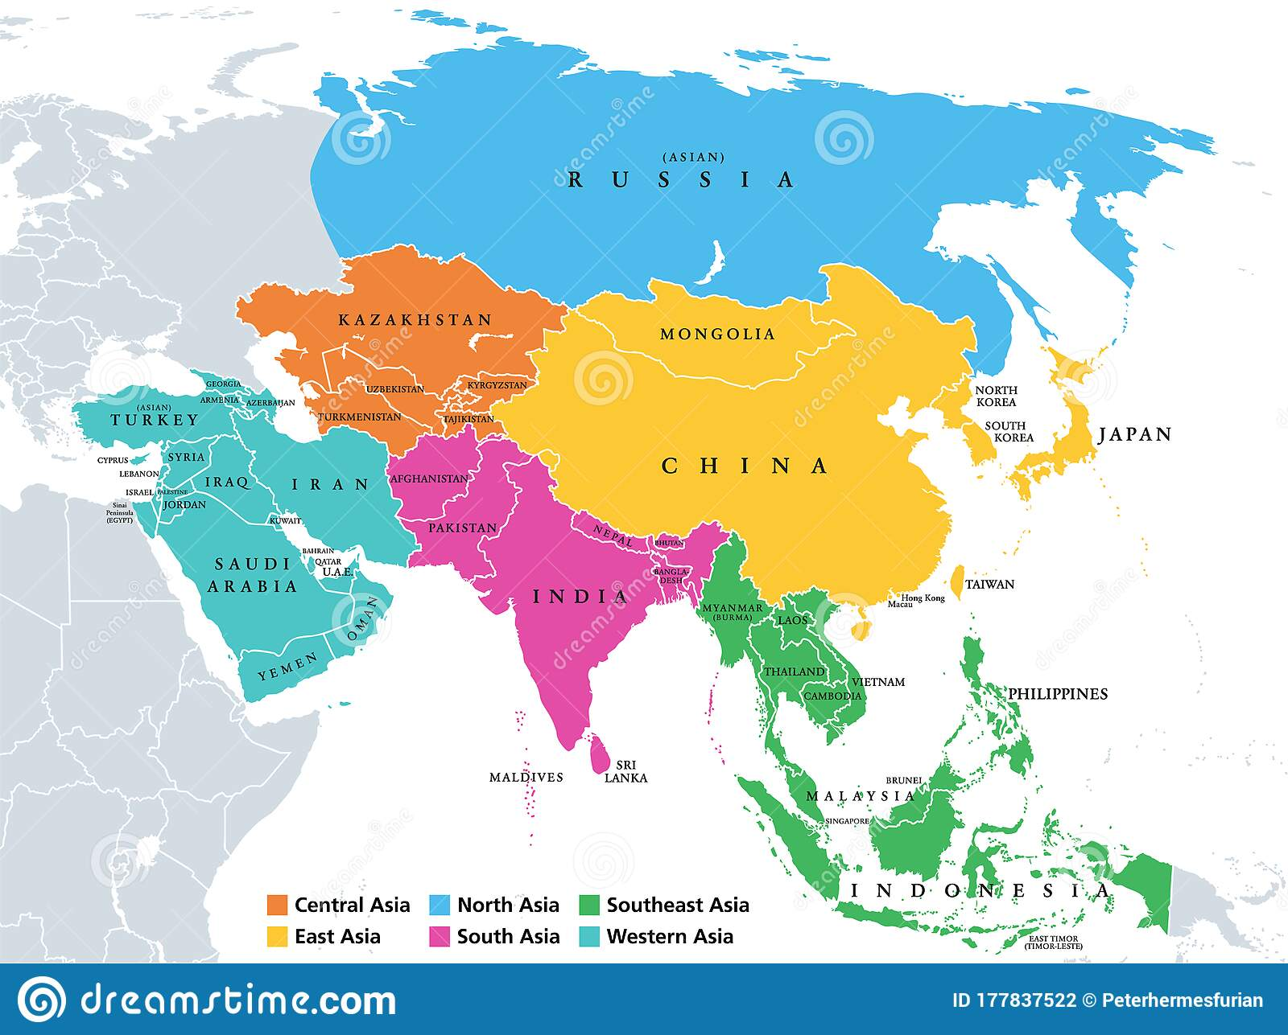
Where is India?
India is in Asia

Slide 3
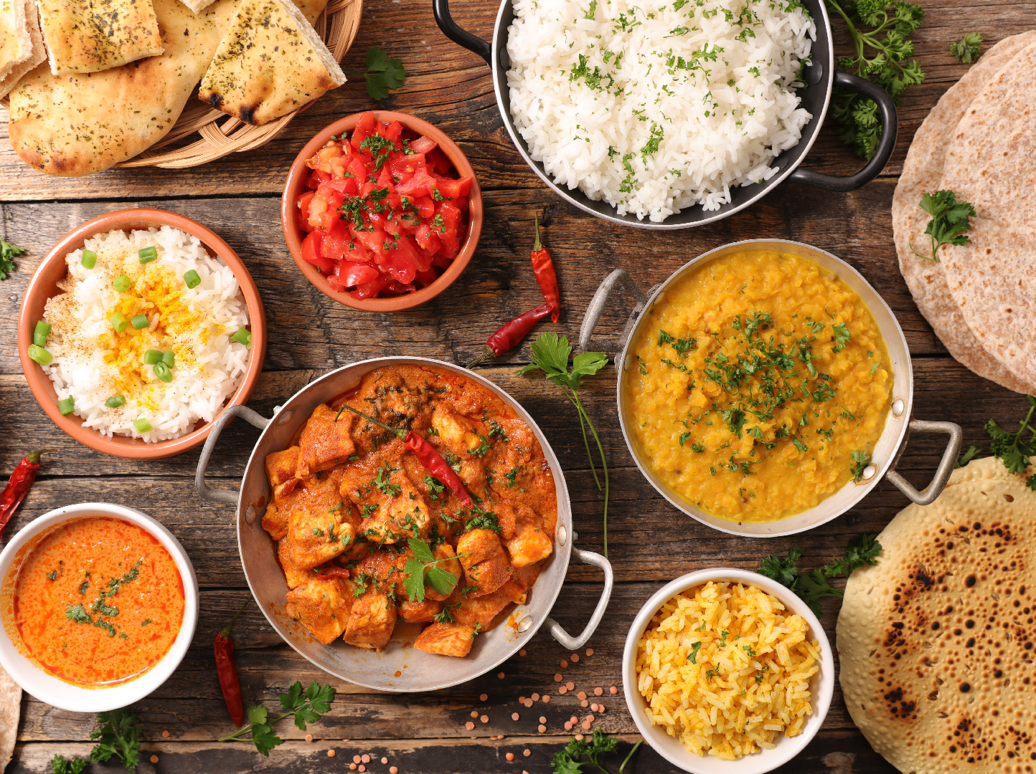
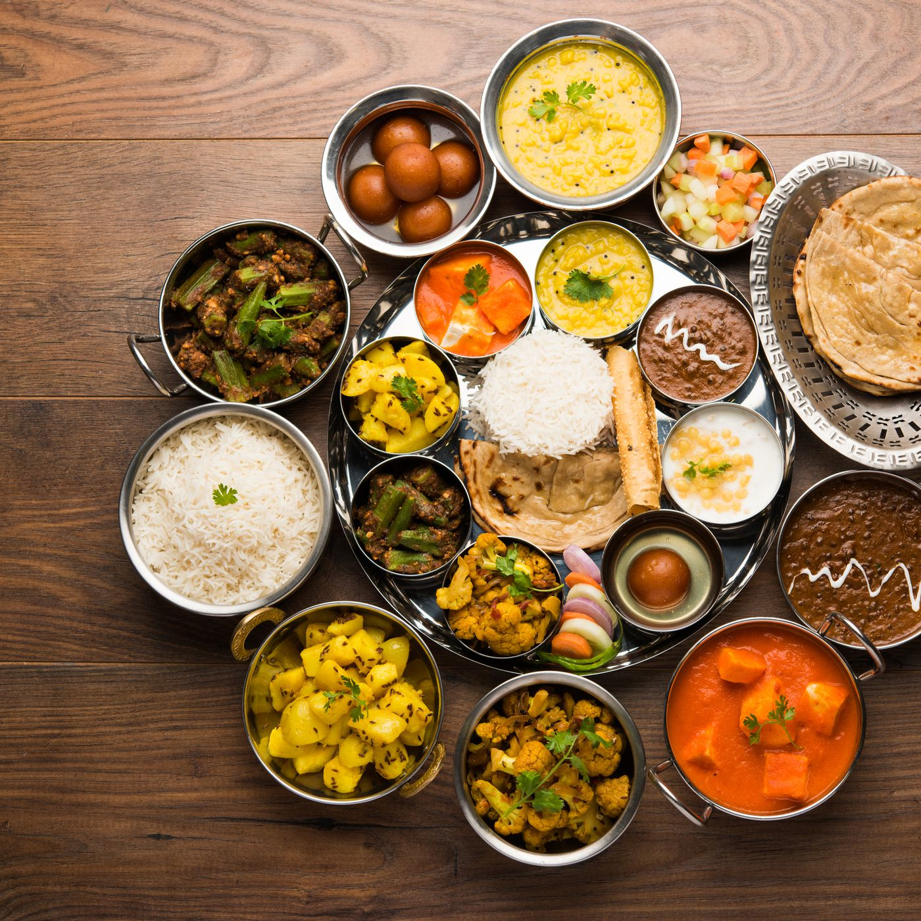
Food in India
Food in India is spicy.
Indian desserts are sweet.
They like to eat Poppadums.
Curry comes from India.

Slide 4
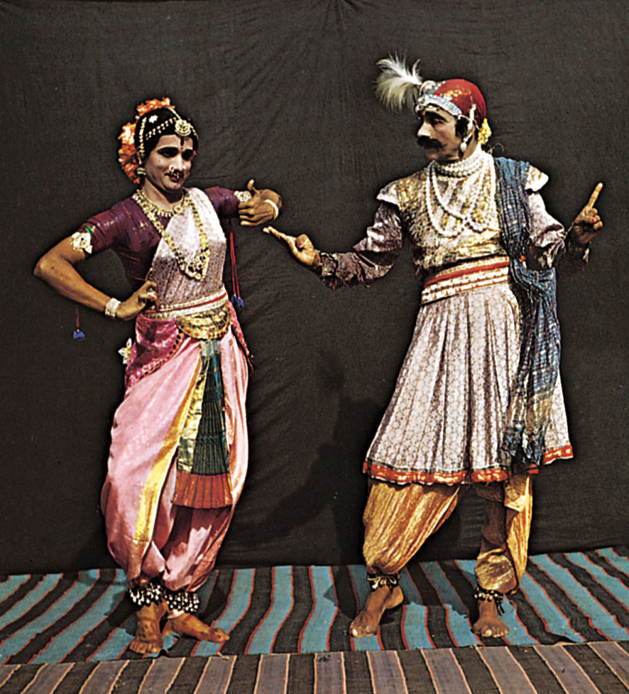
Indian clothing
Women in India wear a body garment or tunic
called a sari.

