Slide 1
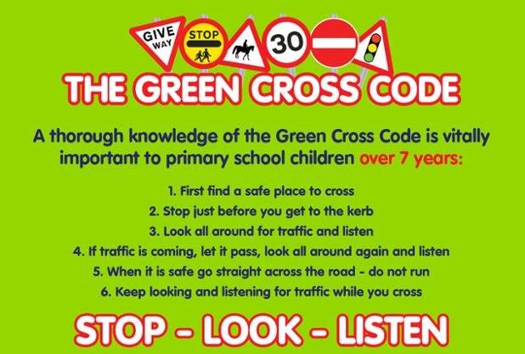

Slide 2


ROAD SAFE NI
Northern Ireland
Primary School
Road Safety Quiz 2018
Kindly sponsored by CRASH SERVICES

Slide 3
ROUND 1
ROAD SAFETY

Slide 4
1. Only one road sign is an octagon shape. What does it tell road users to do?
2. You are cycling along a road towards a Pelican Crossing, the amber light is flashing, what should you do?
3. What type of clothing should you wear to ensure that you are seen in the hours of darkness?
4. In the traffic light sequence, which light comes after a solitary amber light?
5. What is the very first instruction given in the Green Cross Code?
6. What does a blue sign with a white bicycle and a white pedestrian mean?
7. What colour are the road signs found on motorways ?
8. If there is no pavement and you have to walk on the road you need to …………

Slide 5
ROUND 2
GENERAL
KNOWLEDGE

Slide 6
In which country did Pharaohs rule?
What are molars, premolars, incisors and canines all types of?
In the Jungle Book by Rudyard Kipling, who was the leader of the wolf pack?
What type of fruit is dried to make a prune?
The name of which of Santa’s reindeer means “lightning” in German?
How many months of the year have 31 days?
Which legendary king sat at a round table?
8. Which of the following animals is a herbivore:
a) Crocodile, b) Giraffe, c) Tiger?

Slide 7
ROUND 1
ROAD SAFETY
ANSWERS

Slide 8
1. STOP
2. Check the crossing is clear and if so you can proceed
3. Reflective
4. Red
5. First find a safe place to cross
6. Cycle and pedestrian route
7. Blue and White
8. Walk on the right hand side of the road facing oncoming traffic

Slide 9
ROUND 3
ROAD SAFETY

Slide 10
Which five parts of your bicycle should you check each day?
What should you always wear when cycling?
At which type of pedestrian crossing would you find a beacon?
Which shape are road signs that give warnings ?
At what age may a child legally ride in the front seat of a car?
On which side of the car should children get in and out ?
Which part of the body is injured in nearly half of all cycle accidents?
Why can bad behaviour by children in a car be dangerous?

Slide 11
ROUND 2
GENERAL
KNOWLEDGE
ANSWERS

Slide 12
Egypt
Teeth
Akela
Plum
Blitzen
7
King Arthur
Giraffe

Slide 13
ROUND 4
ANAGRAMS

Slide 14
FRAYED OATS 2 WORDS (4, 6)
2. STRAIGHT CLIFF 2 WORDS (7, 6)
3. FAT PHOTO 1 WORD (8)
4. SNIPER DATE 1 WORD (10)
5. WHICH DAY EGO 2 WORDS (7, 4)
6. SUN ABLE 2 WORDS (3, 4)
7. GROCER COD SENSE 3 WORDS (5, 5, 4)
8. ENCIRCLING SOAPS 2 WORDS (7, 8)

Slide 15
ROUND 3
ROAD SAFETY
ANSWERS

Slide 16
Chain, Tyres, Brakes, Reflectors, Lights
Cycle Helmet
Zebra
Triangular
12 years old or 135cm whichever comes first
The side next to the pavement
Head
It can distract the driver causing an accident

Slide 17
ROUND 5
ROAD SIGNS

Slide 18



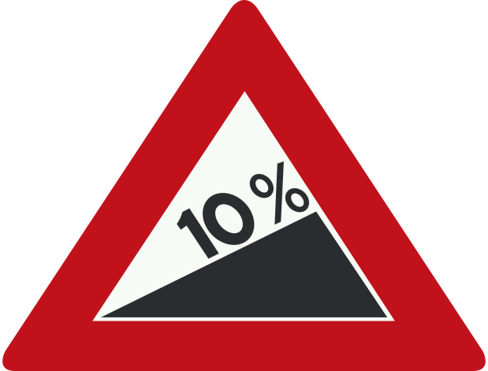
Identify the road sign
1
2
4
3

Slide 19




Identify the road sign
5
6
8
7

Slide 20
ROUND 4
ANAGRAMS
ANSWERS

Slide 21
ROAD SAFETY
TRAFFIC LIGHTS
FOOTPATH
PEDESTRIAN
HIGHWAY CODE
BUS LANE
GREEN CROSS CODE
PELICAN CROSSING

Slide 22
ROUND 6
IDENTIFY THE
LOGO

Slide 23


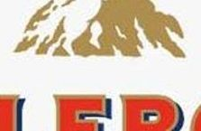

2
1
4
3

Slide 24




6
5
7
8

Slide 25
ROUND 5
ROAD SIGNS
ANSWERS

Slide 26
Identify the road sign
1
2
Crossroads
No U Turns
4
3
No Through road
Steep hill upwards

Slide 27
Identify the road sign
5
6
No entry for vehicular traffic
No right turn
8
7
Two way traffic crosses one way road
End of Motorway

Slide 28
ROUND 7
WORD SEARCH

Slide 29
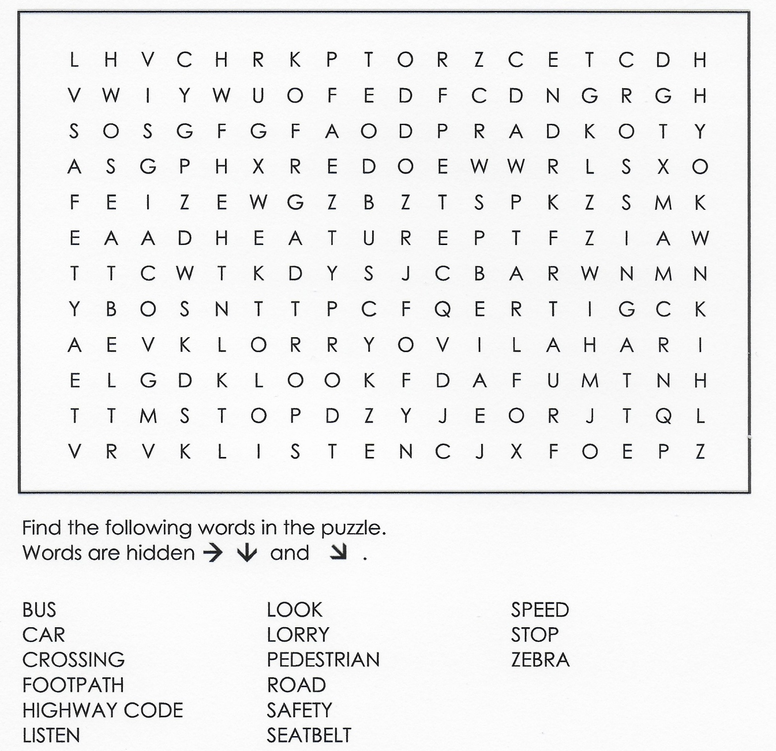

Slide 30
ROUND 6
IDENTIFY THE
LOGO ANSWERS

Slide 31




1
2
3
4

Slide 32




5
6
8
7

Slide 33
ROUND 8
Road Safety

Slide 34
1. In mph, what is the speed limit in most built up areas such as towns?
2. What colour are the lines painted to form a box junction ?
3 At which type of crossing may a cyclist ride across ?
4. At a Pelican Crossing, what does a flashing green man signal mean to pedestrians?
5. At what age can you legally drive a car ?
6. What is the name of the Dfi road safety calendar mascot ?
7 Which shape are road signs that give orders ?
8. Only one road sign is an upside down triangle, which one ?

Slide 35
ROUND 7
WORD SEARCH
ANSWERS

Slide 36
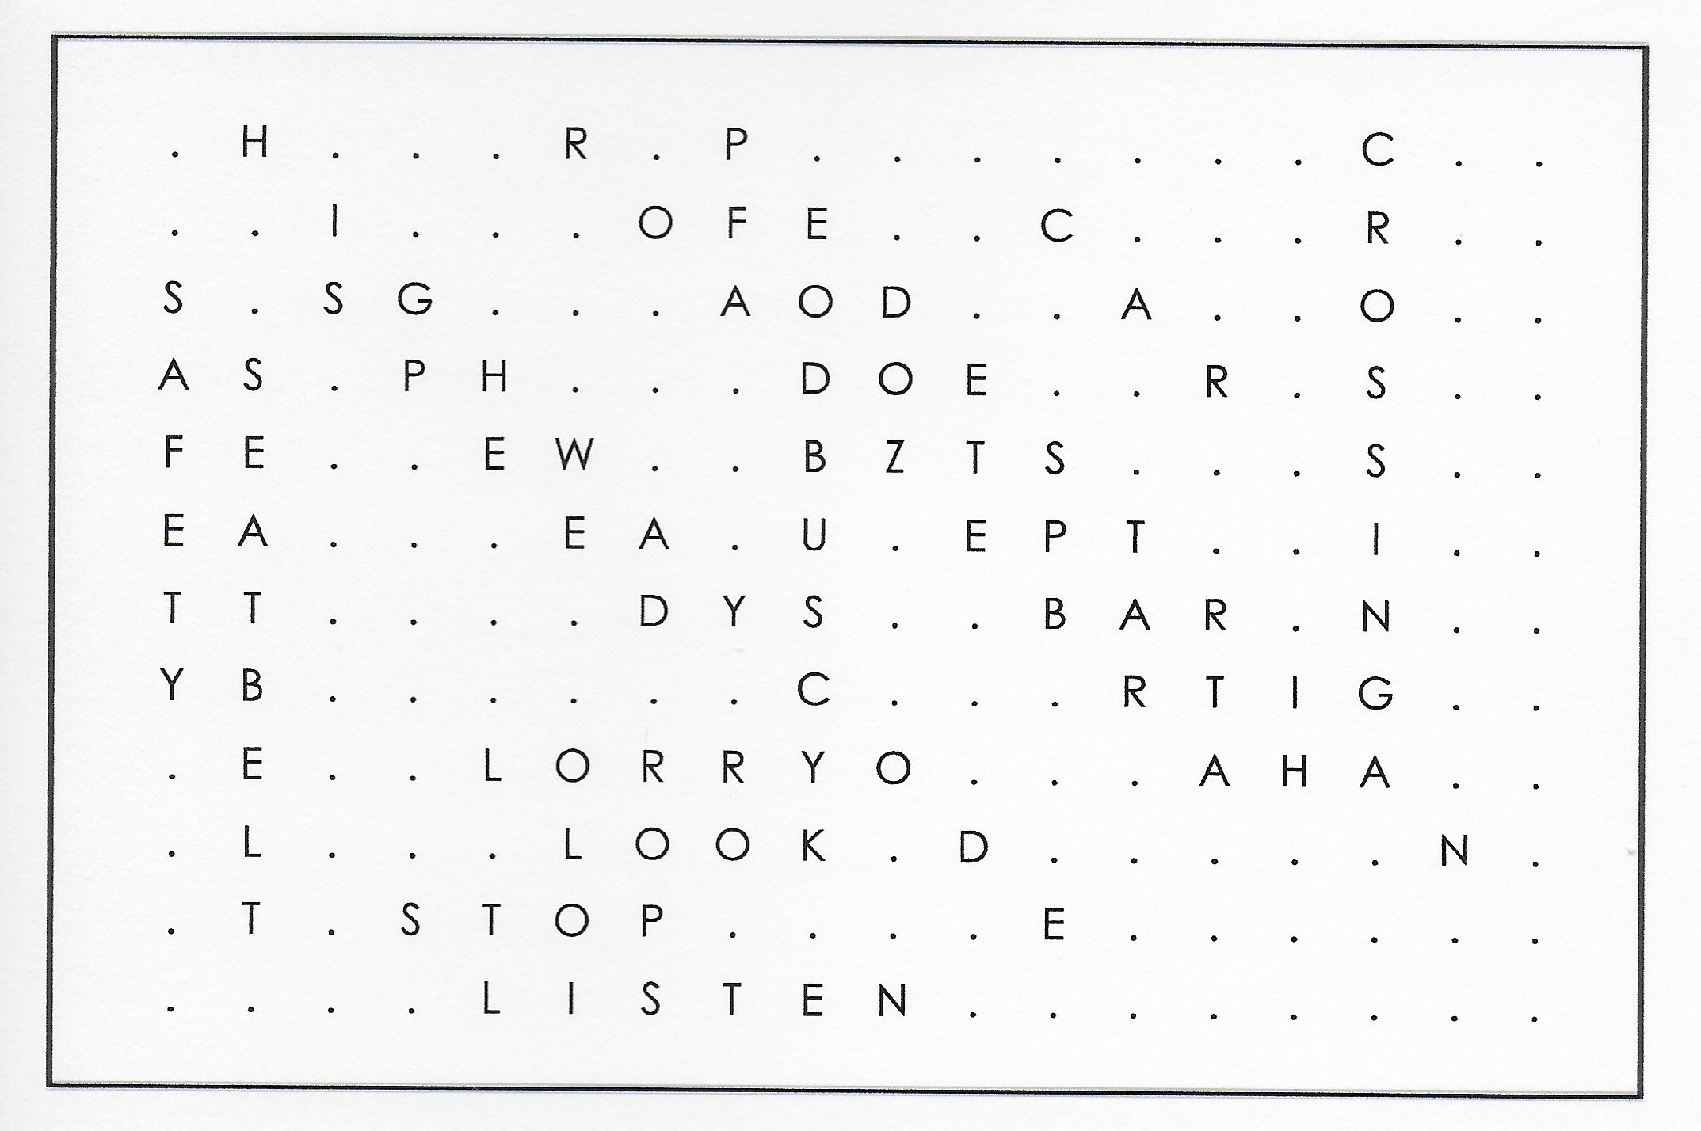

Slide 37
ROUND 8
Road Safety
Answers

Slide 38
1. 30mph
2. Yellow
3 A Toucan crossing
4. If you are already on the crossing you may continue. If you are not on the crossing, Do Not Start to Cross.
5. 17 years old
6. Skooter
7 Round
8. GIVE WAY

Slide 39

www.facebook.com/roadsafeni
FOR PICTURES OF THIS EVENT
THANK YOU - SAFE HOME

