Slide 1
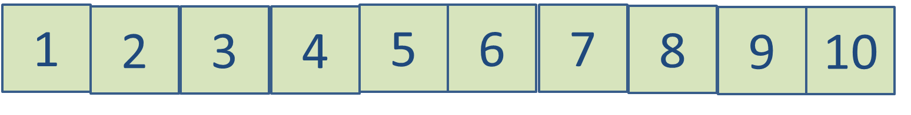
1
2
3
4
5
6
7
8
9
10

Slide 2
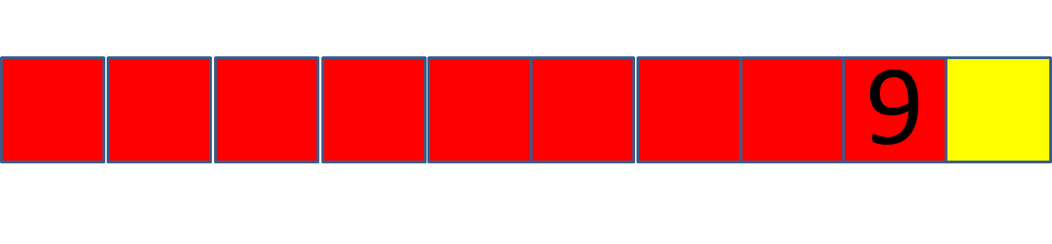




9
8
7
6
5

Slide 3
5
4
3
9
9
2
1

Slide 4






Slide 5
1
9
9
1
2
8
8
2

Slide 7


3
7
7
3
4
6
6
4

Slide 9

5
5
5
5

Slide 11


9
8
7
6
5

Slide 12
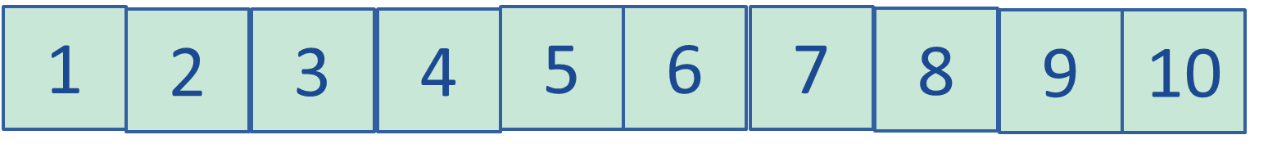


4
16
4
15
5
14
6

Slide 13
16
15
14

Slide 14
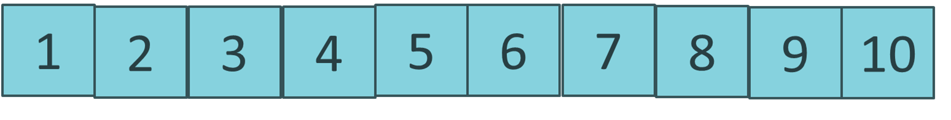



13
7
12
8
11
9

Slide 15






+
=
+
=

Slide 16



+
=
20
+
=
20

Slide 17





+
=
+
=

Slide 18


+
=
20
=
+
20

Slide 19



+
=
+
=

Slide 20
+
=
20
+
=
20

Slide 21


+
=
+
=

Slide 22
+
=
20
+
=
20

Slide 23

+
=
+
=

Slide 24

+
=
20

Slide 25
13
12
11

Slide 26

11
11
19
18
17

Slide 27
11
11
19
18
17

