Slide 1
11
13
12
14
Teen Numbers
Worksheets
16
18
15
17
19

Slide 2
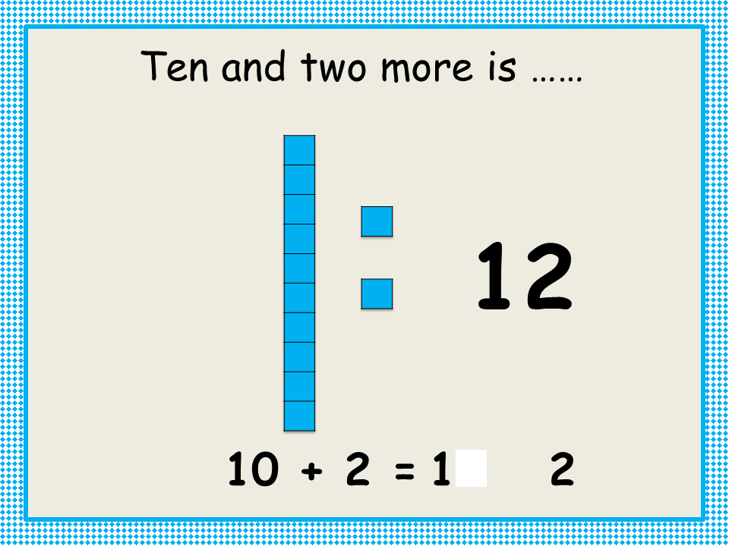
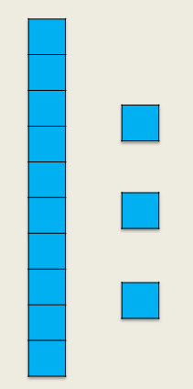
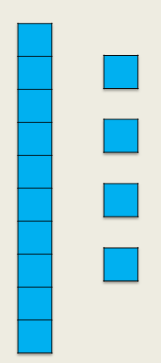
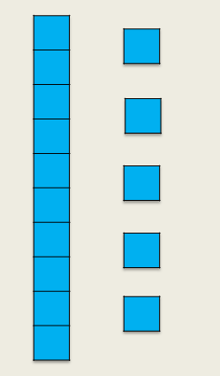
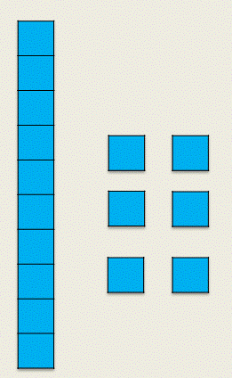
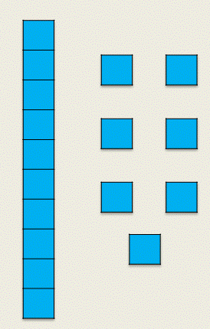
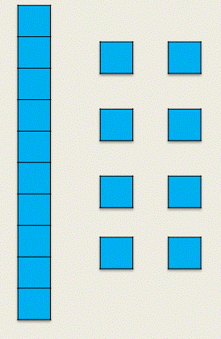
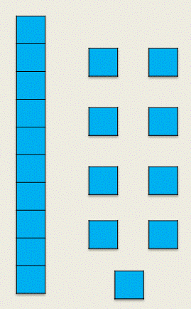
Teen Numbers Can you fill in the missing numbers in the number sentences? |  |  | 10 + 1 = ____
 | 10 + 2 = ____ |  | 10 + 3 = ____
 | 10 + 4 = ____ |  | 10 + 5 = ____
 | 10 + 6 = ____ |  | 10 + 7 = ____
 | 10 + 8 = ____ |  | 10 + 9 = ____

Slide 3
Teen Numbers Can you write the number sentences? |  |  | 10 + 1 = ____

Slide 4
Teen Numbers Can you write the number sentences and draw the representations? |  |  | 10 + 1 = ____
 |  |  | 10 + 3 = ____
 | 10 + 4 = ____
 |  |  | 10 + 7 = ____
 | Make your own!

