Slide 1


Primary 5– Summer Block 2 – Measurement: Money
Step 1: Pounds and Pence
© Classroom Secrets Limited 2018

Slide 2
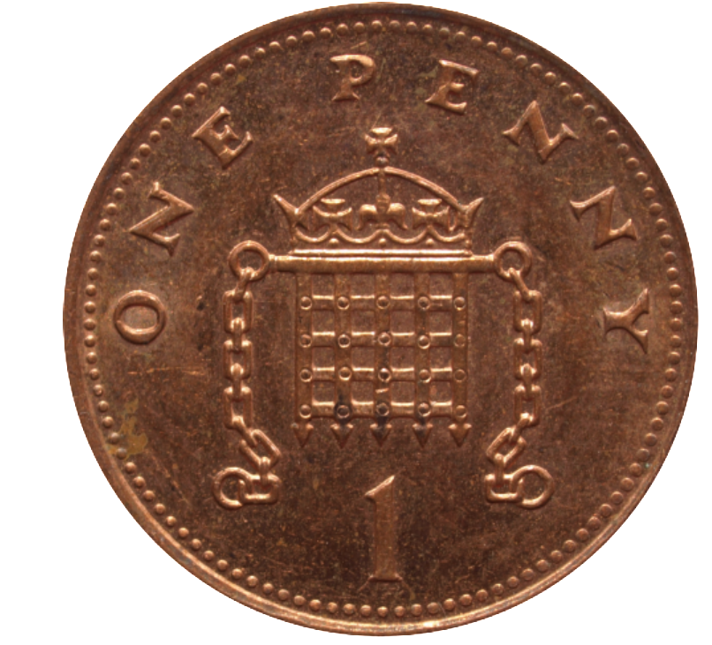
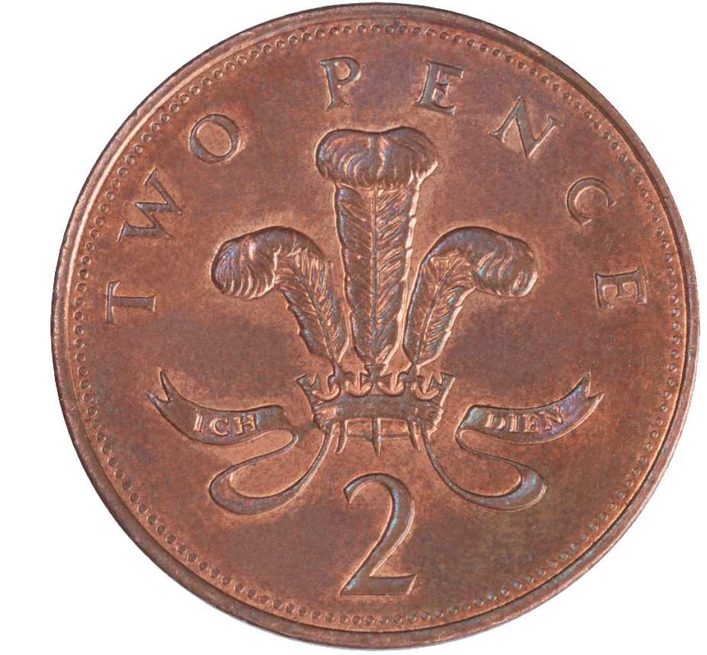
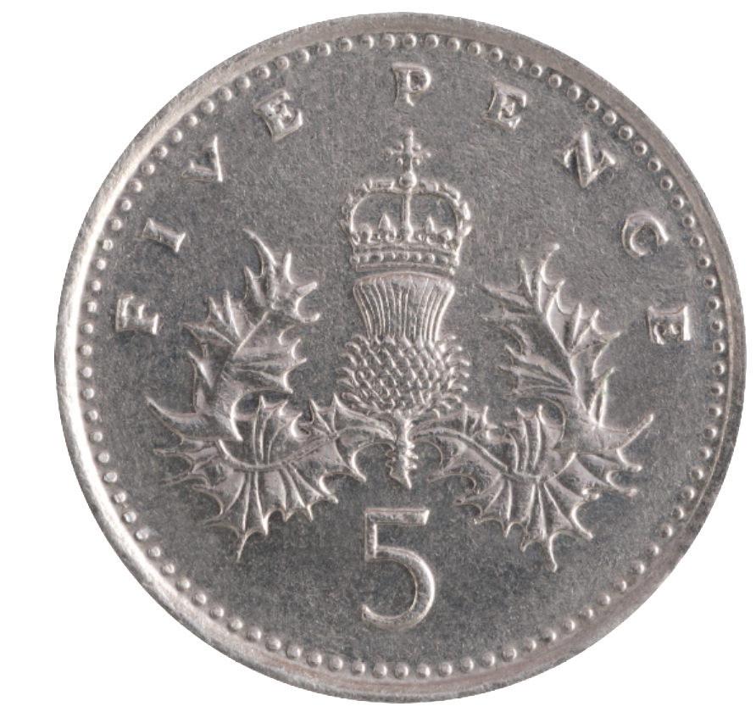
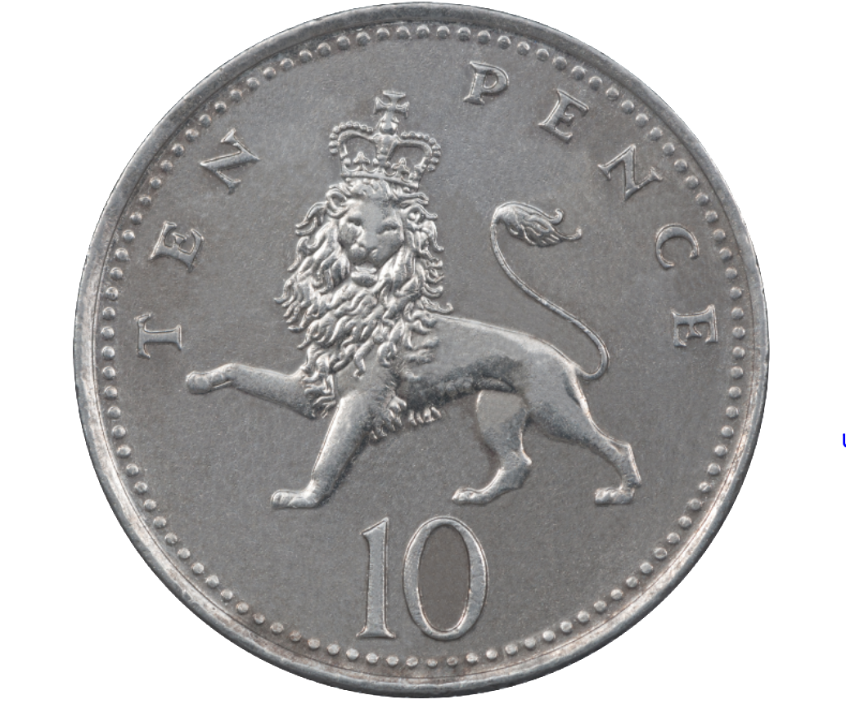
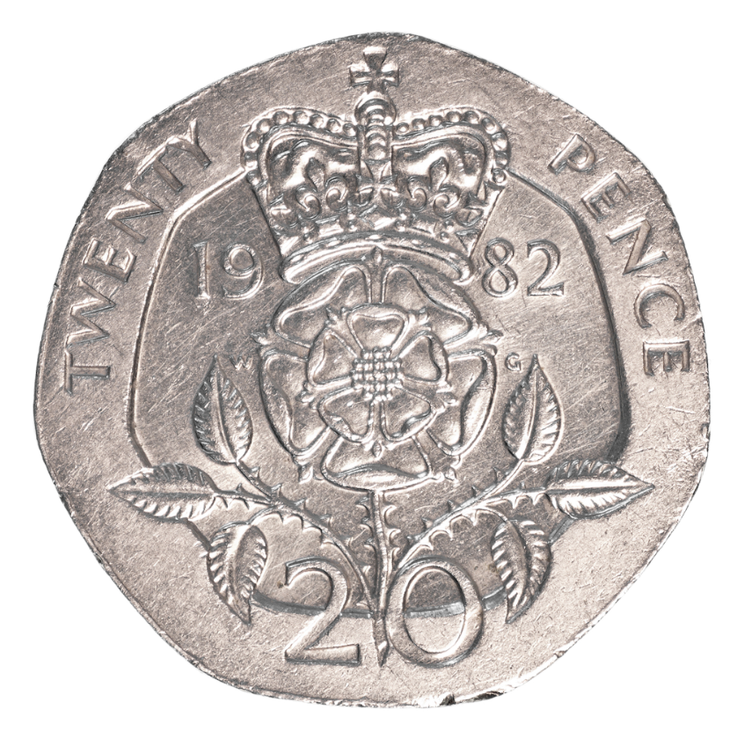
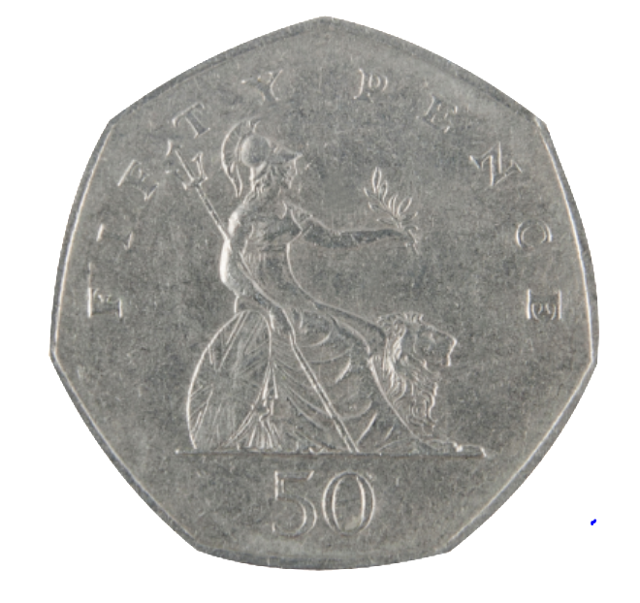
Introduction
Make 10p using only bronze coins.
Make 50p using only silver coins.
Make £1 using only silver coins.
Is there more than one way of doing it?
© Classroom Secrets Limited 2018

Slide 3
Introduction
Make 10p using only bronze coins.
Make 50p using only silver coins.
Make £1 using only silver coins.
Here is a selection of answers.
© Classroom Secrets Limited 2018

Slide 4
Varied Fluency 1
Complete the table.
£ | p | £ and p
2 | 26
 | 907
 |  | £3.55
© Classroom Secrets Limited 2018

Slide 5
Varied Fluency 1
Complete the table.
£ | p | £ and p
2 | 26 | £2.26
 | 907 | £9.07
3 | 55 | £3.55
© Classroom Secrets Limited 2018

Slide 6
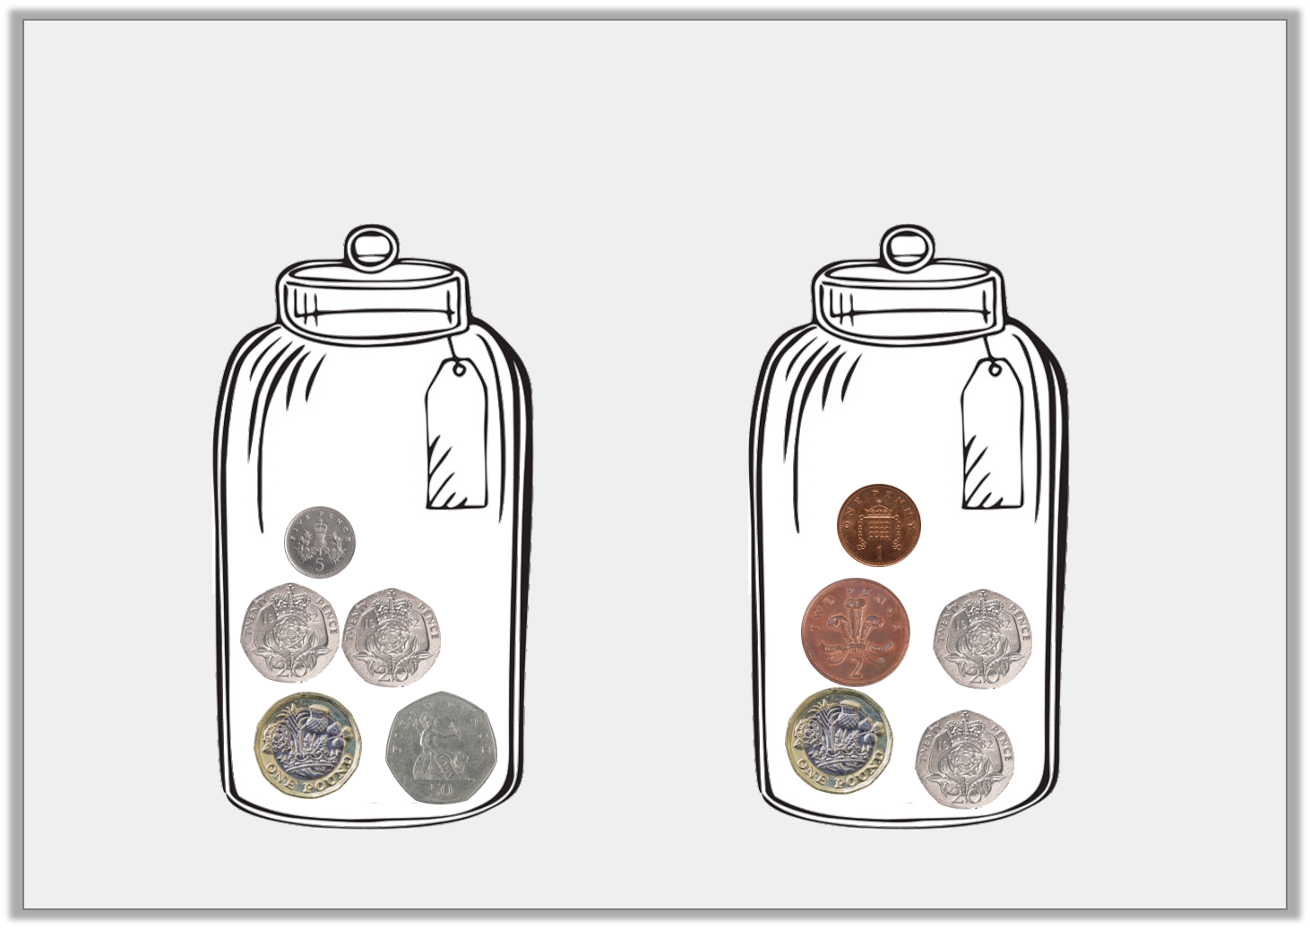
Varied Fluency 2
How much money is in each jar?
A
B
© Classroom Secrets Limited 2018

Slide 7
Varied Fluency 2
How much money is in each jar?
A
B
£1.95
£1.43
© Classroom Secrets Limited 2018

Slide 8
Varied Fluency 3
I have five pound coins, a fifty pence coin and 2 ten pence coins. How much money do I have altogether?
© Classroom Secrets Limited 2018

Slide 9
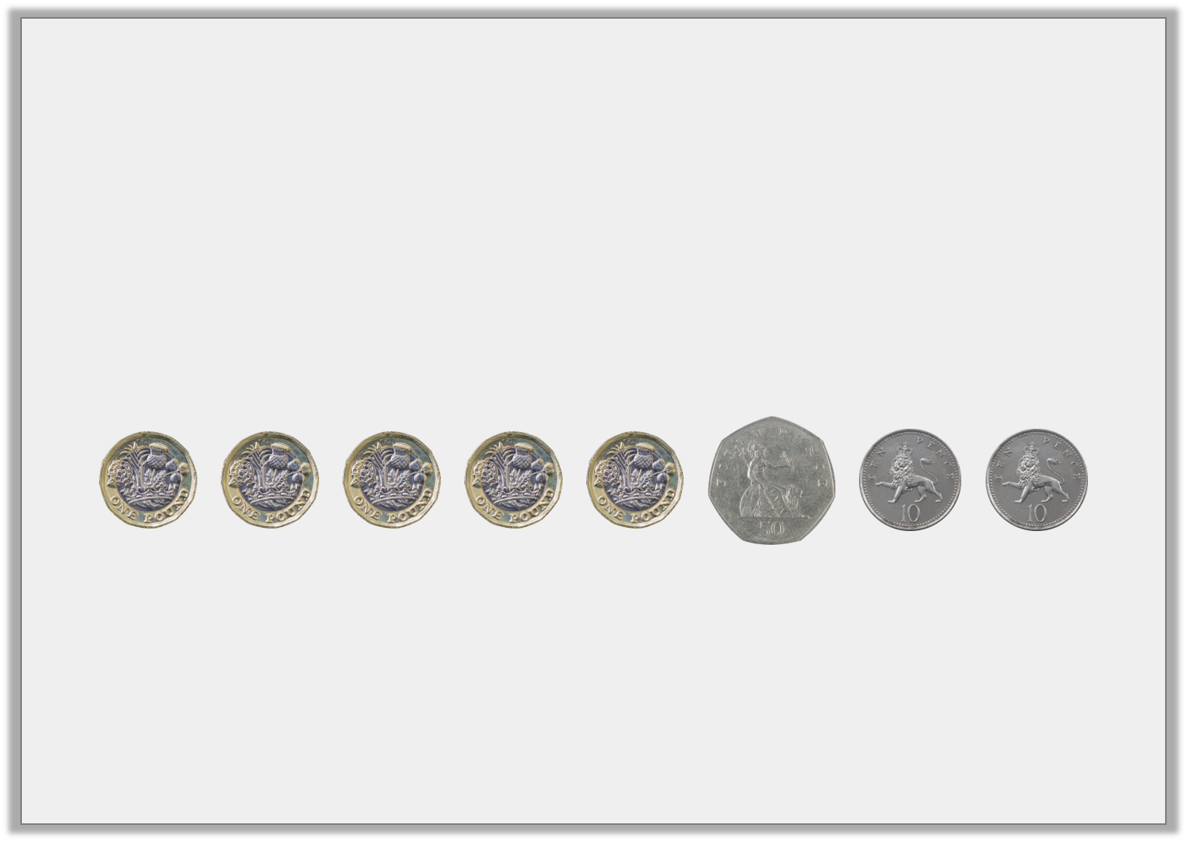
Varied Fluency 3
I have five pound coins, a fifty pence coin and 2 ten pence coins. How much money do I have altogether?
£5.70
© Classroom Secrets Limited 2018

Slide 10
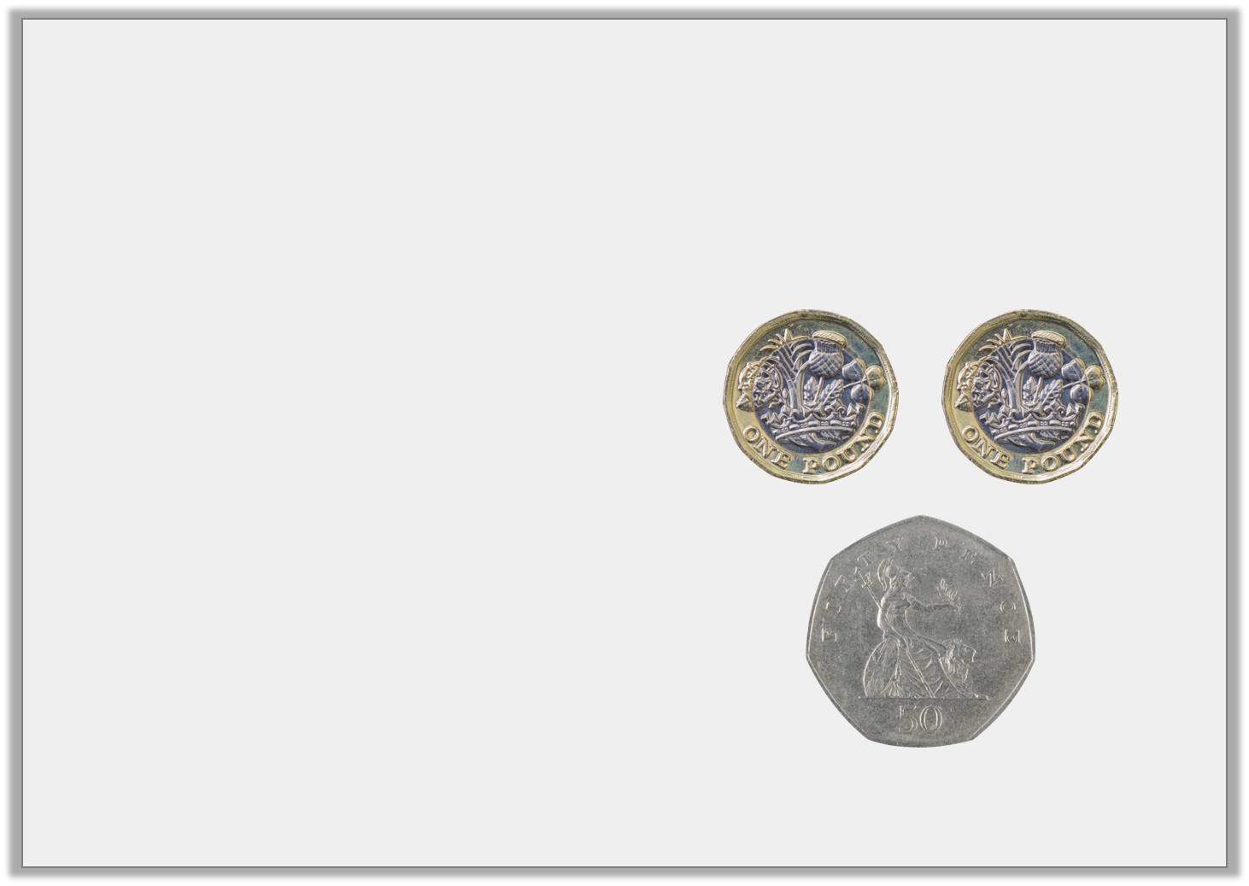
Varied Fluency 4
Which is the correct written version for the amount of coins shown?
A) £2.05
B) £2.5
C) £2.50
© Classroom Secrets Limited 2018

Slide 11
Varied Fluency 4
Which is the correct written version for the amount of coins shown?
A) £2.05
B) £2.5
C) £2.50
© Classroom Secrets Limited 2018

Slide 12
Varied Fluency 5
What is the value of the underlined digit?
a) £11.65 | b) £4.09 | c) £11.20
© Classroom Secrets Limited 2018

Slide 13
Varied Fluency 5
What is the value of the underlined digit?
a) £11.65 60p | b) £4.09 9p | c) £11.20 £10
© Classroom Secrets Limited 2018

Slide 14
Reasoning 1
Imran and Beth both want to buy a burger.
A burger costs £1.60.
Imran says, “I have a 50p coin, three 20p coins and four 5p coins.”
Beth says, “I have a £1 coin, two 20p coins and two 10p coins.”
Who can afford to buy a burger?
Explain how you know.
© Classroom Secrets Limited 2018

Slide 15
Reasoning 1
Imran and Beth both want to buy a burger.
A burger costs £1.60.
Imran says, “I have a 50p coin, three 20p coins and four 5p coins.”
Beth says, “I have a £1 coin, two 20p coins and two 10p coins.”
Who can afford to buy a burger?
Explain how you know.
Beth can afford it because…
© Classroom Secrets Limited 2018

Slide 16
Reasoning 1
Imran and Beth both want to buy a burger.
A burger costs £1.60.
Imran says, “I have a 50p coin, three 20p coins and four 5p coins.”
Beth says, “I have a £1 coin, two 20p coins and two 10p coins.”
Who can afford to buy a burger?
Explain how you know.
Beth can afford it because she has £1.60. Imran only has £1.30.
© Classroom Secrets Limited 2018

Slide 17
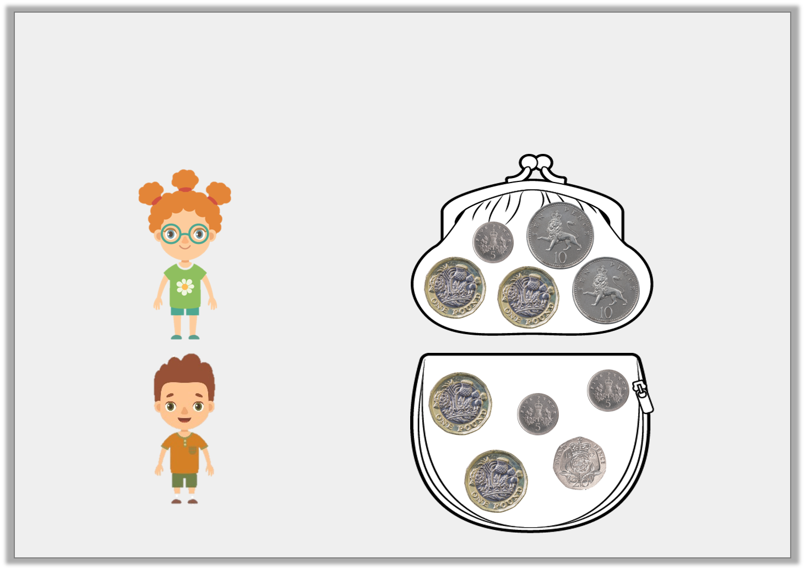
Problem Solving 1
Manon has 5p more than Jon. Match each child to their correct money purse. Write down how much they each have in pence and decimals.
Manon
Jon
© Classroom Secrets Limited 2018

Slide 18
Problem Solving 1
Manon has 5p more than Jon. Match each child to their correct money purse. Write down how much they each have in pence and decimals.
Manon
230p
£2.30
Jon
225p
£2.25
© Classroom Secrets Limited 2018

Slide 19
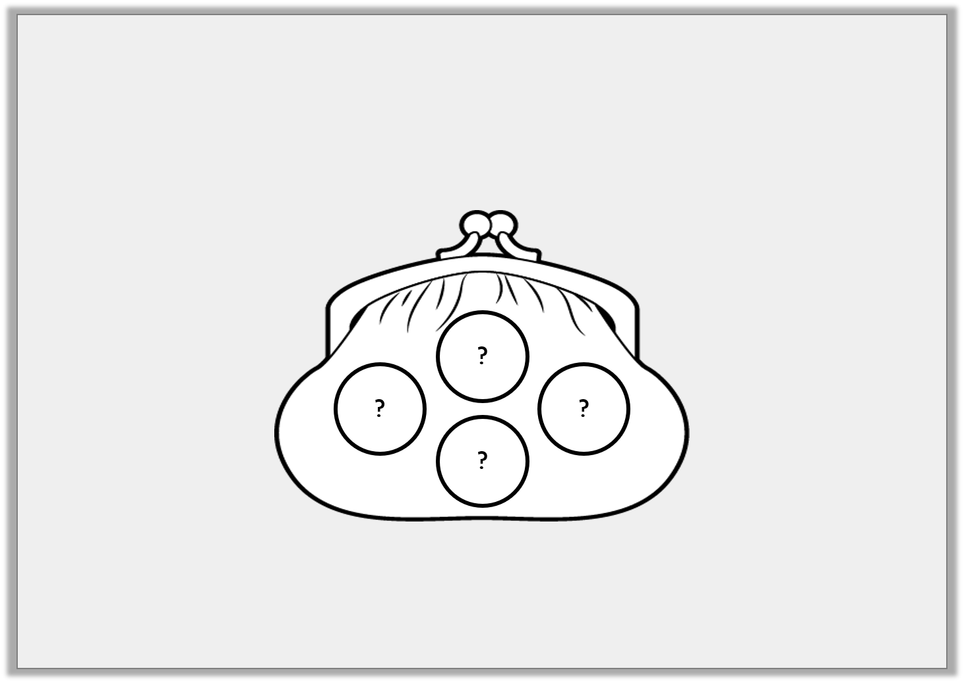
Problem Solving 2
Andrew has £2.10 in his wallet. He has four coins.
What coins could Andrew have?
© Classroom Secrets Limited 2018

Slide 20
Problem Solving 2
Andrew has £2.10 in his wallet. He has four coins.
What coins could Andrew have?
Multiple answers, e.g.
2 x £1 coin and 2 x 5p coin
A £1 coin, 2 x 50p coin and a 10p coin
© Classroom Secrets Limited 2018

