Slide 2






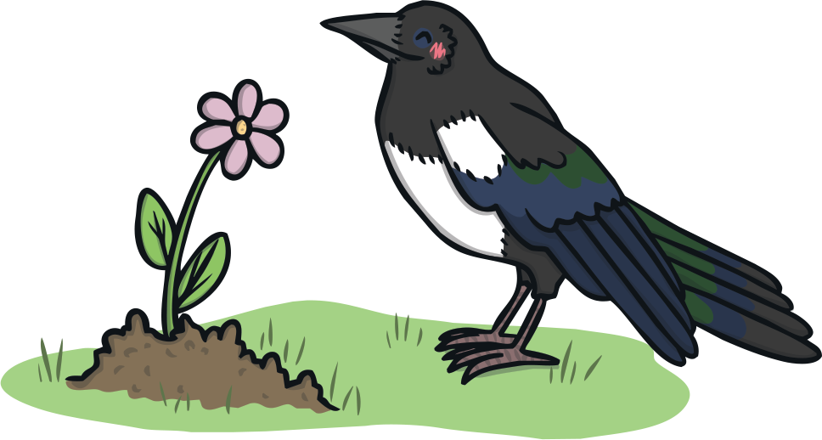
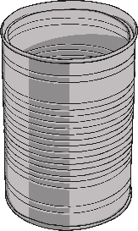
I recycle, I recycle.
So should you, so should you.
Paper, glass and plastic, paper, glass and plastic,
Metal too, metal too!

Slide 3
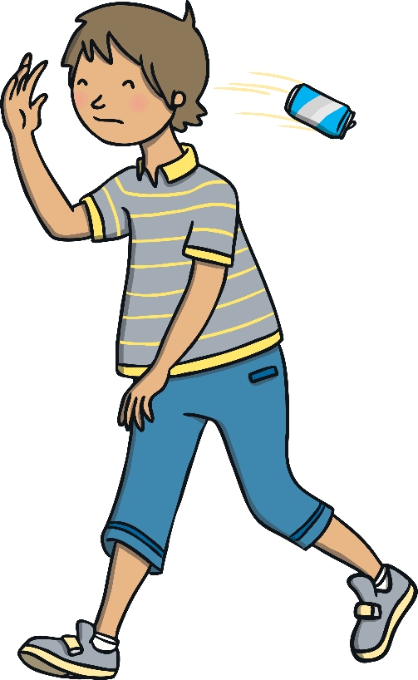

Dropping litter, dropping litter,
Makes us sad, makes us sad.
It’s not kind or helpful, it’s not kind or helpful,
It is bad, it is bad!

Slide 4
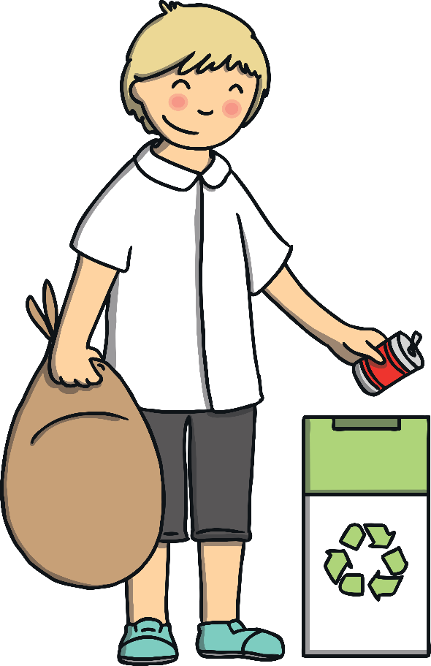

We recycle, we recycle,
You can too, you can too.
Keep things clean and tidy, keep things clean and tidy,
Just like new, just like new!

