Slide 2
Click me for a story!

Slide 3

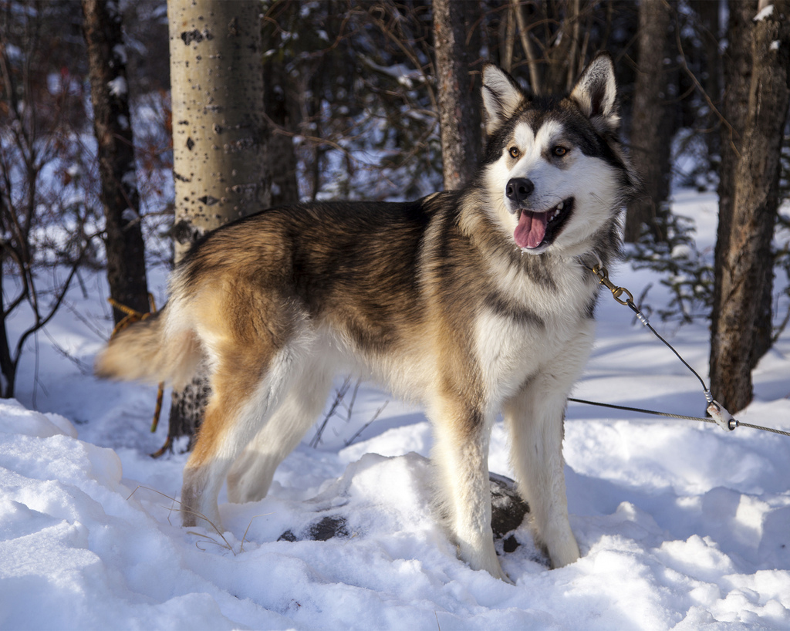
What can you see?

Slide 4
Husky
Photo courtesy of DenaliNPS (@flickr.com) - granted under creative commons licence - attribution

Slide 5
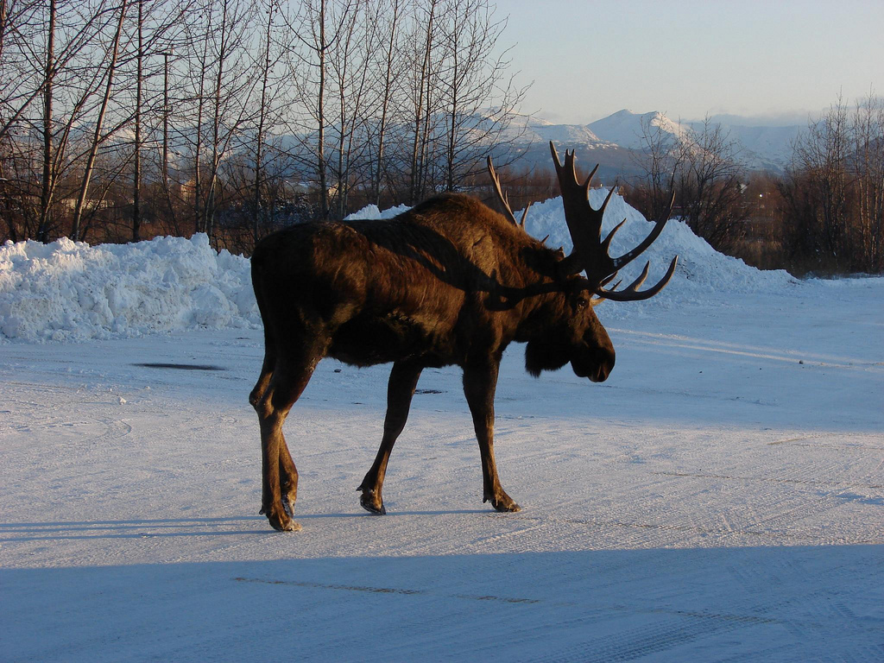
What can you see?

Slide 6
Moose
Photo courtesy of echoforsberg (@flickr.com) - granted under creative commons licence - attribution

Slide 7
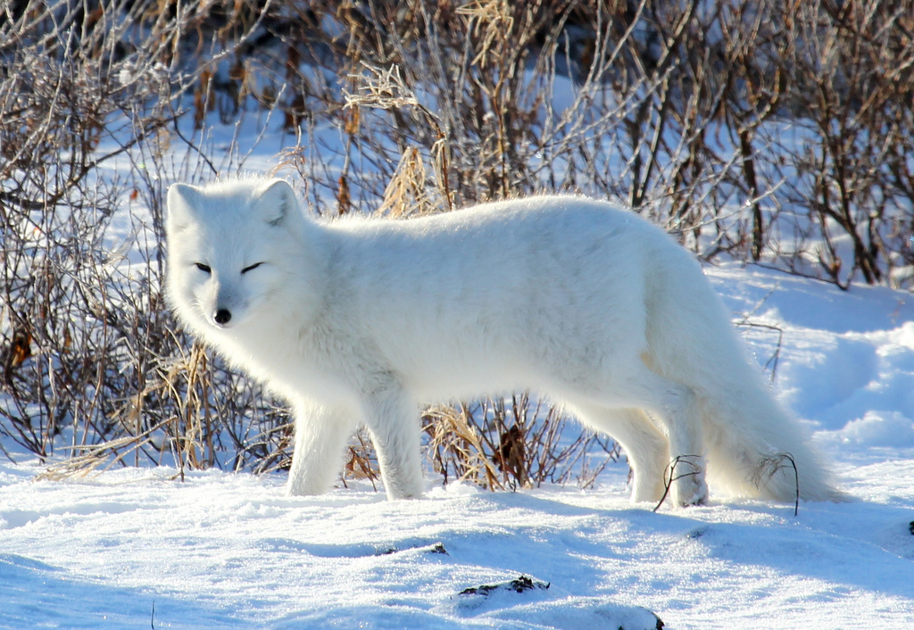
What can you see?

Slide 8
Arctic Fox
Photo courtesy of em_j_bishop (@flickr.com) - granted under creative commons licence - attribution

Slide 9
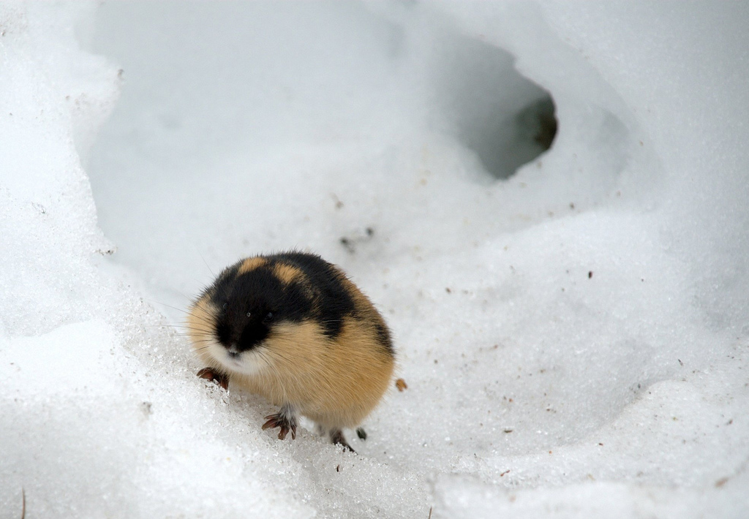
What can you see?

Slide 10
Lemming
Photo courtesy of kgleditsch (@flickr.com) - granted under creative commons licence - attribution

Slide 11
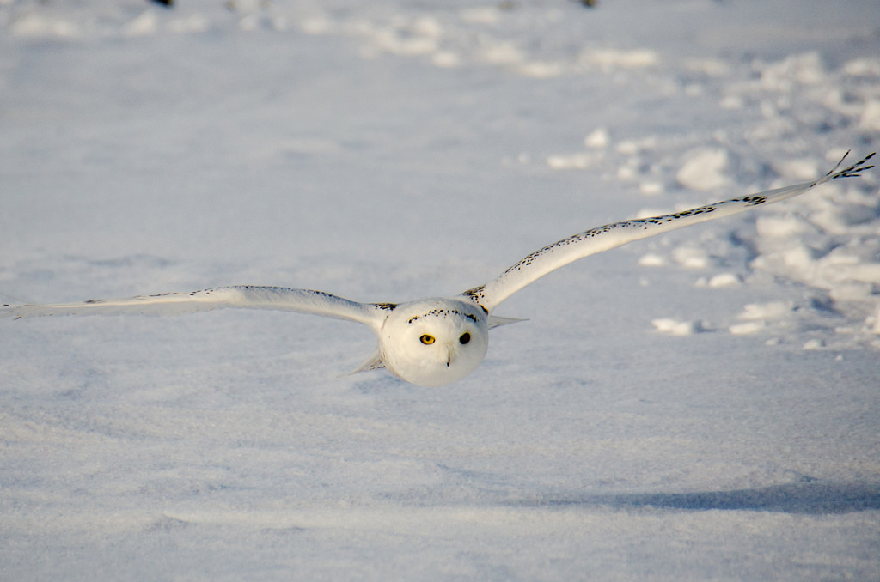
What can you see?

Slide 12
Snowy Owl
Photo courtesy of m01229 (@flickr.com) - granted under creative commons licence - attribution

Slide 13
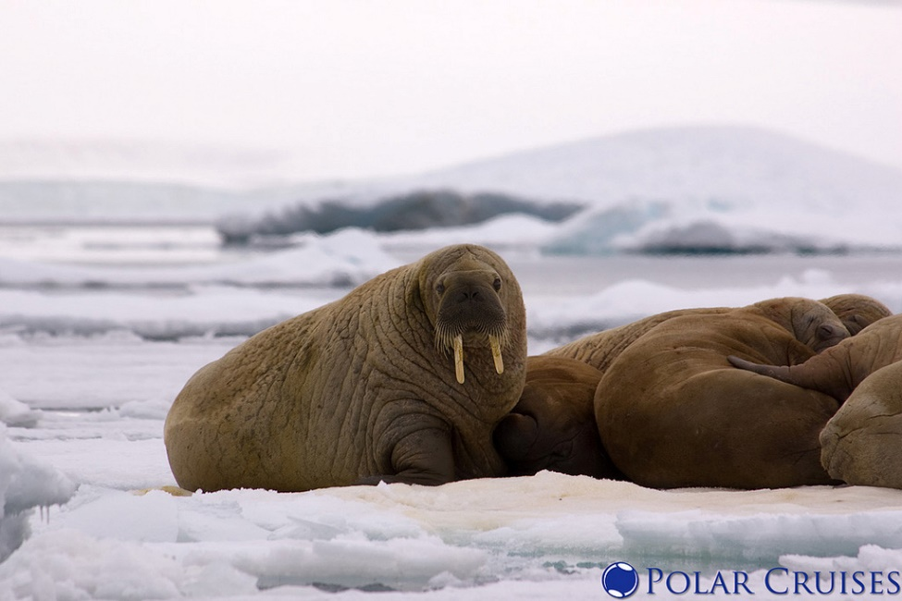
What can you see?

Slide 14
Walrus
Photo courtesy of Polar Cruises (@flickr.com) - granted under creative commons licence - attribution

Slide 15
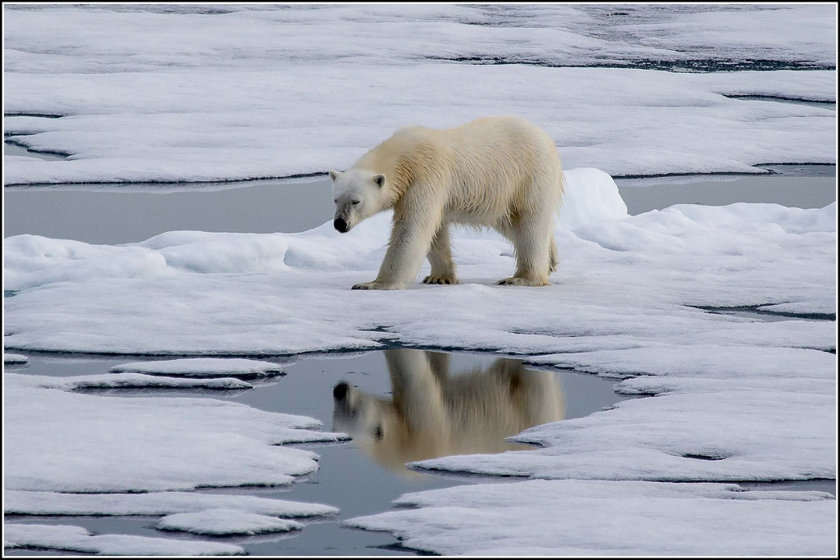
What can you see?

Slide 16
Polar Bear
Photo courtesy of Smudge 9000 (@flickr.com) - granted under creative commons licence - attribution

Slide 17
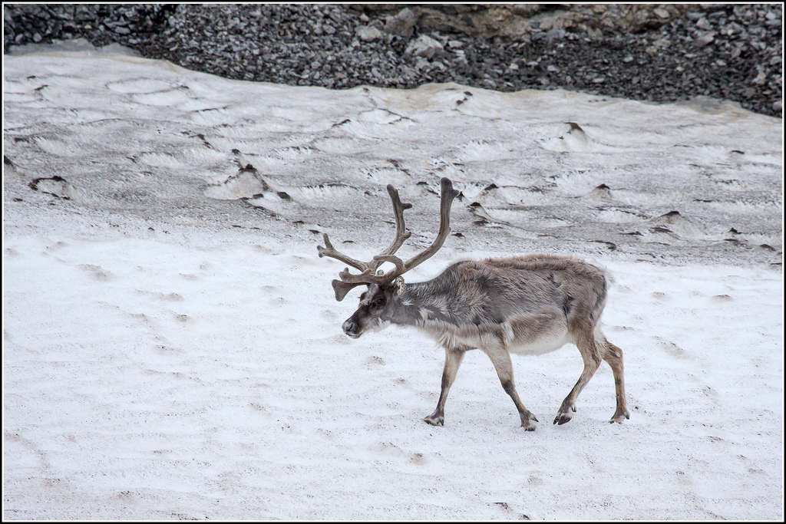
What can you see?

Slide 18
Reindeer
Photo courtesy of Smudge 9000 (@flickr.com) - granted under creative commons licence - attribution

Slide 19
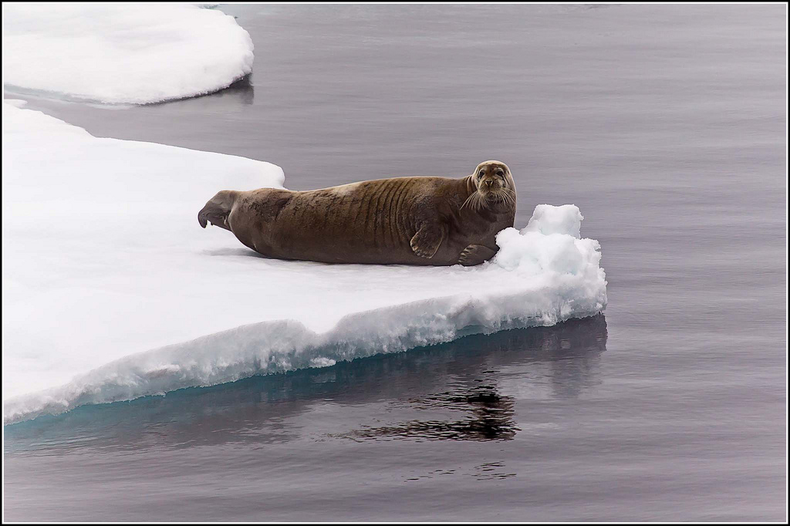
What can you see?

Slide 20
Seal
Photo courtesy of Smudge 9000 (@flickr.com) - granted under creative commons licence - attribution

Slide 21
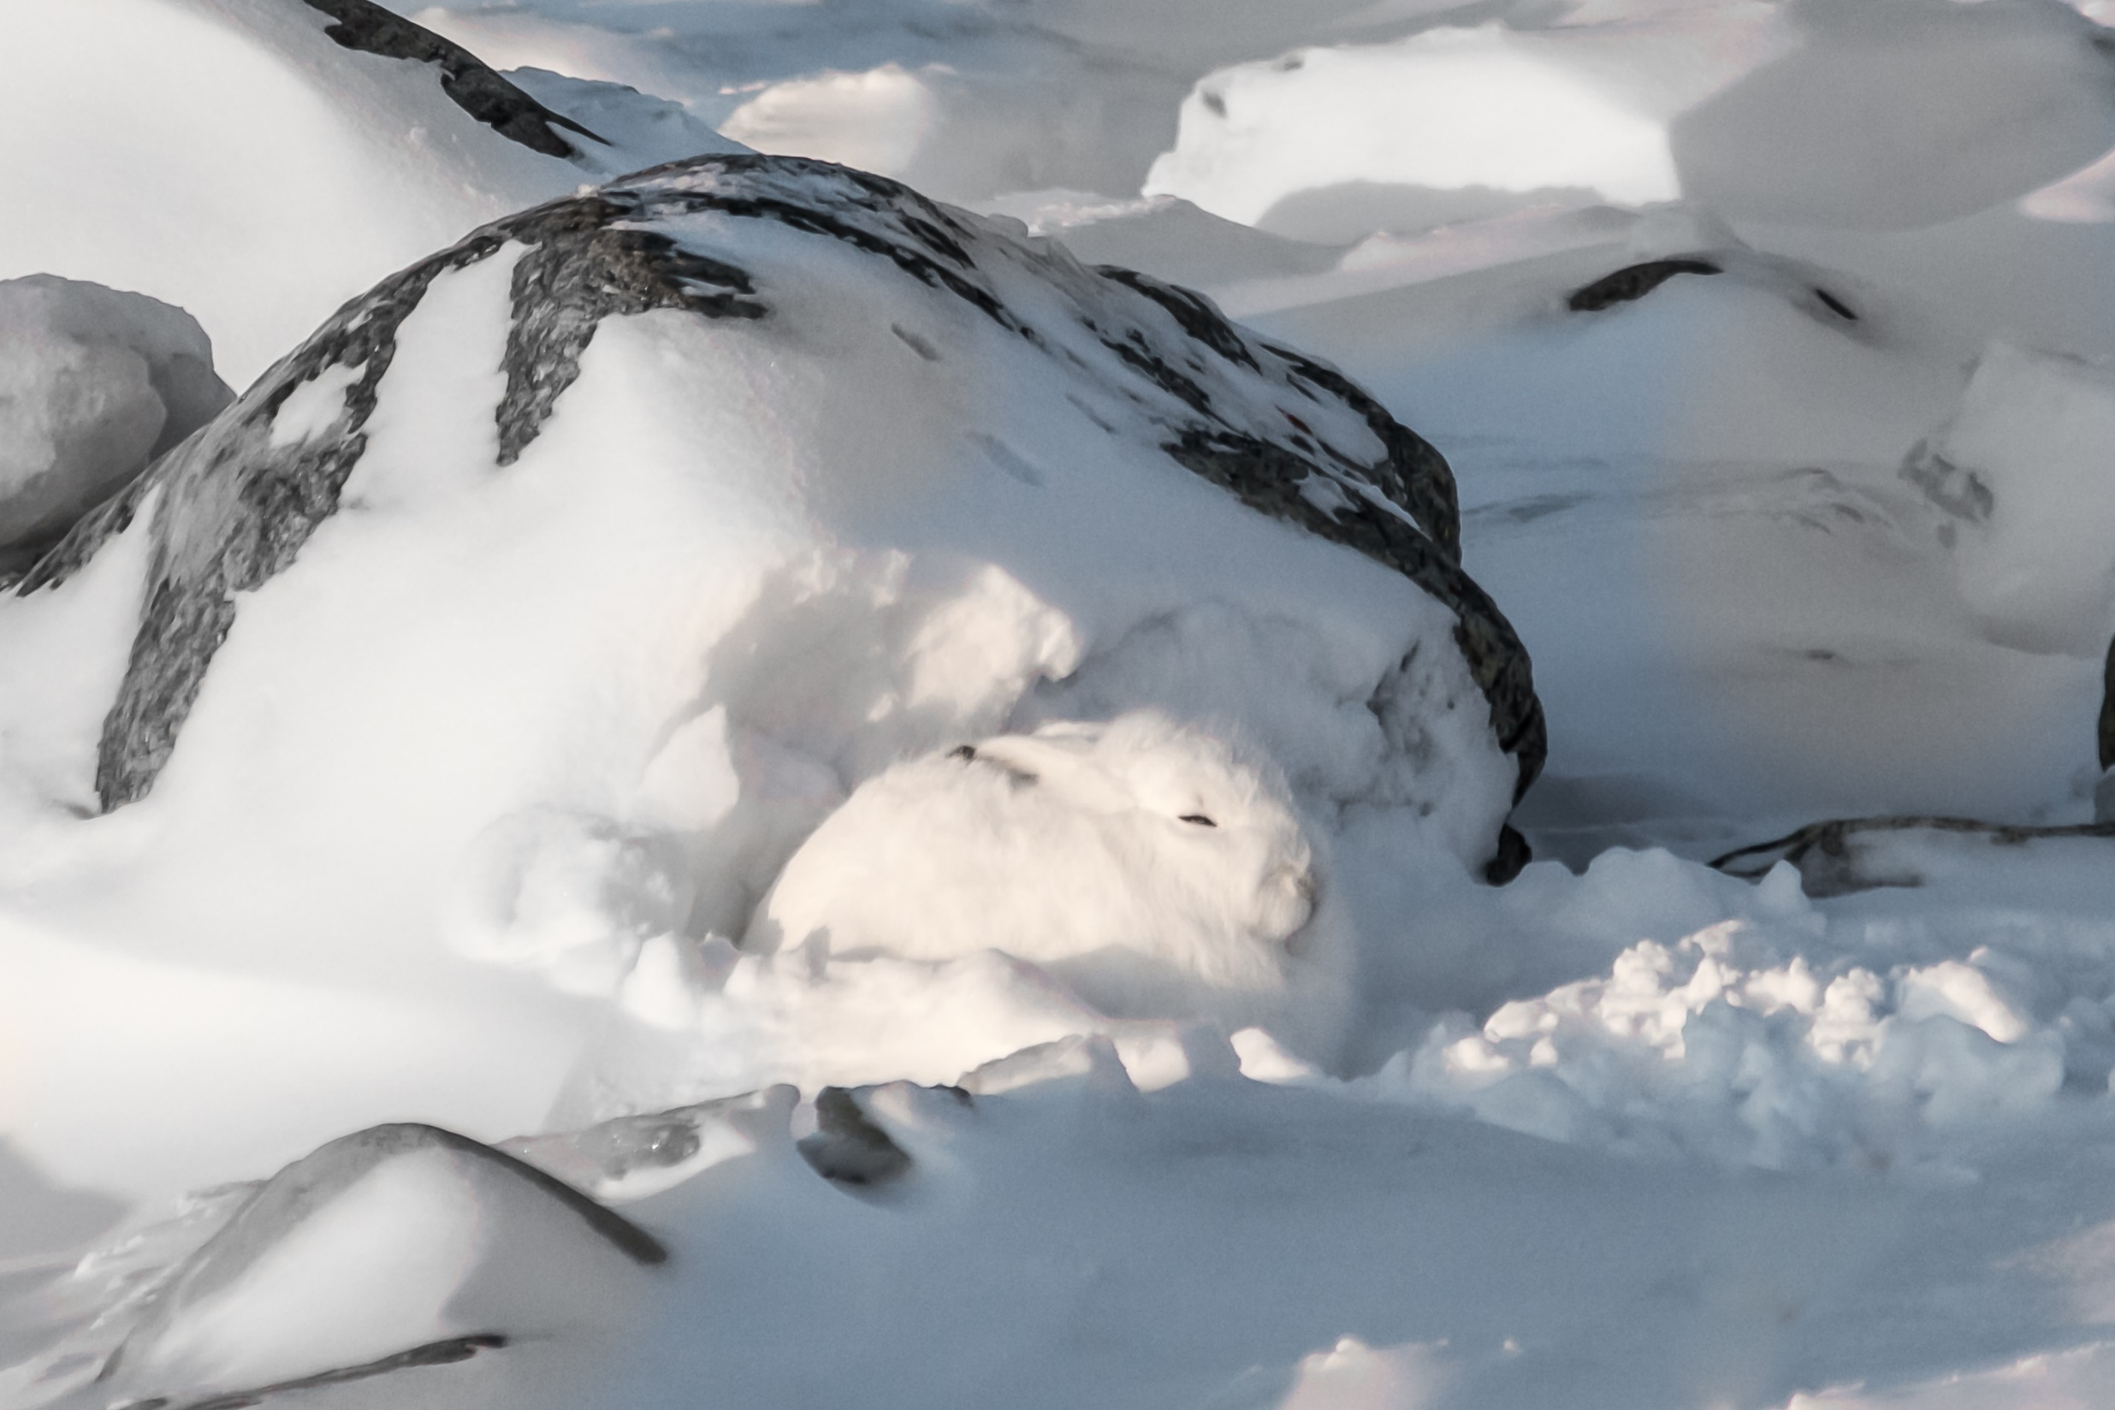
What can you see?

Slide 22
Arctic Hare
Photo courtesy of helenehoffman (@flickr.com) - granted under creative commons licence - attribution

Slide 23
Can you sort the animals?

