Slide 1
What is Greenpeace?

Slide 2

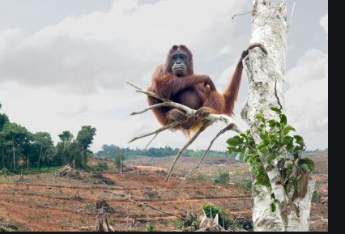
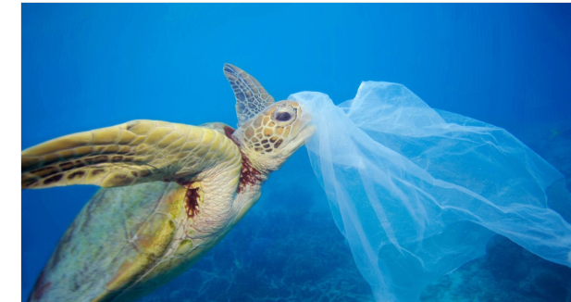
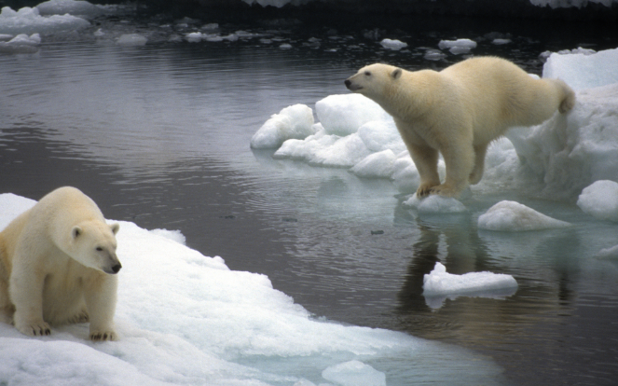
Greenpeace is an organisation that works hard to protect animals. They help animals who are not living happily. These include:
-Orang-utans. The trees they live in are being cut down to make things for humans.
-Sea turtles. Humans use so much plastic that it is getting into the ocean and harming the sea animals.
-Polar bears. They live and hunt on the ice. The ice is melting and disappearing so they have less space to live.

Slide 3
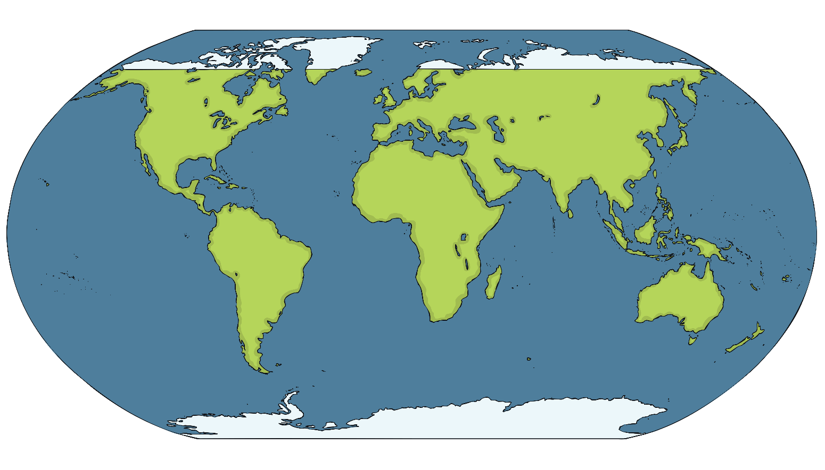
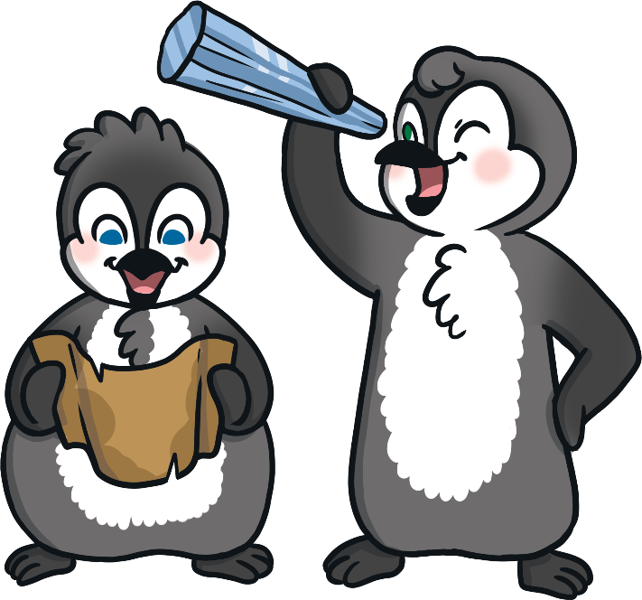
Greenpeace work hard to help animals in the polar lands. Where Are the Polar Lands?
The Arctic
Antarctica
Do you recognise any other places on the map?

Slide 4
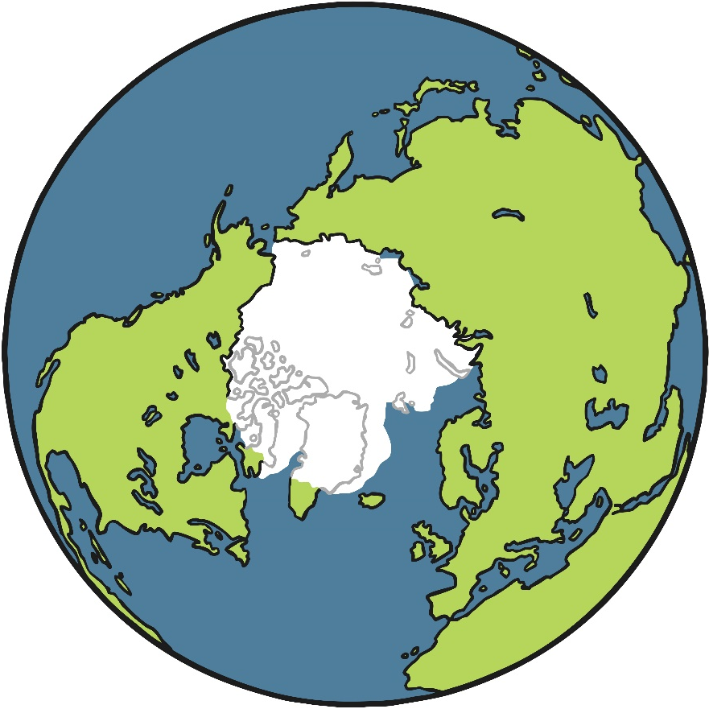
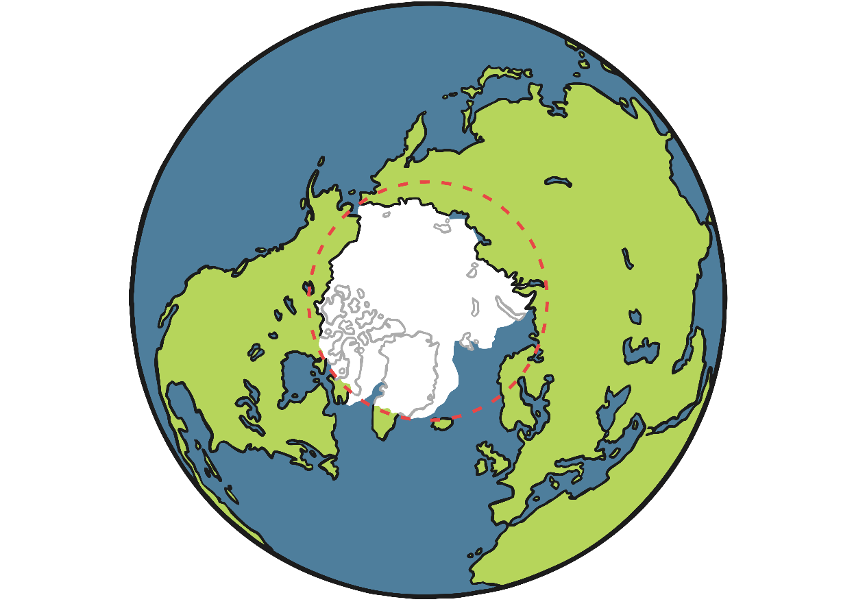
The Arctic – The North Pole
The Arctic is at the very top of the Earth. It includes the areas around the North Pole. The Arctic isn’t a country or a continent. It is actually mostly a frozen ocean.
The Arctic includes parts of lots of different countries. These include Norway, Finland, Sweden, Russia, the USA, Canada, Denmark and Iceland. It also includes the Arctic Ocean.
Arctic Ocean
ARCTIC CIRCLE
Canada
Russia
NORTH POLE
Finland
Sweden
Norway
the USA
Iceland
Denmark

Slide 5
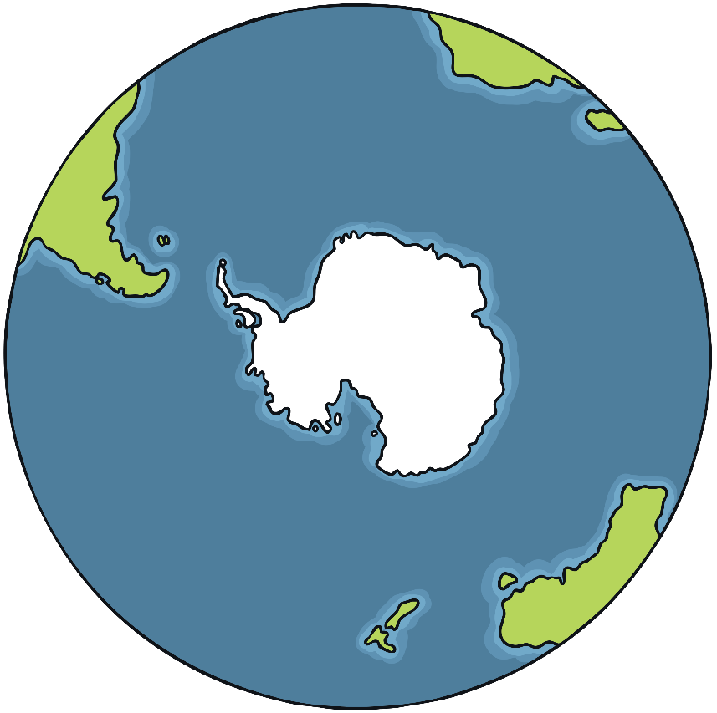

Antarctica- The South Pole
Antarctica is at the bottom of the Earth. It includes the areas around the South Pole. Unlike the Arctic, Antarctica is actually a continent. This is because Antarctica is an area of land, covered in ice.
Antarctica isn’t officially owned by anyone, so it is not called a country. It has no government and no towns or cities.
Madagascar
ANTARCTIC CIRCLE
Madagascar
Falkland
Islands
Falkland
Islands
Antarctica
Antarctica
SOUTH
POLE
Tasmania
Tasmania
Australia
New Zealand
Australia
New Zealand

Slide 6
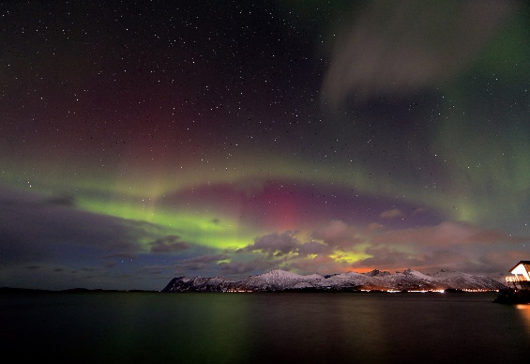
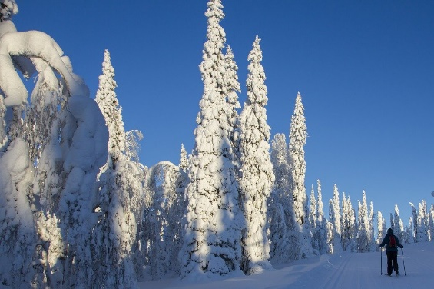
Climate in the Arctic
The Arctic only has two seasons. It has long, cold winters and short, cool summers. The winters last for about 8 months.
In the winter, the sun is so far away from the Arctic that it doesn’t rise at all. This means it can be cold and dark for months.
The average temperatures in the Arctic range from about 12ºC in the summer to about -34ºC in the winter.
What do you think it would be like if you didn’t see the sun for months?

Slide 7
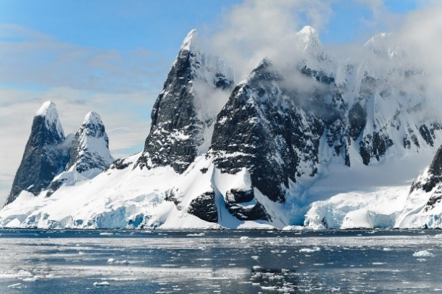

Climate in Antarctica
Antarctica is the coldest and windiest place on Earth. The lowest temperature ever recorded here was -89ºC! The average temperatures range from about 10ºC in the summer to -60ºC in the winter. Antarctica’s winter also lasts for 8 months.
What do you think -89ºC would feel like?

Slide 8
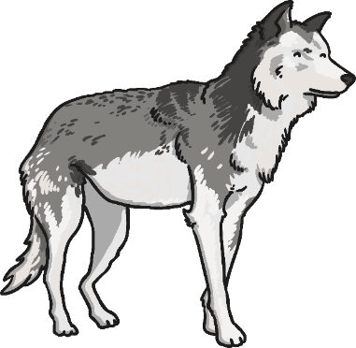

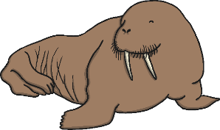
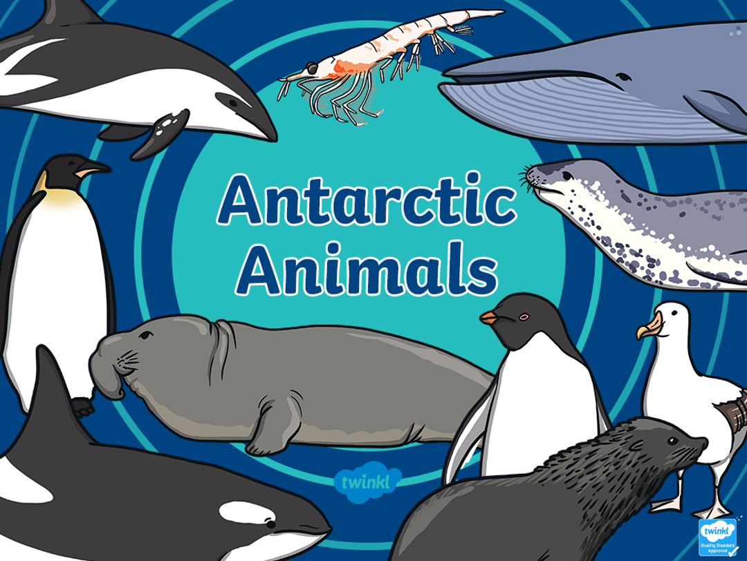
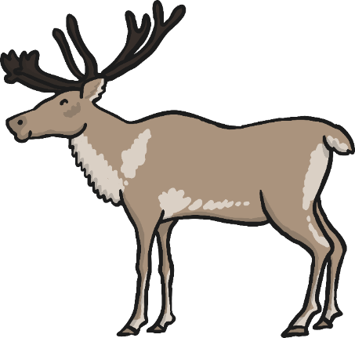

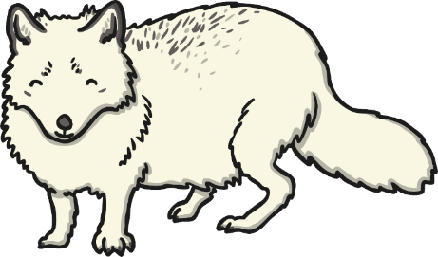

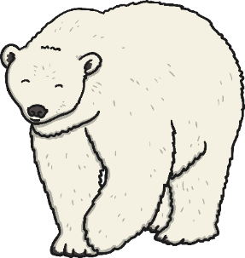
Artic Animals
What do you notice?

Slide 9
Lego Challenge!
https://www.youtube.com/watch?v=Ci4I-VK9jew
Watch the video. It speaks in English and also translates the English into another language. Use this as inspiration to build your own Arctic or Antarctic using Lego.
We can’t wait to see pictures!

Slide 10
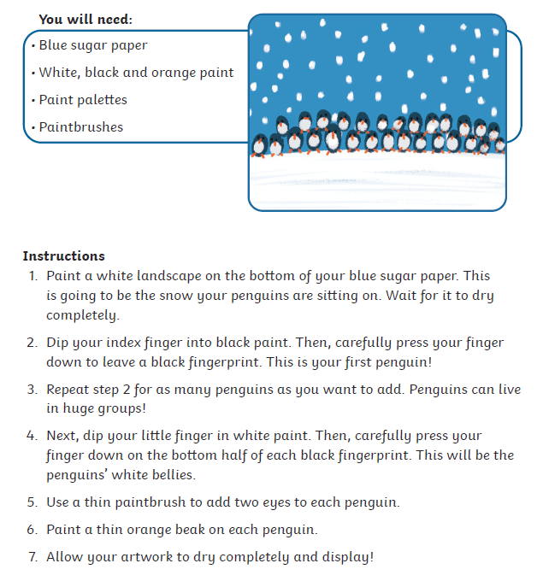
An art activity you may like to try…

