Slide 1
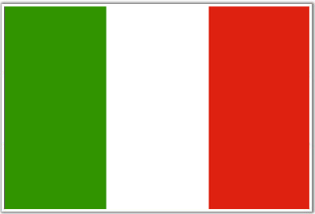
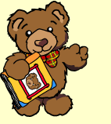
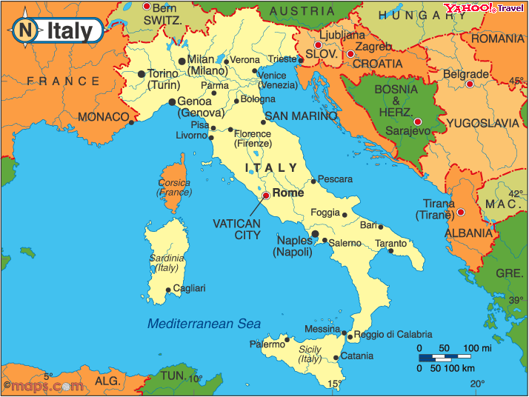
Italian adventure!
Barnaby Bear travels around italy

Slide 2
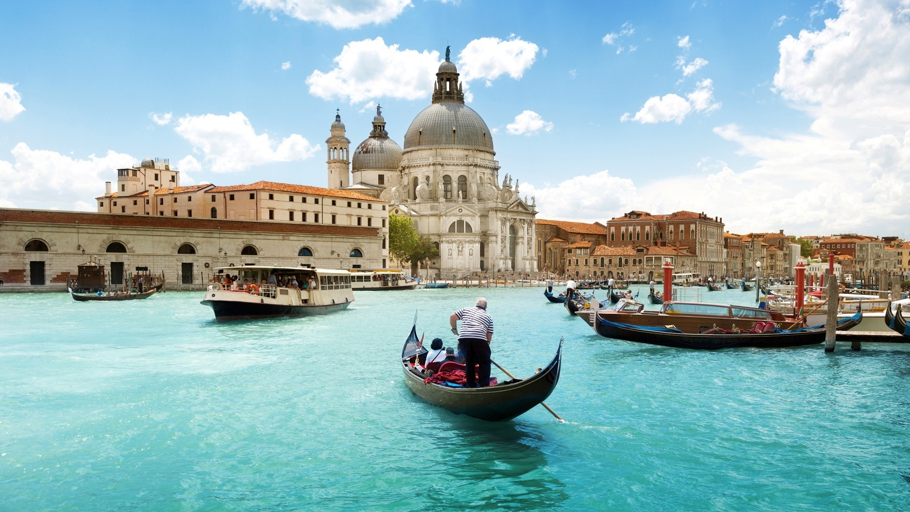
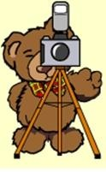
The canals of venice were beautiful … Barnaby went on a gondola.

Slide 3
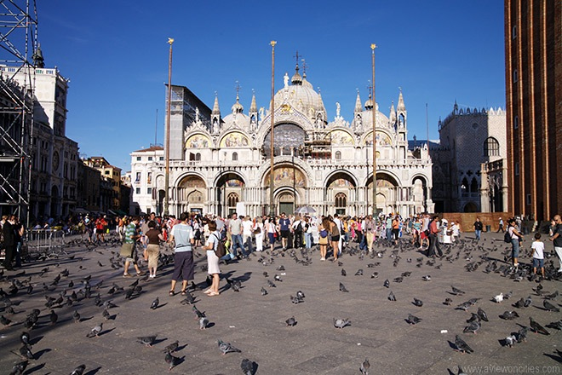
Barnaby visited St Mark’s square in Venice. There were lots of pigeons!

Slide 4
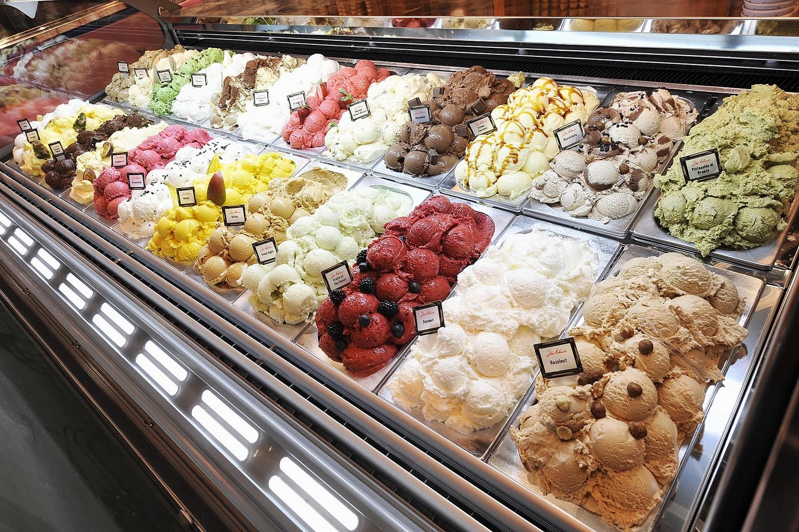
Barnaby loved the italian ice-cream - gelato.

Slide 5
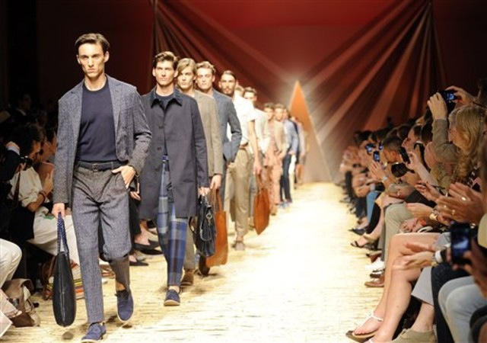
In Milan, barnaby saw a fashion show!

Slide 6
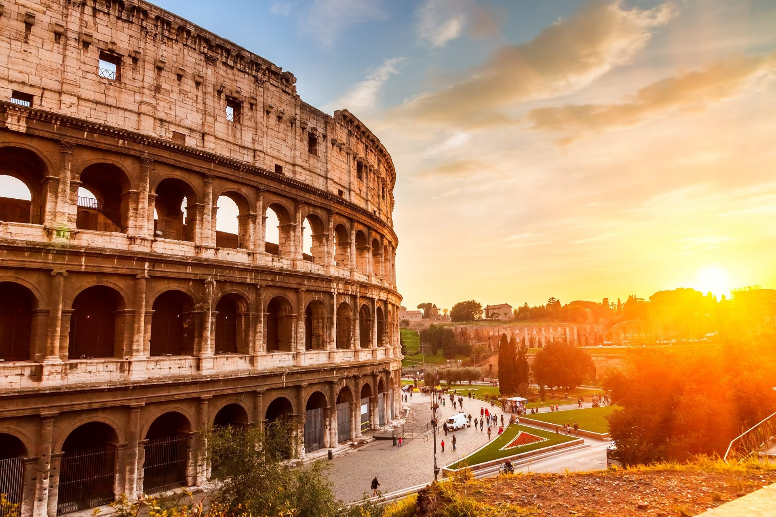

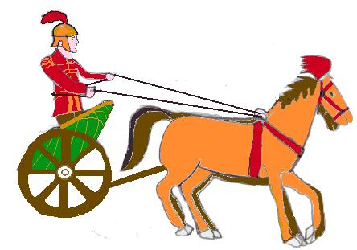
Barnaby saw the coliseum in rome and imagined he was a gladiator!

Slide 7
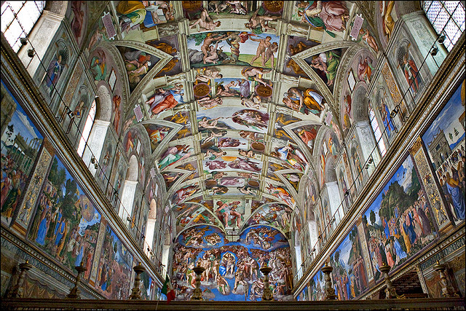
The sistine chapel had amazing paintings on the roof!

Slide 8
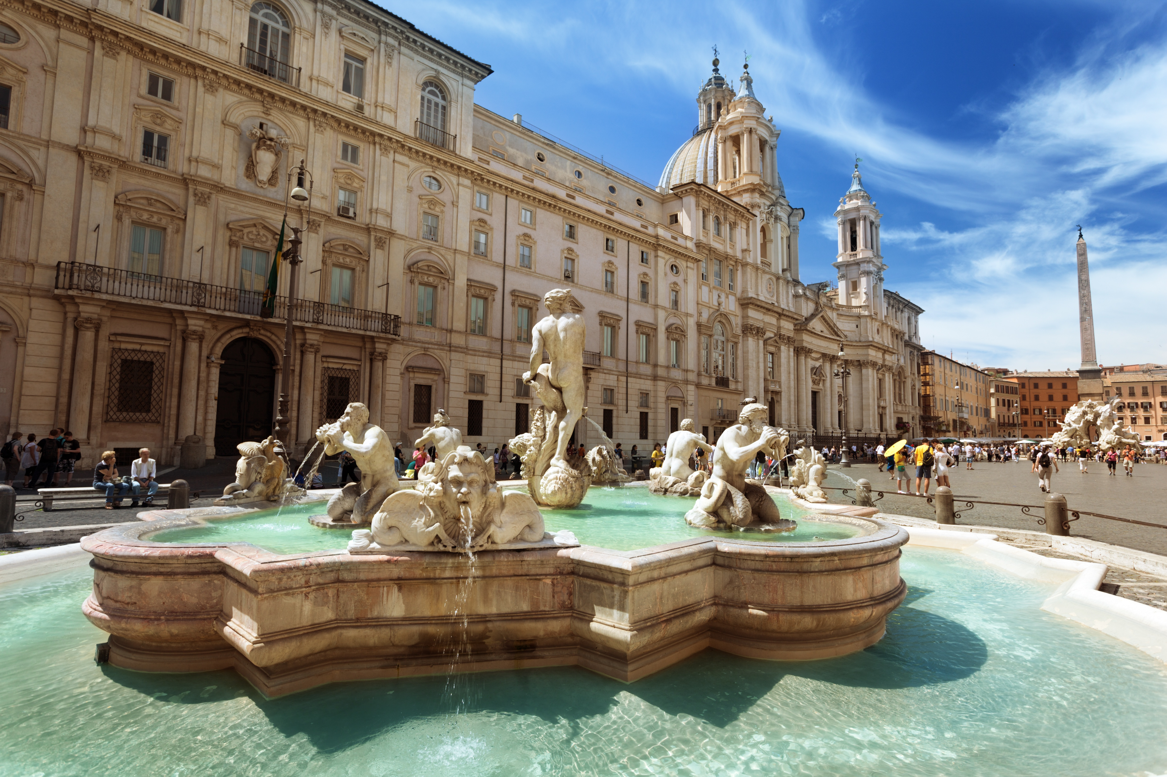
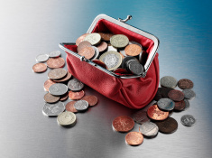
Barnaby threw a coin into the trevi fountain and made a wish!

Slide 9
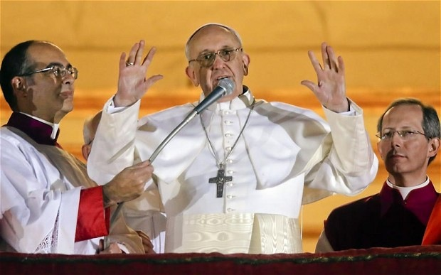
Barnaby listened to pope Francis say some prayers.

Slide 10
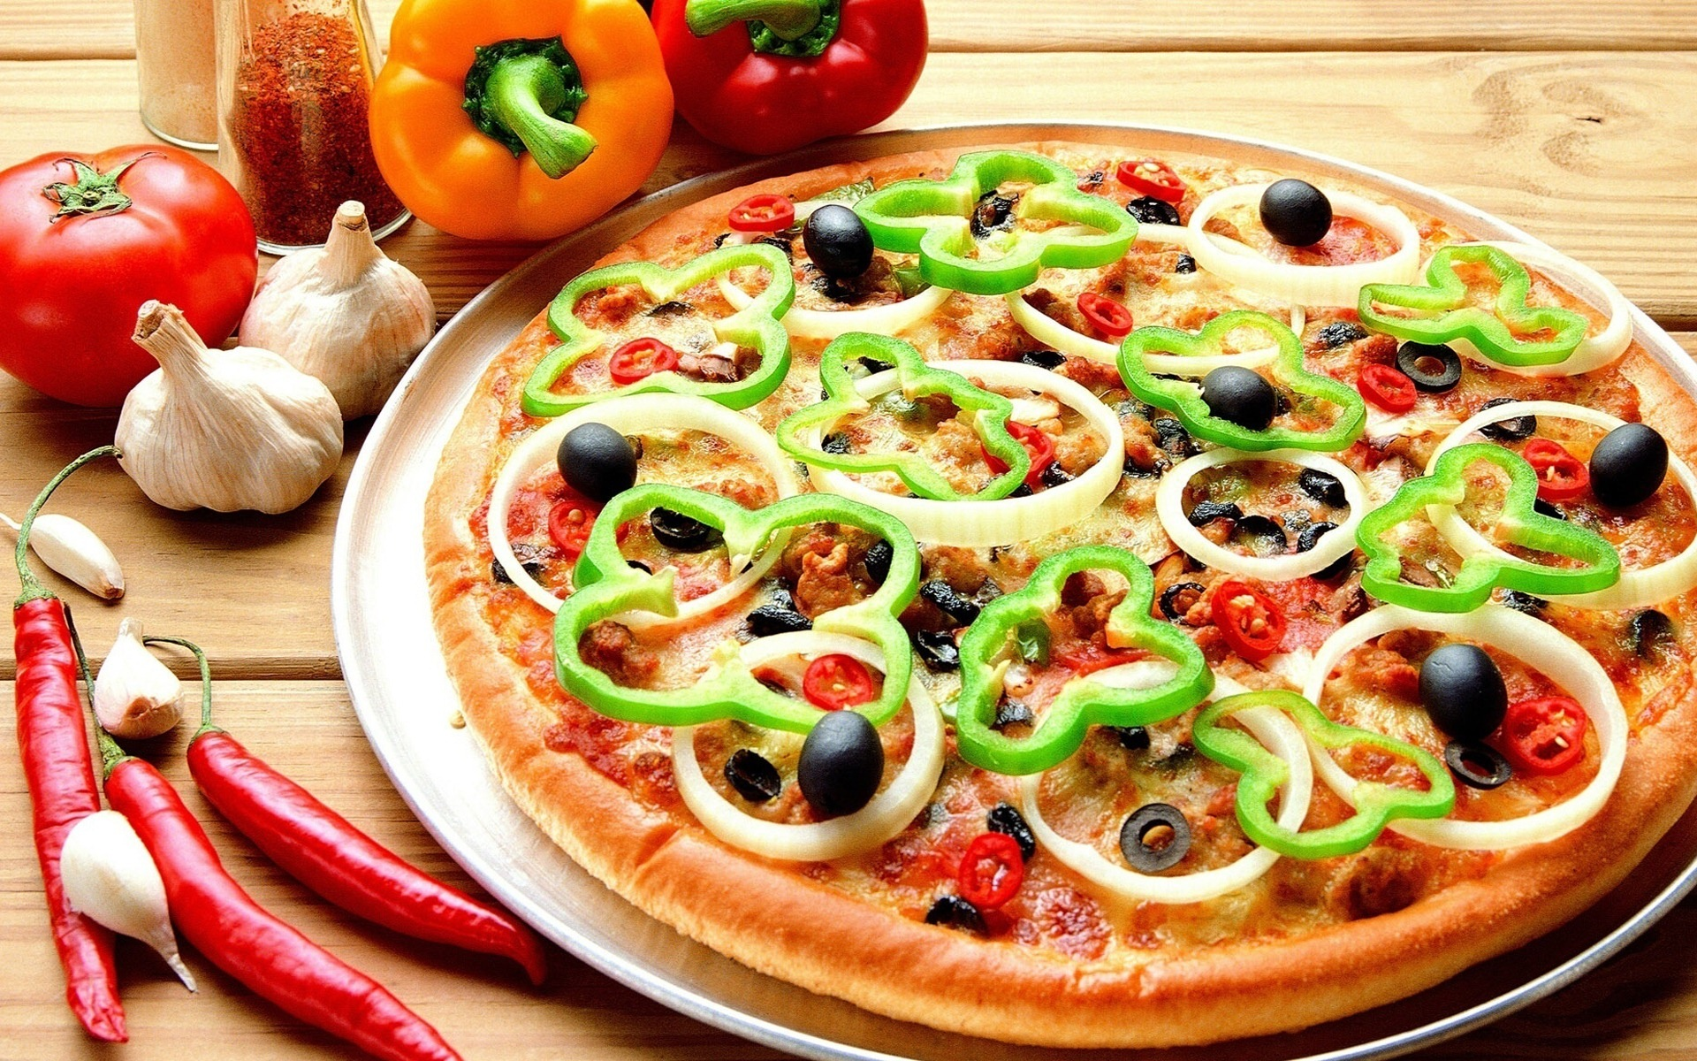
Then barnaby went out for pizza! Yum YUM!

Slide 11
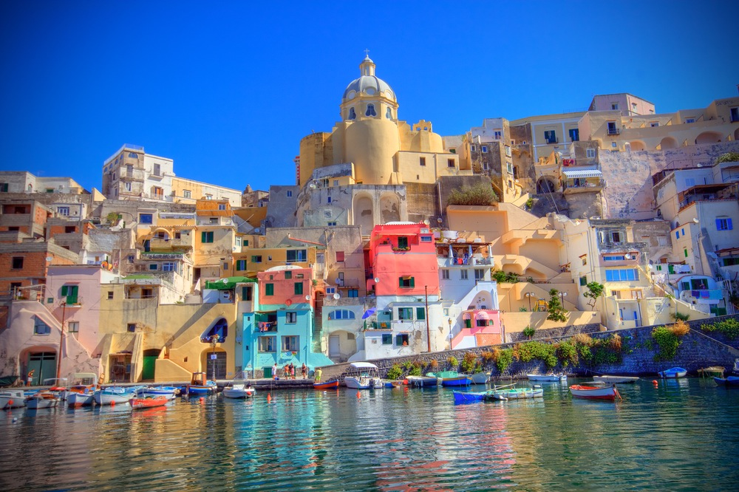
The next day, barnaby saw the colourful houses of naples.

Slide 12
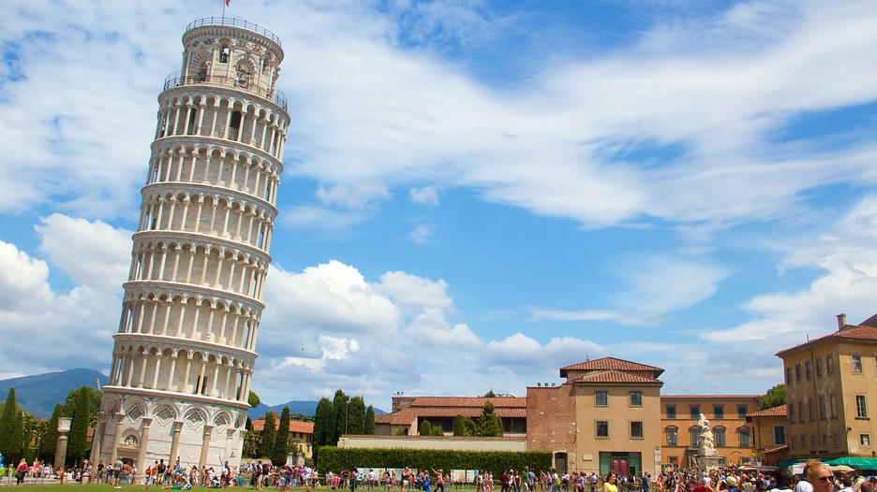
Barnaby loved the leaning tower of pisa!

Slide 13
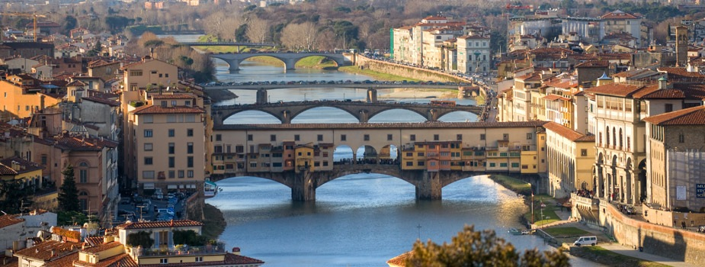
In florence, barnaby took photographs of the bridges across the arno river.

Slide 14
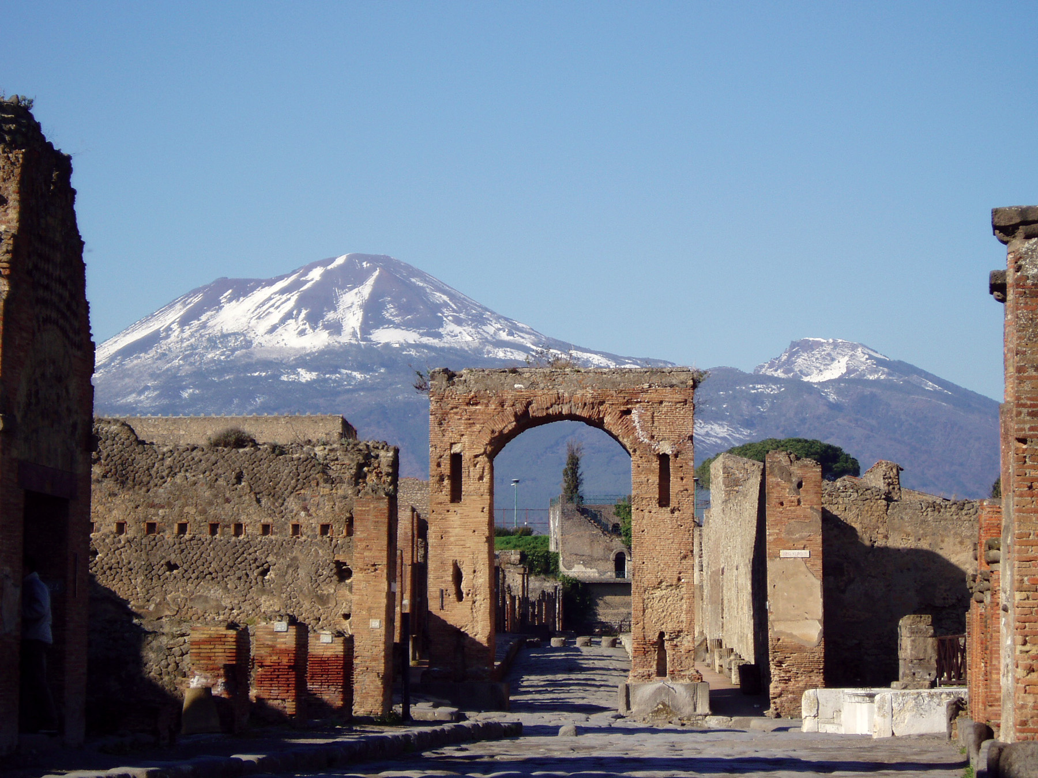

Barnaby was amazed to hear that the volcano mount vesuvias destroyed and buried the city of pompeii over 2,000 years ago!

Slide 15
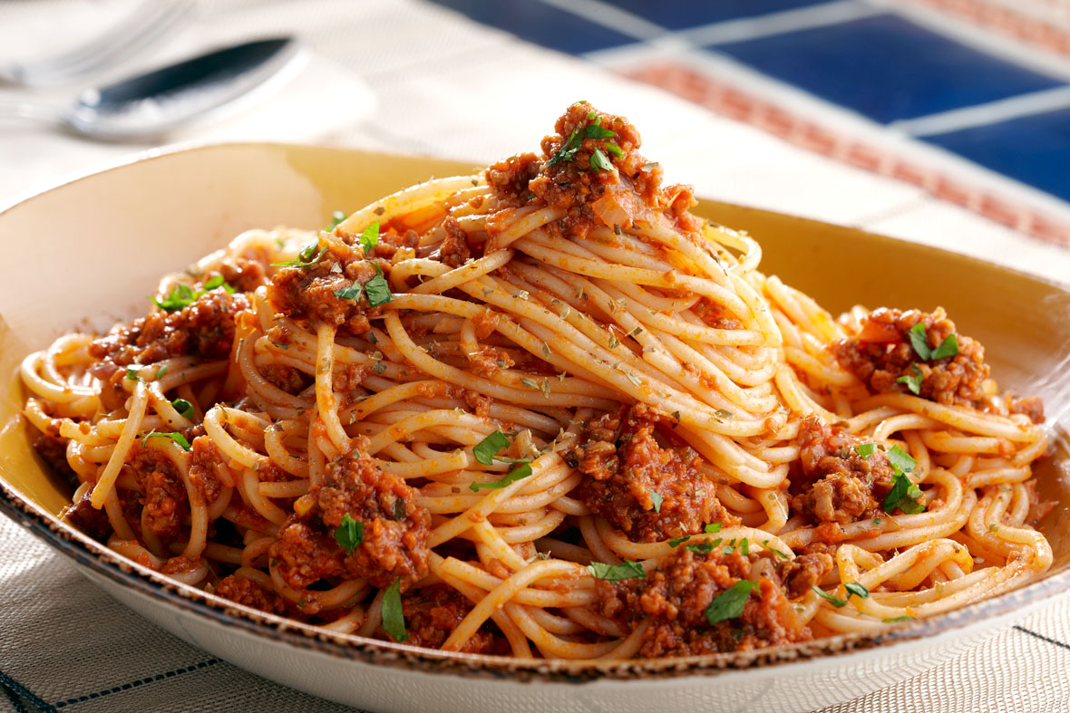
Barnaby enjoyed some spaghetti on his final day …

Slide 16

Barnaby loved his italian adventure. Does italy look like somewhere you’d like to go?

