Slide 2

Who Am I?
I have very thick skin.
I have a hooked top lip.
I have two horns, sometimes three.
I am hunted by poachers for my horns.
My horns are used in medicines.
I live in the desert and forests of Africa.
Who Am I?

Slide 3
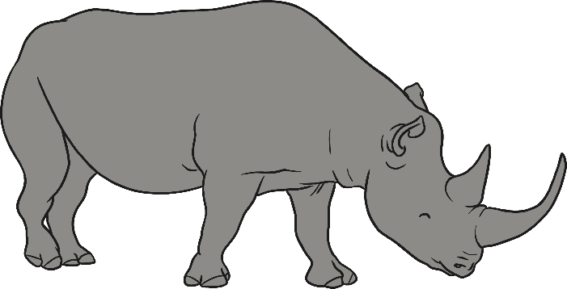
I am a black rhino.
The Black rhino is endangered because it is hunted for its horns.
In some parts of the world, it is believed that the black rhino horn can make people better.
There are only 5000 left
in the world.

Slide 4
Who Am I?
I live in tropical oceans.
My shell displays a beautiful pattern of overlapping scales.
I eat sponges, jellyfish and anemones in coral reefs.
I am hunted for my shell.
Who Am I?

Slide 5
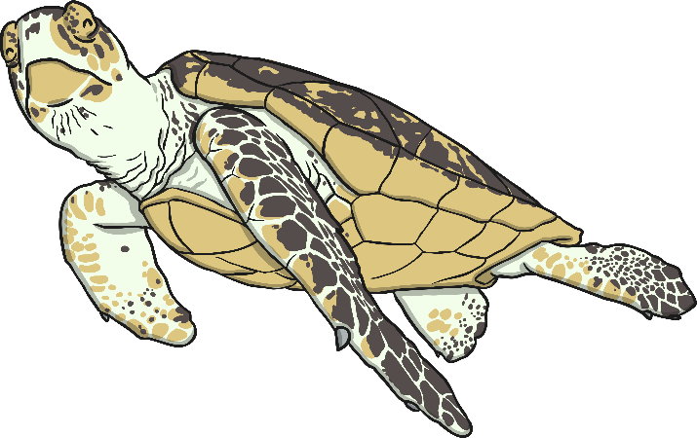
I am a hawksbill turtle.
The hawksbill turtle is endangered because it is hunted for its shell.
The hawksbill turtle shell is used to make jewellery and ornaments because of its tortoiseshell pattern.
These turtles are also often caught on fishing hooks and die.

Slide 6
Who Am I?
I live in the mountains in the rainforest.
I can survive freezing temperatures because I have thick fur.
I can get ill from human diseases.
I eat plant stems, bamboo and fruits.
I look after my babies very well and they are cared for by a big group of us.
I have a lot of feelings like humans do.
Who Am I?

Slide 7
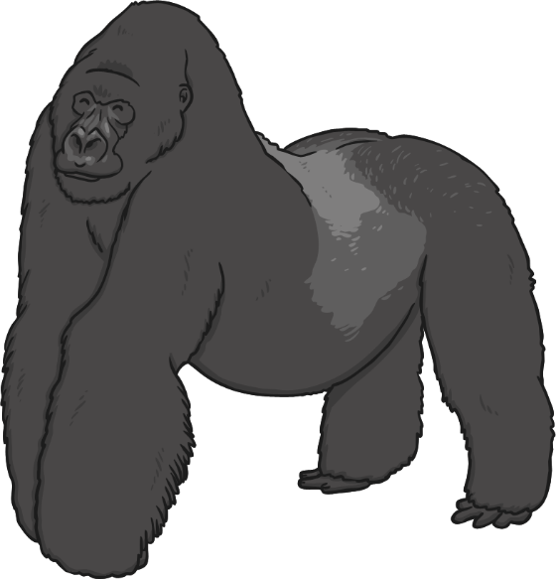
I am a mountain gorilla.
The mountain gorilla is endangered because it is hunted for meat. When illegal hunters kill protected animals, it is called poaching.
Their habitats have been destroyed for farming and to make room for more people to live.
Mountain gorillas can die from human diseases too.

Slide 8
Who Am I?
I live in tropical forests.
I am a very large, grey animal.
I have large ears and a trunk.
If I am a male, I have tusks.
Who Am I?

Slide 9
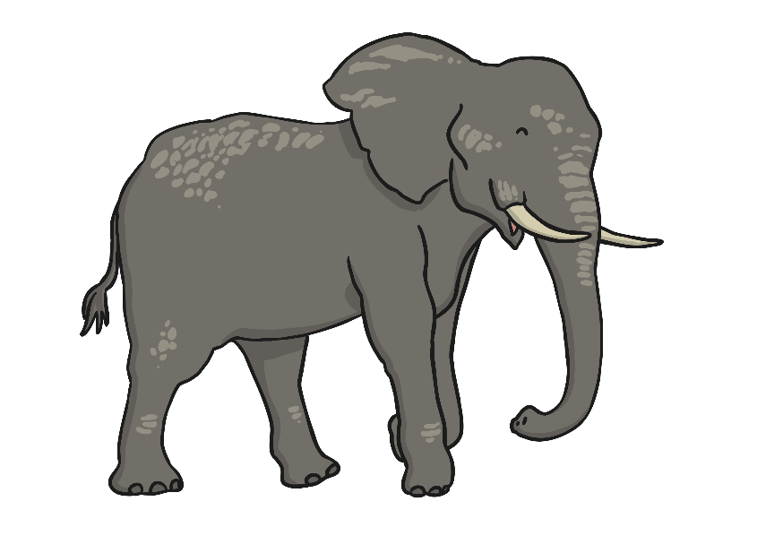
I am a Sumatran elephant.
The Sumatran elephant is endangered because it is poached for its tusks.
Tusks are made from ivory and can be made into furniture, ornaments and jewellery.
Their habitats have been destroyed. This is called deforestation. Trees have been cut down to make paper and other household things.

Slide 10
Who Am I?
I live in the oceans of the world.
I have a heart that is the size of a small car!
I am louder than a jet engine.
I eat krill.
I weigh the same as 33 elephants.
I am the worlds largest mammal.
Who Am I?

Slide 11
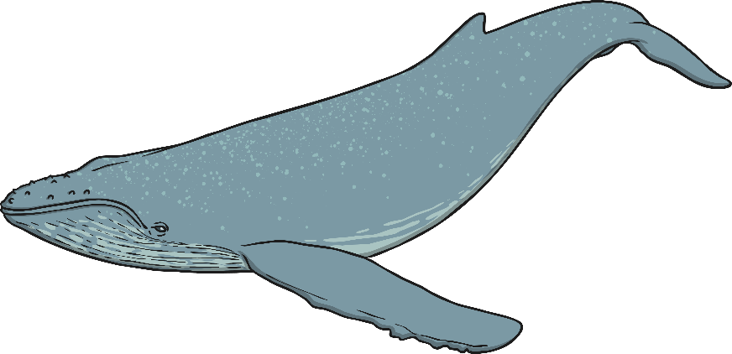
I am a blue whale.
The blue whale is endangered because there are poisonous chemicals in the seas.
They are sometimes hit by ships and can get injured so badly that they die.
They can get caught in fishing equipment.

Slide 12
Who Am I?
I live in in trees high up in the Asian mountains.
I am a bit bigger than a cat.
I look a bit like a bear.
I have brown-red fur.
I am very good at acrobatics. I use my bushy tail to help me balance.
I eat bamboo.
Who Am I?

Slide 13
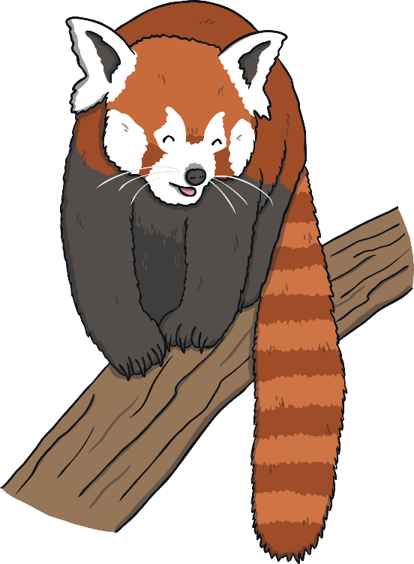
I am a red panda.
The red panda is endangered because the trees they live in are cut down for wood.
They are also hunted for their beautiful fur.
Sometimes, they get caught in traps that are meant for other small animals.

Slide 14
Task Time
Work with a partner and find out some information
about one of these endangered animals:
sea lion
great white shark
hippopotamus
polar bear
snow leopard
Write your own riddle describing the animal but without saying what it is.
Remember
Leave the biggest clue until the last line.

