Slide 1
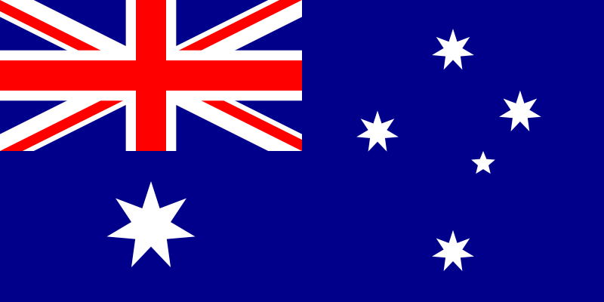


Slide 2
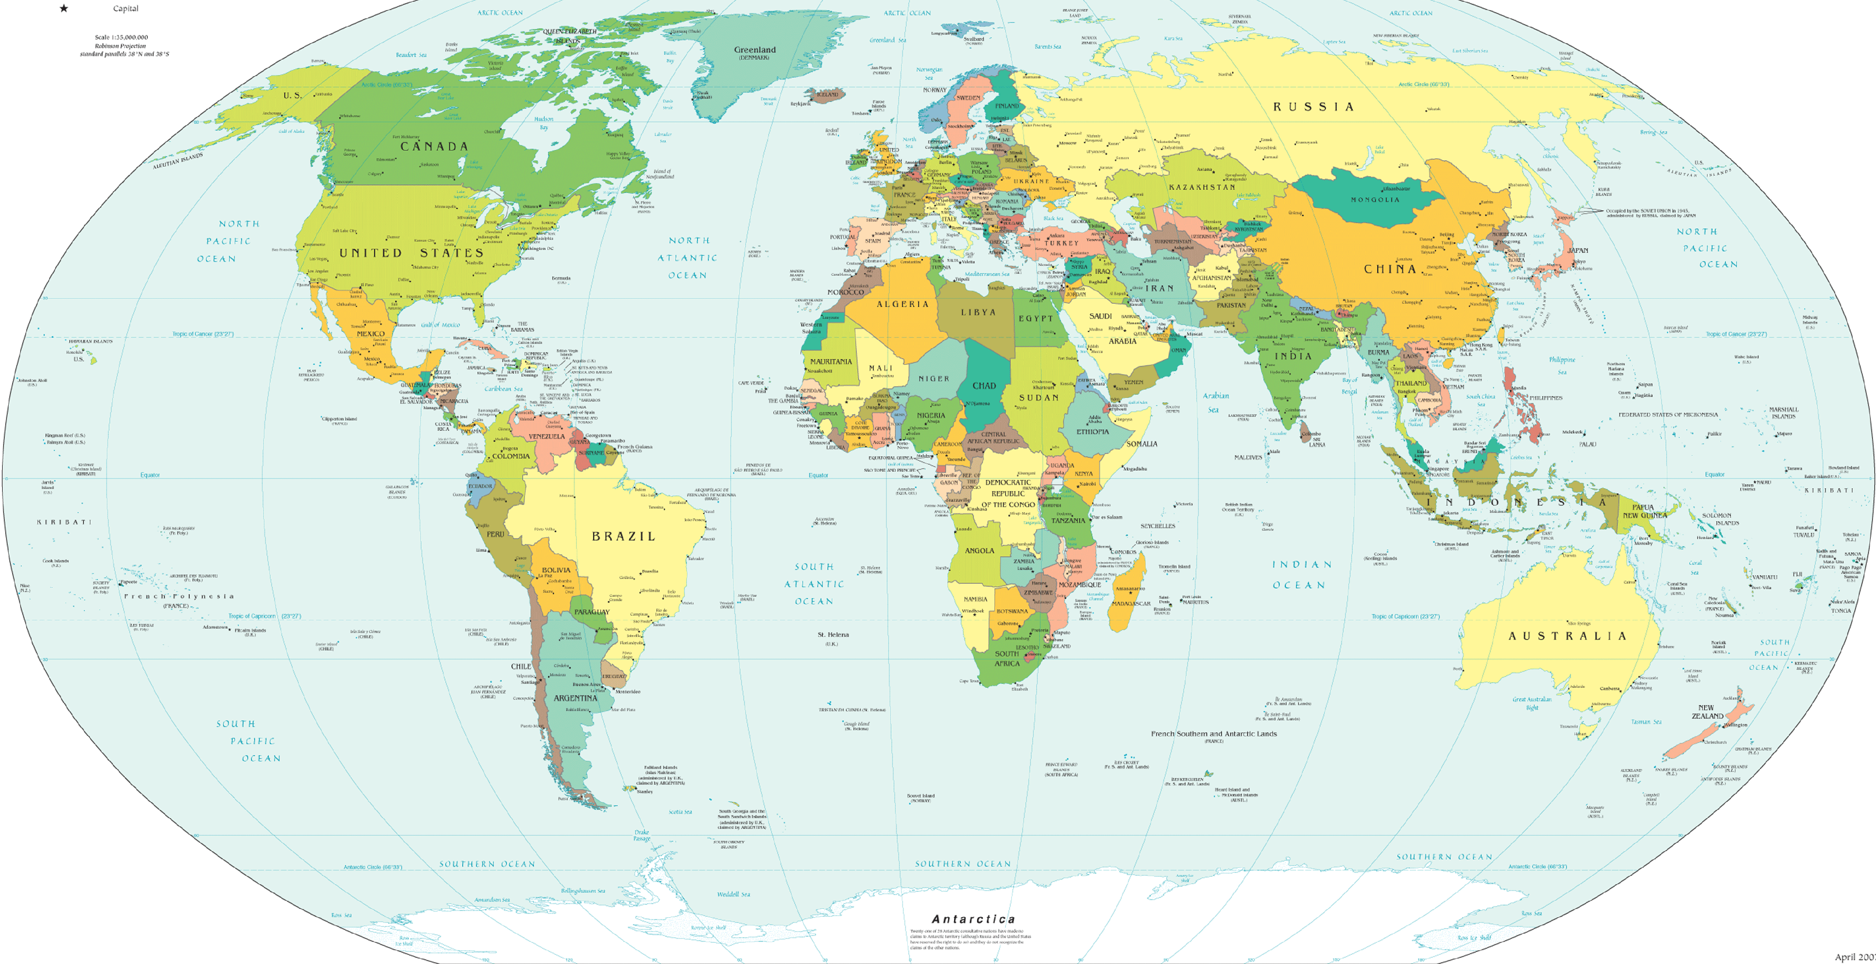
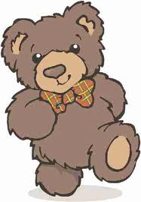
This is Kazakhstan. This is Australia.

Slide 3
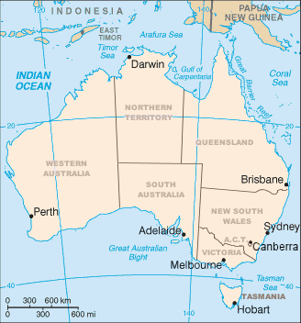
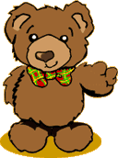
The capital of Australia is Canberra. Can you find it on the map?

Slide 4
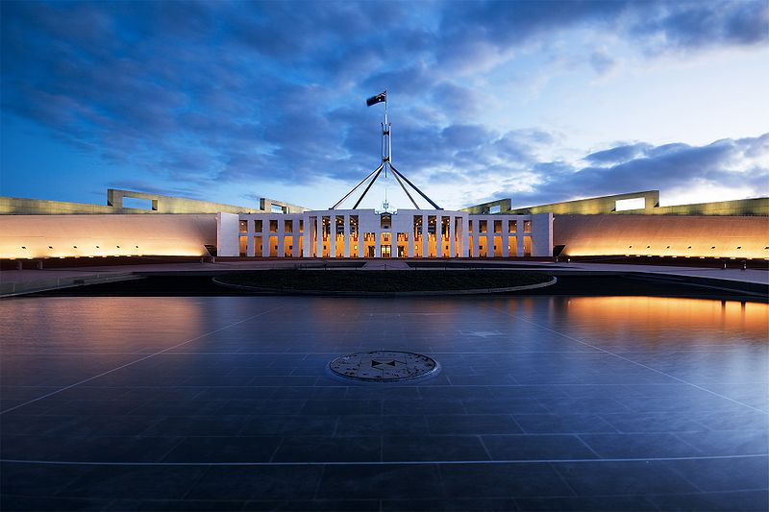
This is where the Prime Minister lives. Is there a building like this in Almaty?

Slide 5
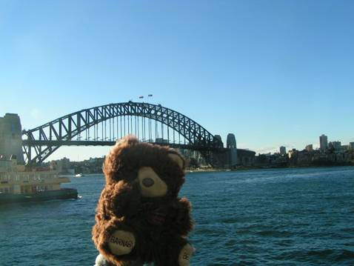
Sydney is the biggest city in Australia. Here is the harbour. What can you see?

Slide 6
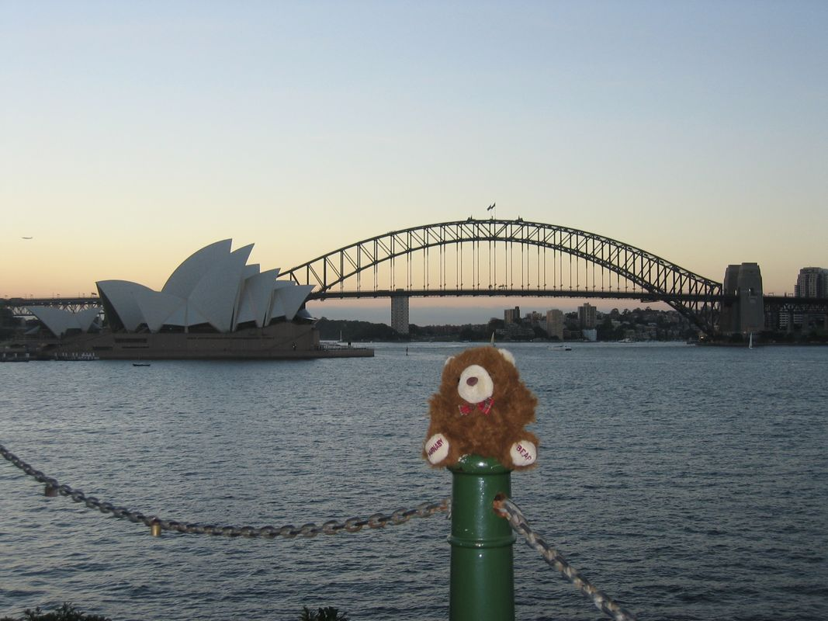
What do you think this building is?

Slide 7
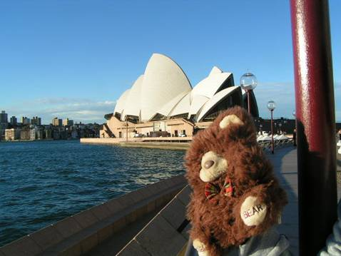
Here it is again!

Slide 8
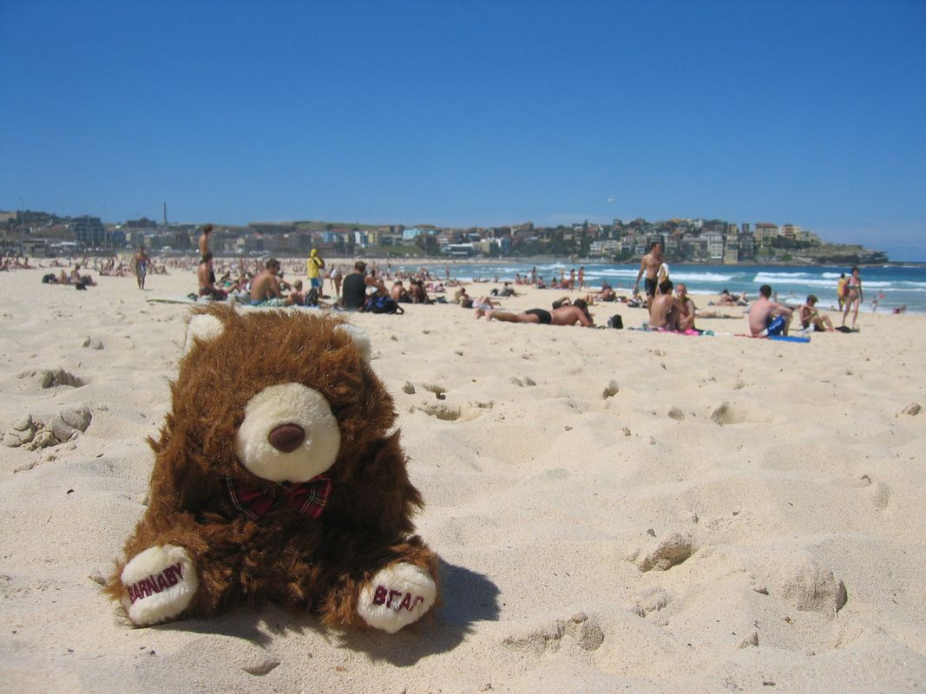
Australia is very hot. Here I am relaxing on the beach.

Slide 9
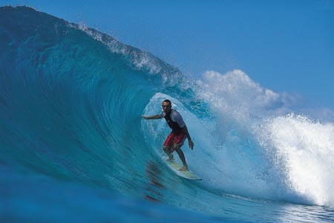

Does anybody know what this sport is called?

Slide 10
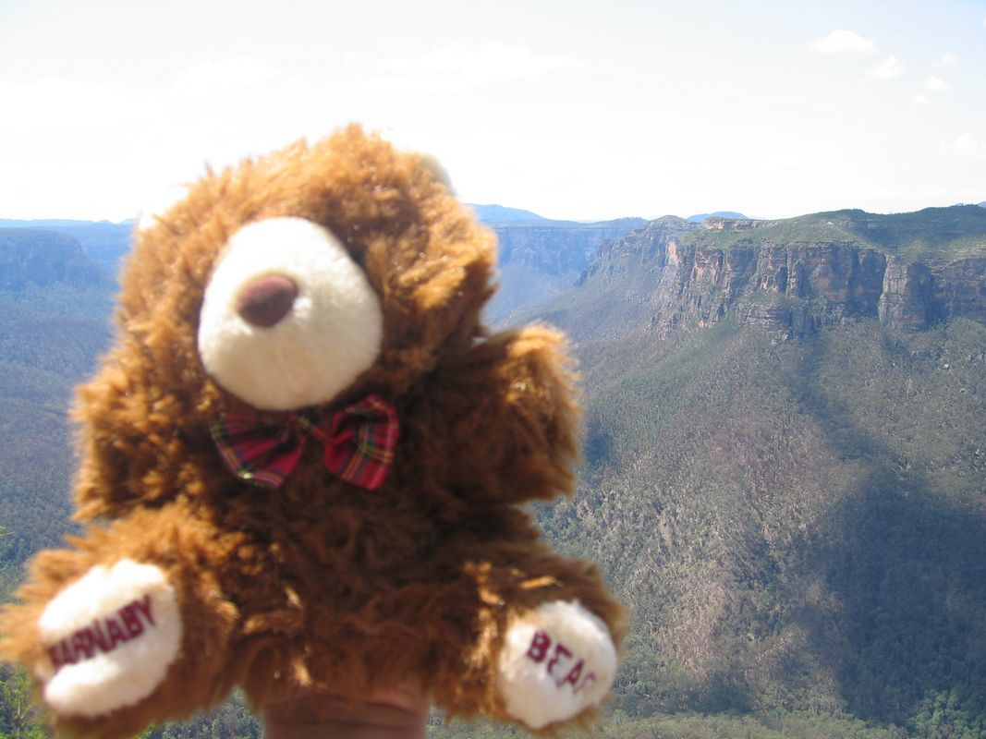
What can you see in the distance?

Slide 11
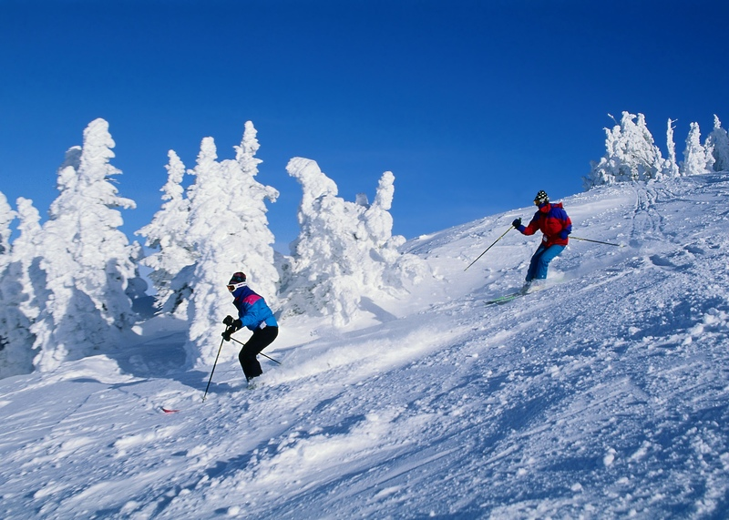
Is there skiing where you live?

Slide 12
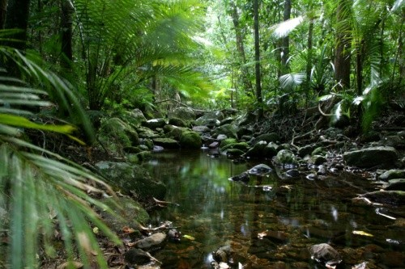
Australia also has jungles.

Slide 13
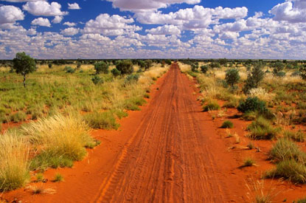
This is called the Outback. It is very flat!

Slide 14
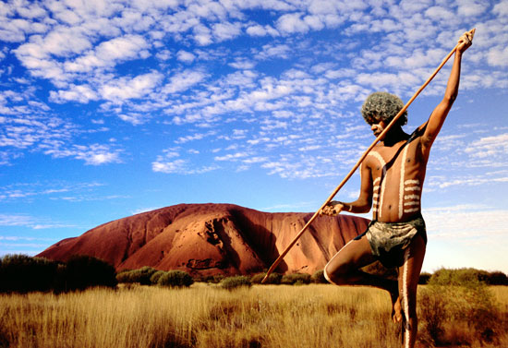
This man is called an Aborigine. He is wearing traditional dress.

Slide 15
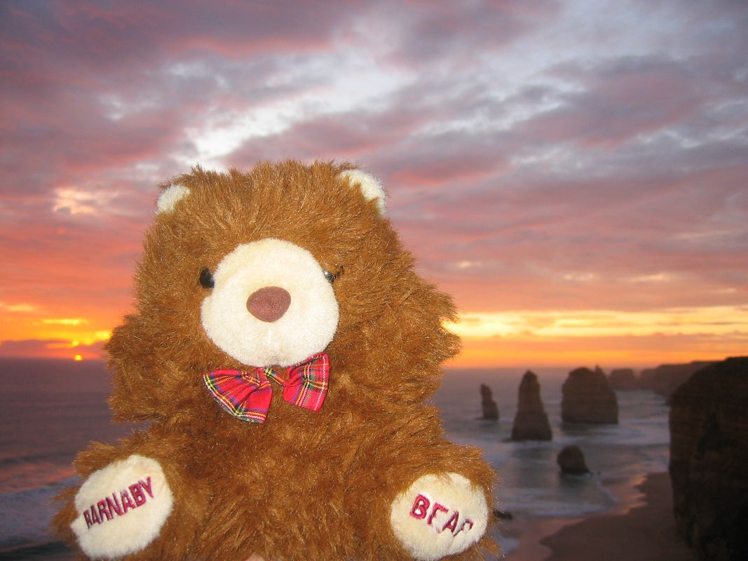

Slide 16
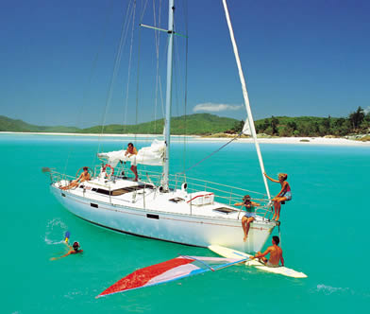
I took a boat trip to the Whitsunday Islands.

Slide 17
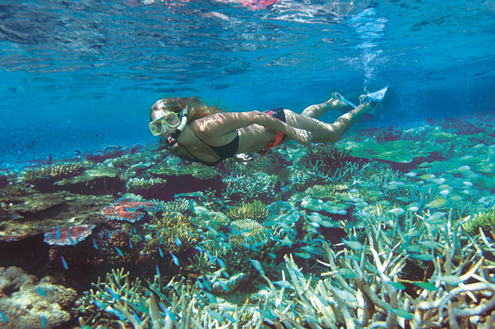
I went snorkelling.

Slide 18
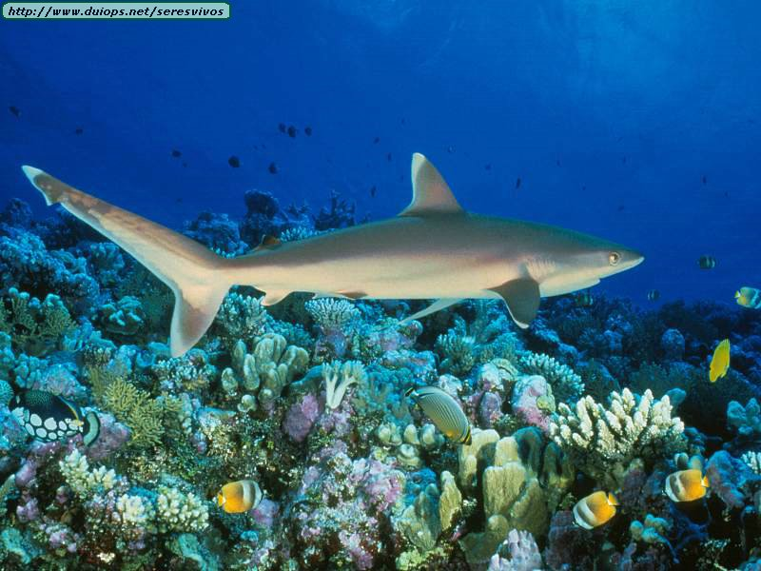
HELP!!!

Slide 19
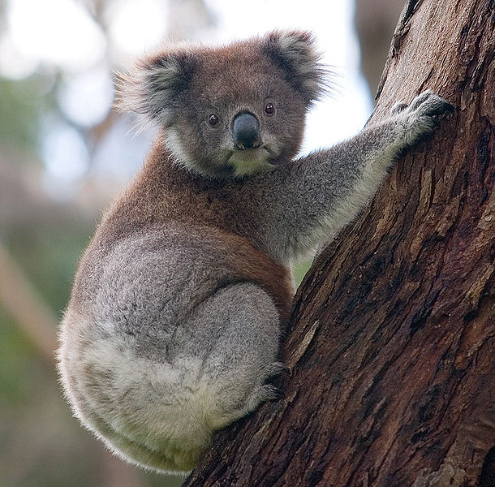
Here is my cousin. The koala bear.

Slide 20
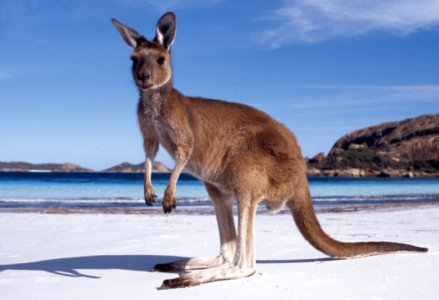

Slide 21
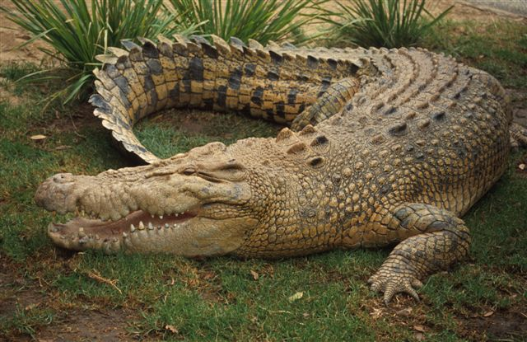

Slide 22
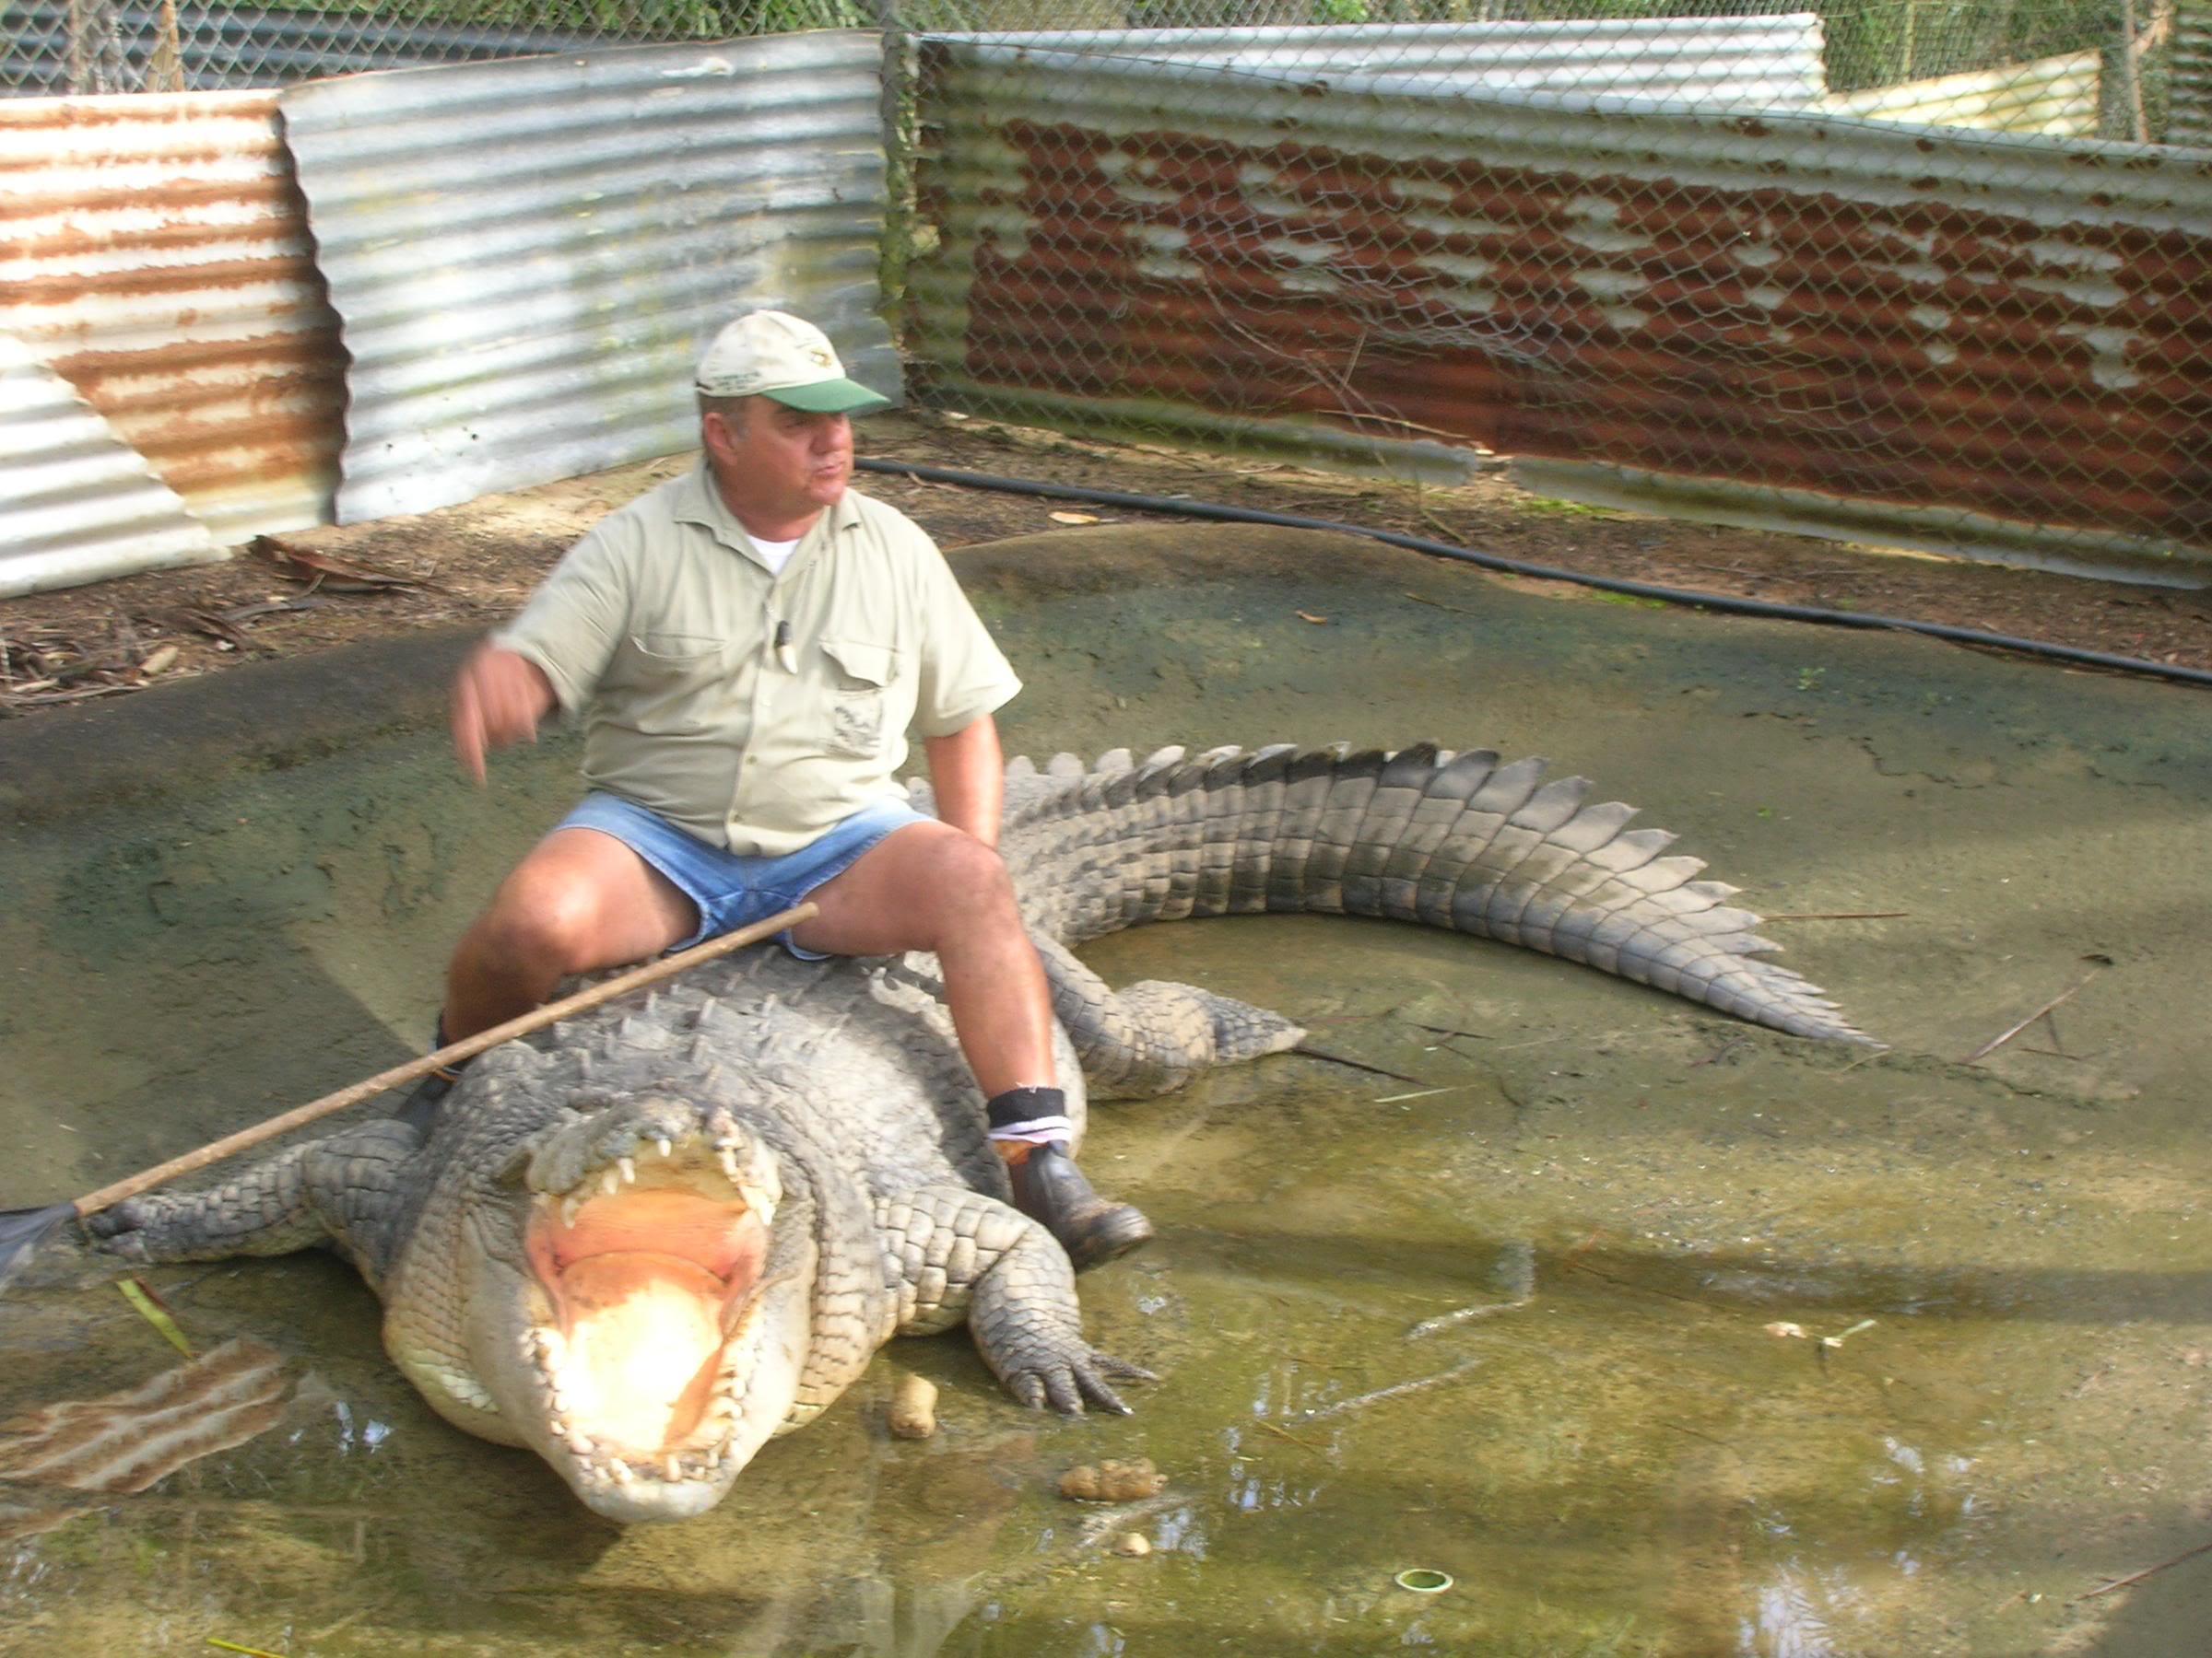

Slide 23
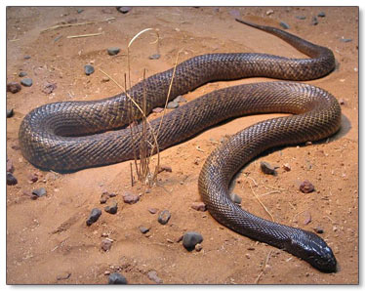

Slide 24
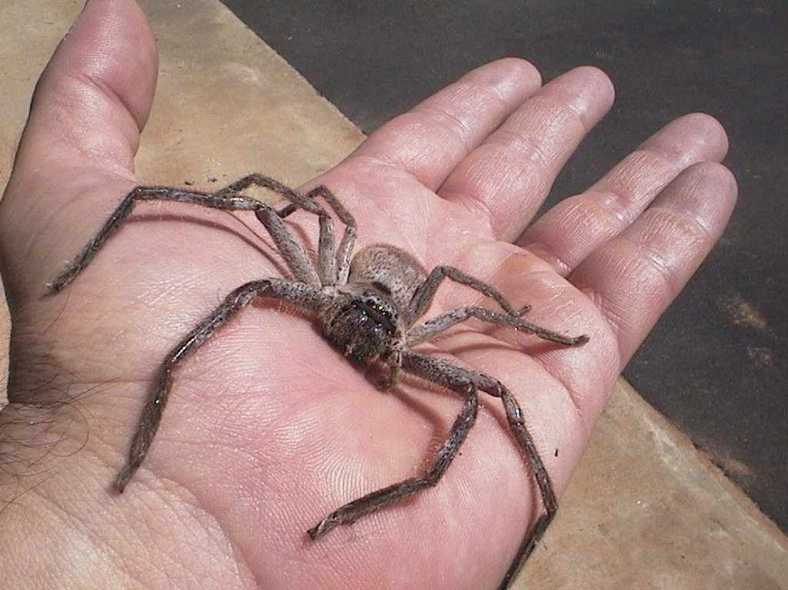

Slide 25
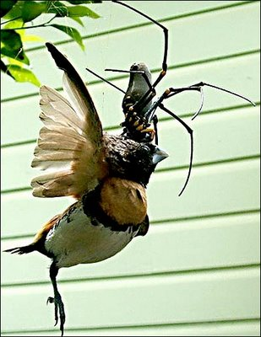

Slide 26
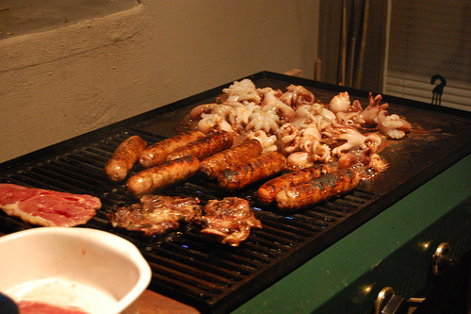
Australians love to barbeque in the hot weather.

