Slide 2
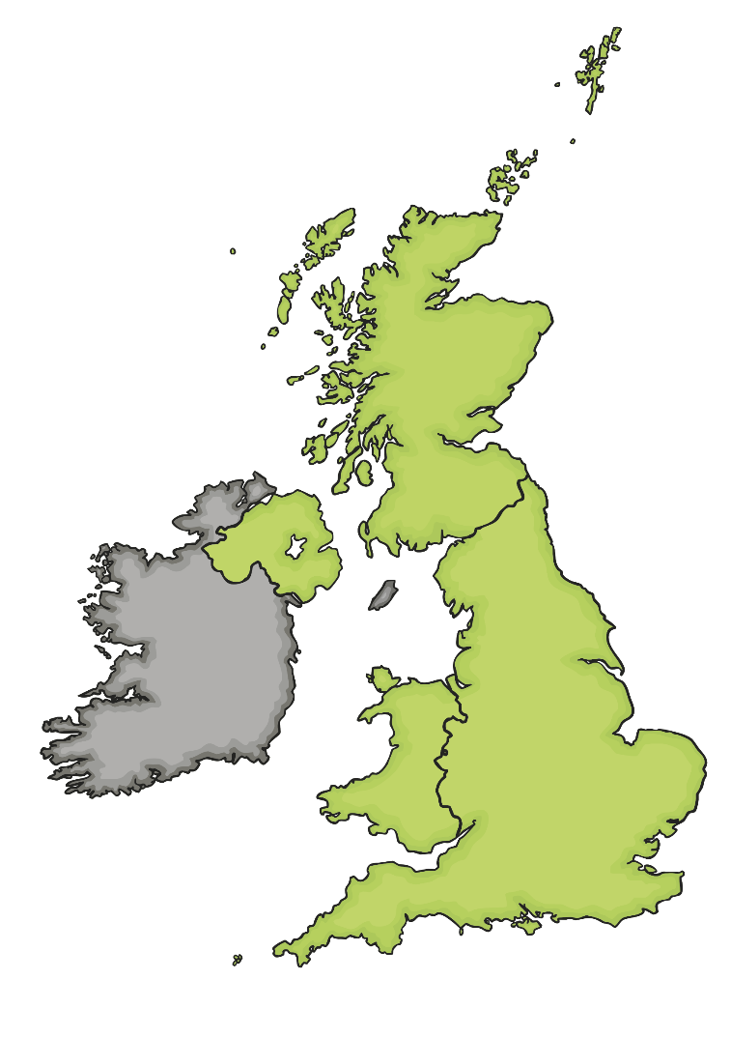
Bombing
As the war progressed, Germany targeted British cities as part of their bombing campaign. Click on the map to find out more.
Belfast docks and shipyards were targeted. 1,000 people were killed and 100,000 people were left homeless.
Clydebank was an important shipbuilding town and was badly bombed. Over half of the city was made homeless after the bombing raids.
The majority of Plymouth city centre was totally destroyed during bombing raids. 900 died and 40,000 people were left homeless.
From 7th September 1940, London was bombed every night (and sometimes during the daytime) for 57 days in a row. 17,500 people lost their lives.
Coventry was bombed on 14th – 15th November 1940. Coventry Cathedral was destroyed and one third of all the city’s houses were damaged. 568 people were killed.
Birmingham was the third most bombed city. It was bombed over several months.
Liverpool was the second most bombed city after London. 1,900 people were killed and 70,000 people were made homeless due to the damage done to their houses.
Cardiff docks were important for bringing supplies in to the country. 355 people were killed during the bombing.

Slide 3
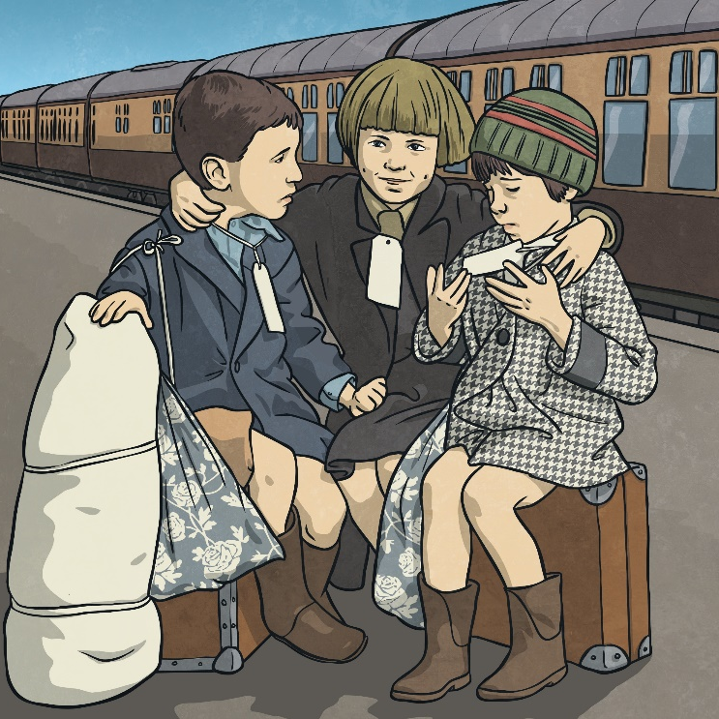
Evacuation
At the start of the war, the government realised that cities would be targeted. They decided to encourage parents to allow their children to be evacuated to safer, rural locations.
Parents were given a list of things to pack for their children. The children had labels attached to them with their name, age and home address on them.
Children were taken on trains or buses to their new locations. A person called a billeting officer would collect the children and take them to a village hall. People who had volunteered to take in the evacuees would then walk amongst them and choose the children they liked the look of.

Slide 4
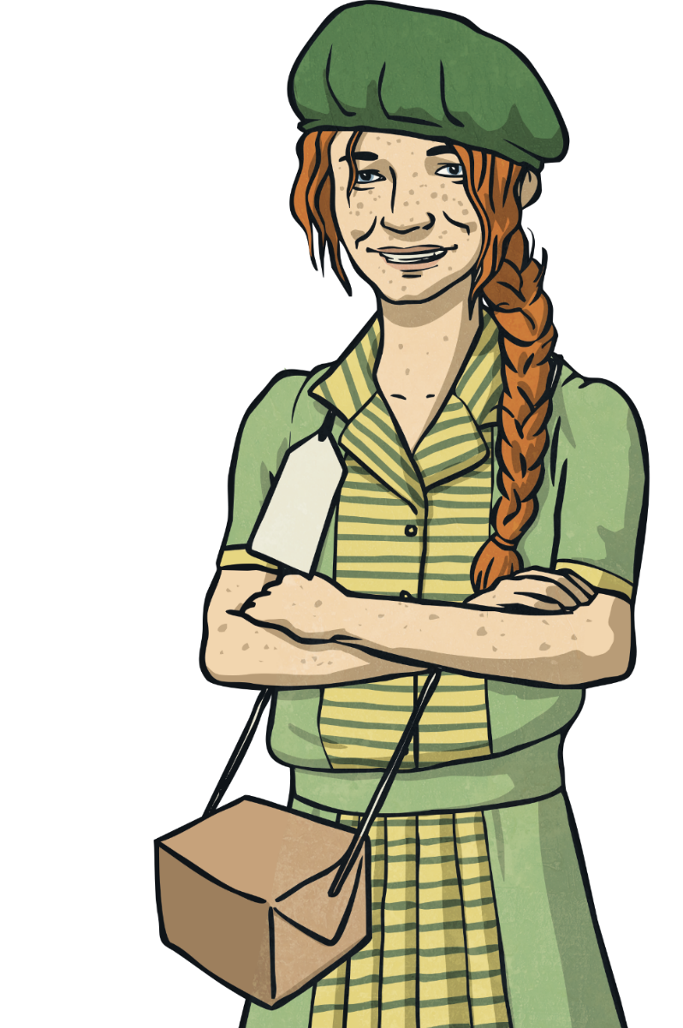
Evacuation
Over one million children were evacuated during the Second World War. Thousands of children were sent to places such as Australia and New Zealand.
What impact do you think the bombing
raids had on children?
Talk About It

Slide 5
Evacuation
For some children, evacuation was a positive experience. For others it was not. Talk about the positives and negatives of being evacuated.
Talk About It
Positive Points of Evacuation | Negative Points of Evacuation
Children were kept safe from bombs. | Children missed their parents.
Children got to live in the peaceful, beautiful countryside. | Sometimes brothers and sisters were kept in separate places.
Many children stayed with caring people. | Some children stayed with people who weren’t very nice to them.

Slide 6
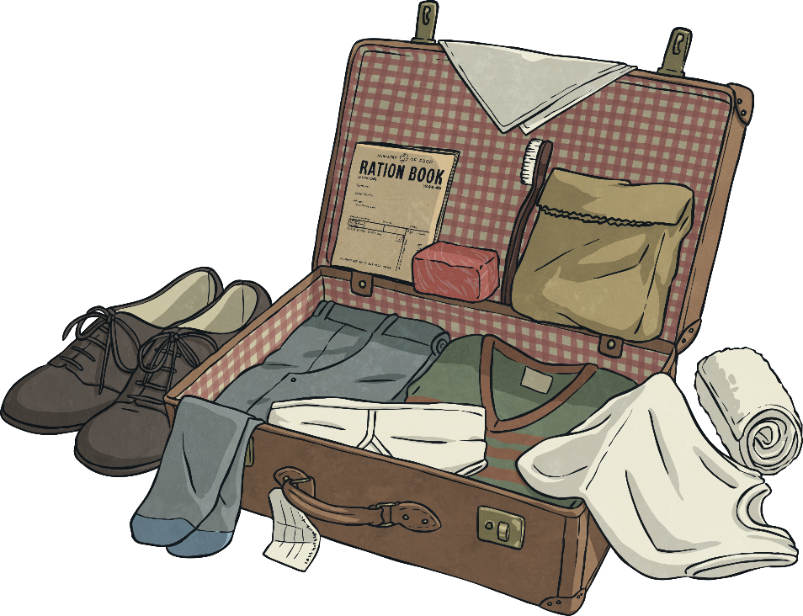
Evacuation
Parents were given a list of things to pack for their children which included a gas mask, underwear, pyjamas or a nightie, plimsolls, toothbrush, comb, a towel, soap, a flannel, handkerchiefs and a warm coat.
This list doesn’t sound like very much, but some families struggled to even get these items. A lot of children who were being evacuated came from very poor families.
Some children took a toy with them but it would have been something small. They had to be able to carry all their possessions themselves in one small suitcase.

Slide 7
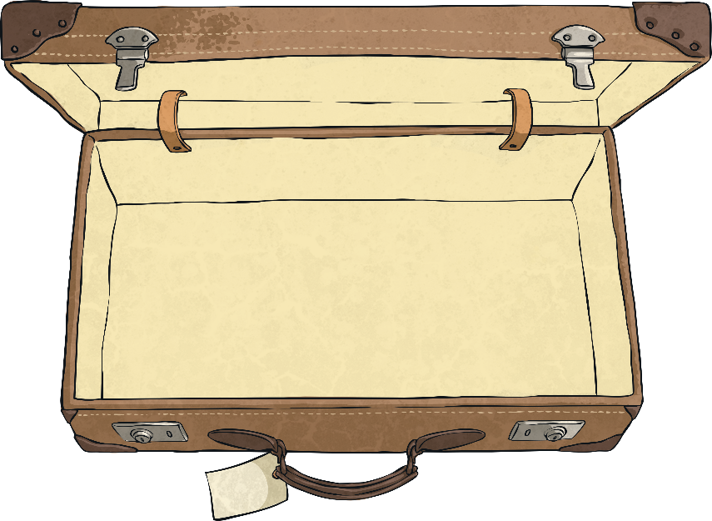
Evacuation
Your task is to imagine you are being evacuated and you have to decide what
to pack.
You will need to think about the following things:
What practical items will you need?
Will you take a toy?
Will you pack any items that remind you of home?
Whatever you pack, you must be able to carry it all yourself.

Slide 8
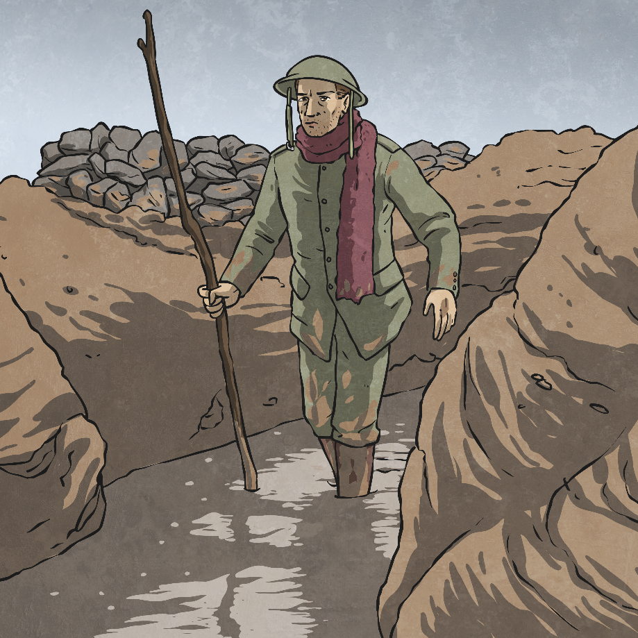
Glossary
censored – To have parts taken out.
conscription – Where it is the law that people join one of the armed forces.
evacuated – To be taken to a place
of safety.
self-sufficient – To be able to produce everything needed without getting
things from somewhere else.

