Slide 1
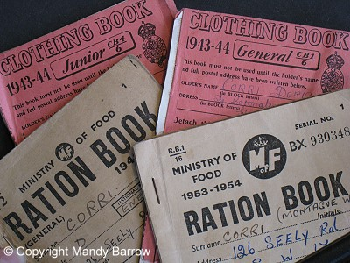
WALT: know some facts about rationing
WILF: you can say and write at least two things about rationing
Rationing in WW2

Slide 2
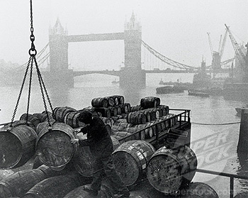
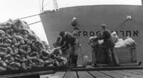
WALT: know some facts about rationing
WILF: you can say and write at least two things about rationing
Before Second World War 2 began, Britain imported over 50 million tons of food from many different countries every year.

Slide 3
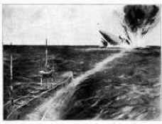
WALT: know some facts about rationing
WILF: you can say and write at least two things about rationing
Britain stopped importing food when the war started because ships bringing the food were destroyed by German submarines.

Slide 4
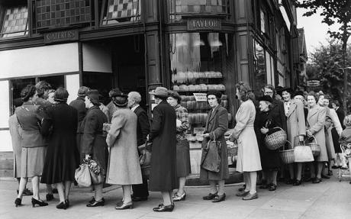
WALT: know some facts about rationing
WILF: you can say and write at least two things about rationing
The government knew that this would lead to a shortage of food, so rationing was introduced in January 1940.

Slide 5
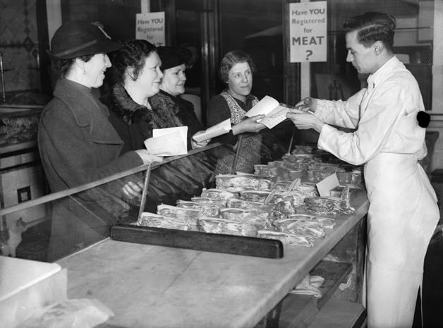
WALT: know some facts about rationing
WILF: you can say and write at least two things about rationing
Rationing meant that each person could buy only a fixed amount of certain foods each week.

Slide 6
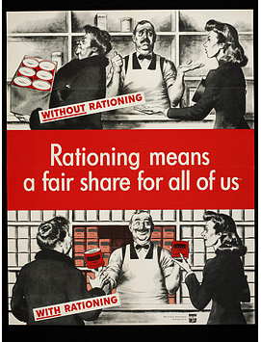
WALT: know some facts about rationing
WILF: you can say and write at least two things about rationing

Slide 7
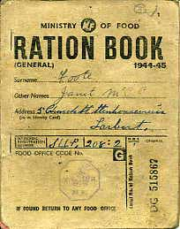
WALT: know some facts about rationing
WILF: you can say and write at least two things about rationing
Everyone was given a ration book.
The book contained coupons.
The coupons were used instead of money to ‘buy’ food.

Slide 8
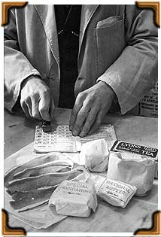
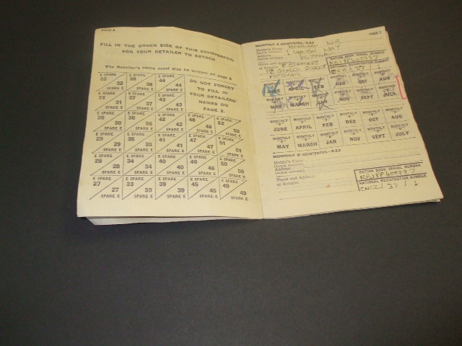
WALT: know some facts about rationing
WILF: you can say and write at least two things about rationing

Slide 9
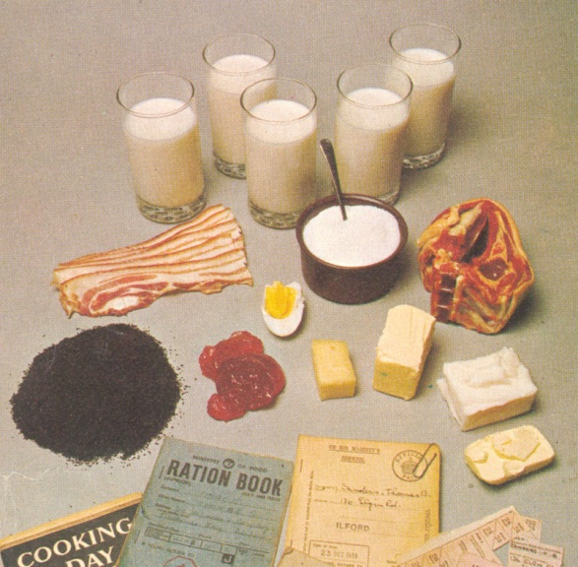
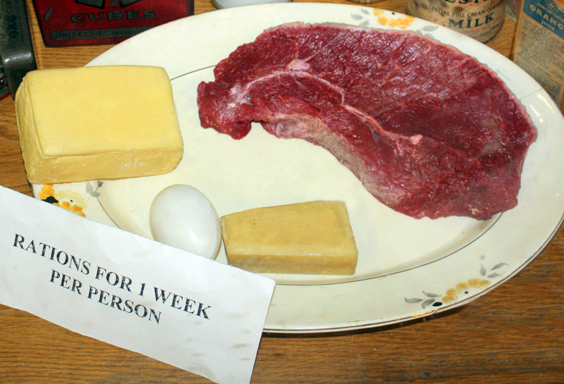
WALT: know some facts about rationing
WILF: you can say and write at least two things about rationing
Rationed food included butter, sugar, tea, meat, eggs, cheese, jam, sweets and milk.
Potatoes, fruit and fish were not rationed.

Slide 10
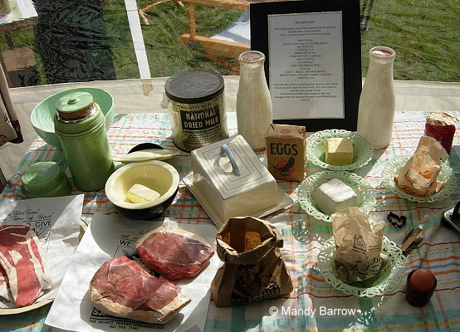
WALT: know some facts about rationing
WILF: you can say and write at least two things about rationing

Slide 11
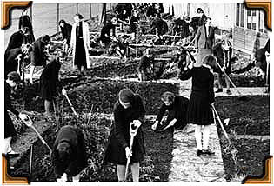
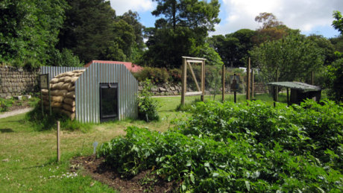
WALT: know some facts about rationing
WILF: you can say and write at least two things about rationing
People started to grow their own food.
Gardens and parks were used to grow vegetables to eat at home.

Slide 12
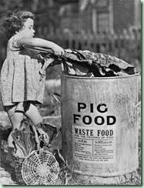
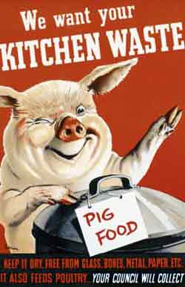
WALT: know some facts about rationing
WILF: you can say and write at least two things about rationing
Any food waste was collected in large bins and used to feed pigs and other animals.

Slide 13
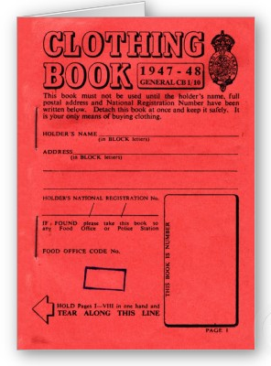
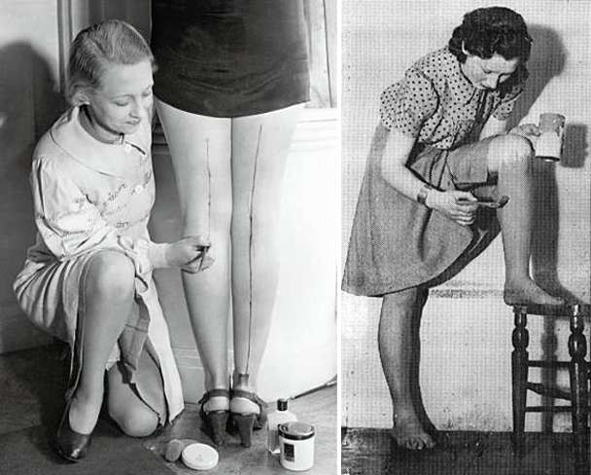
WALT: know some facts about rationing
WILF: you can say and write at least two things about rationing
Clothes were rationed from 1941. There was a shortage of material to make clothes.

Slide 14
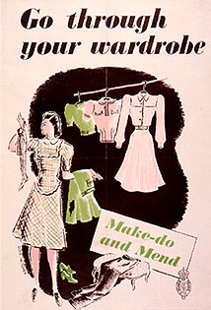
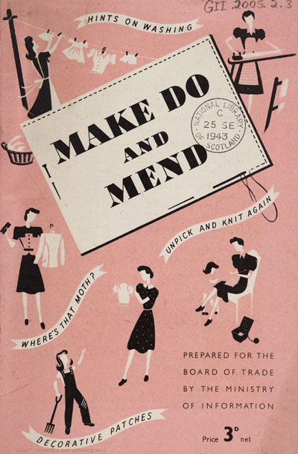
WALT: know some facts about rationing
WILF: you can say and write at least two things about rationing
People were encouraged to ‘make do and mend’.

Slide 15
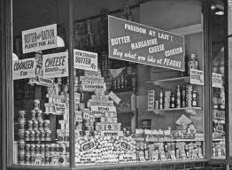
WALT: know some facts about rationing
WILF: you can say and write at least two things about rationing
Food rationing lasted until 1954 in Britain.

