Slide 2

Instructions
Teddy is getting ready for a teddy bears’ picnic.
Can you help Teddy find the things he needs?
Each slide shows some food Teddy needs for the picnic.
Carefully, count how many items there are on each plate and click on the plate matching the amount that Teddy needs.

Slide 3
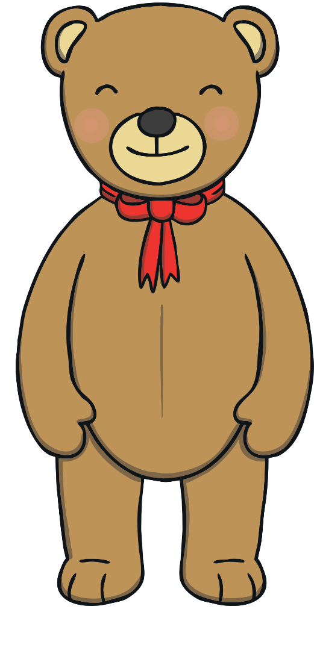


I would like 1 pie.
Click on the plate showing 1 pie.

Slide 4
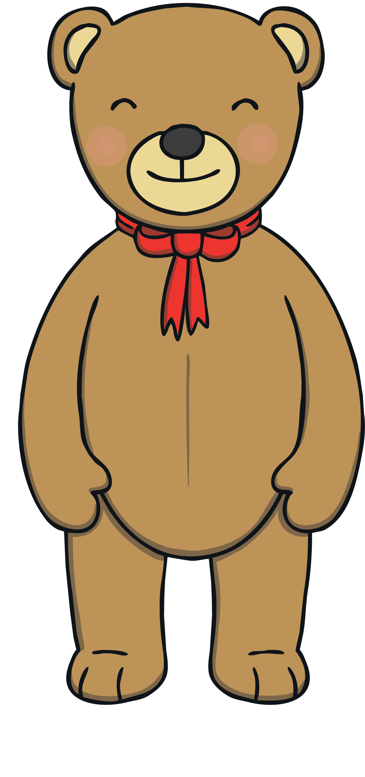


Great! There is 1 pie on this plate.
Next

Slide 5
Try again.
Back

Slide 6

I would like 2 bananas.
Click on the plate showing 2 bananas.

Slide 7
Great! There are 2 bananas on this plate.
Next

Slide 8
Try again.
Back

Slide 9

I would like 3 pears.
Click on the plate showing 3 pears.

Slide 10

Great! There are 3 pears on this plate.
Next

Slide 11
Try again.
Back

Slide 12
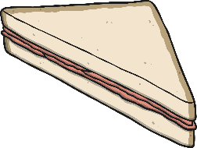
I would like 4 sandwiches.
Click on the plate showing 4 sandwiches.

Slide 13

Great! There are 4 sandwiches on this plate.
Next

Slide 14
Try again.
Back

Slide 15


I would like 5 cakes.
Click on the plate showing 5 cakes.

Slide 16

Great! There are 5 cakes on this plate.
Next

Slide 17
Try again.
Back

Slide 18

I would like 6 apples.
Click on the plate showing 6 apples.

Slide 19

Great! There are 6 apples on this plate.
Next

Slide 20
Try again.
Back

Slide 21

I would like 7 oranges.
Click on the plate showing 7 oranges.

Slide 22

Great! There are 7 oranges on this plate.
Next

Slide 23
Try again.
Back

Slide 24


I would like 8 limes.
Click on the plate showing 8 limes.

Slide 25

Great! There are 8 limes on this plate.
Next

Slide 26
Try again.
Back

Slide 27

I would like 9 sweets.
Click on the plate showing 9 sweets.

Slide 28
Great! There are 9 sweets on this plate.
Next

Slide 29
Try again.
Back

Slide 30

I would like 10 strawberries.
Click on the plate showing 10 strawberries.

Slide 31


Great! There are 10 strawberries on this plate.
Finish

Slide 32
Try again.
Back

