Slide 1
Poem writing, Brain hurting, Thought provoking
KENNINGS
Learning Objectives:
To learn what a kenning is.
To write examples of our own kennings.

Slide 2
What is it ?
A kenning is a way of describing something using clues rather than just saying what it is.
Each line is two words long.
A heat giver
A light maker

Slide 3
The word kenning comes from a viking phrase which means:
"to express a thing in terms of
another“
It is like a ‘mini riddle’ used to describe something

Slide 4

Here is an example of a kenning about a cat:
A paw licker
A day dreamer
A milk drinker
A ball chaser
A dog hater
A mouse chaser
A stroke lover

Slide 5

Lets see if you can guess what these kennings are describing
A great jumper
A water drinker
A straw eater
A strong walker
A race runner

Slide 6

A ball chaser
A crowd pleaser
A fast runner
A sneaky diver
A corner taker
A goal scorer
A mate hugger

Slide 7

A word holder
A story teller
A best seller
A page turner
A cliff hanger
A fantasy gateway

Slide 8

How do I write one ?
It is not as hard as it seems.
Remember:
To start each kenning with A ………
A night flyer,
A mouse eater,
A silent swooper

Slide 9
Remember:
To use verbs to describe the object further ………
A night flyer,
A mouse eater,
A silent swooper

Slide 10
And if you want a challenge use alliteration
A night flyer,
A mouse eater,
A silent swooper

Slide 11
Think about what the subject does….
For example a wolf
Comes out at night
Eats meat
Hunts its prey
Lives in the woods
Howls at the moon
This becomes…………

Slide 12
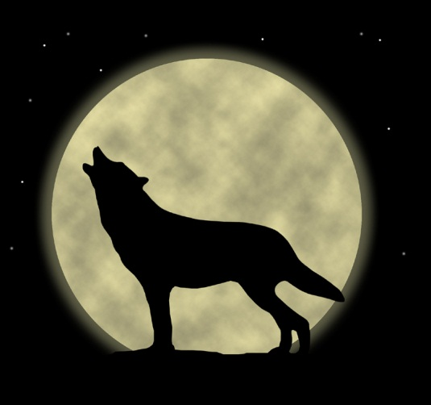
A night mover
A meat eater
A prey hunter
A wood dweller
A moon howler

Slide 13
Now it's your turn !
GET WRITING !

