Slide 1


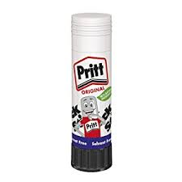


My Titanic Project.
By Charlie
P6 Room 11

Slide 2
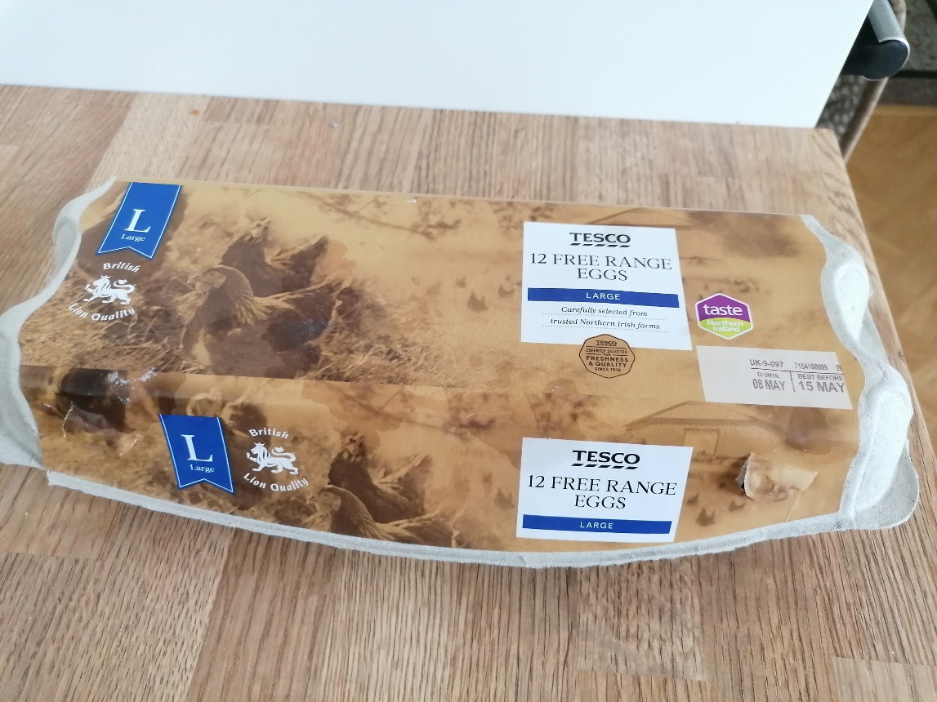
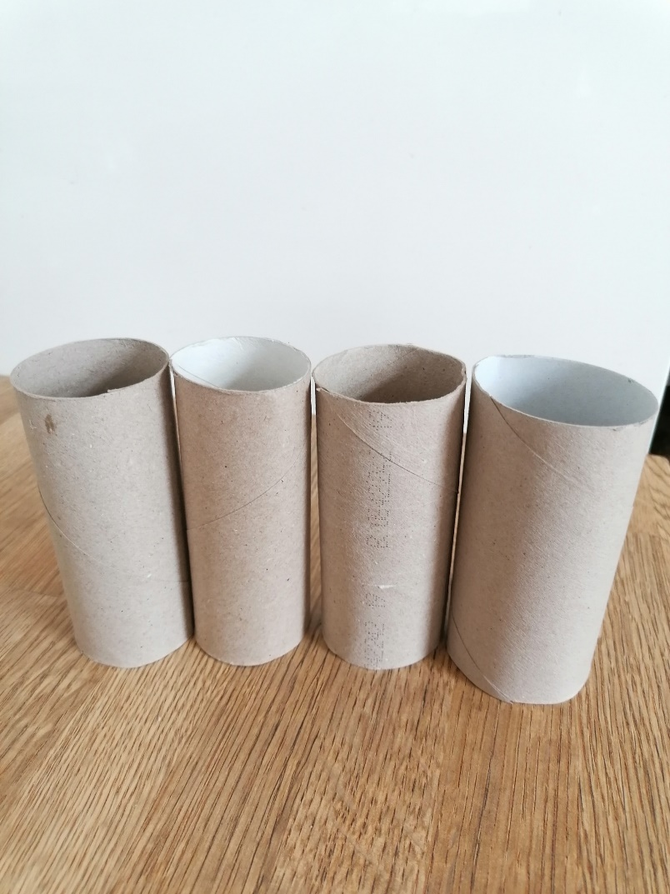
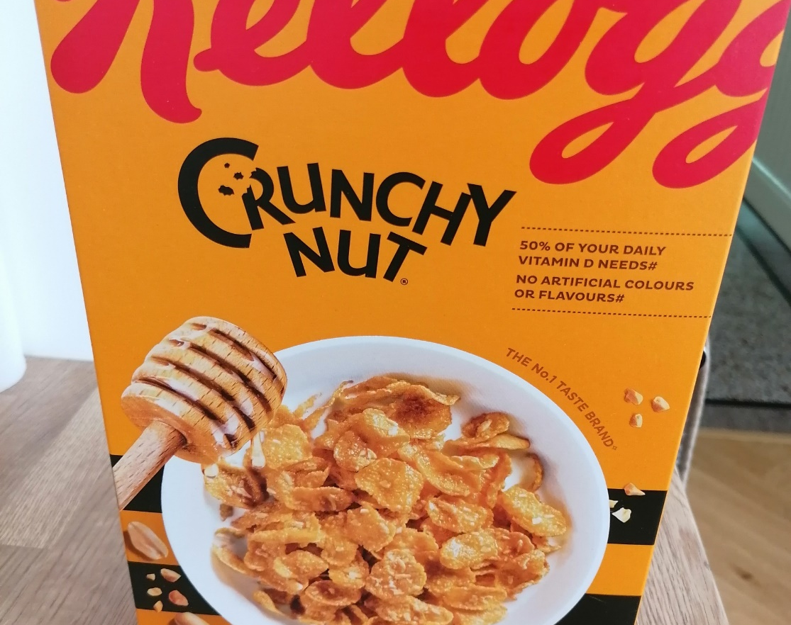
Items needed…
First I went into my garage to check in the recycling box to see what I could use.
. Cereal box x1
. Egg box x1
. Toilet roll tubes x4

Slide 3
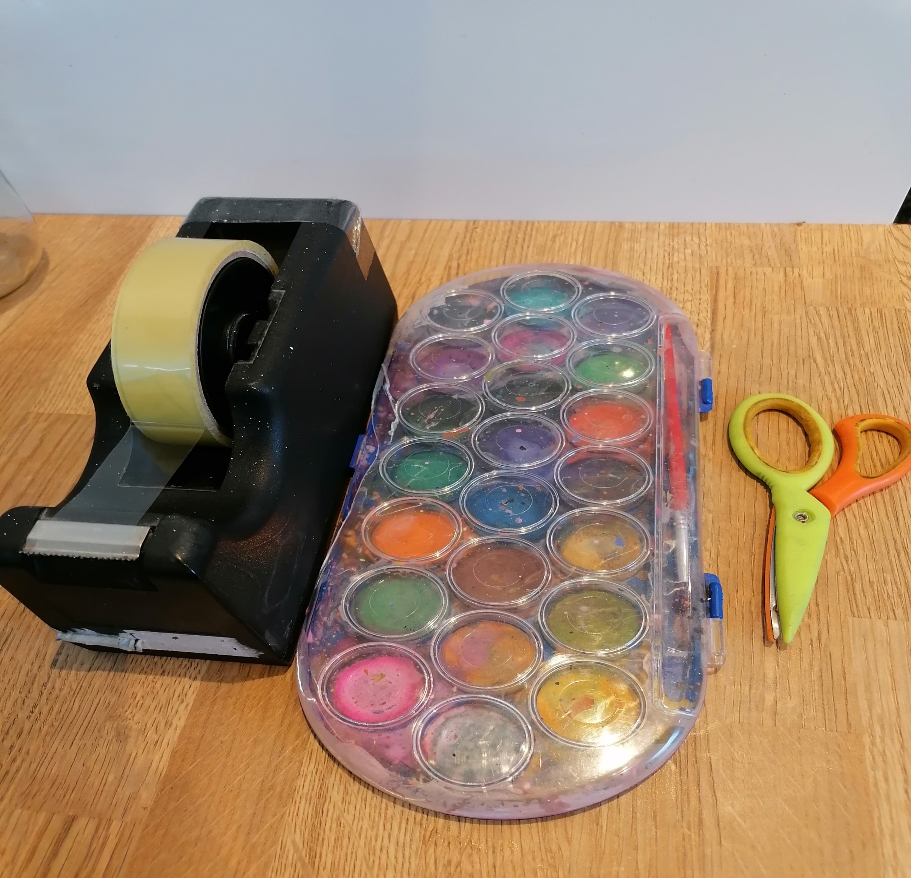
To decorate…
. Paint
. Wrapping paper
. Scissors
. Sellotape
. Tinfoil

Slide 4
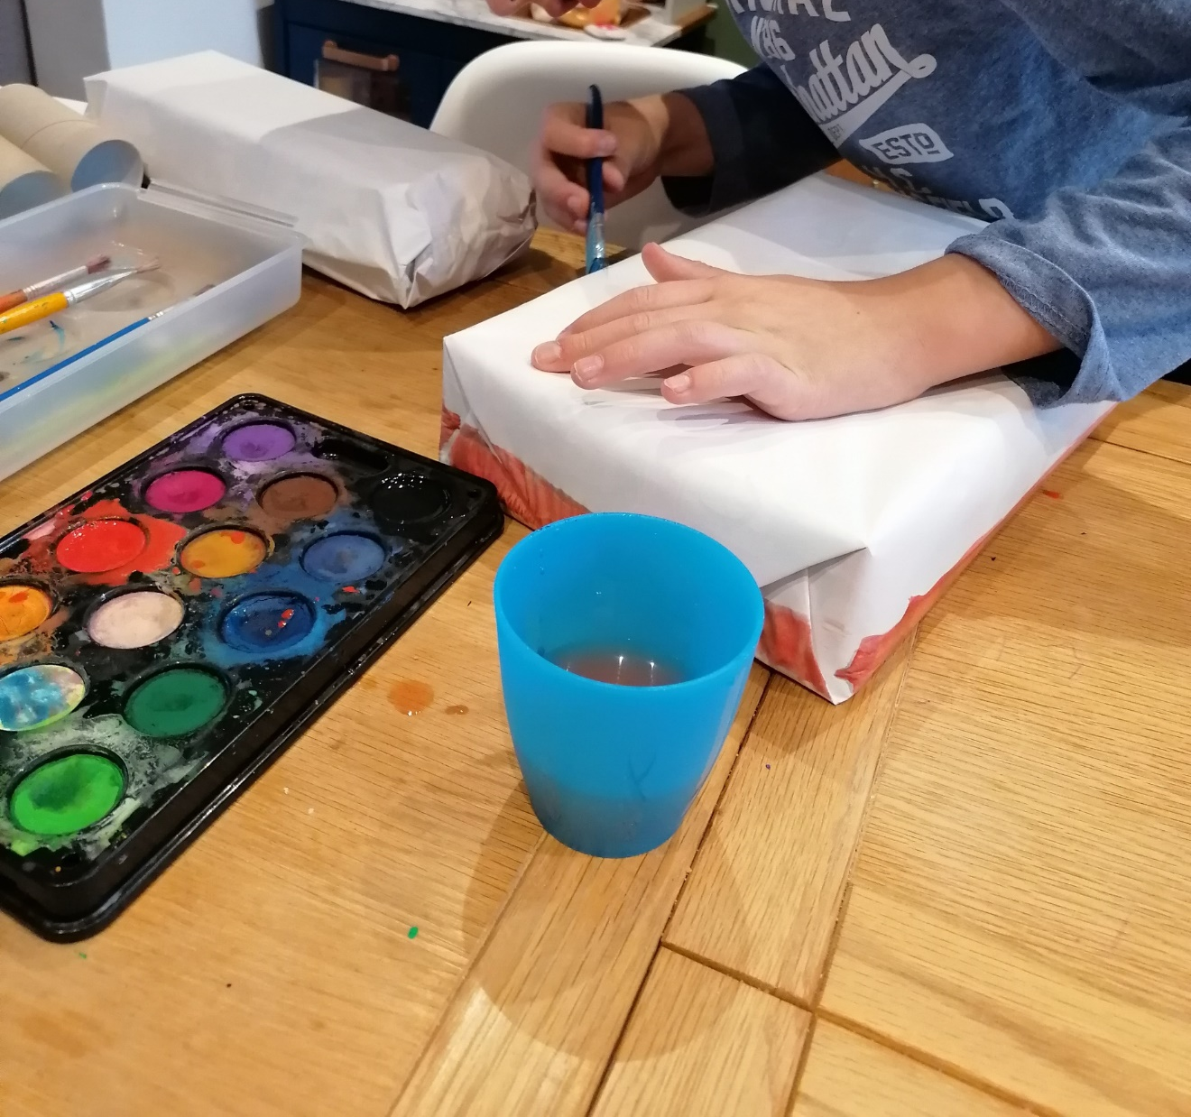
Once all items were wrapped I then started to paint it.

Slide 5
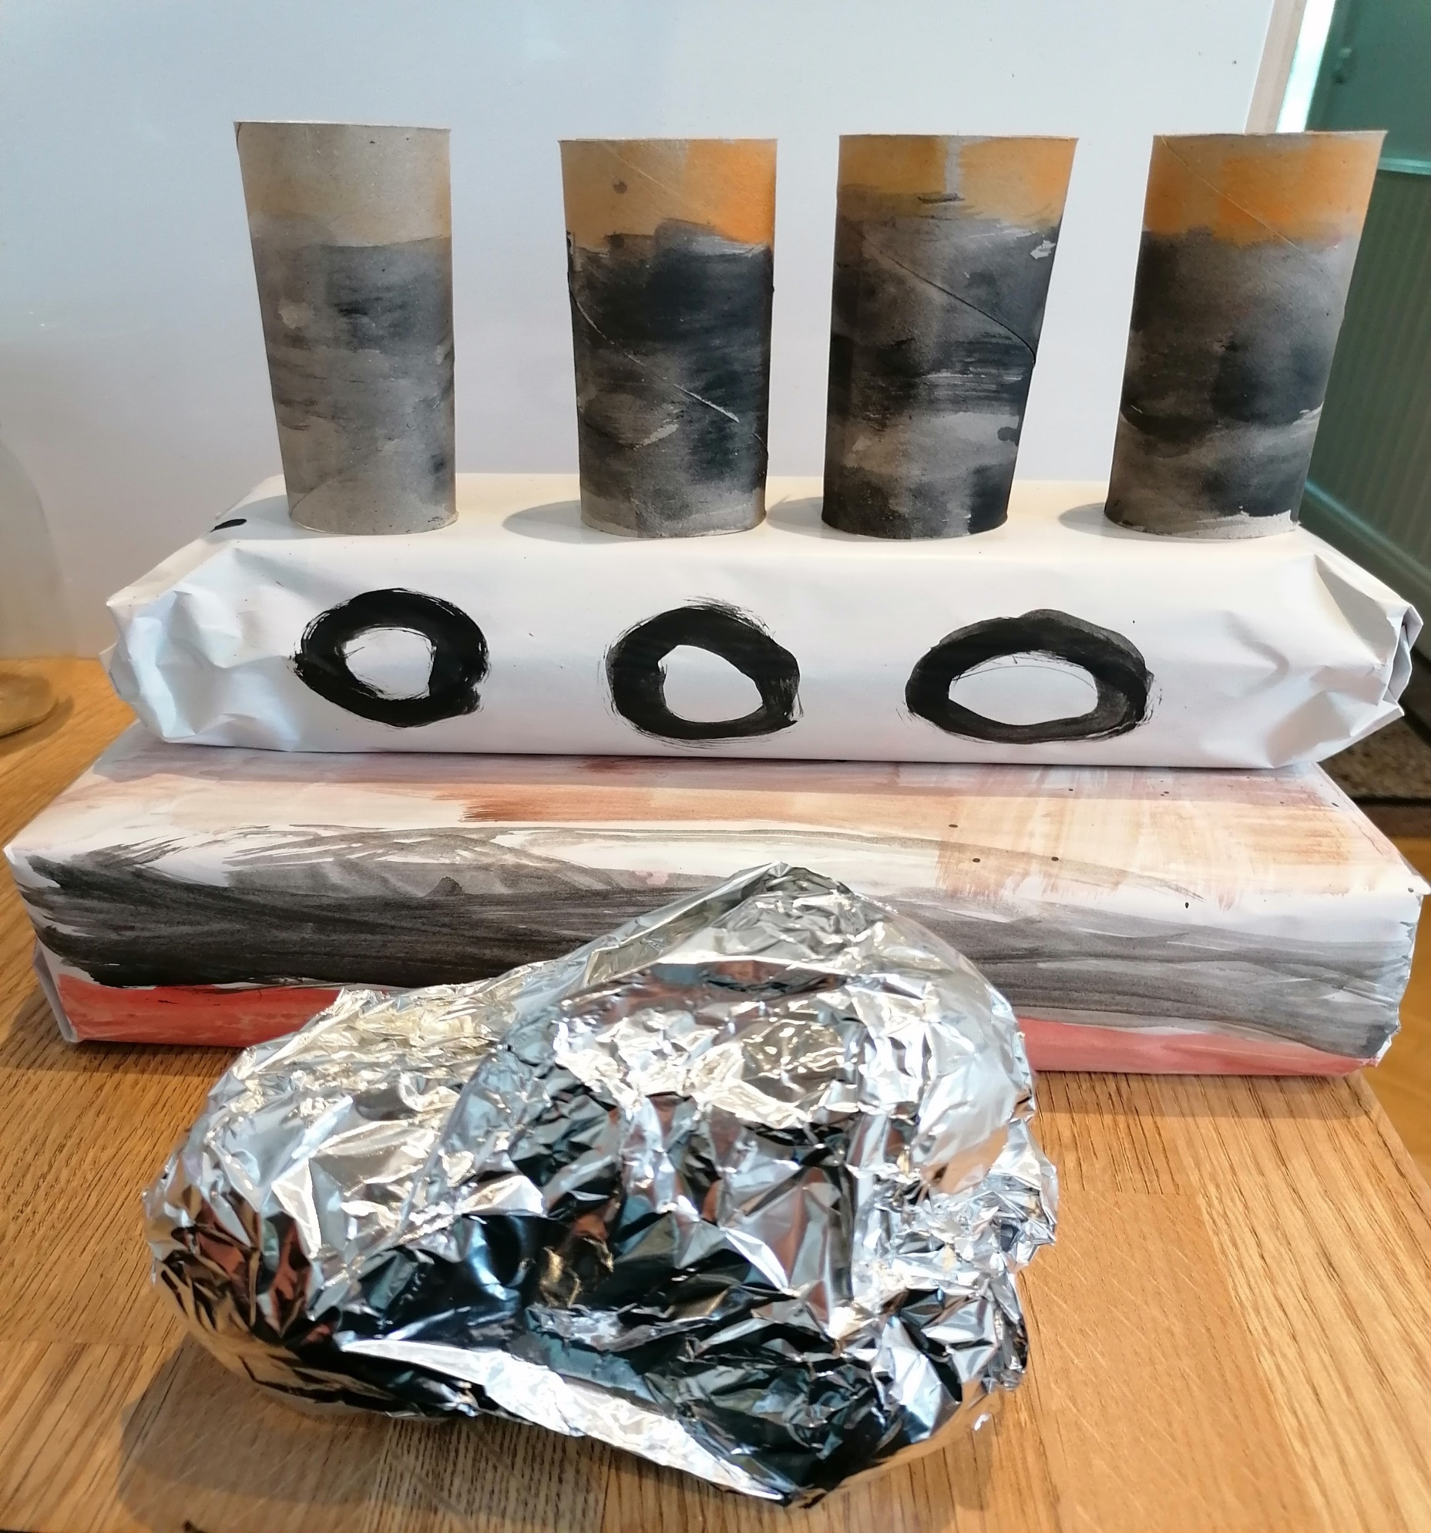
My project
When I finished painting it I then put the tinfoil over a bag of onions to make the iceberg, this is what my project looks like.

Slide 6
END

