Slide 1
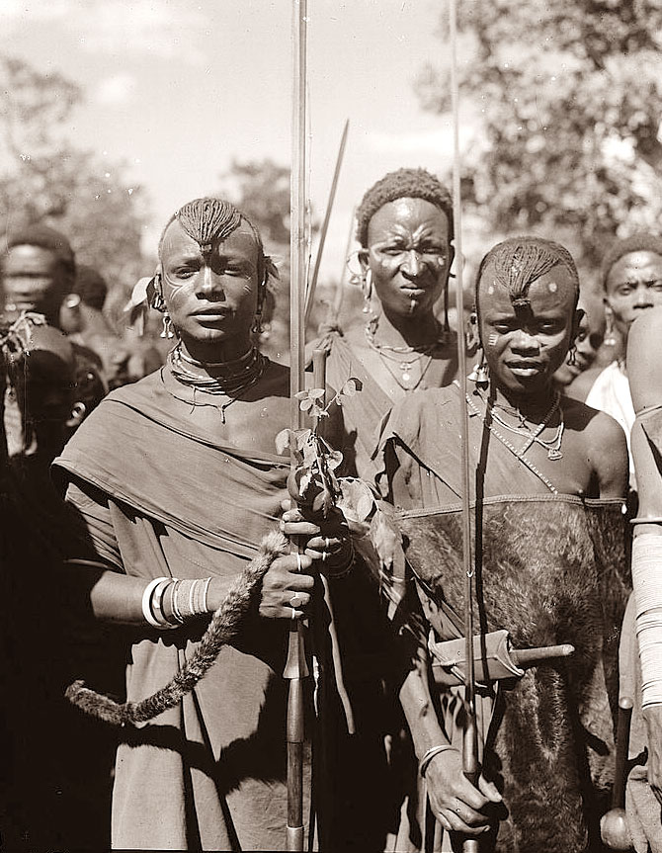
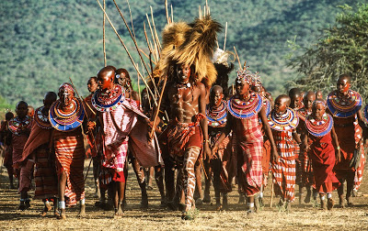
Select one of the pictures below
Think of 3 questions you would like to ask them or would like answered based on the picture
A.
B.
Share your responses with the class
In pairs, try to answer these questions (try analysing your chosen picture to get your responses)

Slide 2
The maasAI tribe
Write the date and title in your books
Learning objectives:
I have an understanding of what life is like in the Maasai tribe
I can describe the main features of a Maasai home
I can present and explain the main features of a Maasai home to the class

Slide 3
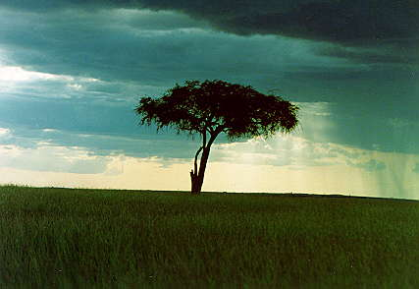
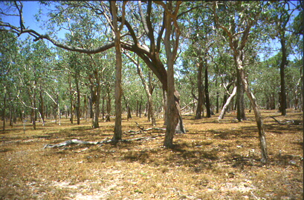
What is the Maasai Mara?
The Maasai Mara is in Kenya
It is a very large Savannah
Picture A shows what the Savannah is like.
What is the plant life (vegetation) like in picture A?
Mixture of grasses and trees
What do you in particular notice about the trees?
The trees are spaced quite far apart, meaning the canopy (the leafy part at the top of the tree) does not close
What impact does this have on the grasses?
Lots of light reaches the ground, meaning there are plenty of grasses
A.

Slide 4
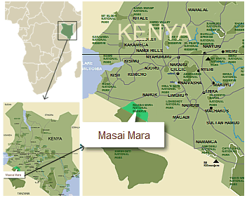
Where is the maasai mara?
How would you describe where the Maasai Mara is located?

Slide 5
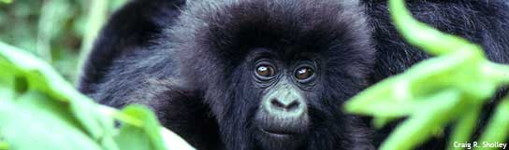
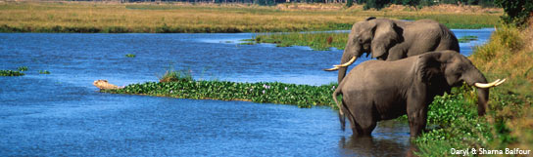
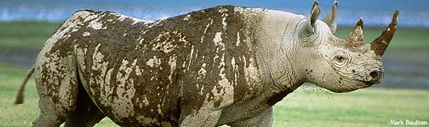
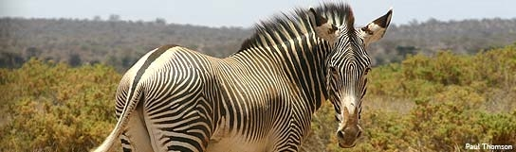
Animals in the Masai Mara

Slide 6
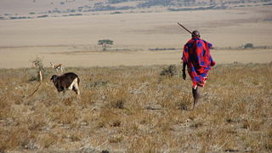
The Maasai Tribe
The Maasai people live in the Maasai Mara.
They own large herds of cattle such as cows, goats and sheep.

Slide 7
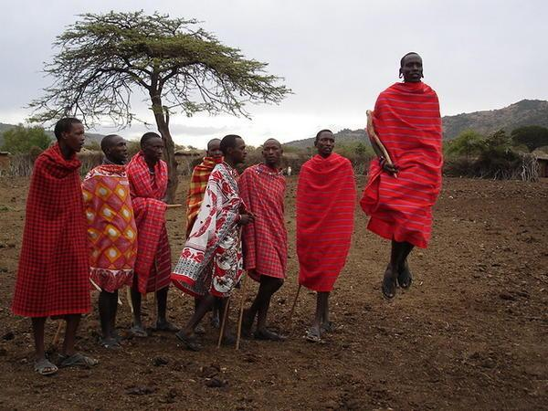
Maasai tribe
The Maasai tribe live in the African Savannah.
The Maasai tribe share the same ideas and way of life.
They use the land as their home.

Slide 8
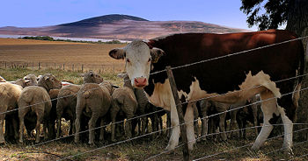
Cattle
Cattle plays an important part in the life of the Maasai Warriors.
What do you think the Maasai people use the cattle for?
Meat and milk
They actually drink blood from the animals!

Slide 9
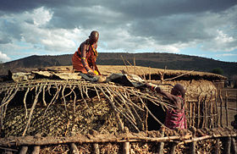
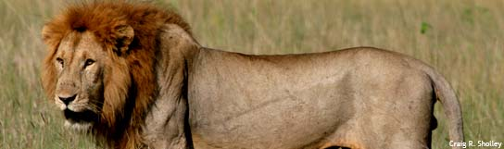
Mud huts
What do you think the huts are made of?
Mud, sticks, grass and cow dung
Why do you think they keep their small animals in the house?
Protect them from wild animals

Slide 10
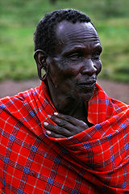
Maasai Men
Maasai men are in charge of their tribe.
Their favourite colour is red.
The men go out to kill big animals so that their families can eat them.

Slide 11
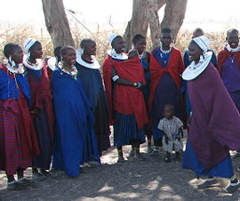
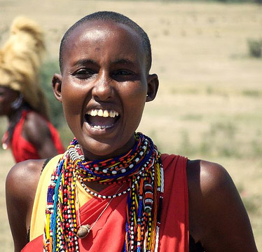
Masai Women
Maasai women look after the children.
What do you notice about the Maasai women?
They wear lots of beads
Why do you think that is?
The more beads they wear, the richer they look

Slide 12
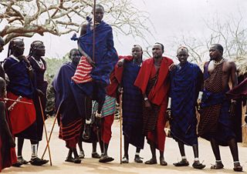
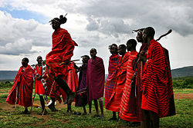
Jumping Dance
What are the Maasai men doing?
Performing the ‘jumping dance’
Why are they doing it?
Showing off to the girls, that is how you get a girlfriend in this tribe!

Slide 13

Learning objectives
I have an understanding of what life is like in the Maasai tribe
I can describe the main features of a Maasai home
I can present and explain the main features of a Maasai home to the class

Slide 14
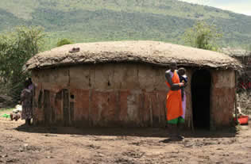
Living in a maasai home
We are going to watch a video which shows us what a Maasai home is like
From this video you need to write down FOUR FACTS about what a Maasai home is like
(http://www.youtube.com/watch?v=6mByW8hsCXE)

Slide 15
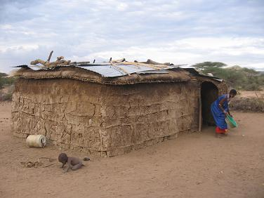
What is maasai home like?
Features of a Maasai Home

Slide 16
Learning objectives
I have an understanding of what life is like in the Maasai tribe
I can describe the main features of a Maasai home
I can present and explain the main features of a Maasai home to the class

Slide 17
Planning a maasai home
30 minutes
TASK- you are going to plan and create a typical Maasai home, in the form of an poster
You will work in pairs
Sort out the cards that are given to you and place these around the plan of the Maasai home (stick them in), drawing arrows to the feature it is referring to
Once this is done, write down next to each label why that particular feature is important
Use the success criteria to help you
Be prepared to present your plan to the other pairs in your line of tables (2 minutes maximum, peer assessed)

Slide 18
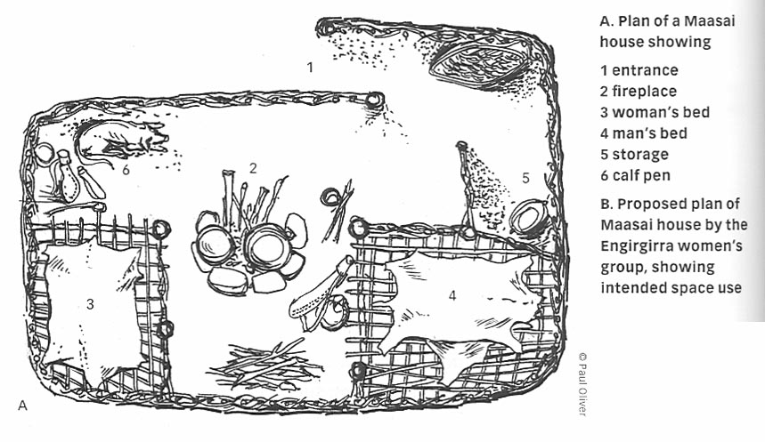
Layout of a maasai home

Slide 19
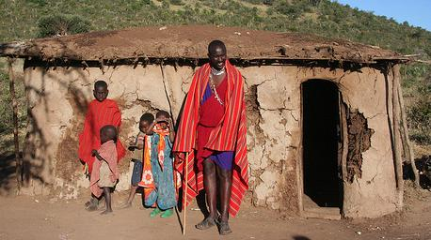
Presenting your maasai home poster
It’s now time for each pair to present their posters to the other tables in their row (2 minute time limit)
When one pair is presenting their poster, one of the other pairs will be responsible for peer assessing another group
Use the Peer Assessment Hamburger sheet

Slide 20
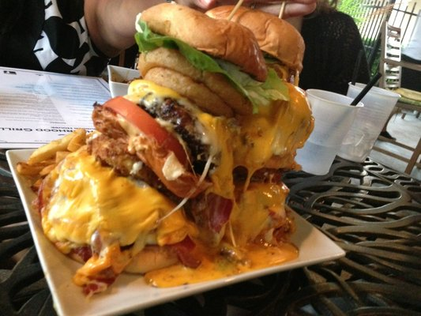
Peer feedback
5 minutes
Look at the feedback you have been given from your peers
What did you do well?
How could your group improve in future?

Slide 21
Learning objectives
I have an understanding of what life is like in the Maasai tribe
I can describe the main features of a Maasai home
I can present and explain the main features of a Maasai home to the class

Slide 22
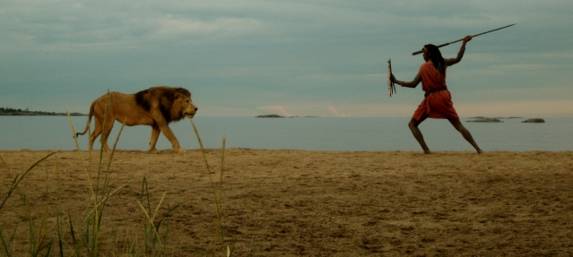
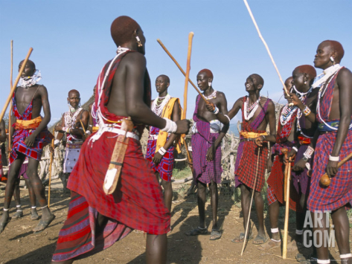
Plenary- interviewing a maasai warrior
We need one volunteer to pretend to be a Maasai warrior!
The rest of the class needs to prepare questions to ask him/her based on the pictures below (2 questions each)
The Maasai warrior should try to respond based on what we have learnt today

