Slide 2



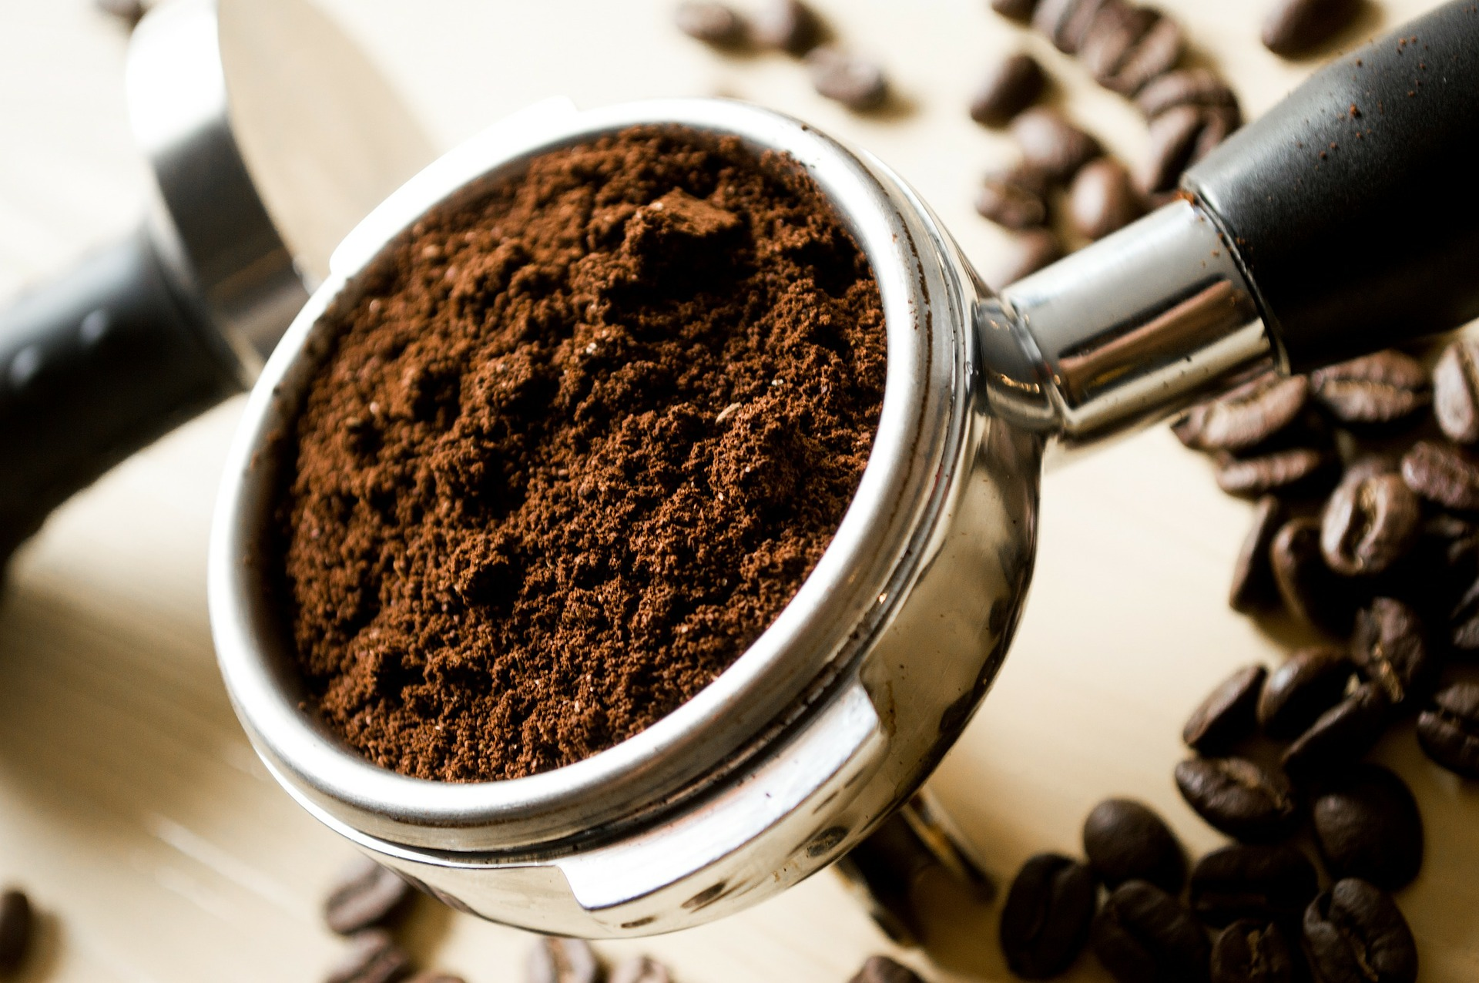
Daily News
Environment x UK News
29th April 2019
Coffee Could Be Recycled to Replace Palm Oil
The secret to protecting our environment might just be hidden in your teacher’s coffee cup! At times it seems that the adult world runs on coffee! This creates a lot of waste.
After they’ve been used to make the coffee, the grounds often get thrown away. As it decomposes, it releases methane, a greenhouse gas.
Two Scottish businessmen say they’ve found a way to use these coffee grounds to replace palm oil. This is used in many different foods and products because it’s very efficient.
However, many people believe it is responsible for the deforestation of the rainforest, as large areas are being burnt to create room for these palm trees.
This is destroying the habitat of many endangered animals, such as the orangutan and some breeds of tigers.
It’s been put forward as part of a competition for business ideas to improve the world.
Other ideas competing for the prize include a plan to make laminating pouches biodegradable and new technology to help care for bees.
Read the full article online here.
What is palm oil?
What are greenhouse gases?
What new inventions could help protect the environment?
Photo: Coffee grounds being used to make a coffee.
Notes:
Teacher Note - Please do not let the next video automatically play at the end of the clip. Please check the content in this link, including any comments, is suitable for your educational environment before showing. Twinkl accepts no responsibility for the content of third party websites.

Slide 4


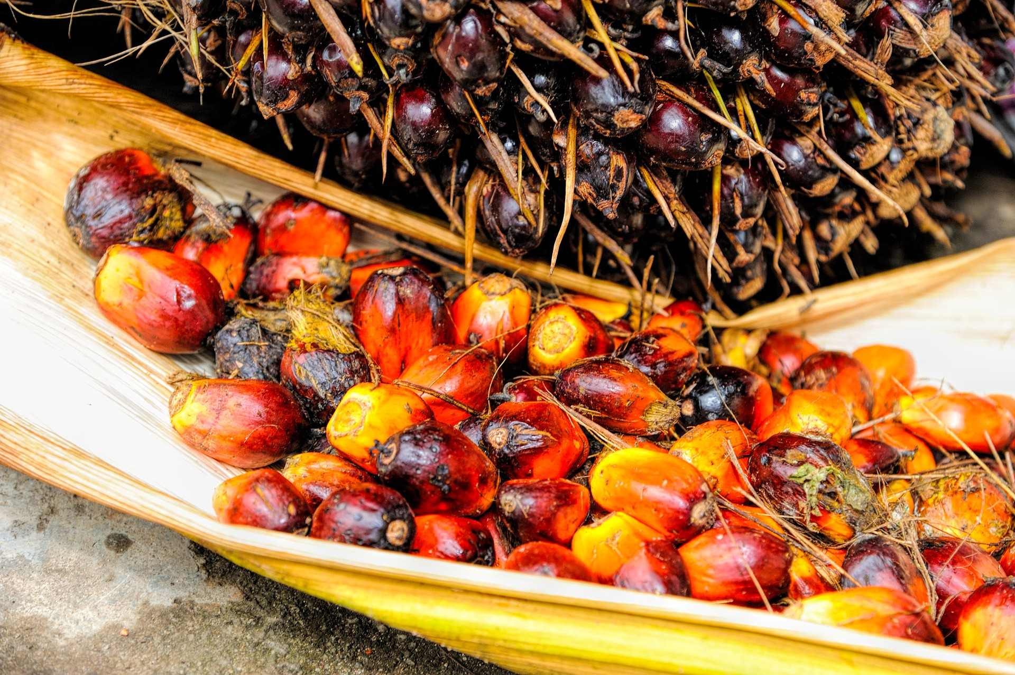

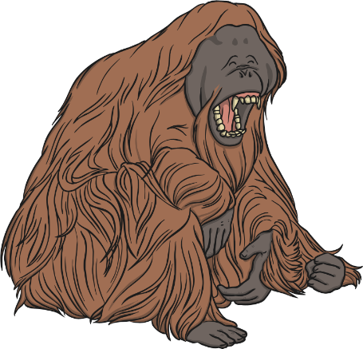

What Is Palm Oil?
vegetable
occur
controversy
Palm oil is a vegetable oil, similar to sunflower oil, made from the fruit of African palm trees.
However, there is a lot of controversy around palm oil.
It’s been linked to the deforestation of the world’s rainforests. Last year, a huge number of trees were cut down, often to make space for farming.
While these trees occur naturally in West Africa, they are now mostly grown in Indonesia and Malaysia.
It’s quite cheap to make and can be made quickly. It’s used in many different foods and goods, such as ice cream, chocolate and even shampoo or lipstick!
This is particularly bad for many endangered animals, such as orangutans, elephants and tigers.
Find out more about Palm Oil here.
Do you think we should use palm oil?

Slide 6
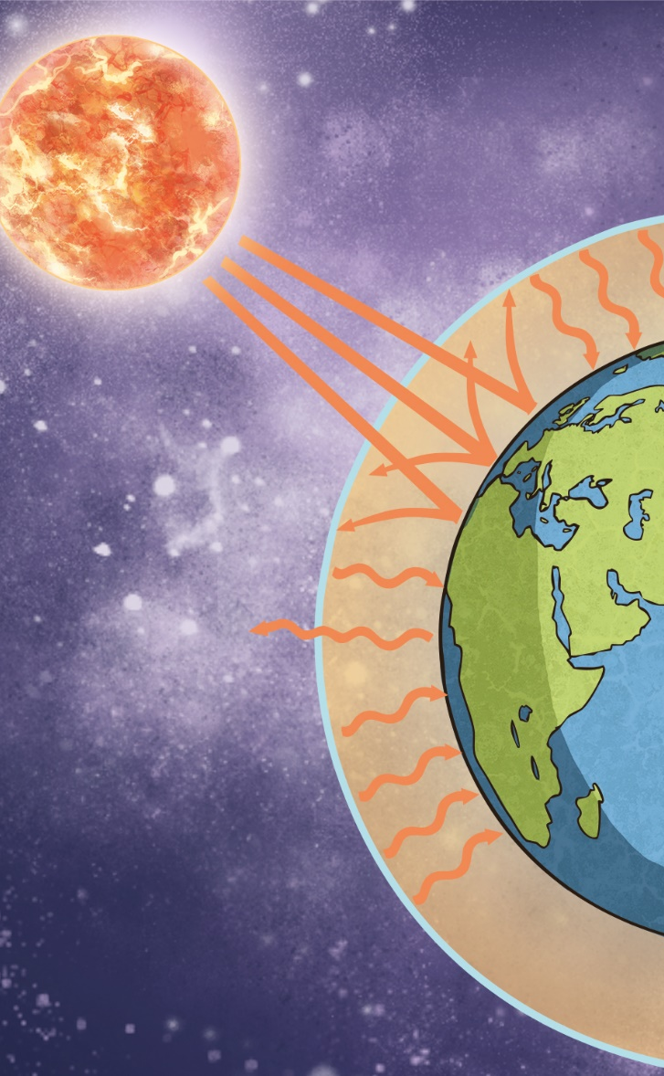
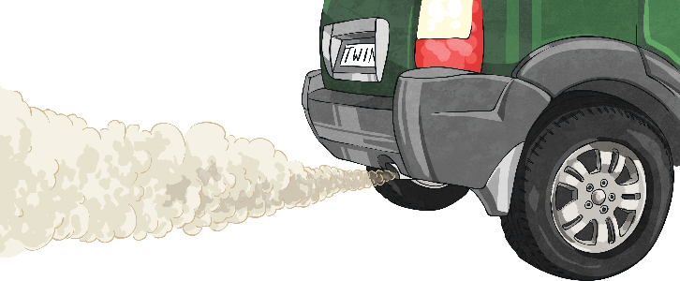

What Are Greenhouse Gases?
according
varieties
attached
Greenhouse gases are harmful gases, such as carbon dioxide or methane, which scientists believe are causing global warming.
These harmful gasses make this layer thicker, trapping in more heat and warming up the Earth.
This is called climate change. In the last 100 years, the average temperature has risen by about 1°C, causing more extreme weather.
These gases are released by vehicles, by burning fossil fuels, by decomposing coffee or even by cows!
There are simple things we can do to help. Using leftover coffee as compost to grow flowers releases less methane into the atmosphere.
Investigate the causes of climate change here.
Our atmosphere has a layer of gas, which keeps some heat in.
What else can we do to help stop climate change?

Slide 7


Slide 8
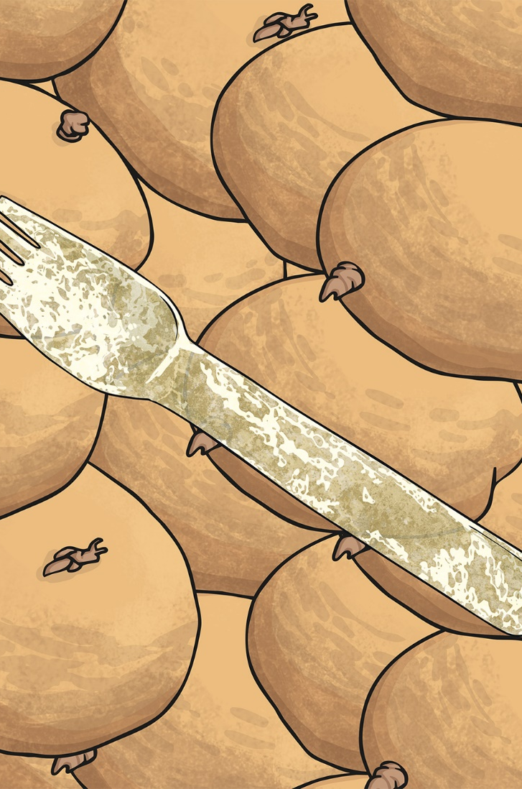
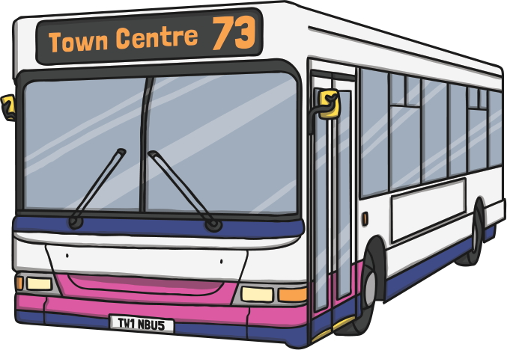

What New Inventions Could Help Protect the Environment?
environment
equipment
competition
Scientists and engineers have been working hard to protect our environment.
Some buses in Southampton have been designed to clean up air pollution! Special equipment on the roof filters polluted air.
A company in Bulgaria has been exploring ways to make the laminating plastic used in glossy magazines biodegradable.
Last year, one inventor made spoons and forks out of potato starch!
Two UK inventors created a wind turbine small enough to hang from a window.
Write a plan for an invention to help protect the environment.
He hoped this would be used to replace single-use plastic, which can damage our ocean and harm marine animals.
It won a competition for amazing inventions from across the world.
What problems in the environment need solving?

Slide 9
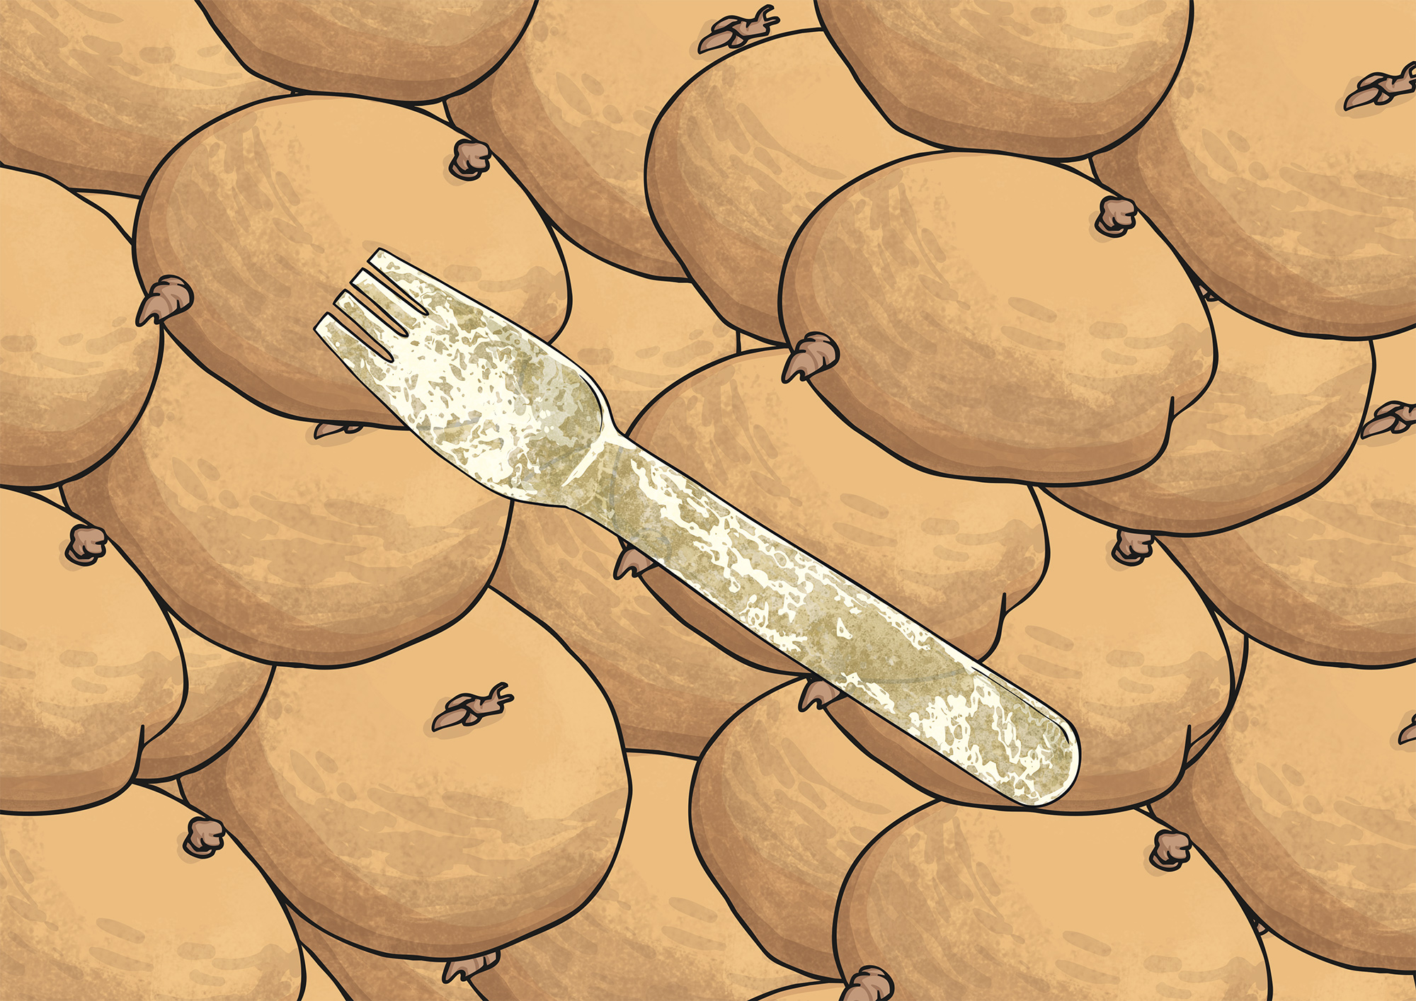

Slide 10
Glossary
Word | Definition
greenhouse gas | A gas which contributes to climate change.
deforestation | The action of clearing a wide area of trees.
endangered | An animal species which is in danger of being wiped out.
biodegradable | A material which can be easily decomposed by bacteria.

