Slide 1
Now that you have your plan, you can use the information that you have collected to write your Biography.
Remember, your Biography needs to be your own writing. The next page shows you the features that you should include.

Slide 2
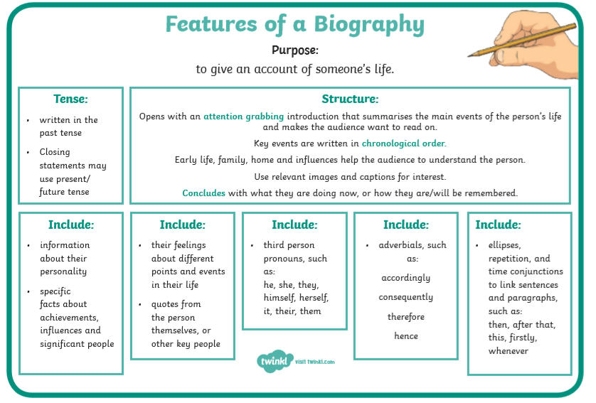

Slide 3
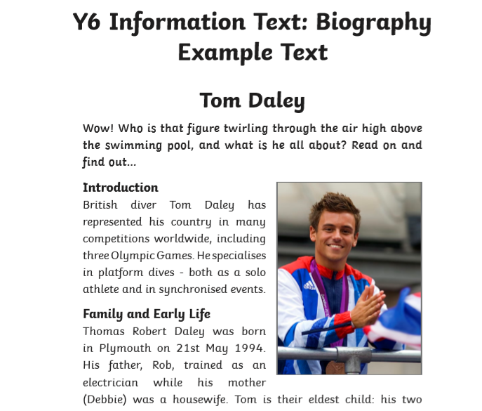
Here is an example of a Biography.
Can you spot any of the features from the previous page?
Highlight them.
This will help you with your writing.

Slide 4
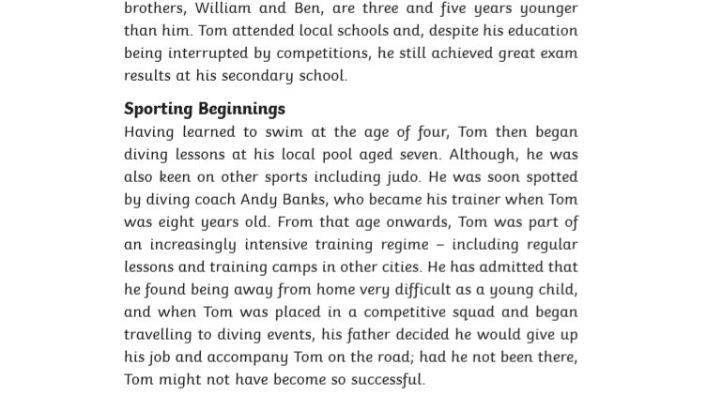
Example text:

Slide 5
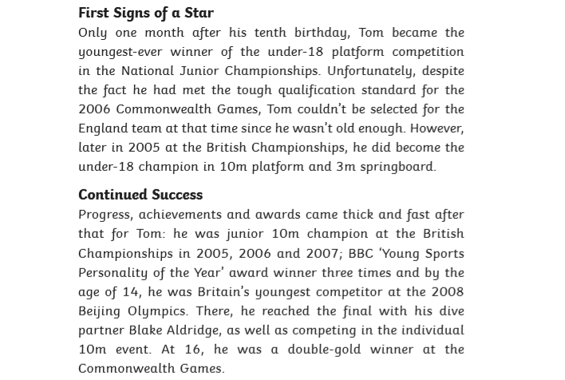
Example text:

Slide 6
Bear Grylls
Example of how to start your biography:
The title is the name of the person you are writing about
In the middle of the page and underlined
Capital letters for proper nouns
Commas for parenthesis
Heading
Past tense
Early Life
Bear Grylls, also known as Edward Michael Grylls, was born in London, England, to Sir Michael Grylls and Lady Sarah Grylls. His elder sister- Lara Fawcett- gave him his nickname ‘Bear’ when he was just a week old. Ever since he was a child, he’s always been extremely interested in adventure sports, such as…
Single quotation marks
Third person pronoun
Dashes for parenthesis
Top tips: Try to remember to use a range of punctuation in your writing and to underline your headings with a ruler. You can create your biography on your computer if you prefer. Include photographs where possible.

Slide 7
Bear Grylls
Now it’s time for you to write your Biography. Follow this layout for your writing:
Early Life
Career
Personal Life
Achievements

Slide 8
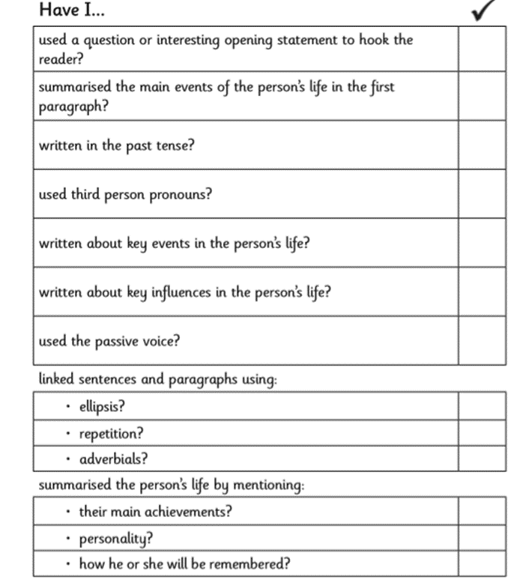
Finished?
Check over your work for any punctuation and spelling errors.
Then use this checklist to make sure you have included the
Features in your writing.

Slide 9
Self assessment:
LI: To write a biography on Bear Grylls.
Success Criteria | I think:
I can research Bear Grylls and create a plan for my Biography using bullet points.
I can ensure that my Biography is written in the third person, in chronological order and in the past tense.
I can read over my work checking for punctuation and spelling errors.
Remember to ask your parents/carers to email over a copy of your work to your class teacher. Your work could be featured on the school website.

