Slide 1
Writing
LI: To write a biography on Bear Grylls.
Success Criteria
I can research Bear Grylls and create a plan for my Biography using bullet points.
I can ensure that my Biography is written in the third person, in chronological order and in the past tense.
I can read over my work checking for punctuation and spelling errors.

Slide 2
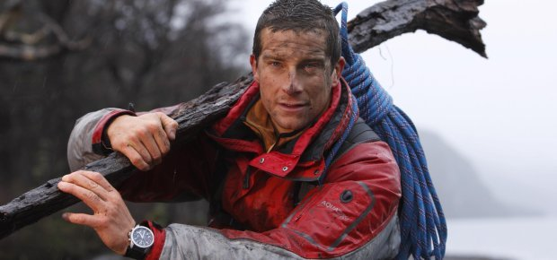
Bear Grylls
Do you know anything about Bear Grylls?
Are there any clues in the picture that can tell you what he is well-known for?

Slide 3
Bear Grylls
Bear Grylls is an adventurer, popularly known for his survival tactics in his television series Man vs. Wild.
Since he was a child, he has always been interested in adventure sports such as: mountaineering, sailing, and sky diving.
He is also known for hiking in the Himalayan Mountains of Sikkim and West Bengal, and on 16th May 1998, he climbed Mount Everest and registered his name in the ‘Guinness Book of Records.’

Slide 4
Watch these short survival skill tips from Bear Grylls:
https://www.youtube.com/watch?v=whua9J4p870
https://www.youtube.com/watch?v=tJKZ7dkdcEs
https://www.youtube.com/watch?v=gzsMrlPx2d8

Slide 5
What is a Biography?

Slide 6

Biography
A biography is facts about someone else’s life.
It is about a real person, but is not written by the person. It is written in third person.
The author must know a lot about the person and research the person, so that they can write a lot about them.

Slide 7
Biography
A biography describes key facts about a person.
such as, where, when and how they live (or have lived if the person is no longer alive)
It is written in chronological order

Slide 8

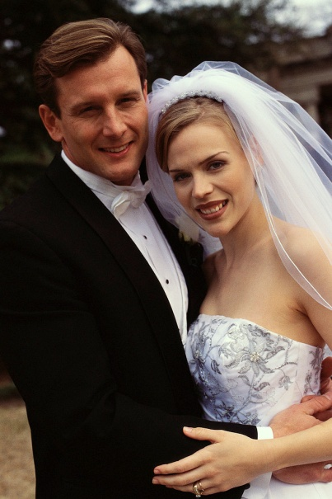

Biography
Provides details that show events in a person’s life.
A biography might talk about a person’s achievements, things that have happened to them, and their likes and dislikes.

Slide 9


Biography
A biography will talk about how the person feels about different things.
It might talk about the work a person does or the things they believe in.

Slide 10
Your first task is to research Bear Grylls. You can use the websites below to research about him and use the information to complete the planning sheet on the next few pages.
https://metro.co.uk/2018/06/26/bear-grylls-wife-age-children-career-television-7660757/
https://www.thefamouspeople.com/profiles/bear-grylls-6100.php
https://www.channel24.co.za/TV/FeaturedArticle/24-Facts-Bear-Grylls-20120314
Thursday’s Task
Top tip: Remember to check the year that the websites were published as his age may be different now. Also, remember to check that the information is accurate by using different websites.

