Slide 2
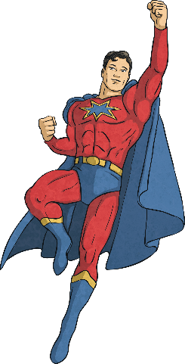
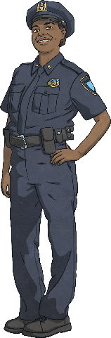
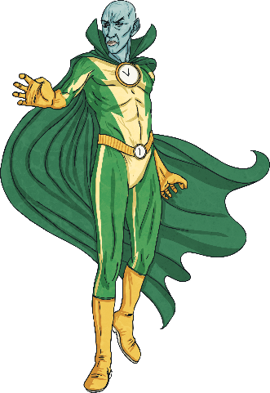
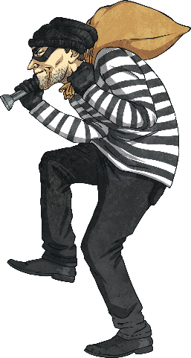
Types of Characters
When an author writes a story, the author decides what type of characters the story will have.
The protagonist is normally the main character in a story. This character is often portrayed in a positive light so the reader roots
for them throughout the story.
The antagonist is the person, or group of people, who are actively working against the protagonist.

Slide 3
Character Actions
As the author develops the characters, they give us clues to determine important character traits.
One clue we can look at is the character’s actions.
Jocelyn pushed Shelia off the swings.
Benjamin collected cans to donate to the local shelter.
After looking at these actions, we might be able to determine characters with positive and negative traits.

Slide 4
Character Words
However, actions do not give us the whole picture. We also need to look at a character’s words; this may be their thoughts or what they say aloud.
“Watch out! There’s a bee!” Jocelyn yelled. Jocelyn pushed Shelia off the swing hastily. “Thank you, Jocelyn. You saved my life!” gushed Shelia, hugging her friend tightly.
“I have to have that new bike,” thought Benjamin. “I’ve got to do something to convince them.” So, Benjamin had the bright idea to collect cans of food and donate them to the local shelter. “Since I’m such a good person, my parents will have to buy me the bike now!” he schemed.
With this new information, we might determine that different traits now fit Jocelyn and Benjamin.

Slide 5
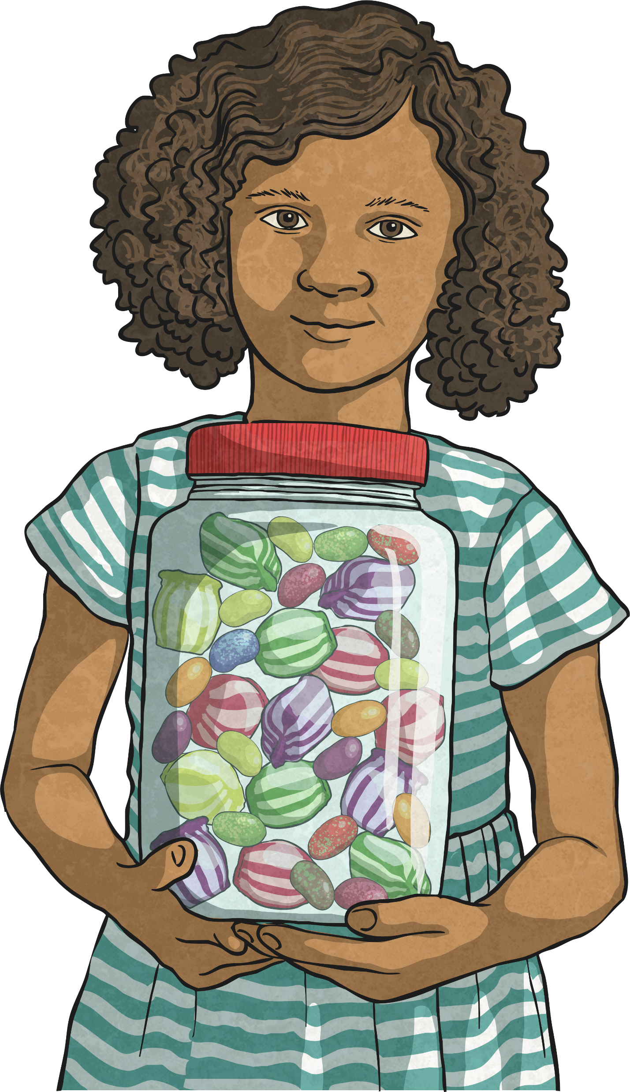
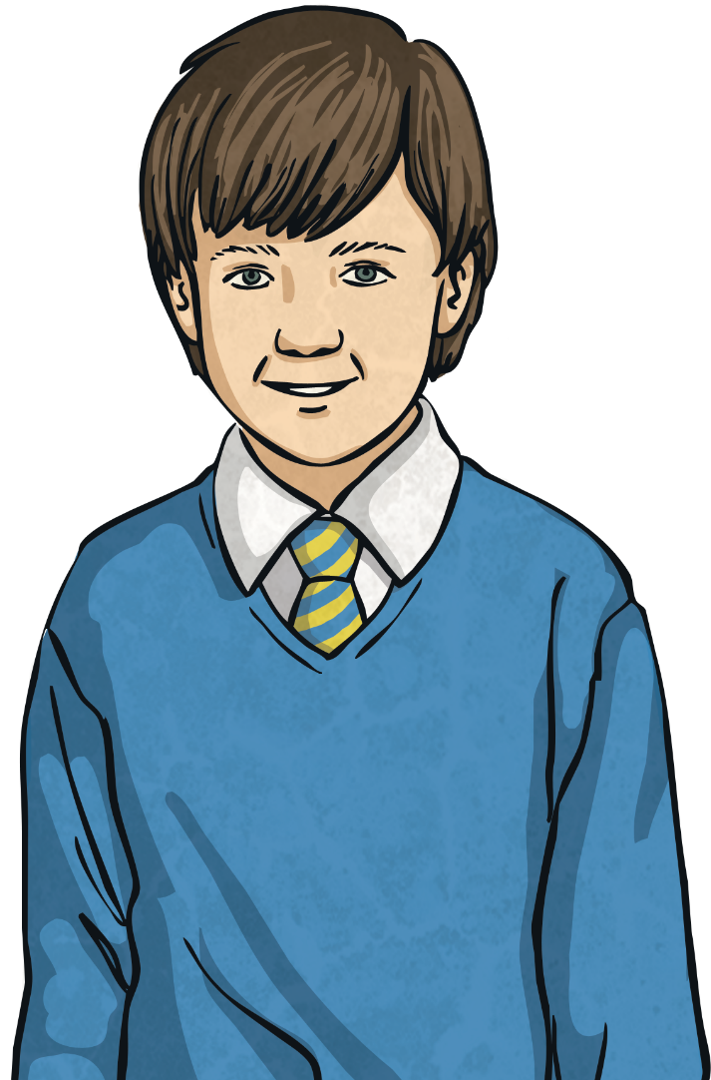
Character Traits
After reading about a character’s actions and words, we can use those clues to determine a character’s traits.
Positive
Negative
Thoughtful
Helpful
Persevering
Greedy
Impolite
Dishonest

Slide 6
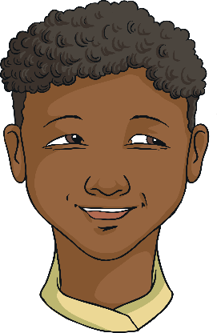
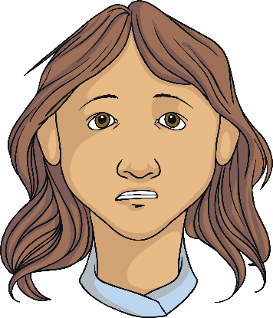
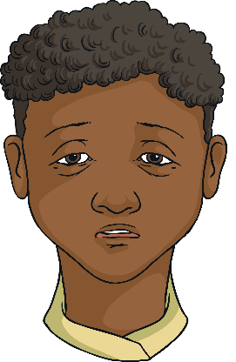

Character Feelings
A character’s feelings are different to a character’s traits.
A character’s traits describe the character’s personality. These are usually seen through their actions, such as: confident, smart, inconsiderate.
A character’s feelings are their response in that moment to actions around them, such as: scared, annoyed, embarrassed.
We would not normally use ‘feeling words’ to describe a character’s traits.

Slide 7
Character Change
During many stories, characters change and develop as the plot unfolds.
For example, in the beginning of a story, a character may seem rude but an important event may change their personality. This often leads to them developing into a more positive, kinder individual.
Alternatively, some characters may begin their stories appearing to be helpful or kind but the events of their journey leave them struggling to remember how to be good.
What examples of change have you read in a book or seen in a movie?

