Slide 1
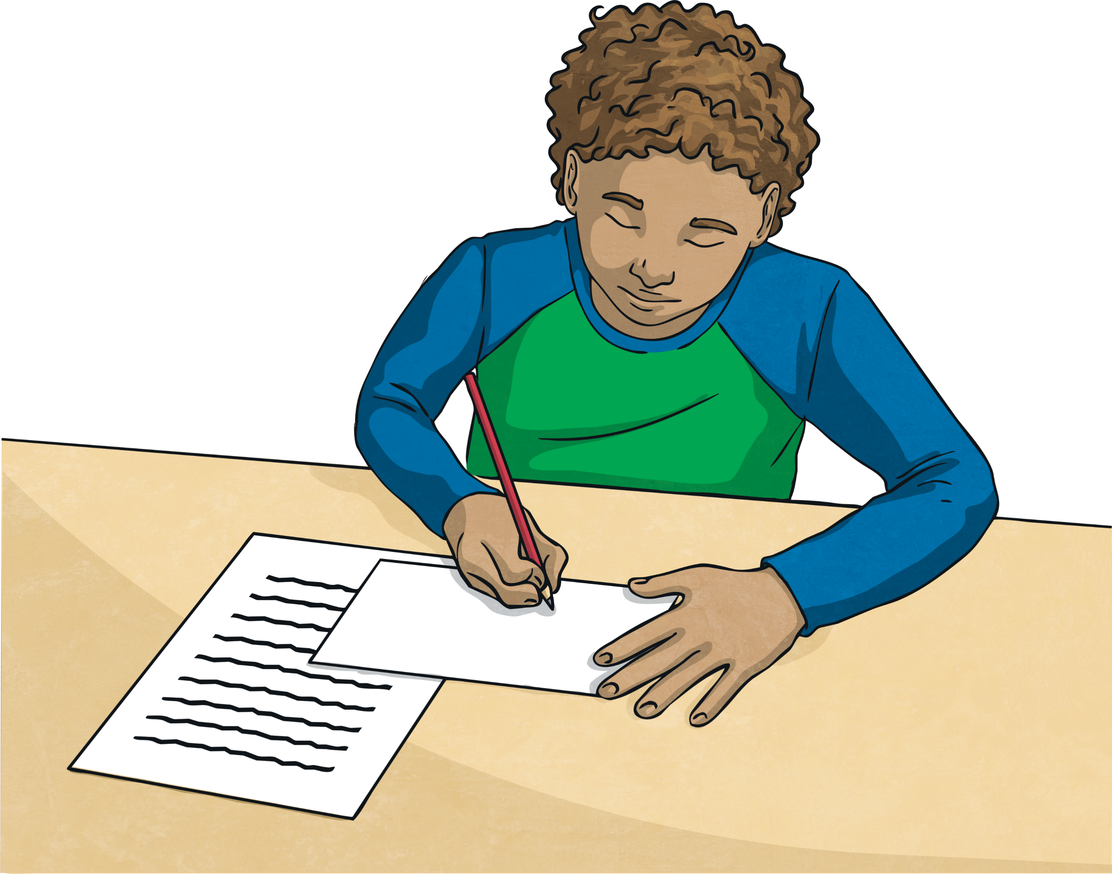
Part 2: Useful Words and Phrases
Now you have completed your list of For and Against points, you are almost ready to write your argument.
Balanced arguments require you to use formal and technical language, so before you get started, here are a few useful words and phrases that may help…

Slide 2
Useful Words and Phrases
Causal/contrasting conjunctions and adverbials
Here are some useful words and phrases to help you write your argument
Firstly | Secondly | On the one hand | As a result | Because
Consequently | Due to | For this reason | Hence | Thus
In consequence | In order to | In this way | Otherwise | An outcome of
Since | So that | Subsequently | Therefore | Although
Though | Even though | While | On the other hand | However
Despite this | Nevertheless | Otherwise | On balance | In conclusion

Slide 3

Introducing Your Argument
To begin writing your argument, we need an opening paragraph. This needs to introduce the argument in a clear, concise and interesting way.
Here’s the opening paragraph in the example:
Anyone who has ever been to school knows what it is like to be sent home with piles of homework. For years, teachers have been setting extra maths, spellings and other assignments to be completed outside of regular lesson times. But with the increasing pressures of modern day life, there is a growing call for homework to be banned. Here are some of the arguments for and against.
You need to introduce the issue in your argument now. Remember, set out the argument clearly!
Explaining what you will be doing in the balanced argument
Introducing argument
Third person

Slide 4

Writing the Argument
Once you have written the introduction to the argument, you then have to write about the different points.
Use your for and against plan to help organise your writing. After the introduction, start a new paragraph with a ‘for’ argument. Remember to write in the third person and to use formal language.
On the next paragraph, write an opposing view from the ‘against’ column of your plan.
Continue this way until you have argued all your points in an equal, balanced way.
Then, it’s time for the final paragraph…

Slide 5
Final Paragraph
The final paragraph is a bit different. It concludes the argument and includes your own opinion. It is written in the first person (I).
Here is the final paragraph in the example.
In conclusion, there are many strong arguments for and against banning homework from schools. If it helps a child’s education, then surely homework is a good thing. Then again, time away from studying to play is also incredibly important to a child’s wellbeing. On balance, I don’t believe homework should be banned because it really is an important part of learning. However, I also believe there should still be time in the day for fun! Therefore, perhaps schools should come up with a compromise: keep homework, but don’t set so much!
Now write the final paragraph for your argument.
Concluding
the argument
Your opinion
First
person

