Slide 1

What Is a Balanced Argument?
A balanced argument looks at different points of view on an issue, providing arguments for and against. It presents a balanced set of arguments without leaning one way or the other.
When writing a balanced argument, it is important to remember that it doesn’t matter whether you are for or against the issue to begin with. You must present both sides of the argument fairly.
Then, in the final paragraph, after balancing both sides of the argument, you can state which side you agree with.

Slide 2
What Makes a Good Balanced Argument?
It needs:
an introduction;
opposing views of for and against;
supporting evidence;
a concluding paragraph that includes the writer’s own
opinion; to be interestingly written.
It should have:
a mixture of causal conjunctions and adverbials.
It has to be:
written in the third person (except final paragraph);
written using formal and technical language.

Slide 3



Should Homework Be Banned?
Let’s take a look at an example…
Here is a balanced argument about whether homework should be banned!
You may already have an opinion but wait until you’ve heard both sides of the argument before making your final choice!

Slide 4

Should Homework Be Banned?
Anyone who has ever been to school knows what it is like to be sent home with piles of homework. For years, teachers have been setting extra maths, spellings and other assignments to be completed outside of regular lesson times. But with the increasing pressures of modern day life, there is a growing call for homework to be banned. Here are some of the arguments for and against.
Many people see homework as an important part of school life; almost like an extension of the lesson. If the teacher cannot fit everything that is needed to be taught into the lesson, then being able to set homework is essential. This way, pupils can continue the learning at home, which in turn helps their understanding and knowledge of the subject.
In fact, recent research shows a positive link
between the amount children do for homework
and their achievement levels.

Slide 5
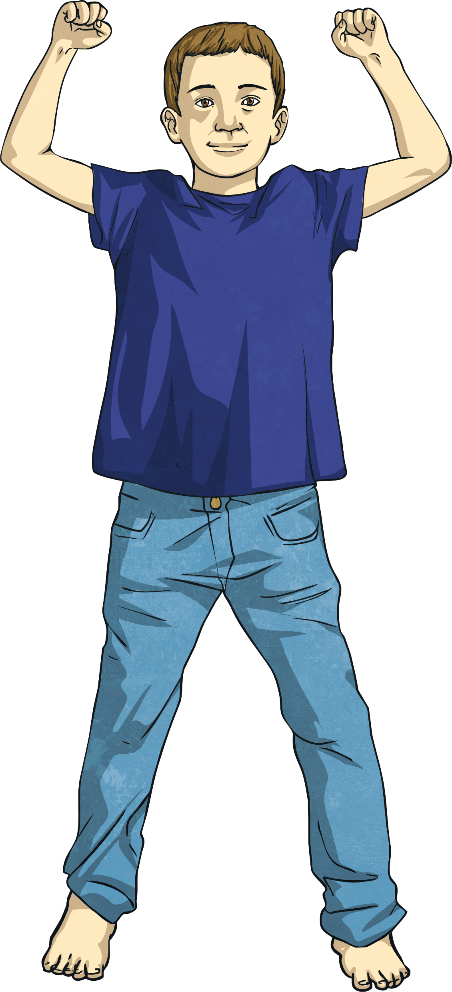
Should Homework Be Banned?
On the other hand, aren’t children entitled to a break from learning? After spending all day at school, a few hours ‘downtime’ spent watching television, playing computer games or exercising outside is essential for a healthy, fun-loving child. In fact, the government’s own health guidelines recommend people aged between 5-18 should exercise for at least 60 minutes a day. Where are children going to fit that in if they are busy doing homework every evening?
While there are a lot of people that understand that argument, the fact remains that children go to school to be educated and many parents welcome the chance to support their child’s education at home. Practising spelling or helping their child read gives parents the opportunity to play a part in their child’s learning. It also gives them a clearer understanding of how their child is progressing. Similarly, a lot of children enjoy doing homework with their parents. Why introduce a blanket ban if some children and parents actually enjoy it?

Slide 6
Should Homework Be Banned?
The flip side of the argument is that many parents feel overwhelmed with the amount of homework their child brings home. With so many after school activities and clubs on offer, they feel there isn’t enough time to fit everything in. Furthermore, due to ever-increasing government expectations, parents sometimes feel unable to help their child as the work is too hard or on a subject matter they are not familiar with.
In conclusion, there are many strong arguments for and against banning homework from schools. If it helps a child’s education, then surely homework is a good thing. Then again, time away from studying to play is also incredibly important to a child’s wellbeing. On balance, I don’t believe homework should be banned because it really is an important part of learning. However, I also believe there should still be time in the day for fun! Therefore, perhaps schools should come up with a compromise: keep homework, but don’t set so much!

Slide 7
Should Homework Be Banned?
Did you change your mind?
What do you think?
Which argument was stronger?

Slide 8
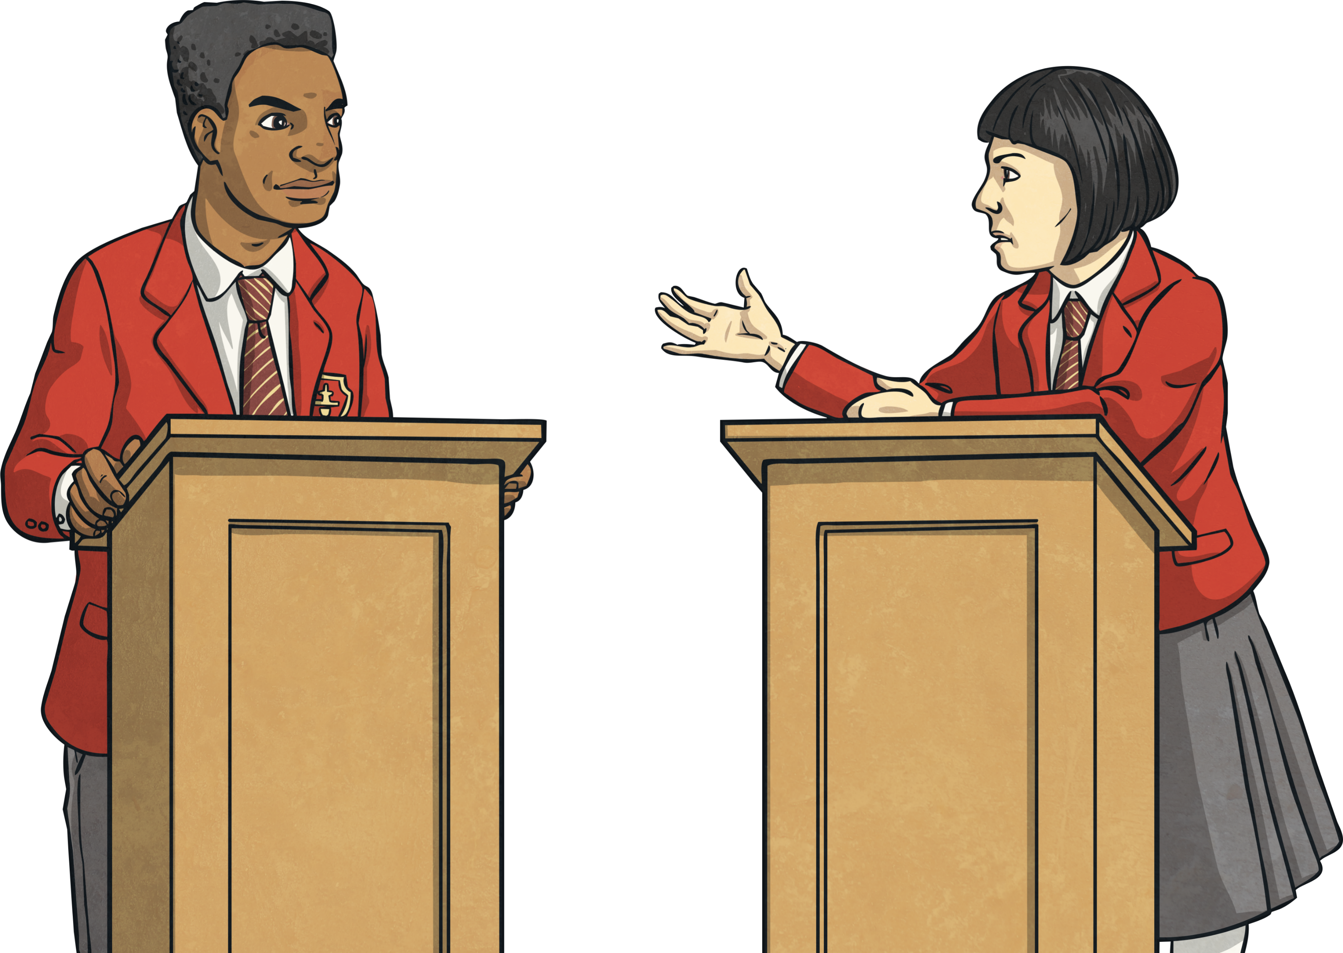
How Do You Write a Balanced Argument?
Firstly, you need a subject to write about. In the example, it was about whether homework should be banned.
Then you need to come up with the arguments for and against.
Here is a list of ideas you could write an argument about:
Should girls be allowed to play football with boys after the age of 12?
Should dogs be banned from parks?
Should school uniform be compulsory?
Should all children be entitled to pocket money?
Should children be limited to one hour's access to the internet per day?

Slide 9
Can you remember the first argument in the example? Look back and see.
The first argument in the example is that many people think homework is an important part of school life, and that it helps pupils continue their learning at home.
For and against… we need to note down the different sides of the argument.
Many people see homework as an important part of school life; almost like an extension of the lesson. If the teacher cannot fit everything that is needed to be taught into the lesson, then being able to set homework is essential. This way, pupils can continue the learning at home, which in turn helps their understanding and knowledge of the subject. In fact, recent research shows a positive link between the amount children do for homework and their achievement levels.
That needs to go on the planning sheet…
In the example, it’s all about whether banning homework is a good or bad idea. Your issue will have different arguments.

Slide 10
Write the title of your argument here
Should Homework Be Banned?
For | Against
Homework is an important part of school life and helps pupils continue their learning at home. (Research shows a positive link between homework and achievement levels.) Many parents like being a part of their child’s learning and welcome the chance to help them at home. | Children need time away from education, including time to play and do exercise. (Government guidelines: 60 minutes exercise a day.) Other parents feel overwhelmed with the amount of homework their child brings home. Some don’t understand it and struggle to find time to help their child.
Write your first argument here

Slide 11
Now we need to note down the other arguments.
You will also need supporting evidence to back up your argument.
Now note down all the for and against points for your argument.

