Slide 2
Aim
I can recognise and use compound sentences.
Success Criteria
I can recognise that a compound sentence contains two main (independent) clauses joined by a co-ordinating conjunction.
I can use ‘FANBOYS’ to remember the seven co-ordinating conjunctions.
I can write my own compound sentences.

Slide 3
Getting Started
What is a simple sentence?
A simple sentence is a group of words that expresses one complete thought. Every simple sentence must contain a subject and a verb. They can also be called a main or independent clause.
Can you spot the subjects and the verbs in these main/independent clauses?
Samira likes football.
Samira likes football.
Samira likes football.
subject
verb
Ben loves basketball.
Ben loves basketball.
Ben loves basketball.

Slide 4



Getting Started
Both of these main/independent clauses make sense on their own.
Samira likes football.
Ben loves basketball.
and
When we link them together with a co-ordinating conjunction, they form a compound sentence.

Slide 5
Getting Started
There are seven co-ordinating conjunctions that we can remember using the mnemonic ‘FANBOYS’.
for
and
nor
but
or
yet
so
Samira likes football.
?
Ben loves basketball.
Which other co-ordinating conjunctions could be used to link these two main/independent clauses?

Slide 6
Next Steps
for
and
nor
but
or
yet
so
It was time for maths.
?
My pencil broke.
Which co-ordinating conjunctions could be used to link these two main/independent clauses to create a compound sentence?
Is there one that fits best?
Are some co-ordinating conjunctions easier to use than others?

Slide 7
Next Steps
for
and
nor
but
or
yet
so
Luke had lots of friends.
?
He was a friendly boy.
Which co-ordinating conjunctions could be used to link these two main/independent clauses to create a compound sentence?
Is there one that fits best?
Are some co-ordinating conjunctions easier to use than others?

Slide 8
Next Steps
for
and
nor
but
or
yet
so
Sally practised her spellings.
?
She got full marks in
the test.
Which co-ordinating conjunctions could be used to link these two main/independent clauses to create a compound sentence?
Is there one that fits best?
Are some co-ordinating conjunctions easier to use than others?

Slide 9
Next Steps
for
and
nor
but
or
yet
so
?
You can choose strawberry
ice cream.
You can choose vanilla ice cream.
Which co-ordinating conjunctions could be used to link these two main/independent clauses to create a compound sentence?
Is there one that fits best?
Are some co-ordinating conjunctions easier to use than others?

Slide 10
Next Steps
for
and
nor
but
or
yet
so
We can go swimming.
?
We can’t jump in the pool.
Which co-ordinating conjunctions could be used to link these two main/independent clauses to create a compound sentence?
Is there one that fits best?
Are some co-ordinating conjunctions easier to use than others?

Slide 11
Next Steps
for
and
nor
but
or
yet
so
Max didn’t want to be late.
?
He hurried
to school.
Which co-ordinating conjunctions could be used to link these two main/independent clauses to create a compound sentence?
Is there one that fits best?
Are some co-ordinating conjunctions easier to use than others?

Slide 12
Compound Sentence Hunt
Can you spot the compound sentences in this piece of text?
Which co-ordinating conjunctions have been used?
It was a hot, sunny day and the park was very busy. Izaac played on the swings but he didn’t go on the vertical slide. It was too scary. It was soon dinner time so Dad got out their picnic. Izaac could have ham sandwiches or he could have cheese sandwiches. He chose cheese for he loved the stuff! There was soon no food left so Izaac went back on the swings. He would have liked a turn on the rope swing yet there was a big queue. Dad said it was time to go home. Izaac rode his scooter through the park gates and he smiled.
It was a hot, sunny day and the park was very busy. Izaac played on the swings but he didn’t go on the vertical slide. It was too scary. It was soon dinner time so Dad got out their picnic. Izaac could have ham sandwiches or he could have cheese sandwiches. He chose cheese for he loved the stuff! There was soon no food left so Izaac went back on the swings. He would have liked a turn on the rope swing yet there was a big queue. Dad said it was time to go home. Izaac rode his scooter through the park gates and he smiled.
It was a hot, sunny day and the park was very busy. Izaac played on the swings but he didn’t go on the vertical slide. It was too scary. It was soon dinner time so Dad got out their picnic. Izaac could have ham sandwiches or he could have cheese sandwiches. He chose cheese for he loved the stuff! There was soon no food left so Izaac went back on the swings. He would have liked a turn on the rope swing yet there was a big queue. Dad said it was time to go home. Izaac rode his scooter through the park gates and he smiled.
Ben loves basketball.

Slide 13
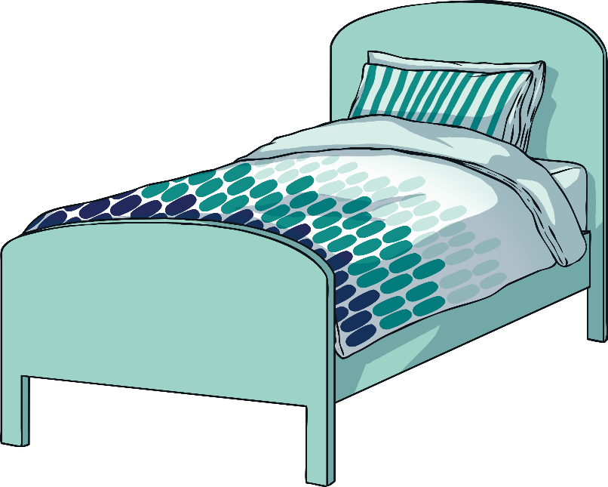
Practise Your Skills
Now, it’s your turn. How could you add a co-ordinating conjunction and another main/independent clause to create a compound sentence?
My bed
was very comfortable.
for
and
nor
but
or
yet
so
?

Slide 14
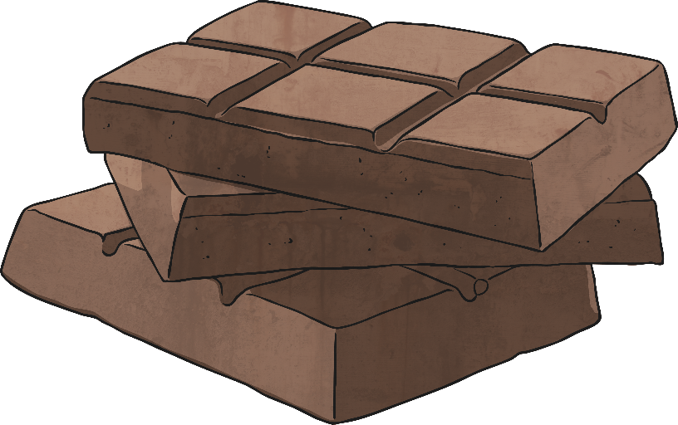
Practise Your Skills
How could you add a co-ordinating conjunction and another main/independent clause to create a compound sentence?
for
and
nor
but
or
yet
so
I love to eat chocolate.
?

Slide 15
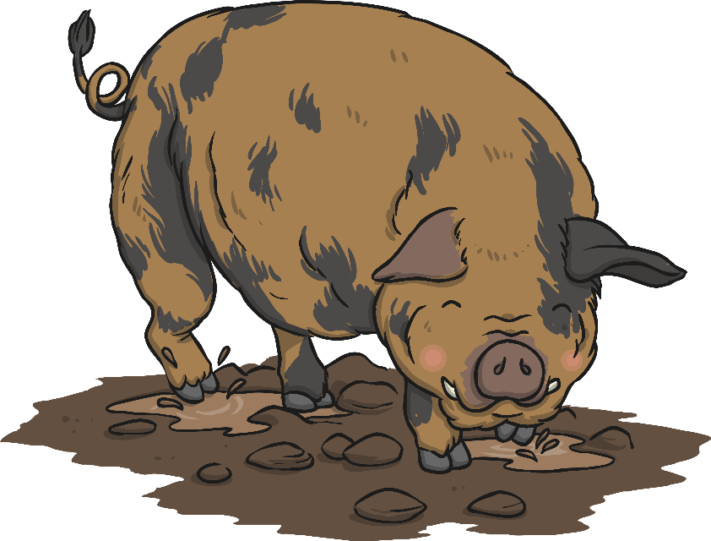
Practise Your Skills
How could you add a co-ordinating conjunction and another main/independent clause to create a compound sentence?
for
and
nor
but
or
yet
so
The pig rolled in the mud.
?

Slide 16
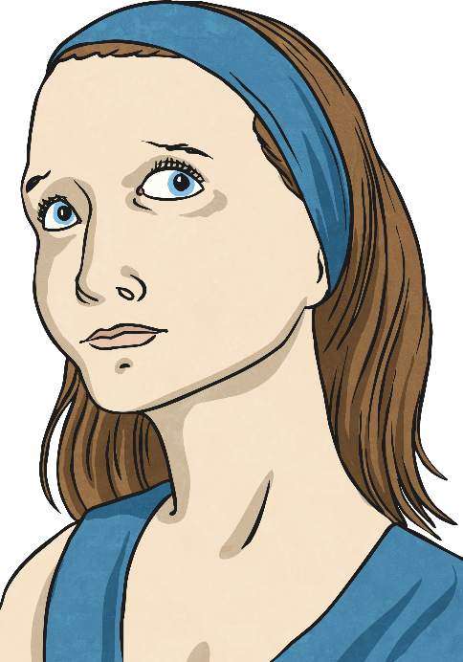
Practise Your Skills
How could you add a co-ordinating conjunction and another main/independent clause to create a compound sentence?
There was a mysterious sound.
for
and
nor
but
or
yet
so
?

Slide 17
Let’s Play
Click on two rectangles to reveal two different main/independent clauses. Can you combine them using a co-ordinating conjunction to create a sensible compound sentence?
Sam was feeling very hungry.
There was a knock on the door.
He ate a huge piece of chocolate cake.
There was no one there.
He felt very poorly.
It was a very loud noise.
Grandad went to the doctors.
My Uncle Tony snores.
The dustbin blew over.
I couldn’t get to sleep.
Everyone laughed.
My curtains were not closed.
The circus clown was hilarious.
The light shone.
It was a beautiful day.
The wind was very strong.
Reset

Slide 18
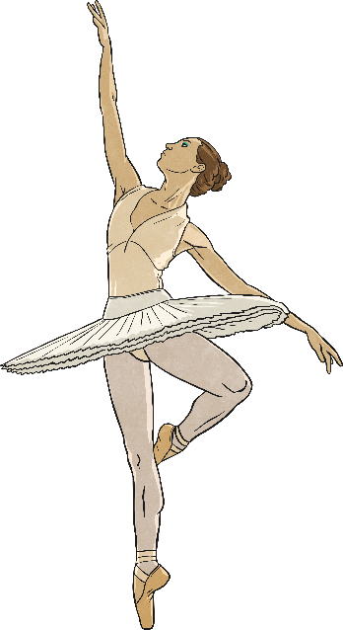
Quick Quiz: Question 1
Can you spot the co-ordinating conjunctions in these sentences?
a) Freddie was playing on his tablet but he suddenly dropped it.
a) Freddie was playing on his tablet but he suddenly dropped it.
b) Olivia was a fantastic dancer for she practised every day.
b) Olivia was a fantastic dancer for she practised every day.
c) Nick dreamed of being a film star so he went to drama school.
c) Nick dreamed of being a film star so he went to drama school.

Slide 19
Quick Quiz: Question 2
Complete the sentences below by writing the co-ordinating conjunctions from the box in the correct places to form compound sentences. Use each conjunction only once.
or
but
and
You can bring a drink on the trip
don’t bring fizzy pop.
You can bring a drink on the trip but
don’t bring fizzy pop.
Would you like to sit next to Cassie would you
like you own seat on the coach?
Would you like to sit next to Cassie or would you
like your own seat on the coach?
Make sure you remember your packed lunch try to
remember a waterproof coat.
Make sure you remember your packed lunch and try to
remember a waterproof coat.

Slide 20
Quick Quiz: Question 3
Can you remember all of the co-ordinating conjunctions that you can use to make co-ordinating conjunctions?
for
and
nor
but
or
yet
so

Slide 21
Aim
I can recognise and use compound sentences.
Success Criteria
I can recognise that a compound sentence contains two main (independent) clauses joined by a co-ordinating conjunction.
I can use ‘FANBOYS’ to remember the seven co-ordinating conjunctions.
I can write my own compound sentences.

