Slide 2
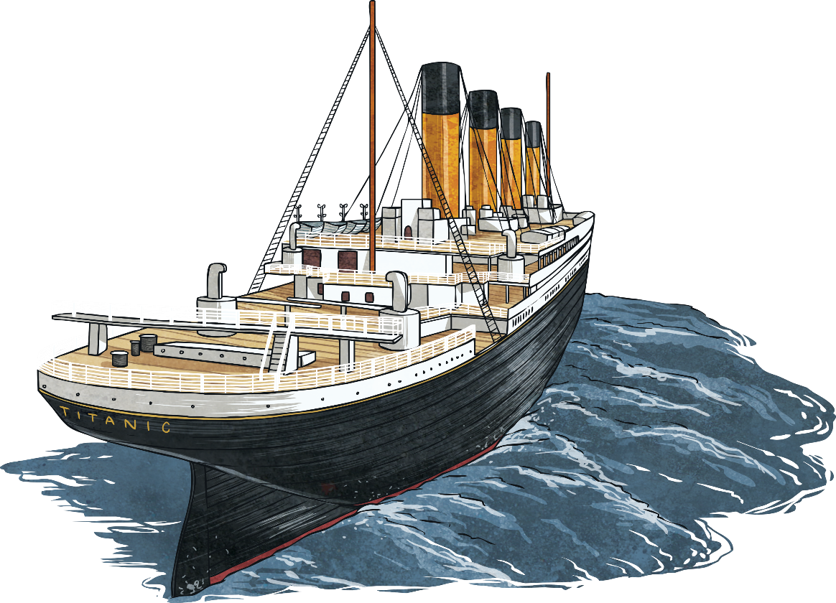
Thomas Morrow
It may be surprising for a ship with such established links to Ulster but there was only one passenger from the province on the Titanic.
Thomas Rowan Morrow was born in the
early 1880s and was from Drumlough,
Rathfriland, in County Down.
He was 31 years old when he
boarded the Titanic.

Slide 3
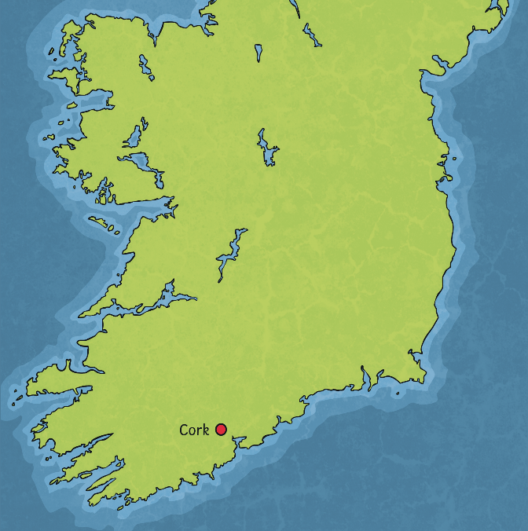

Thomas Morrow
In the early twentieth century, the vast majority of people from Ulster who emigrated to America, departed from Donegal or other places closer to home.
Thomas Morrow instead travelled to Queenstown
(now known as Cobh) in County Cork to
board the Titanic.

Slide 4
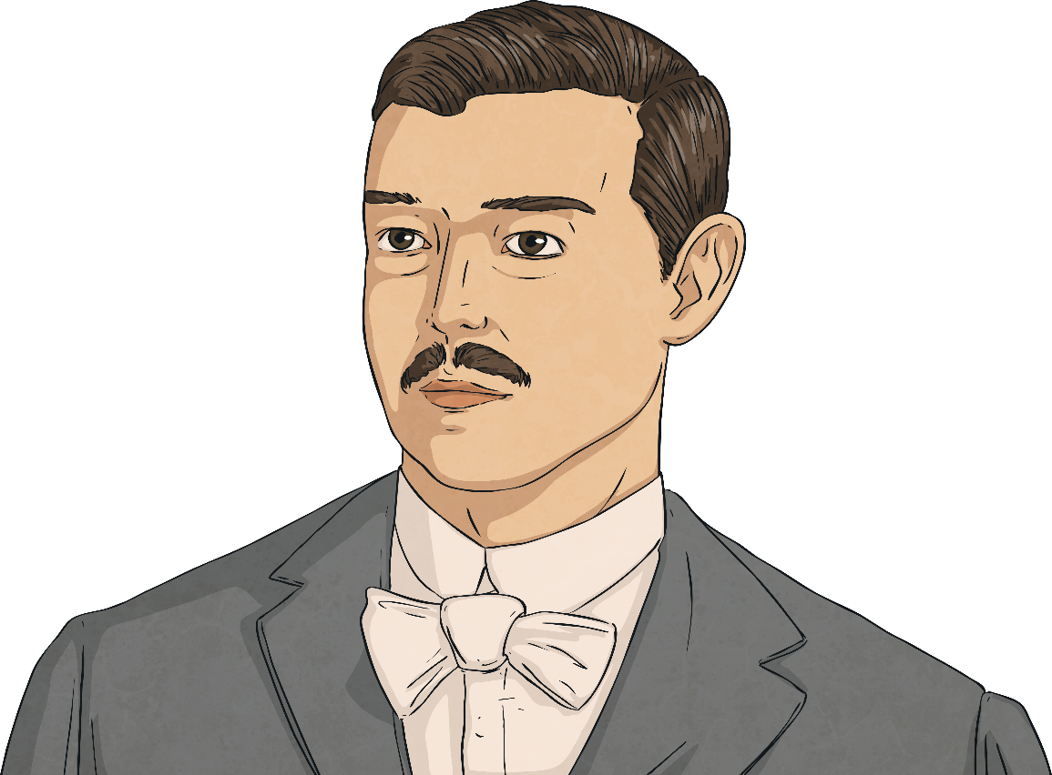
Thomas Morrow
It is not known why Thomas travelled to Queenstown. Out of 113 Irish passengers on board the ship, he was the only one from Ulster.
Family members believe that Thomas’ intention was to join his brother Waddell (who worked as a ranch hand)
near Alberta in Canada.
Thomas’ second cousin was to meet him
in New York and host him until he could
arrange travel to Alberta.

Slide 5
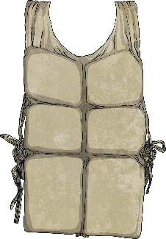
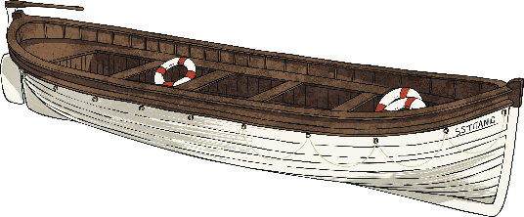
Thomas Morrow
Thomas paid £7, 15 shillings for ticket number 372622.
Sadly, only 75 male passengers survived
the tragedy.
Thomas Rowan Morrow was one of the
dead and his body was never recovered.
To mark the centenary of the sinking, Drumlough Loyal Orange Lodge, where Thomas had once been Worshipful Master, commissioned a bannerette in his memory.

