Slide 2
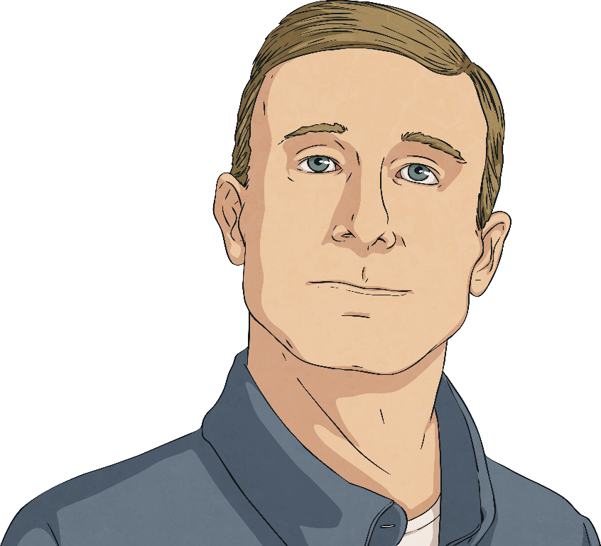
Robert Hopkins
Robert Hopkins was born in Belfast in 1868.
He immigrated to the USA at the turn of the century.
Aged 43, he was an able-seaman on the Titanic.
Robert was asleep when the ship hit the iceberg.

Slide 3
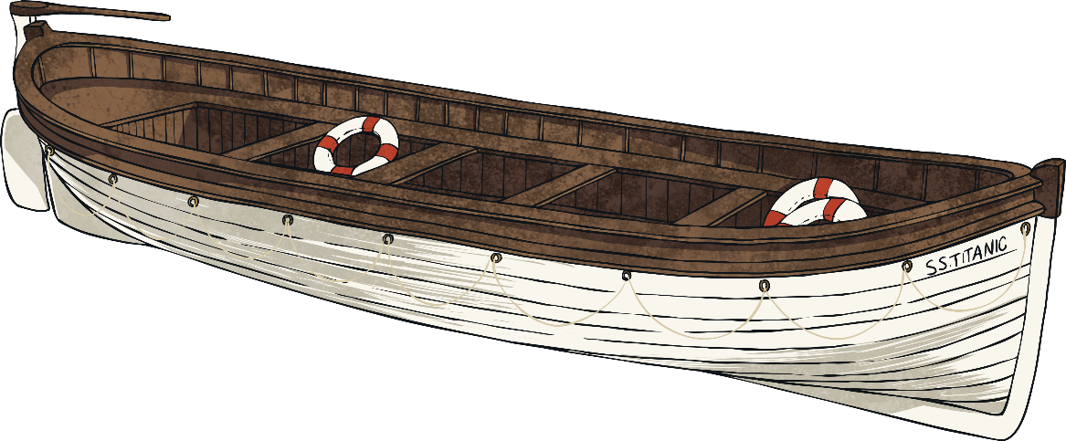
Robert Hopkins
As the crew tried to help the passengers, First Officer William Murdoch asked Robert to board lifeboat 13 and help load and launch it.

Slide 4
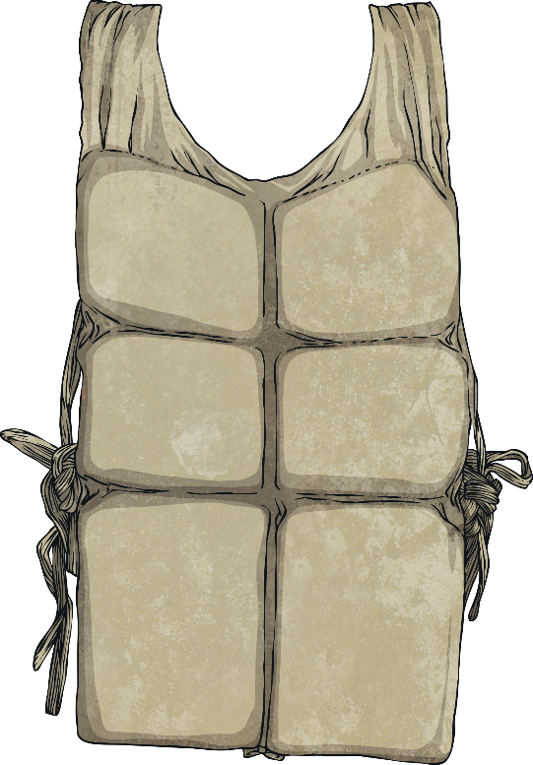

Robert Hopkins
In the midst of the panic surrounding the lifeboat launches, lifeboat 15 was being lowered down with lifeboat 13 underneath it.
Everyone aboard lifeboat 13 was in peril of being crushed and lifeboat 15 was also in danger of collapsing.

Slide 5
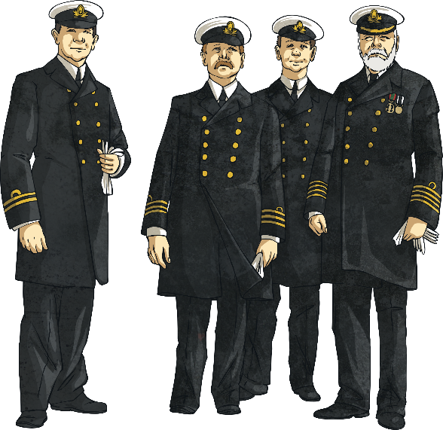
Robert Hopkins
Robert and another crew member, registering what was happening, used a penknife to cut the ropes supporting their lifeboat, therefore averting additional disaster.
The men are credited with saving 103 people who may otherwise have been crushed or thrown into the icy water.

Slide 6
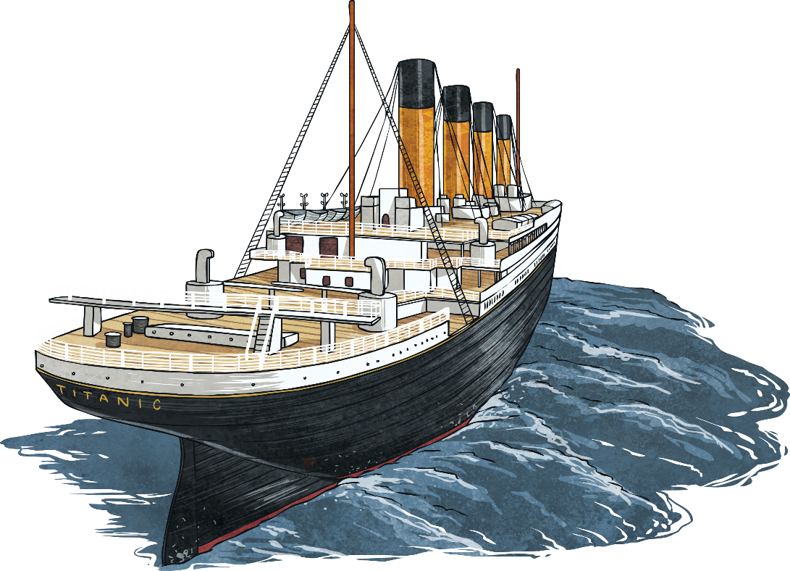

Robert Hopkins
Robert Hopkins survived the Titanic tragedy and went on to live to the age of 74.
He died in 1943 and was buried in New Jersey, in the USA.

Slide 7
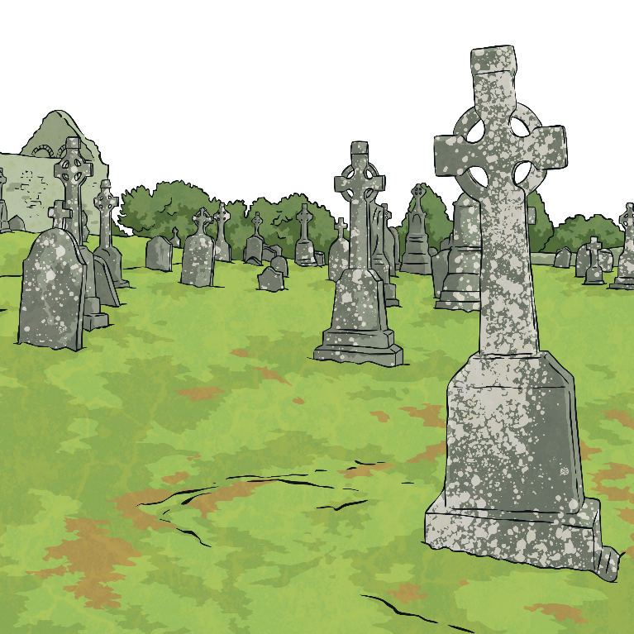
Robert Hopkins
When members of Titanic International Society visited the cemetery where Robert was buried, they were shocked to discover that the man they considered a hero lay in an unmarked grave.

Slide 8
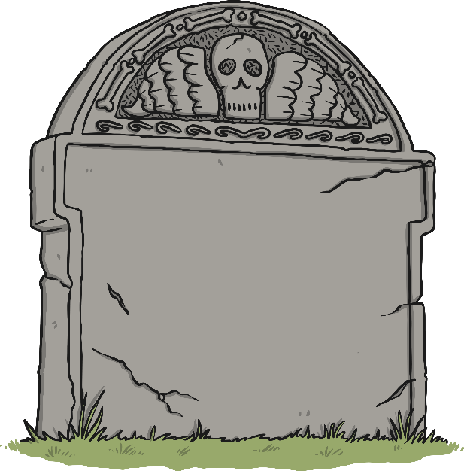
Robert Hopkins
The society later unveiled a black granite headstone for Robert at a ceremony attended by some of his descendants.
The tribute on the gravestone reads:
Beloved father Robert John Hopkins;
able-bodied seaman and survivor of RMS Titanic;
November 30, 1868-November 17, 1943.
Underneath this are the words,
Nearer my God to Thee.

