Slide 2
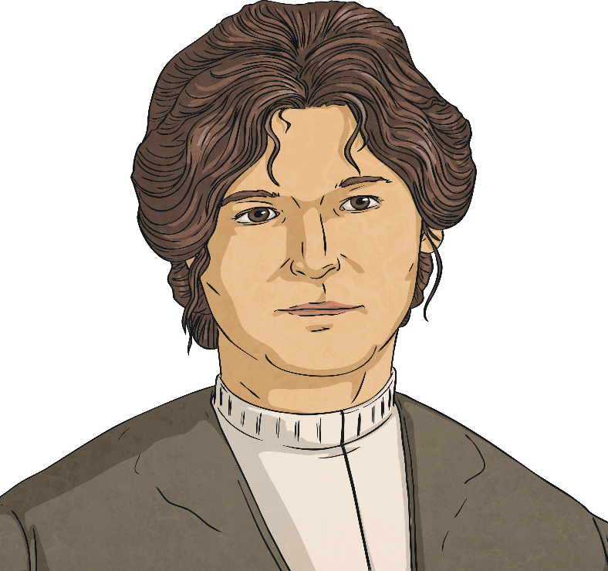
Mary Sloan
Mary Jane Sloan was born at Little Patrick Street in Belfast.
Her father was called John Sloan and he was
a van and cab driver. Her mother was
named Mary Todd.
Her parents had married in 1854, in
Ballyeaston, near Ballyclare, in
County Antrim.

Slide 3
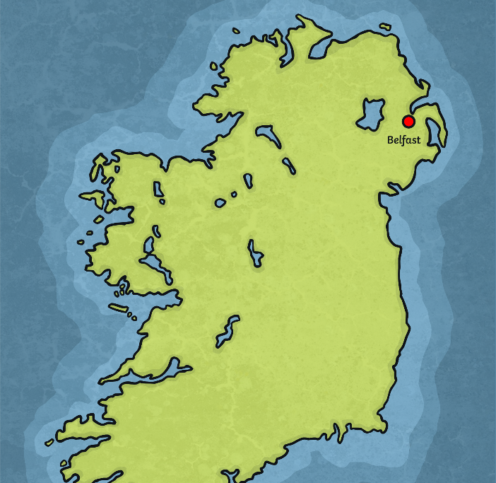
Mary Sloan
Mary's father died in 1889 and, at that time, the family were living at Earl Place, Belfast.
There is information about Mary and her
mother in the 1901 census. They were
recorded as living at London Road
in Belfast.
Mary worked as a stewardess on the
ferry that sailed between Belfast and
Liverpool, the SS Magic.
By the 1911 census, Mary and her mother were
living on Lomond Avenue in Belfast.
Mary’s occupation was listed as a stewardess on the Liverpool boats.

Slide 4
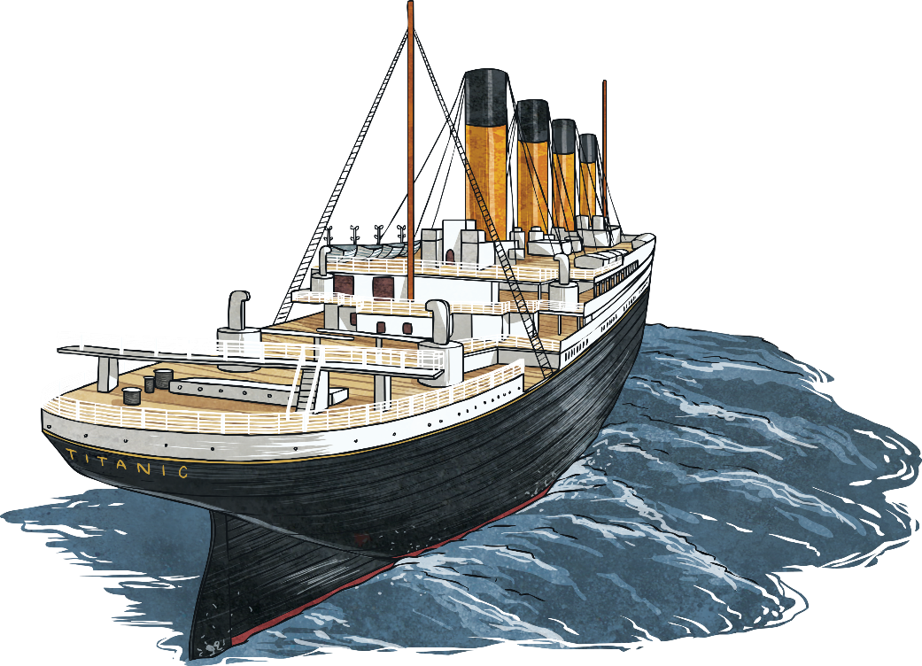
Mary Sloan
Mary signed on to the Titanic in Southampton, giving her sister Margaret’s address.
She wrote that the last ship she had worked on
was Titanic’s sister ship, the Olympic.
Mary had been on board the Olympic when
it collided with HMS Hawke, near the Isle
of Wight, on the 20th September 1911.

Slide 5
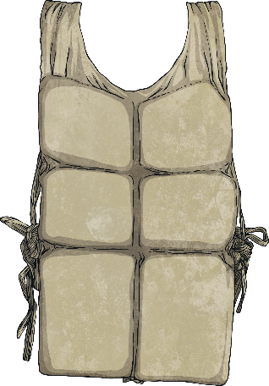
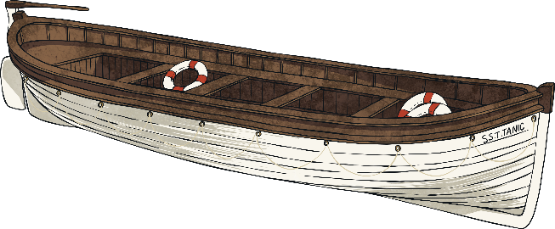
Mary Sloan
Mary Sloan survived the Titanic disaster.
She sent a cablegram to a relative in England, containing just one word - safe.
She also wrote to her family in Belfast, saying,
‘I expect you will be glad to hear from me once more and to know I am still in the land of the living’.
In this letter, Mary wrote about the
Titanic disaster.

Slide 6

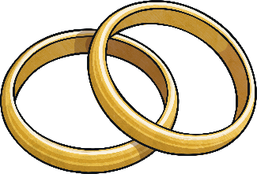
Mary Sloan
After returning to Belfast in May 1912, Mary later went to visit her sister Margaret in Canada, in 1916.
Mary crossed from Canada to the USA in
August 1916, travelling to Ohio.
In 1919, she got married to a divorcee
named William Angus Gleason.

Slide 7
Mary Sloan
It is thought that Mary and William spent some time living in Iowa, before settling in Vancouver in Canada.
In 1929, Mary made a return visit to Belfast, travelling with
her husband.
After William died in 1944, Mary once more returned to Belfast from Canada. She lived in the city with her sister Elizabeth’s daughter.
Mary’s sister Elizabeth died in 1947 and her sister
Margaret died in 1949.

Slide 8
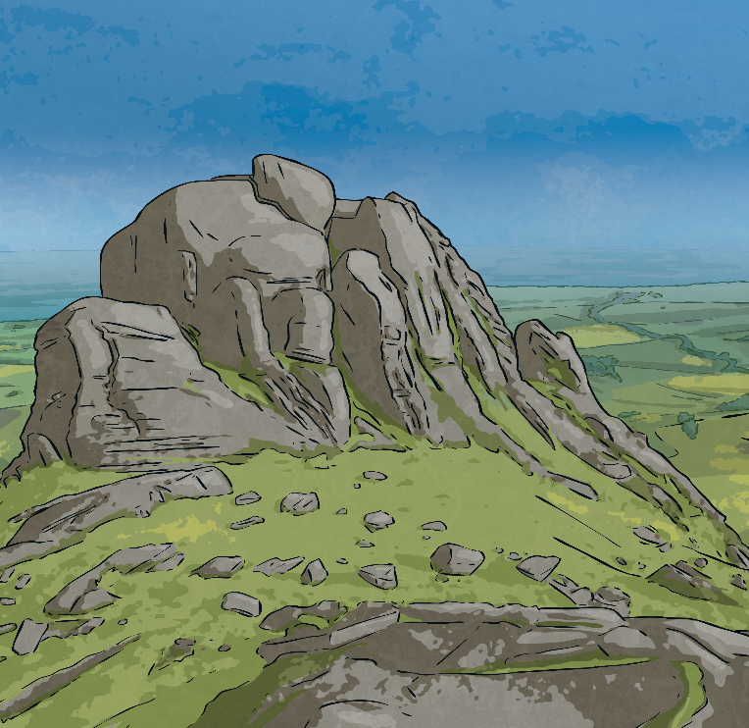
Mary Sloan
Mary died in February 1953.
It is believed that she was 86 when she died but it is difficult to be certain, as her age seemed to be recorded inaccurately at different times of her life and career.
Mary was buried in Dundonald
Cemetery in County Down.

