Slide 1


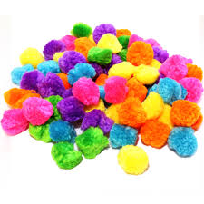
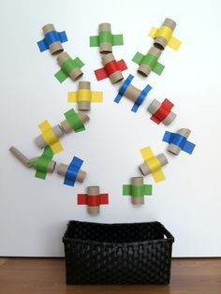

The Toilet Roll Post
If you are wondering what to do with your empty loo rolls take a look at some of these activity ideas
Pom Pom
Drop
Easter Bunny activity

Slide 2
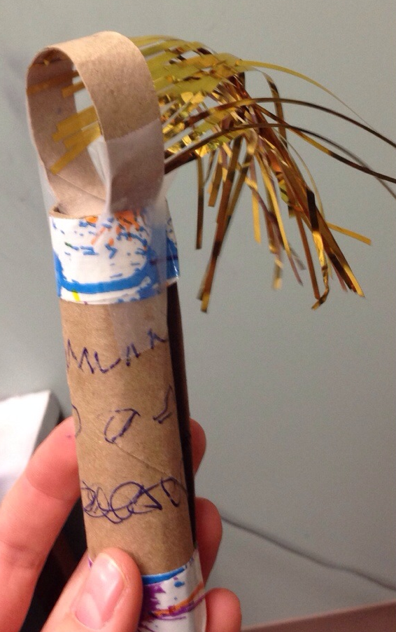
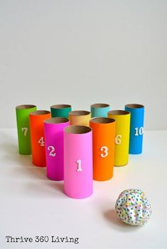
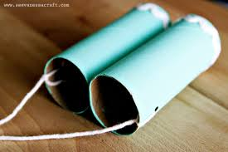
The Toilet Roll Post
Breathing
Wand
Bowling
Binoculars

Slide 3
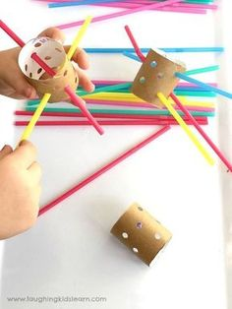
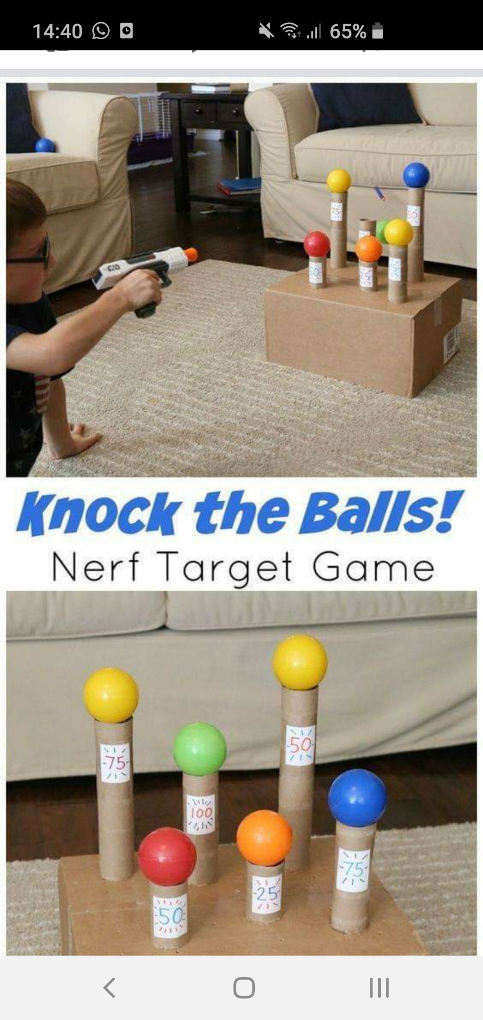
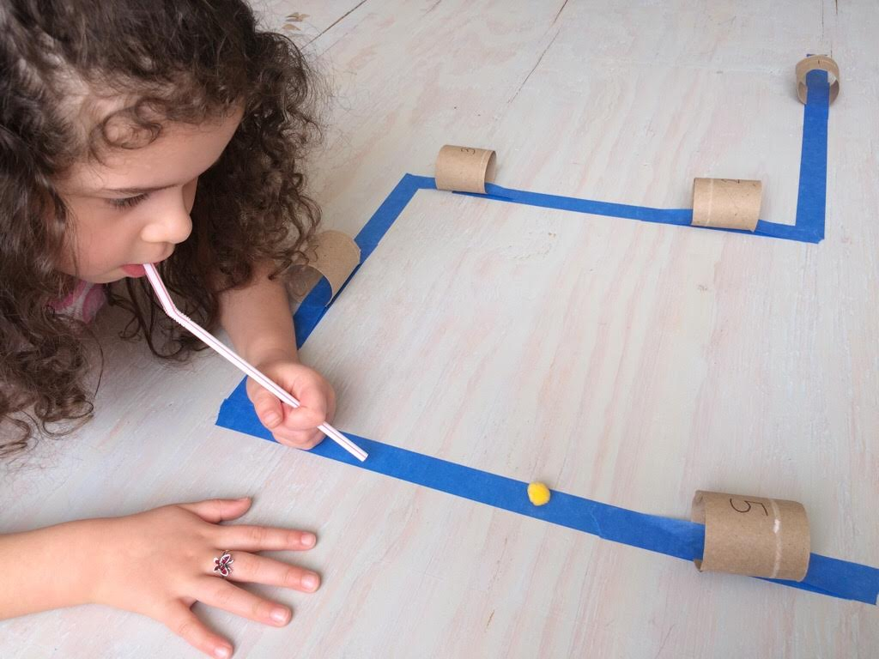
The Toilet Roll Post
Fine Motor
Activity
Knock em’’
Down
Obstacle
Course

