Slide 1

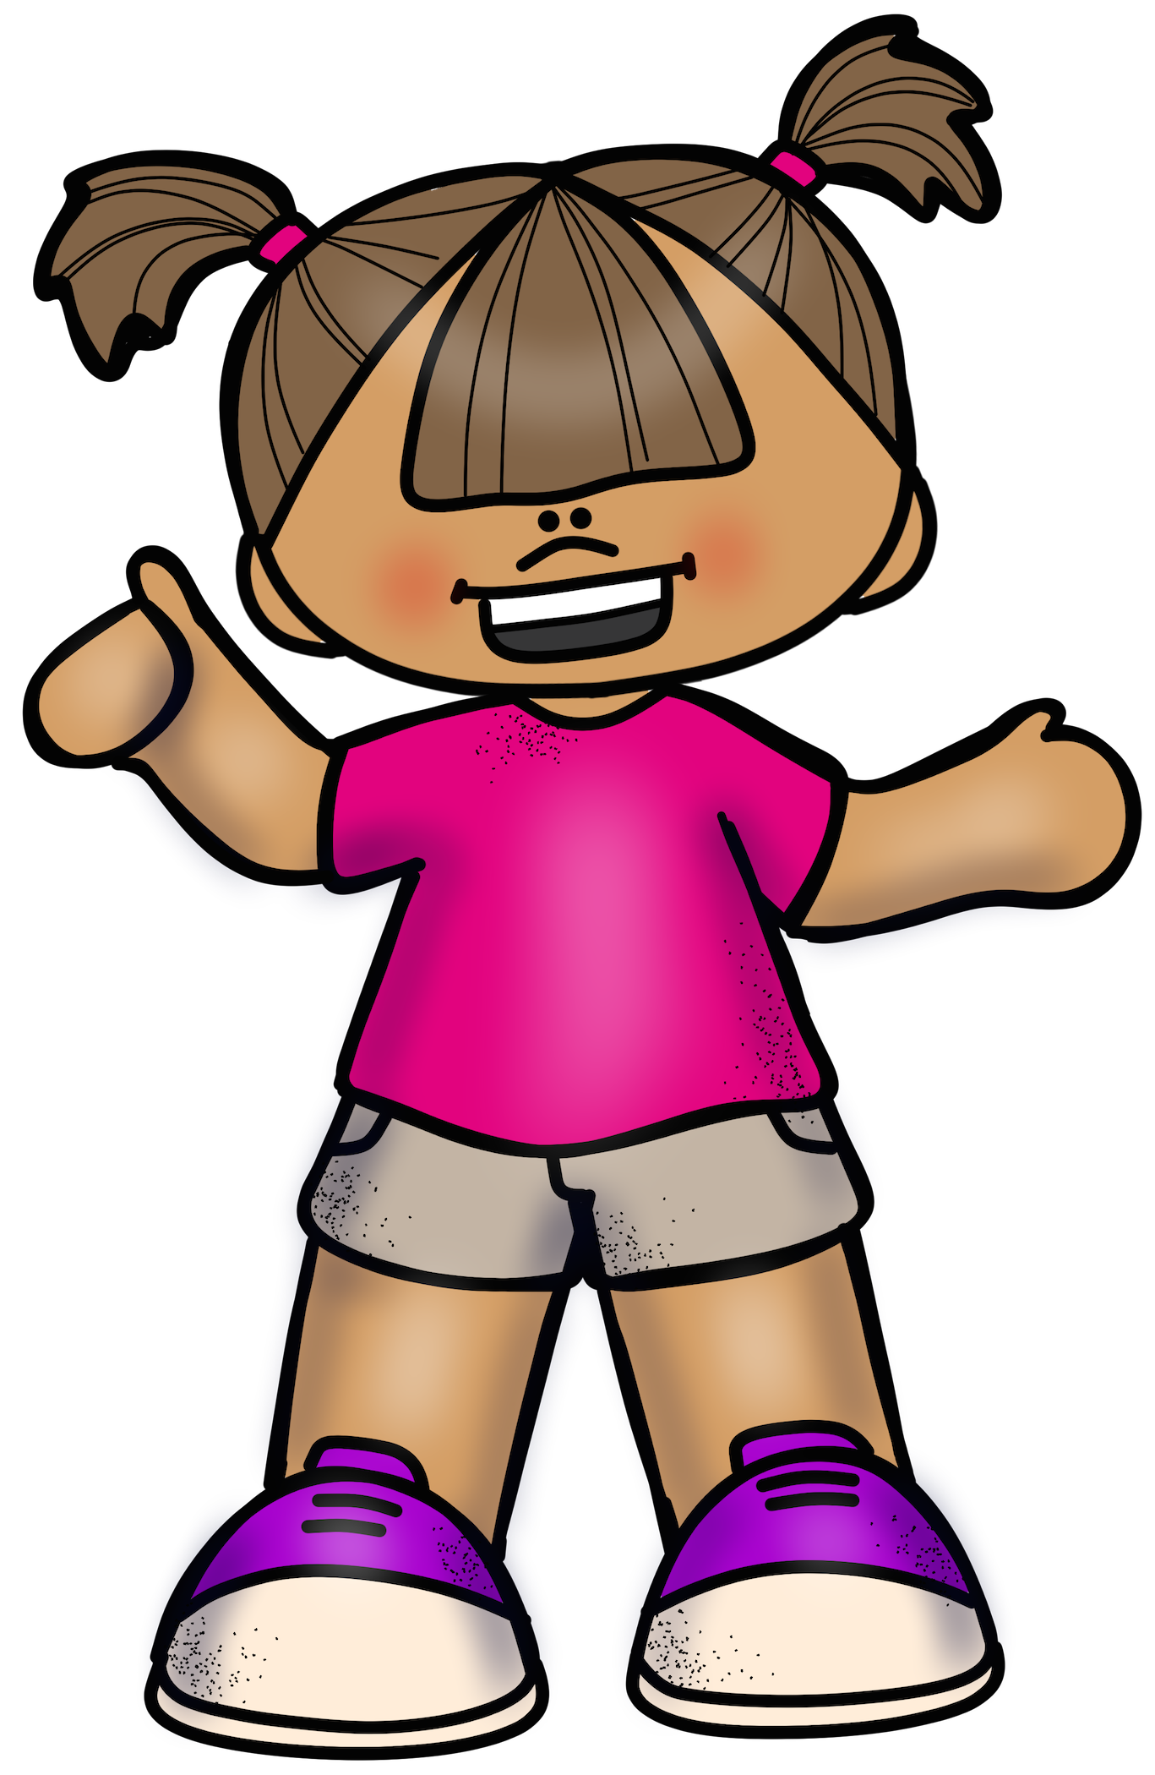
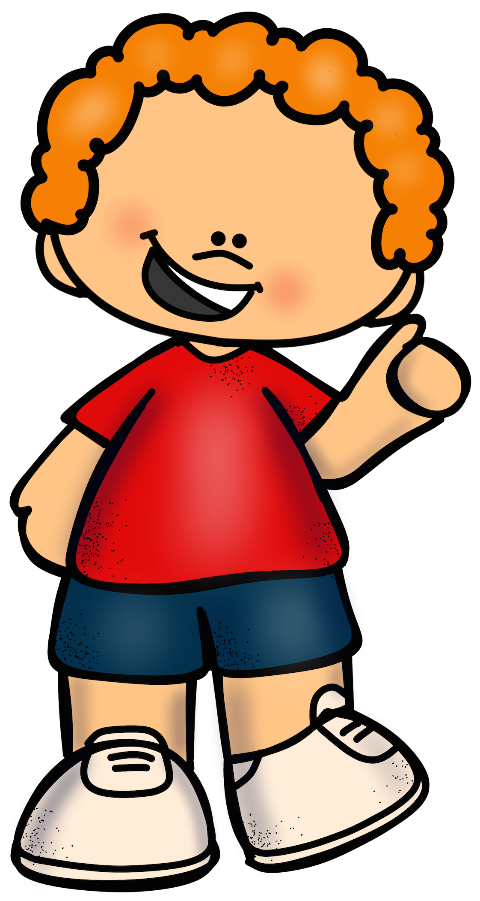
Mental Maths

Slide 2
Shout a number greater than 23

Slide 3
Whisper a number less than 30

Slide 4
In a silly voice say the number that comes in between 39 and 41

Slide 5
Crossly say a number greater than 42

Slide 6
Squeak a number less than 37

Slide 7
True or False?
17 is greater than 27

Slide 8
True or False?
26 is less than 43

Slide 9
True or False?
19 is greater than 29

