Slide 2
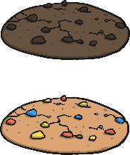



Division
Share the cookies equally between the children.
?
How many cookies do Bobby and Serena get each?
Bobby
Serena

Slide 3


Division
Share the slices of pizza equally between the plates.
?
How many slices of pizza per plate?
Plate 1
Plate 2

Slide 4
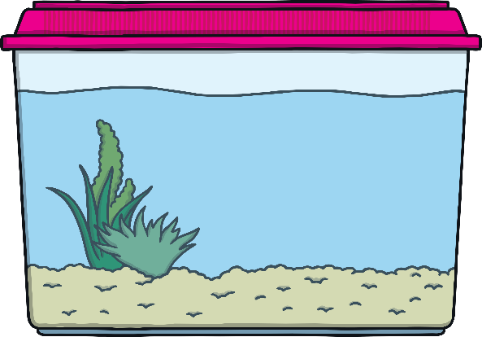

Division
Share the fish equally between the tanks.
?
How many fish per tank?

Slide 5
Division
Share the fish equally between the tanks.
?
How many fish per tank now?

Slide 6




Division
Share the strawberries equally between Anne and Sanjeev.
?
How many strawberries per person?
Anne
Sanjeev

Slide 7



Division
Share the worms between the birds.
?
How many worms does each bird get?
Bird 1
Bird 2

