Slide 2
All about the Number…
17

Slide 3


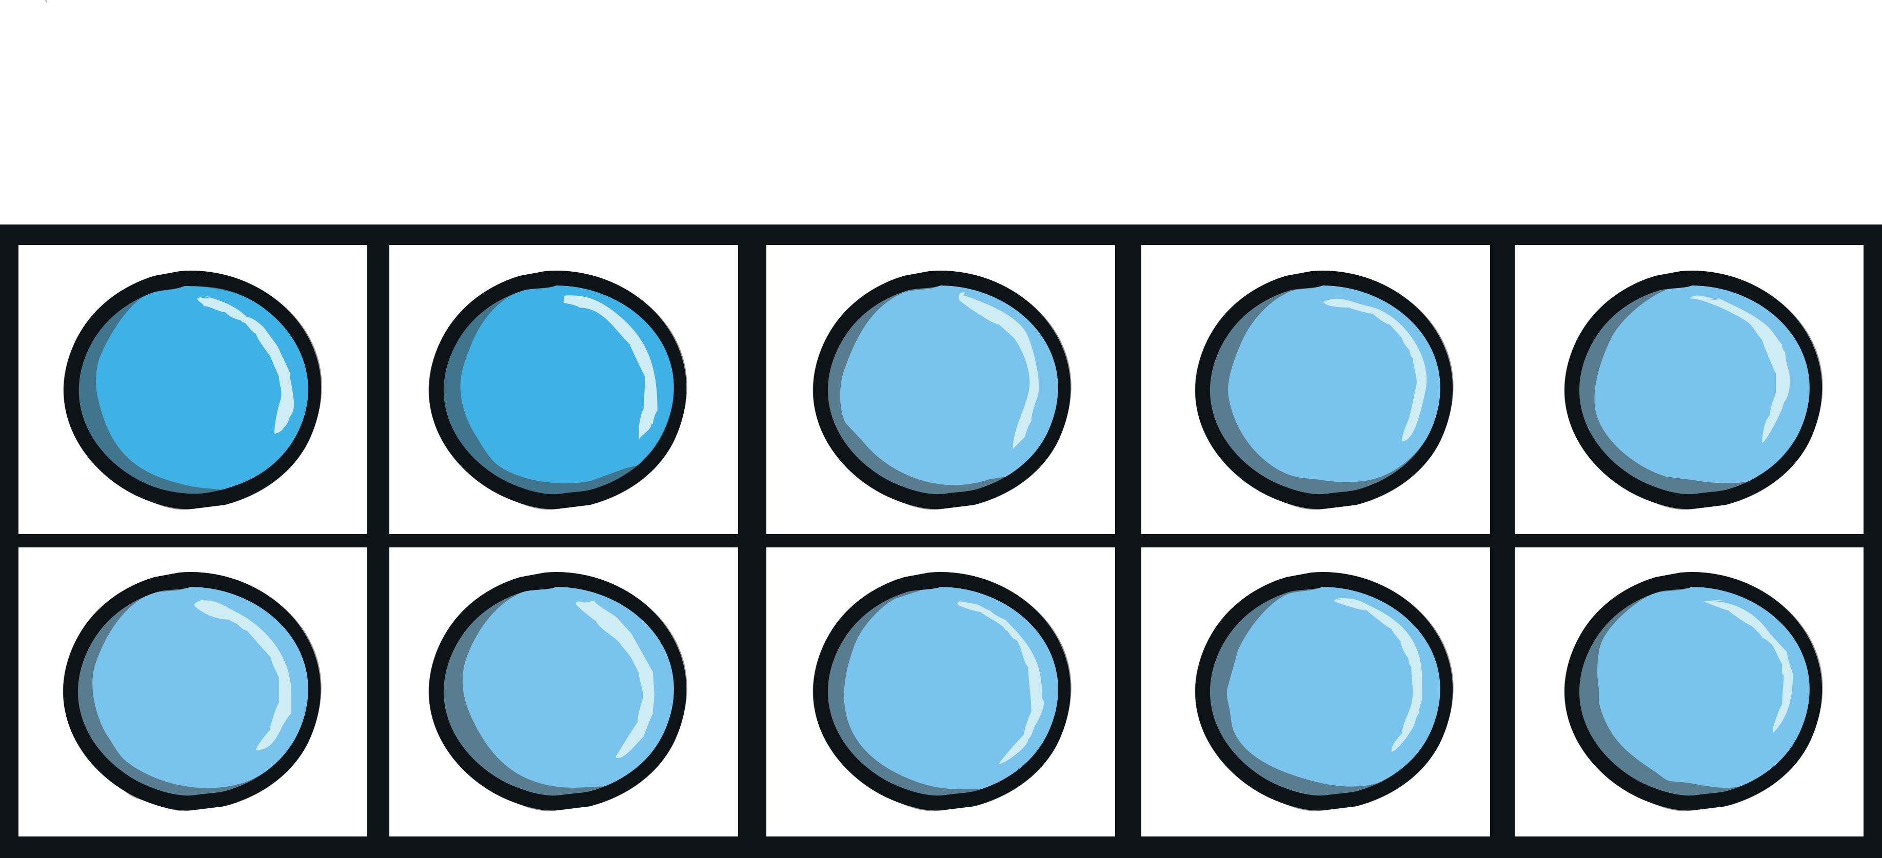



All about the Number 17
The number 17 can be shown in lots of different ways.
seventeen
next

Slide 4
Ten-Frames
These ten-frames make 17 when they are put together.
back
How can you be sure they show the number 17?
Is there a different way to fill in the
ten-frames and still show 17?

Slide 5
Number Words
Do you know what this word says?
seventeen
back
This is the number 17, written as a word.

Slide 6

Number Shapes
How much is being shown?
Which two number shapes are
being used to make 17?
Can you think of two different
number shapes that could make 17?
back

Slide 7
Cube Towers
This is the number 17 shown as towers of cubes.
back
Can you check that there are 17?
How can you be sure?

Slide 8

Number Lines
Can you spot the number 17 on the number line?
Which numbers are next to number 17?
Click the hand to reveal the answer!
0
1
2
3
4
6
7
8
9
10
12
13
5
11
14
15
16
17
18
19
20

Slide 9
Number Lines
20
How about this number line?
Can you spot the number 17?
Is it in the same place?
19
18
17
16
15
14
13
12
11
10
9
8
7
6
5
4
3
2
Click the hand to reveal
the answer!
1
0

Slide 10

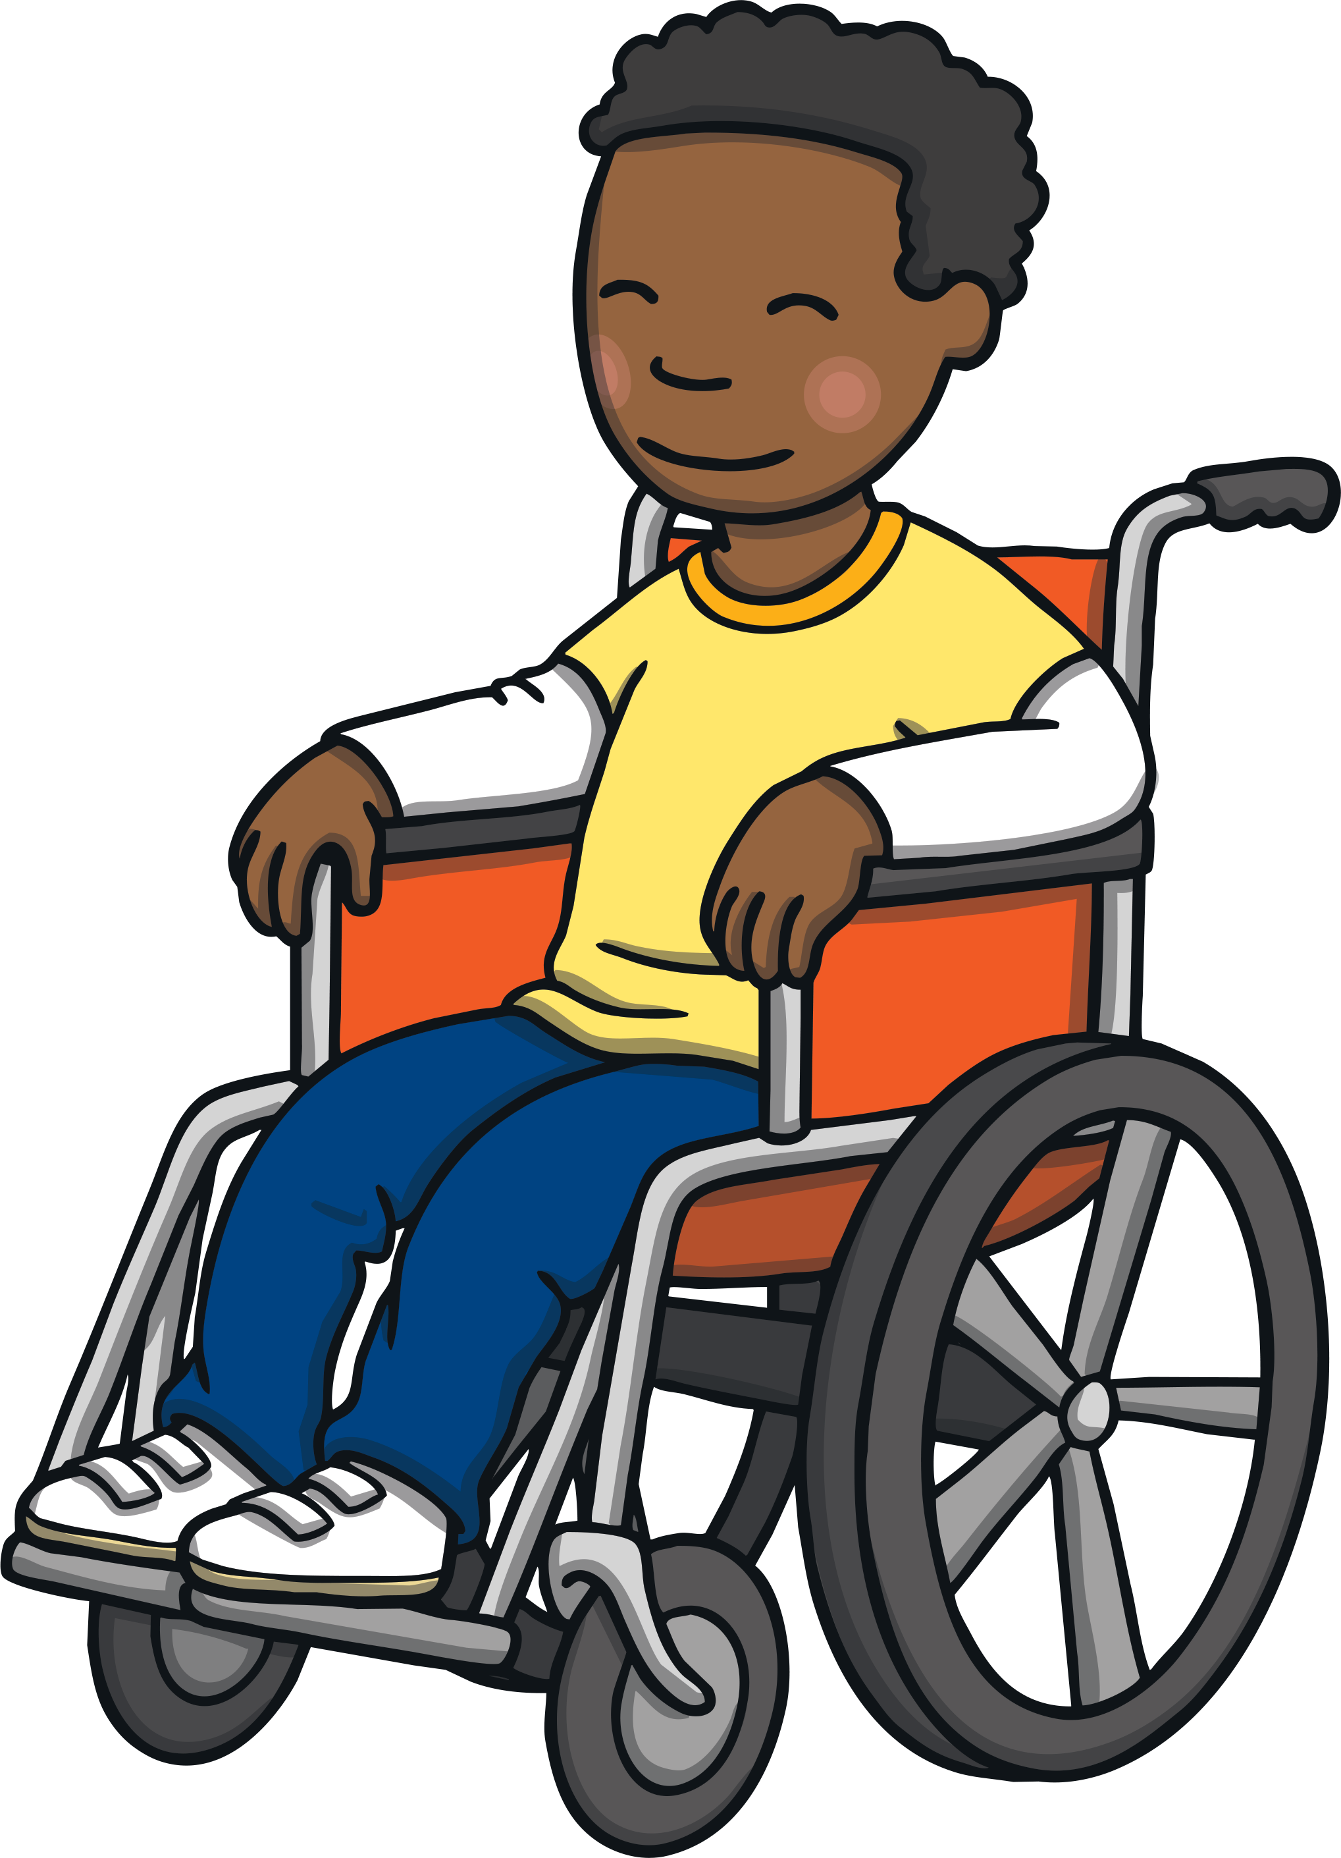

Let’s Try Together!
Adam’s big brother is 17. Can you put 17 candles on the cake?
Click to make the candles appear.

Slide 11






Hope needs to find the jar of sweets with 17 sweets. Can you help her?

Slide 12

Well done!
next

Slide 13

Try Again!
back

Slide 14
Try Again!
back

Slide 15

Numbers as Labels
17
Have you noticed how numbers can be used for labels too? For example, the number on a bus or the number on a door.
Have you ever seen a house with a number 17 on the door?

Slide 16

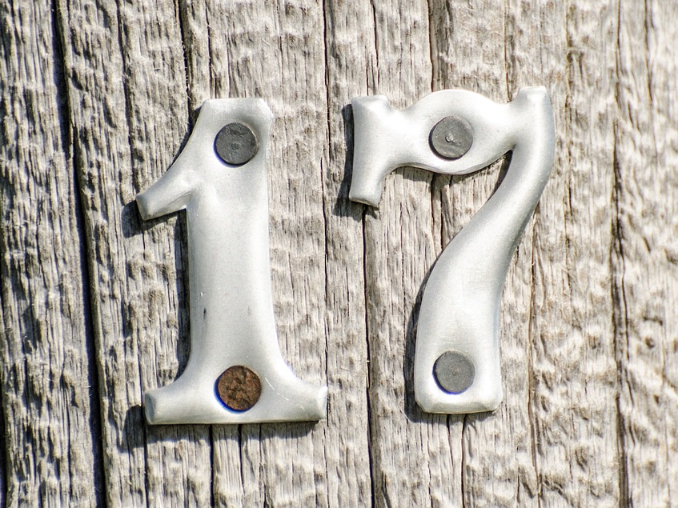
Numbers Everywhere!
Have you ever looked for numbers in your classroom or on your walk to school? Numbers are everywhere! Can you spot the number 17
in your classroom?

Slide 17




Number 17 Challenges
Are you ready for a challenge?
Click on the stars to make a challenge appear.
Finished

Slide 18
Challenge
Quickly, find something in the classroom that shows the number 17.
seventeen
17
back

Slide 19

Challenge
Find 17 small things. Can you make two groups with the 17 things?
How many do you have in each group?
Is there another way?
back

Slide 20

Challenge
Can you tap your head 17 times?
back

Slide 21
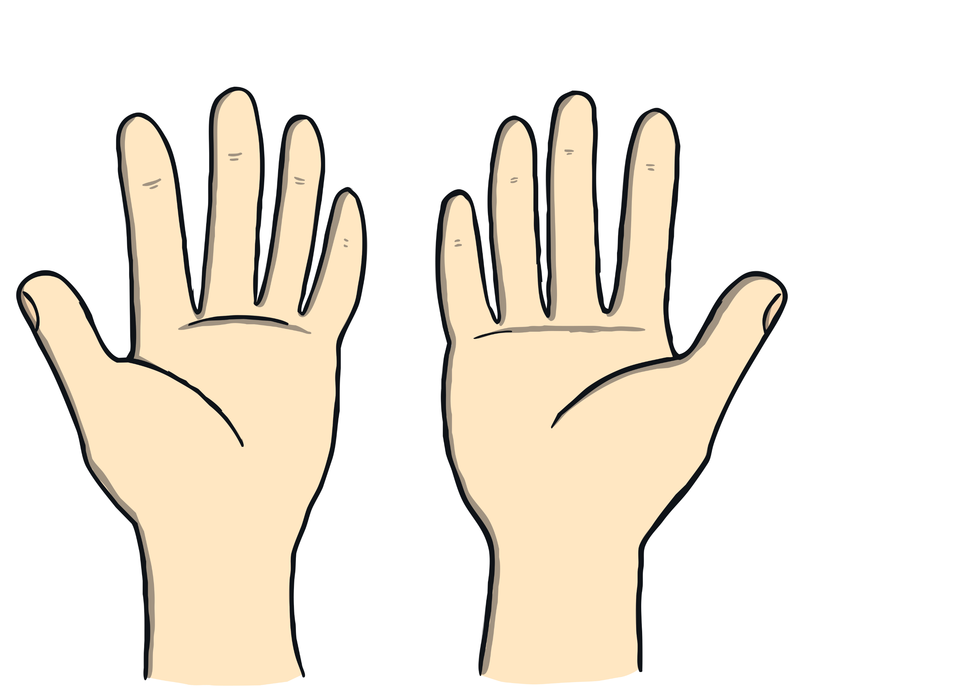
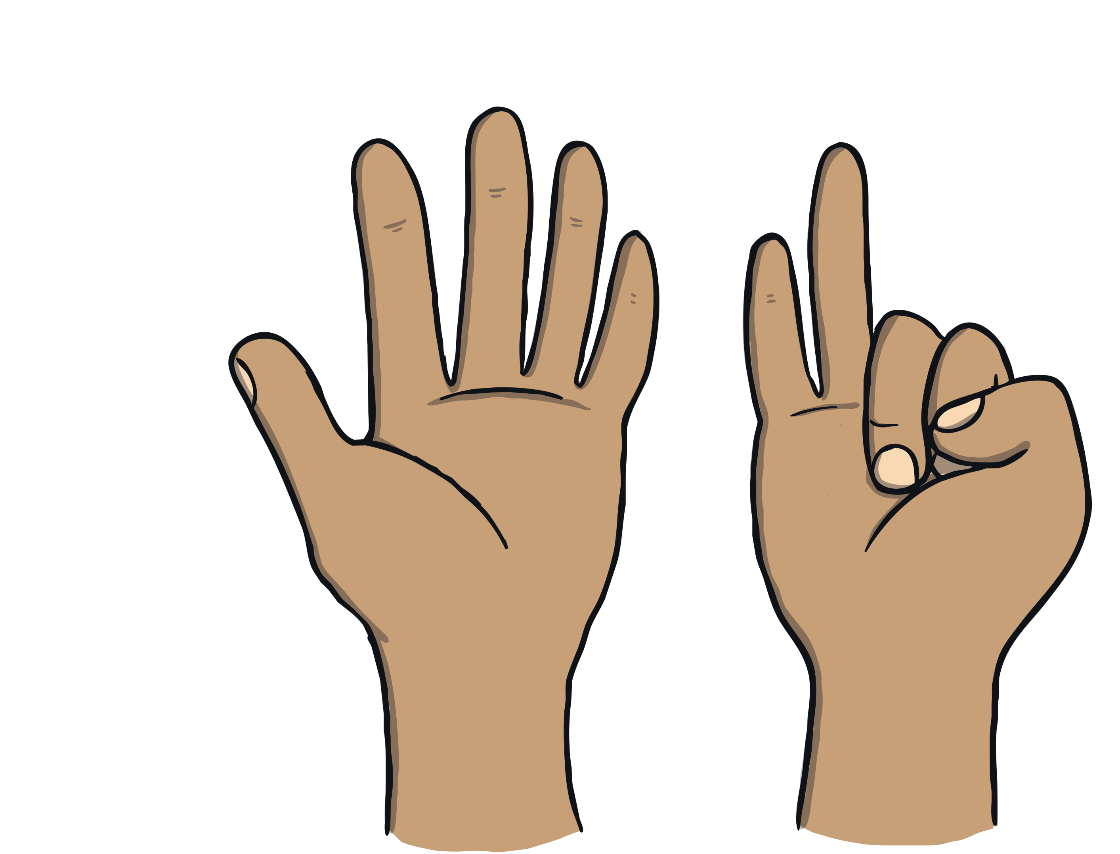
Challenge
Find a partner.
Together, can you show 17 fingers?
How many different ways can you find?
back

Slide 22

Congratulations!
You are now an expert on the number 17.
Can you give yourself 17 pats on the back?
Can you give yourself 17 claps?
seventeen

