Slide 2
All about the Number…
16

Slide 3

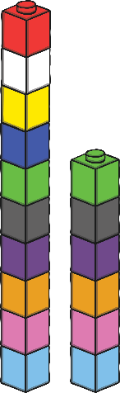
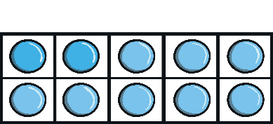

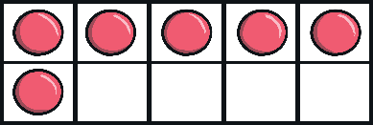
All about the Number 16
The number 16 can be shown in lots of different ways.
sixteen
next

Slide 4
Number Shapes
How much is being shown?
Which two number shapes are being
used to make 16?
Can you think of two different
number shapes that could make 16?
back

Slide 5
Number Words
Do you know what this word says?
sixteen
back
This is the number 16, written as a word.

Slide 6

Cube Towers
This is the number 16 shown as towers of cubes.
Can you check that there are 16? How can you be sure?
back

Slide 7
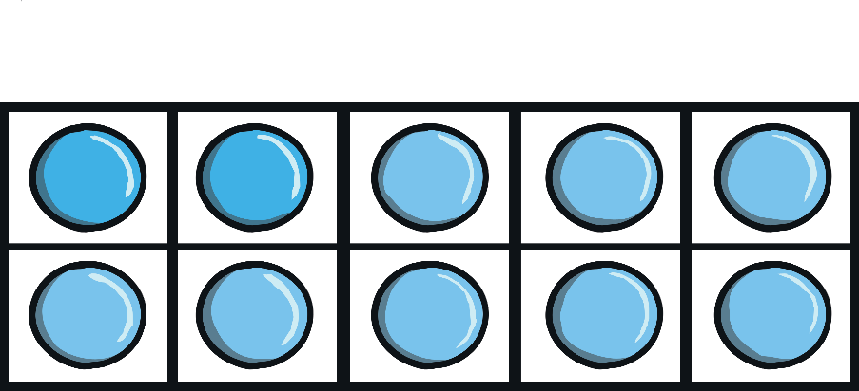
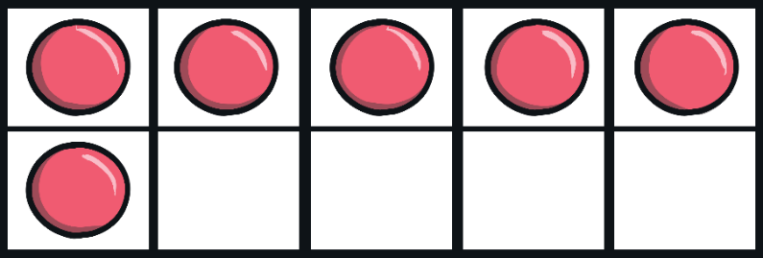
Ten-Frames
These ten-frames make 16 when they are put together.
How can you be sure they show the number 16?
back
Is there a different way to fill in the ten-frames and still show 16?

Slide 8

Number Lines
Can you spot the number 16 on the number line?
Which numbers are next to number 16?
Click the hand to reveal the answer!
0
1
2
3
4
5
6
7
8
9
10
11
12
13
14
15
16
17
18
19
20

Slide 9
Number Lines
20
How about this number line?
Can you spot the number 16?
Is it in the same place?
19
18
17
16
15
14
13
12
11
10
9
8
7
6
5
4
3
Click the hand to reveal
the answer!
2
1
0

Slide 10
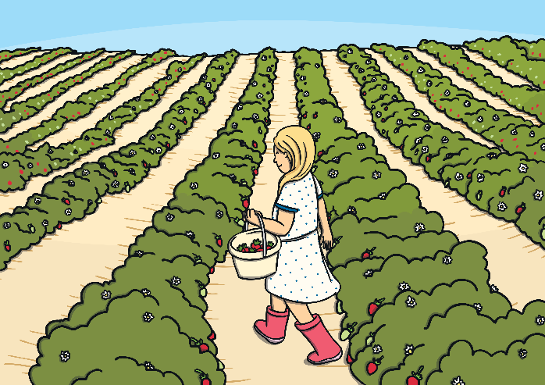

Let’s Try Together
Can you help Lucy pick 16 strawberries?

Slide 11






Adla needs to find the jar of sweets with 16 sweets. Can you help her?

Slide 12




Well done!
next

Slide 13


Try again!
back

Slide 14
Try again!
back

Slide 15

Numbers as Labels
16
Have you noticed how numbers can be used for labels too? Like a number 16 bus or the number on a door.
Have you ever seen a house with a number 16 on the door?

Slide 16
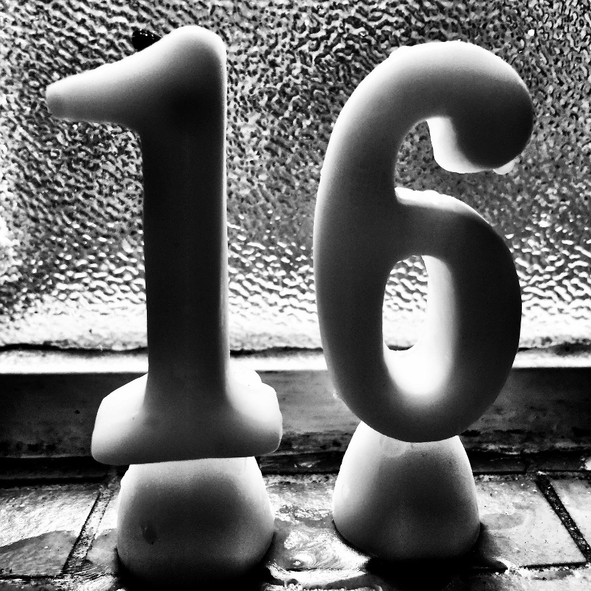
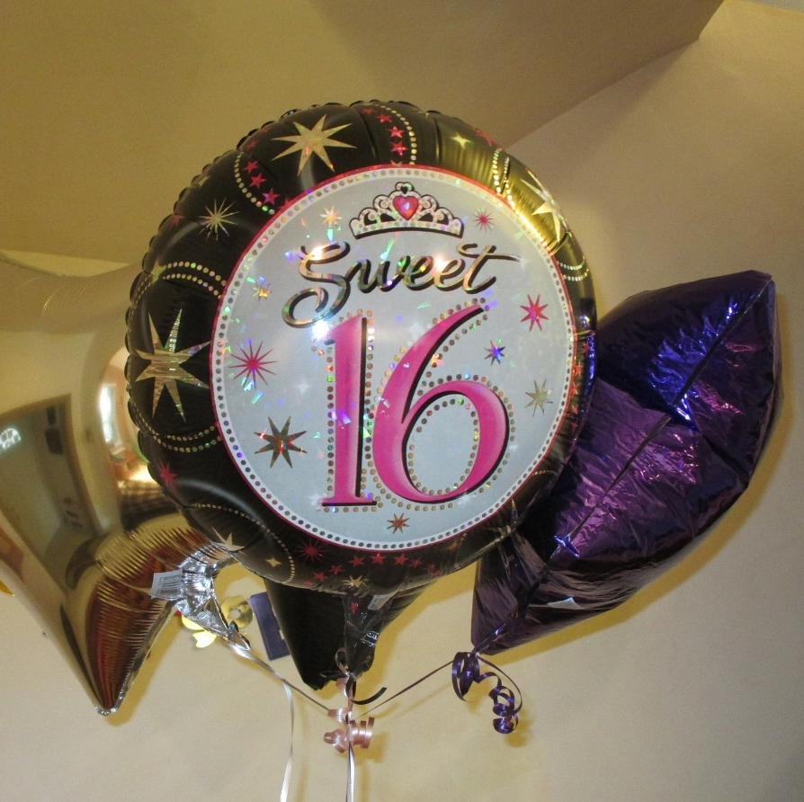
Numbers Everywhere
Have you ever looked for numbers in your classroom or on your walk to school? Numbers are everywhere! Can you spot the number 16 in your classroom?

Slide 17





Number 16 Challenges
Are you ready for a challenge?
Click on the stars to make a challenge appear.
Finished

Slide 18

Challenge
Quickly, find something in the classroom that shows the number 16.
sixteen
16
back

Slide 19

Challenge
Find 16 small things. Can you make two groups with the 16 things?
How many do you have in each group?
Is there another way?
back

Slide 20

Challenge
Find a timer.
Can you sit quietly for 16 seconds?
back

Slide 21
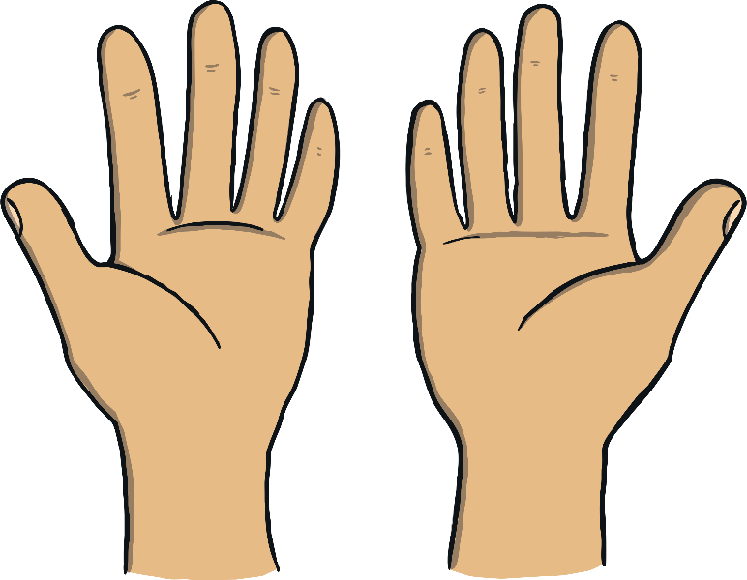
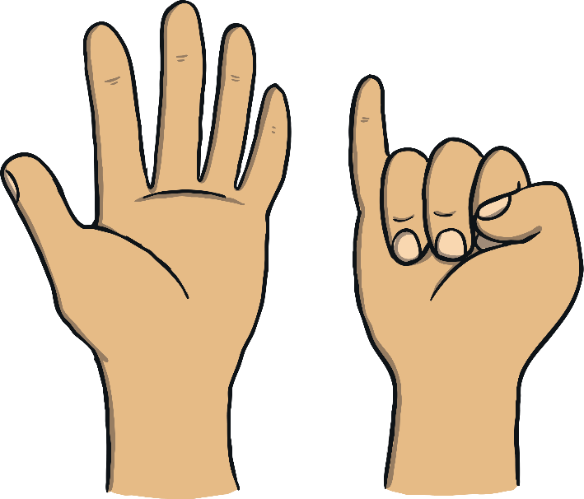
Challenge
Find a partner.
Together, can you show 16 fingers?
How many different ways can you find?
back

Slide 22
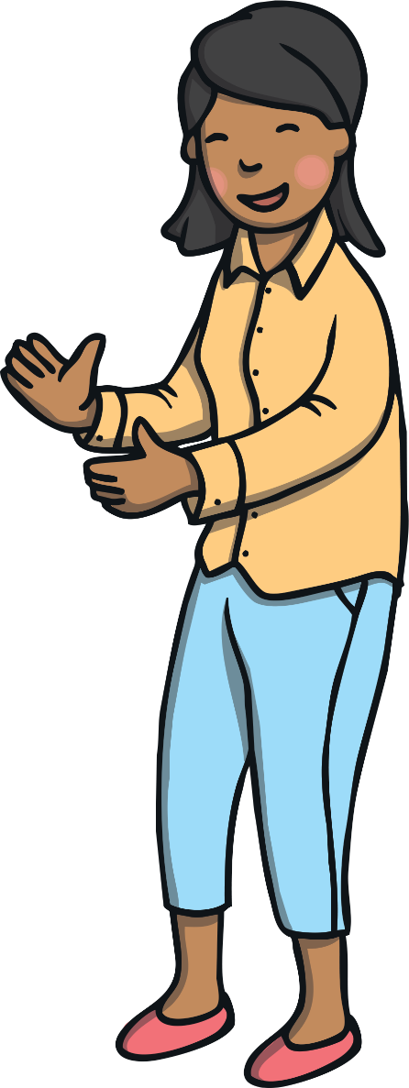

Congratulations!
You are now an expert on the number 16.
Can you give yourself 16 pats on the back?
Can you give yourself 16 claps?
sixteen

