Slide 2

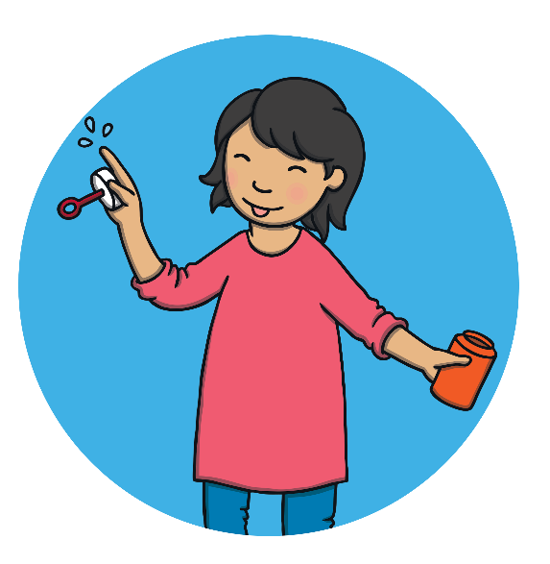
How Many Bubbles Have Been Blown?
I am going to pop one bubble. How many bubbles will there be?
There is one less bubble now. Can you check by counting?
Click me to pop one bubble!
0
1
2
3
4
5
6
7
8
9
10
next

Slide 3
How Many Bubbles Have Been Blown?
I am going to pop one bubble. How many bubbles will there be?
There is one less bubble. How many are there now? Can you find that number on the number line? What do you notice?
Click me to pop one bubble!
0
1
2
3
4
5
6
7
8
9
10
back
next

Slide 4
How Many Bubbles Have Been Blown?
I am going to pop one bubble. How many bubbles will there be? I think there will be 10.
There is one less bubble now.
Click me to pop one bubble!
0
1
2
3
4
5
6
7
8
9
10
back
next

Slide 5
How Many Bubbles Have Been Blown?
I am going to pop one bubble. How many bubbles will there be?
There is one less bubble now. Does that mean there are more or fewer bubbles?
Click me to pop one bubble!
0
1
2
3
4
5
6
7
8
9
10
back
next

Slide 6
How Many Bubbles Have Been Blown?
I am going to pop one bubble. How many bubbles will there be?
Has the number of bubbles changed? Can you tell me how?
Click me to pop one bubble!
0
1
2
3
4
5
6
7
8
9
10
back
next

Slide 7
How Many Bubbles Have Been Blown?
I am going to pop one bubble. How many bubbles will there be?
There are fewer bubbles now. Can you count them for me?
Click me to pop one bubble!
0
1
2
3
4
5
6
7
8
9
10
back
next

Slide 8
How Many Bubbles Have Been Blown?
I am going to pop one bubble. How many bubbles will there be?
There are 6 bubbles. Do you agree?
Click me to pop one bubble!
0
1
2
3
4
5
6
7
8
9
10
back
next

Slide 9
How Many Bubbles Have Been Blown?
I am going to pop one bubble. How many bubbles will there be?
First I had 10 bubbles. Then, I popped 1 bubble. Now, I have 9 bubbles.
Click me to pop one bubble!
0
1
2
3
4
5
6
7
8
9
10
back
next

Slide 10
How Many Bubbles Have Been Blown?
I am going to pop one bubble. How many bubbles will there be?
Oh! I had 1 bubble. Then, I popped 1 bubble. Why do I have zero?
Click me to pop one bubble!
0
1
2
3
4
5
6
7
8
9
10
back
next

Slide 11
How Many Bubbles Have Been Blown?
I am going to pop one bubble. How many bubbles will there be?
Can you check by counting?
Click me to pop one bubble!
0
1
2
3
4
5
6
7
8
9
10
back
end

