Slide 2
Instructions
This PowerPoint begins with a slide showing number shapes representing numbers 11 to 20. This can be used to support children with their counting.
Following this, each slide shows different sea creatures.
Press the starfish button to add one more sea creature to the slide.
Then, click the seashell to reveal some reasoning questions to challenge children further.
When you are ready, you can then click the fish to reveal the answer.

Slide 3










Number Shapes

Slide 4




One More Dolphin
There were 15 dolphins. One more joined the group so now there are 16. One more than 15 is 16.
How many dolphins are there? How can we check?
If one more dolphin joined, how many would there be?
What could we use to help us to work out the answer?
One More
Reasoning Questions
Answer

Slide 5
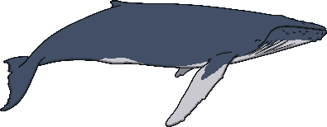
One More Whale
There were 13 whales. One more joined the group so now there are 14. One more than 13 is 14.
Can anyone tell me which number shapes show the number 13?
Can you explain how we can use the shapes to find one more than 13?
One More
Reasoning Questions
Answer

Slide 6

One More Turtle
I think one more than 18 is 20. Am I right? Why or why not?
There were 18 turtles. One more joined the group so now there are 19. One more than 18 is 19.
Can you prove it?
One More
Reasoning Questions
Answer

Slide 7

One More Seal
There were 16 seals. One more joined the group so now there are 17. One more than 16 is 17.
Can you tell me how you used the number shapes to find one more than 16?
Is there another way you could work out what is one more than 16? Tell me about it.
One More
Reasoning Questions
Answer

Slide 8


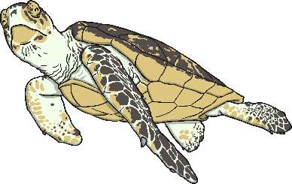

Well Done!
Well done! You found one more than a given number today.

