Slide 1
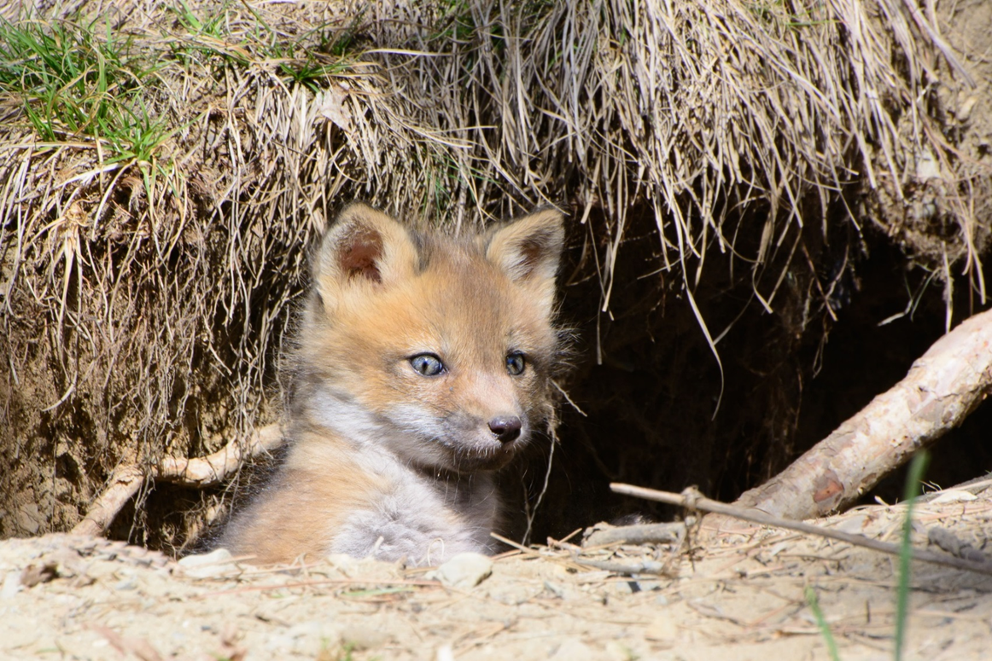
A fox lives in a den.
Photo courtesy of Jim McCree (@flickr.com) - granted under creative commons licence – attribution

Slide 2
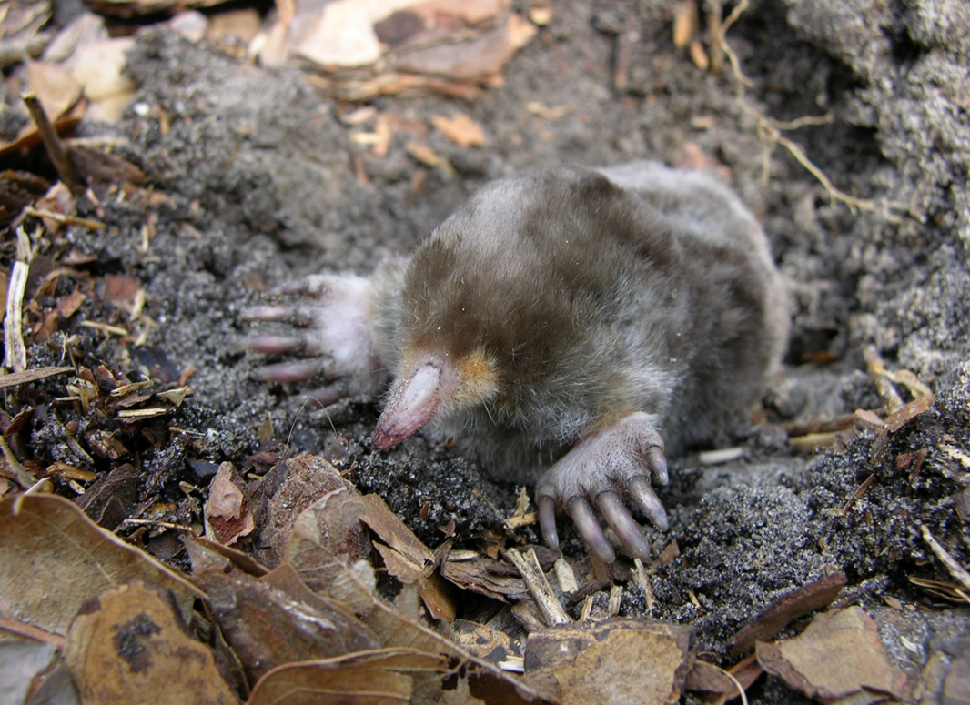
A mole lives in a burrow.
Photo courtesy of ecollc (@flickr.com) - granted under creative commons licence – attribution

Slide 3
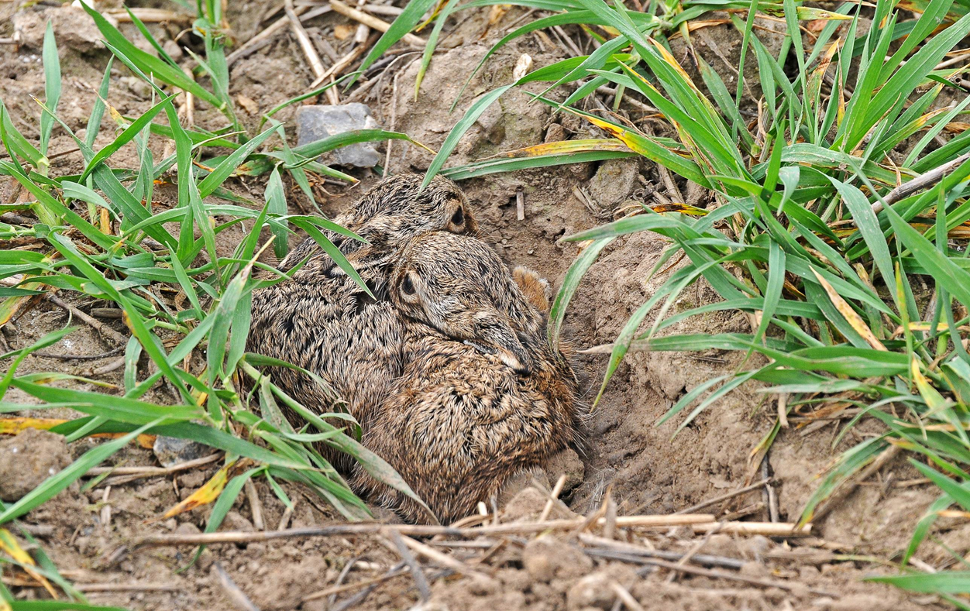
A hare lives in a form.
Photo courtesy of athene1 (@flickr.com) - granted under creative commons licence – attribution

Slide 4
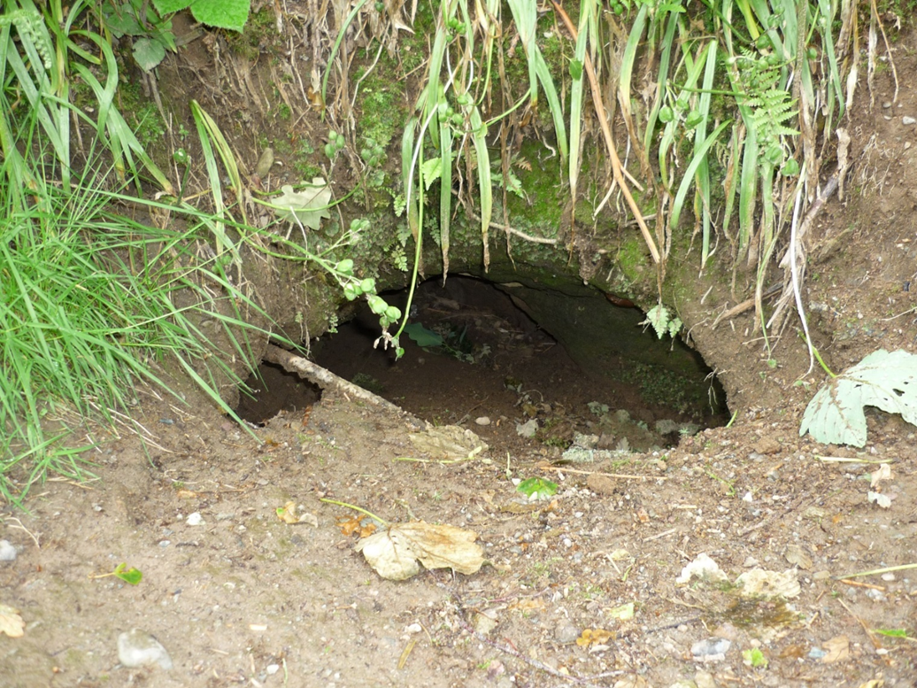
A badger lives in a sett.
Photo courtesy of Jameshine (@flickr.com) - granted under creative commons licence – attribution

