Slide 2
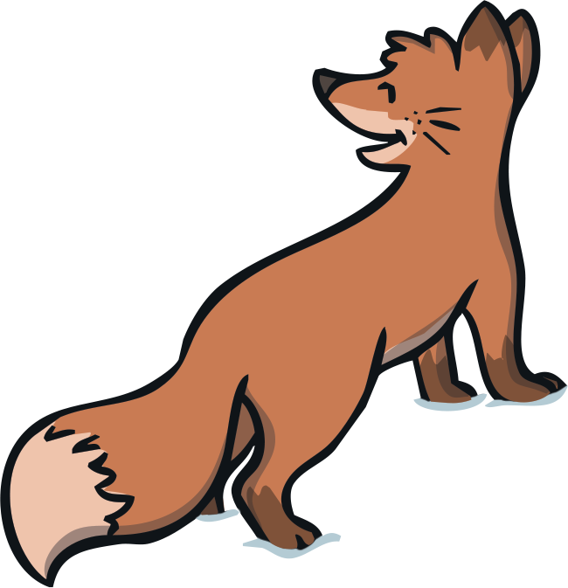
Ten Little Lights
Read the book ‘Ten Little Lights’ and look at the illustrations.
To see a question about the book, click this button:
?

Slide 3
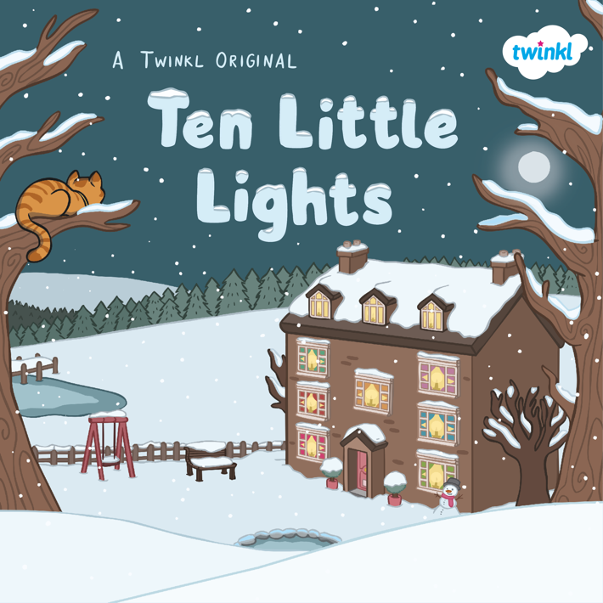
?
What do you think this book is going to be about?
?
Do you think it is fiction or non-fiction?
?
When is this story set?
?
Can you spot any animals on the cover?

Slide 4
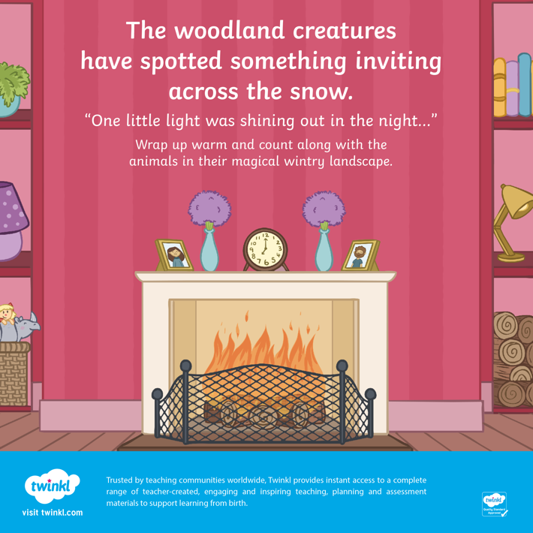
?
Which ‘woodland creatures’ do you think we might see in this book?
?
What does ‘something inviting’ mean?
?
Where do you think the ‘one little light’ is coming from?

Slide 5
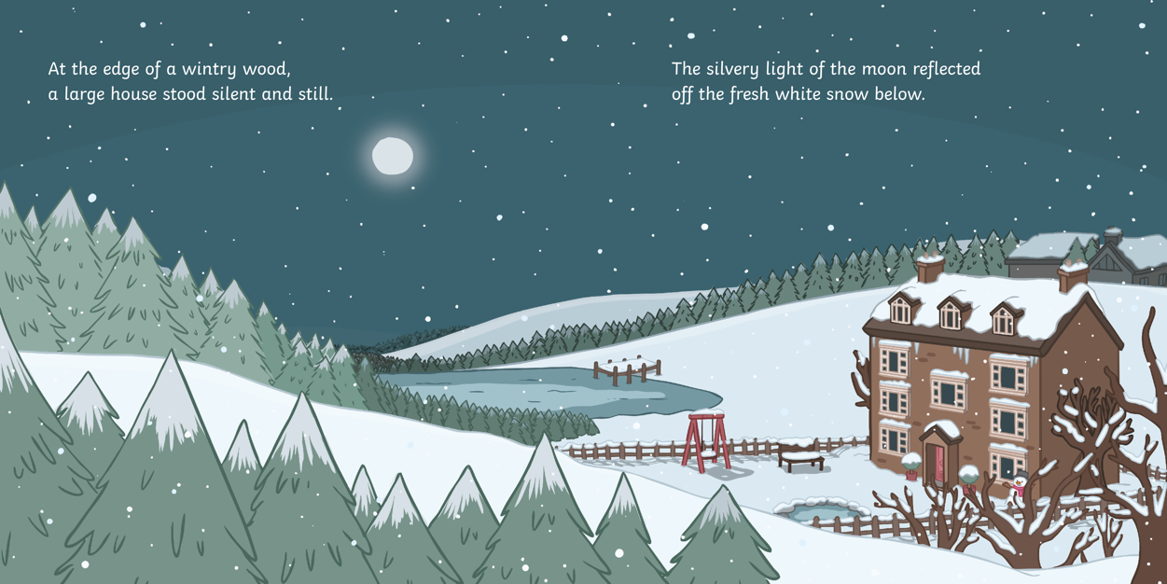
?
?
Who do you think might live here?
Where is this story set?

Slide 6
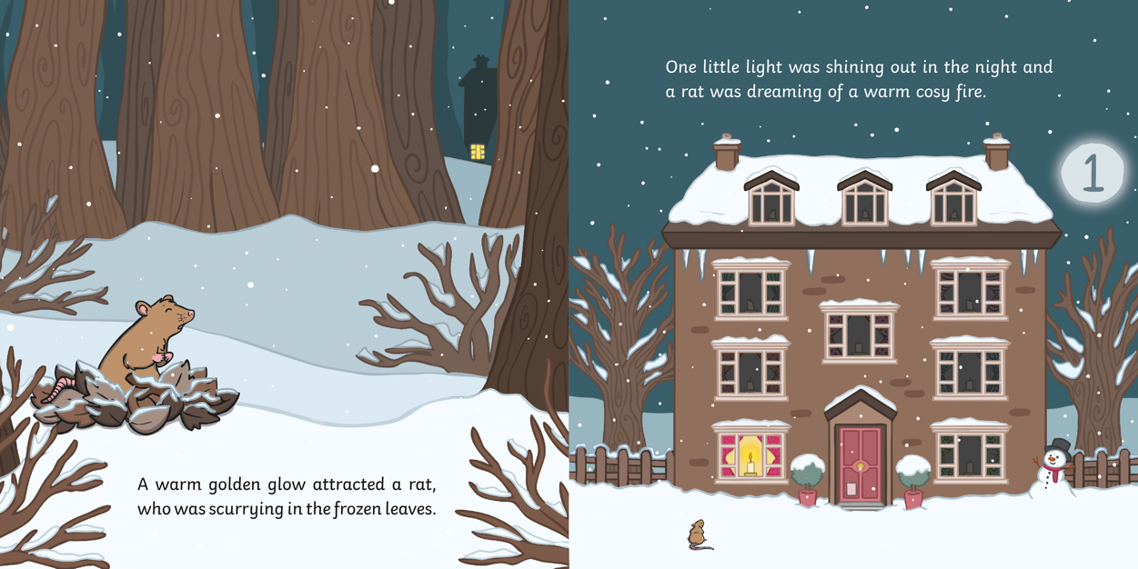
?
Who is first to spot a
light on at the house?

Slide 7
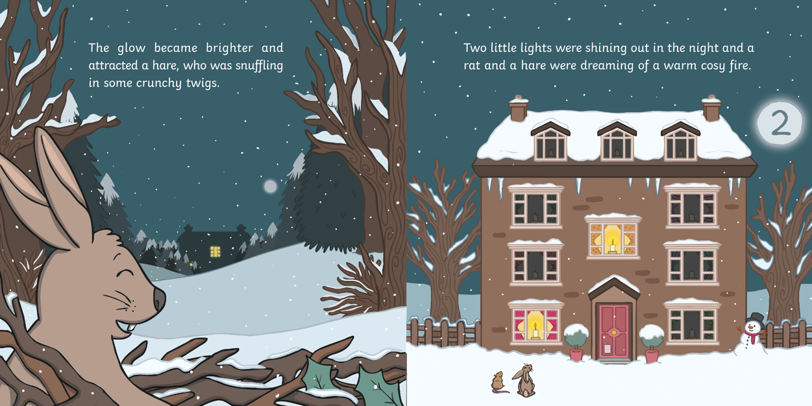
?
Which word is used here to describe the twigs?

Slide 8
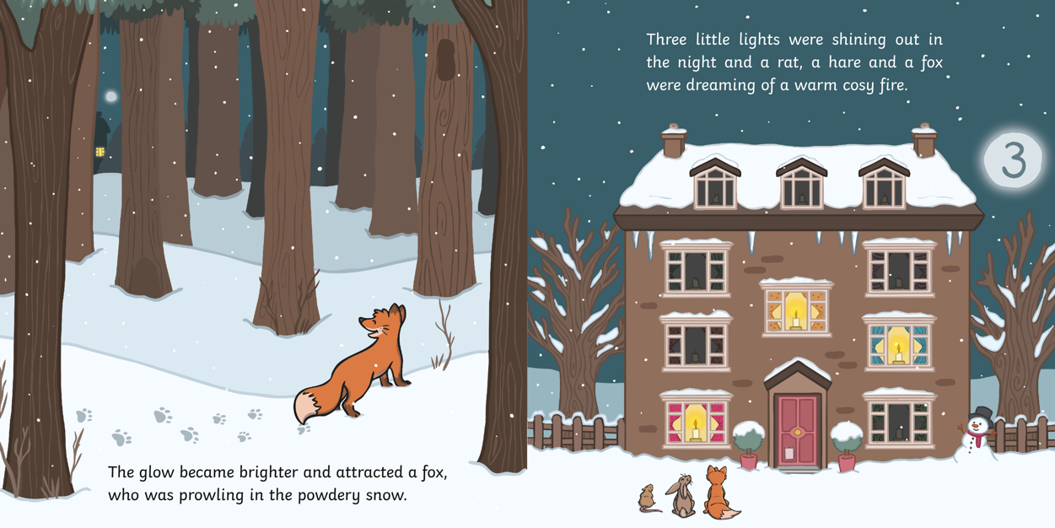
?
How many lights were shining?

Slide 9
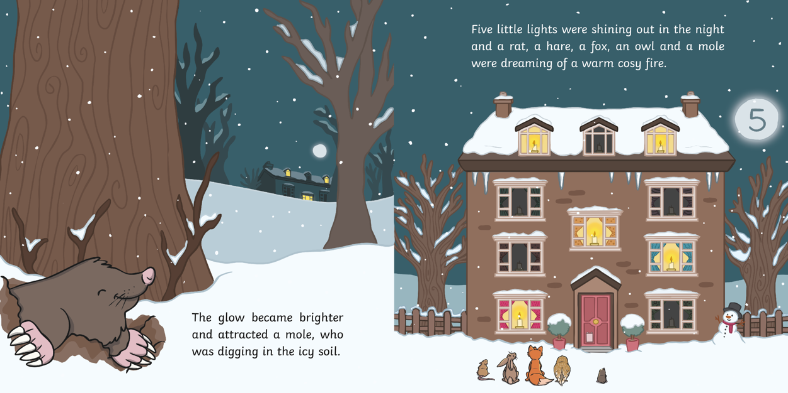
?
Can you spot any describing words?

Slide 10
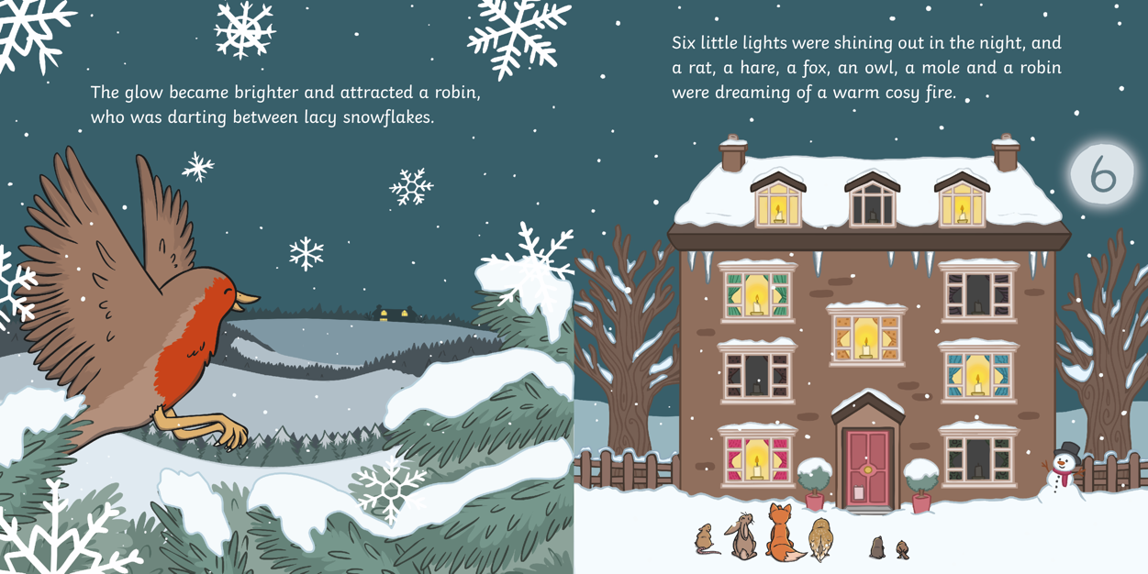
?
The author describes the snowflakes as ‘lacy’. Why do you think they have used this word?

Slide 11
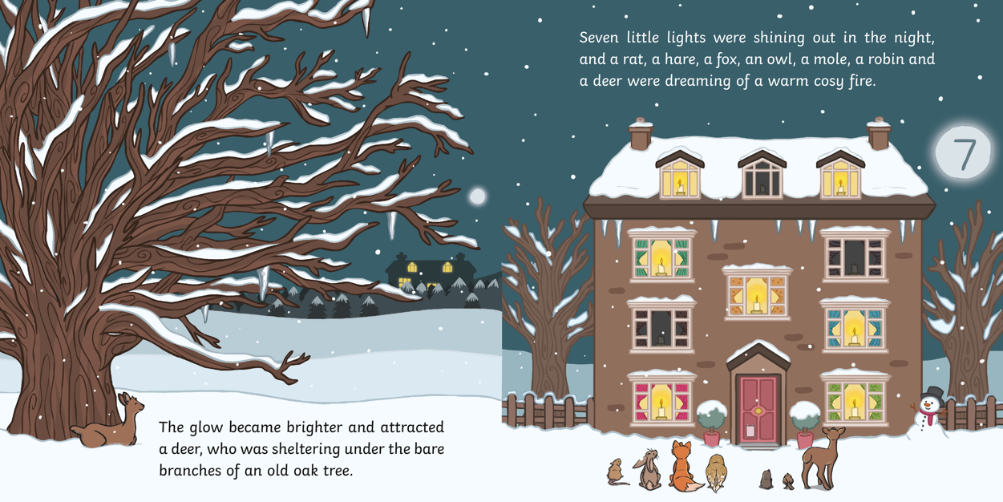
?
What do you think will happen next?

Slide 12
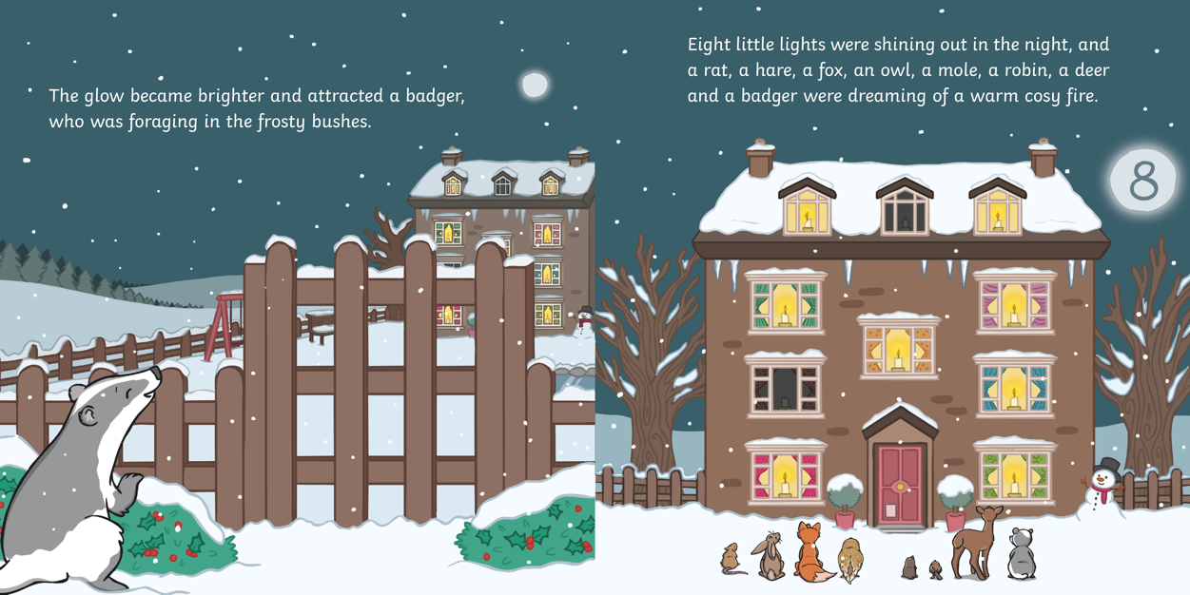
?
What does ‘foraging’ mean?

Slide 13
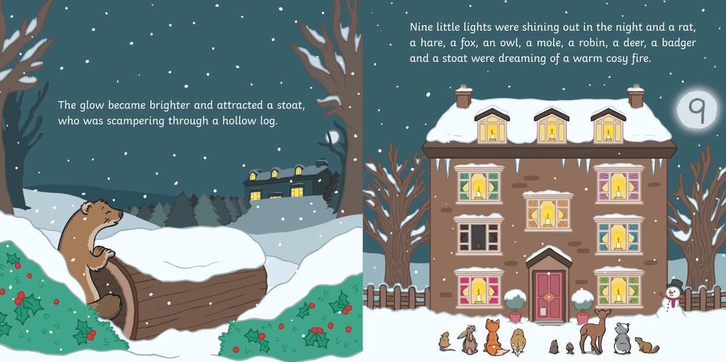
?
Why is the glow shining more brightly each time?
?
What animal do you
think could be next to
join the others?

Slide 14
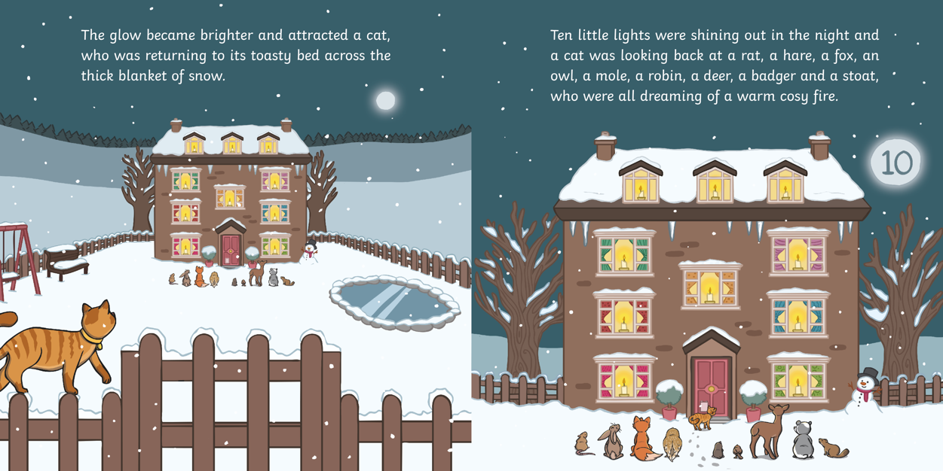
?
Does the cat live in the woods like the other animals do?

Slide 15
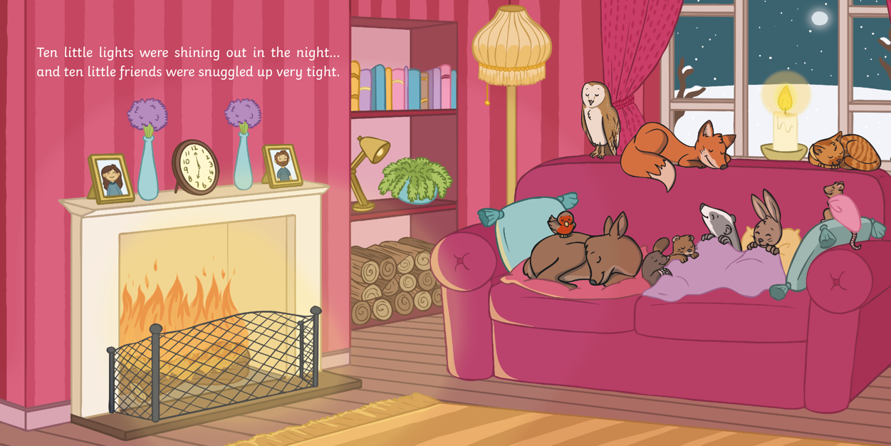
Do you think that the
people who live here know that there are ten little animals asleep by their fire?
?
?
Where are the animals now?

Slide 16
?
In the story, which season is it ?
spring
summer
autumn
winter

Slide 17
?
How would you describe the setting ?

Slide 18
?
Can you name all of the animals that we see in the story?

Slide 19
?
Which of these animals do we meet first?
?
Which do we meet last?

Slide 20
?
How do you think the animals get inside the house?

Slide 21
?
What do you think might happen in the morning?

Slide 22
?
Did you enjoy this story?
When do you think would be the best time to read this story?
?
Would you recommend this book to a friend? Why?
?

