Slide 1
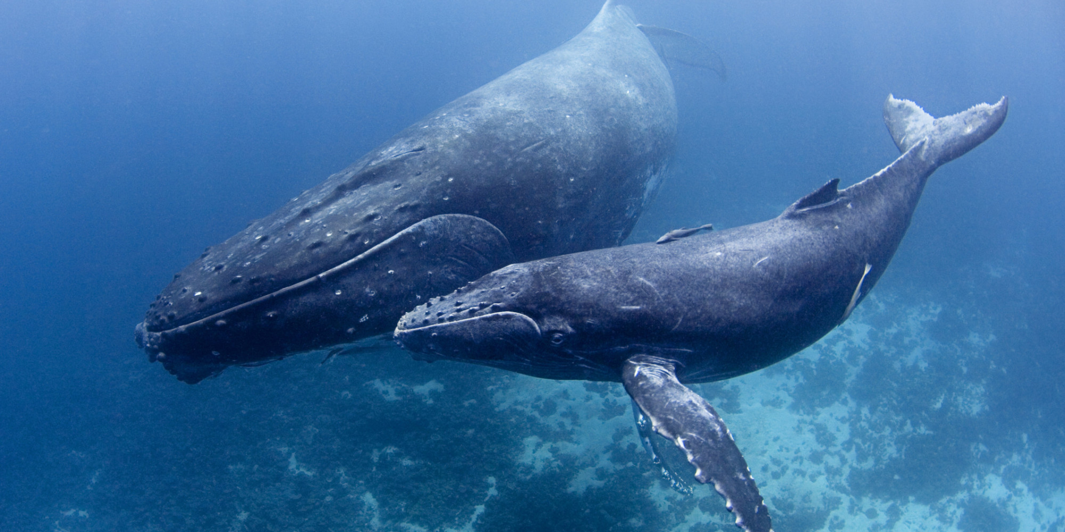
Where Do Whales Live?

Slide 2
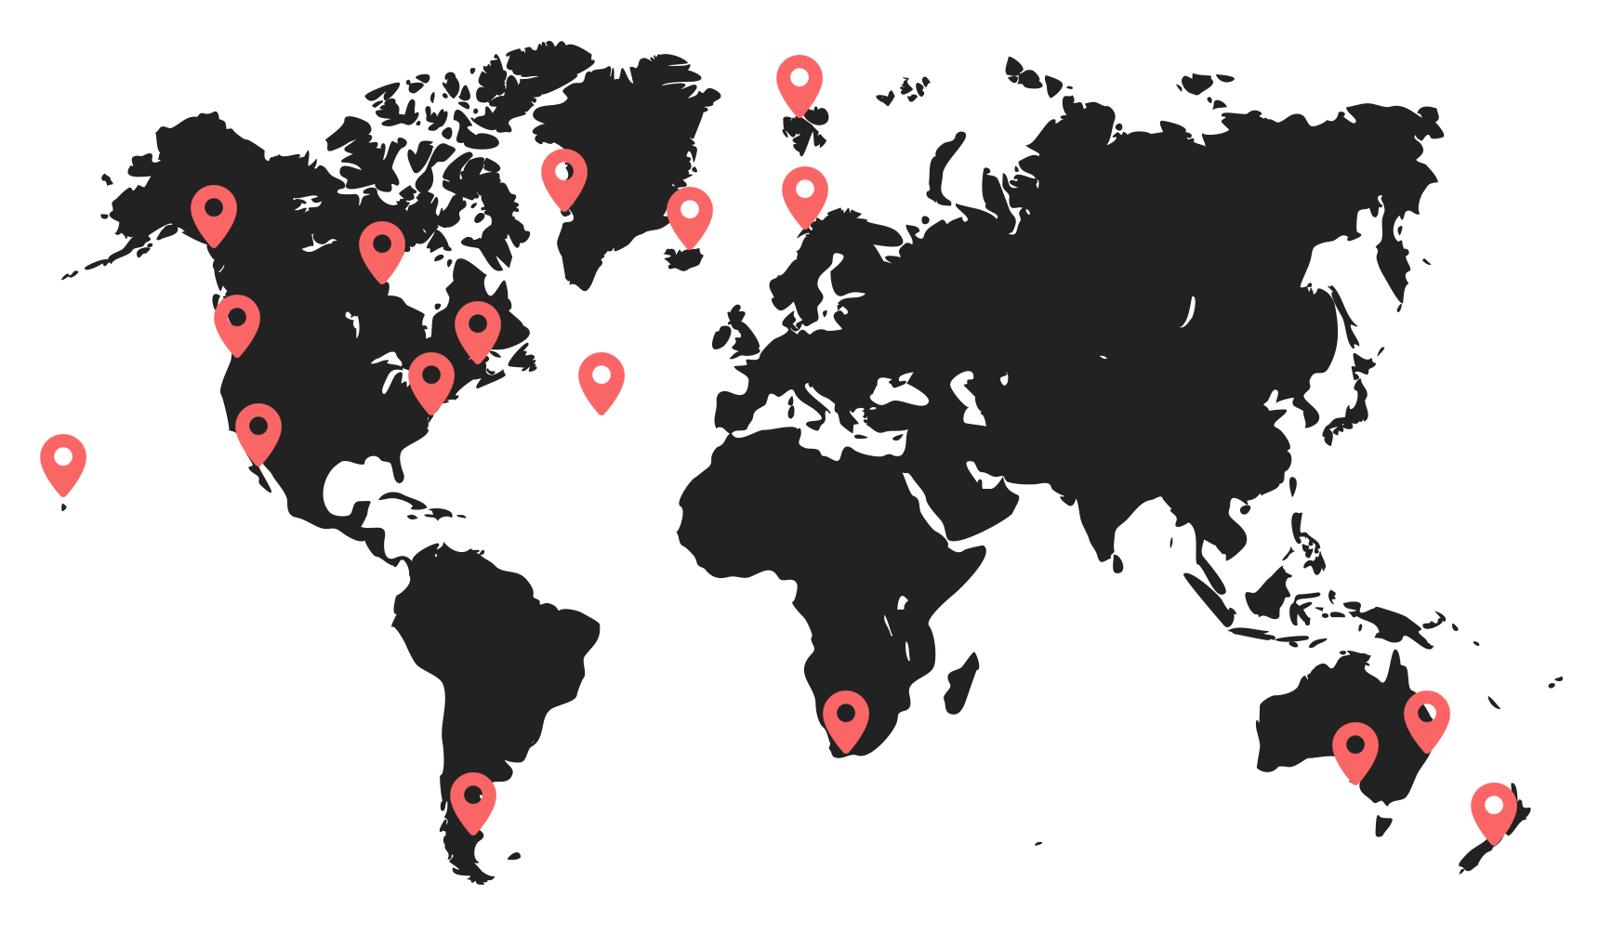
Where something lives is known as its habitat. Have a look at the different places different whales can live. What do you notice?

Slide 3
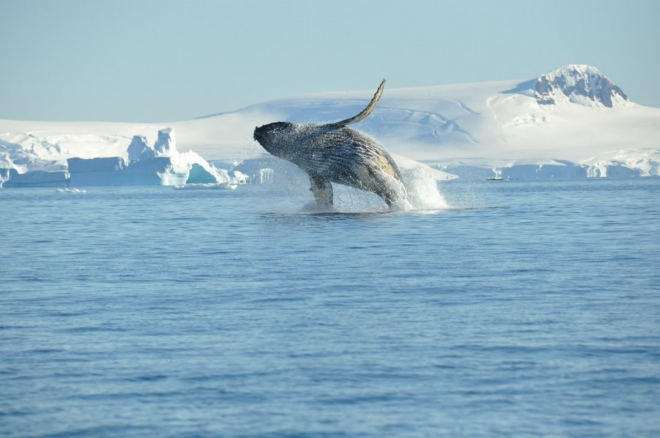
Baleen Whales
Baleen whales can live in icy places such as the Arctic.
When a baby whale is born, they swim to warmer water to keep the calf warmer.

Slide 4
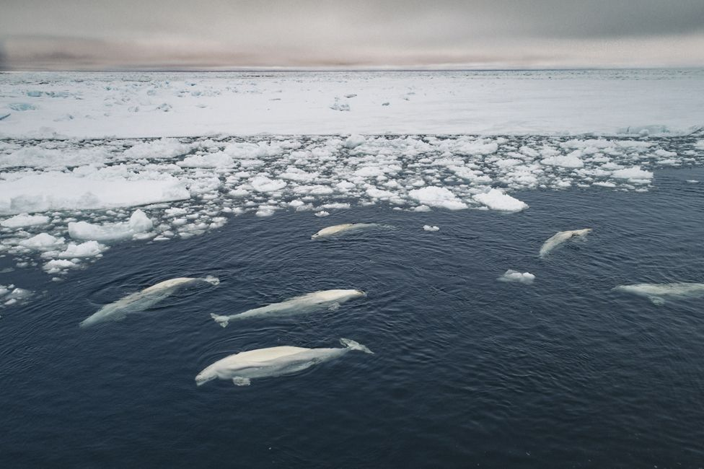
Toothed Whales
Most toothed whales live in cold water near the Antarctic such as the narwhal, beluga and orca.
However orcas and dolphins can also live in warm waters around Africa.

Slide 5
Have you been writing about baleen or toothed whales? Now can you write a fact about their habitat? You can do this on your own lined piece of paper or use the template but please keep it safe for Friday’s activity.
Example –
Toothed whales can live in icy waters. Orcas can live in warm waters too.
Word bank on next slide.

Slide 6


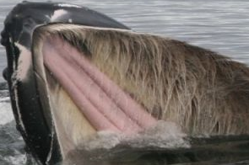
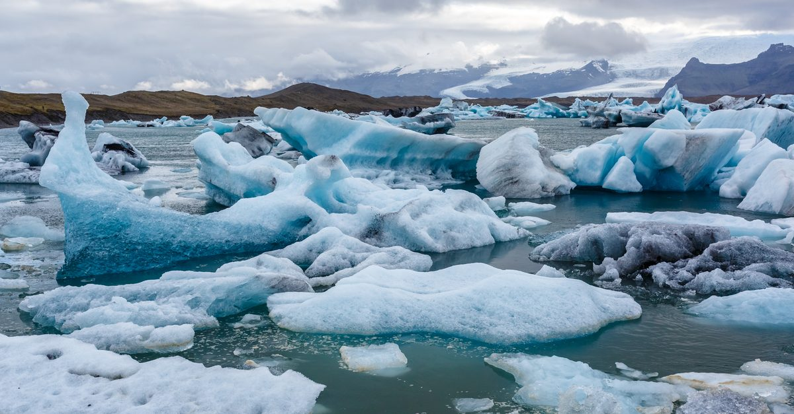


whale
baleen
toothed
warm
water
icy

