Slide 1
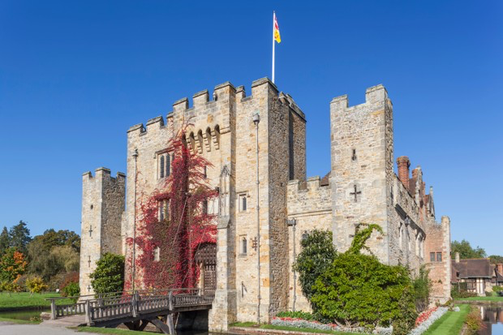
Jobs in a Castle

Slide 2
Armourer
An armourer made the armour to fit each knight. Every knight was a different height and shape. Every piece of armour was different. This was a very important job.
Artist
Artists were employed by Kings and Noble men to paint portraits and decorate furniture.

Slide 3
Baker
The baker made bread. Bread was eaten by everybody who lived in the castle, every day.
Barber
A barber would cut hair but they also had to be a dentist and a surgeon!

Slide 4
Blacksmith
Bower
The blacksmith was one of the most important jobs in the castle. Blacksmiths made shoes for the horses, made weapons, sharpened weapons and repaired armour.
The bower made bows, arrows and crossbows. They used mostly wood to make them.

Slide 5
Candle Maker
The candle maker made candles to light the castle. They also used torches and lanterns to light the castle. When a candle was made it have twelve lines on it. When lit at the top of the hour, the candle would burn from line to line at the rate of one hour for each line. A medieval clock!
Carpenter
Carpenters were skilled craftsmen who shaped and made thins out of wood. Carpenters built furniture, roofing and wood panelling. Carpenters were considered to be elite tradesmen.

Slide 6
Cook
A cook was employed in the castle kitchens to roast, boil and bake food in the fireplaces and ovens. Fruit, vegetables and herb were grown in the kitchen’s garden. They would often sleep on the kitchen floor with the other kitchen staff. It was very cramped.
Ditcher
The ditcher was a labourer who dug castle moats. They also dug foundations for building.

Slide 7
Gardener
The gardener needed a knowledge of herbs and plants. A gardeners work was critical to the safety of the castle. Castle walls had to be kept free of ivy or anything else that could be used to climb the castle walls. Gardeners were expected to dig defensive ditches.
Gong Farmer
Toilets were called garderobes and they were built into the castle walls. Everything dropped down into the moat or a cesspit. The smelly job of cleaning out the cesspit was done by men called gong farmers.

Slide 8
Jester
The jester entertained the court. He told jokes, danced and sang songs. If he was not funny, he was sent to the dungeon!
Knight
It was the job of the knight to learn how to fight. A knight had to learn how to use a sword, a battle axe, a dagger and a lance. A knight had to train for 14 years. They would leave their home at 7 years old to live with a Lord and start training.

Slide 9
Priest
People enjoyed singing at the church, as it was one of the few kinds of entertainment. The priest told Bible stories each week. People came and told him their worries.
Shoe Maker
A shoe maker or cobbler was a craftsman who made shoes.

Slide 10
Watchman and Soldiers
A watchman was responsible for the security of the castle. There was a day watchman and a night watchman.
The soldiers would protect the castle from enemy attacks. They used arrows, crossbows and longbows, as well as throwing stone missiles to crush invaders. Sometimes they would throw boiling water on the enemies!

