Slide 1
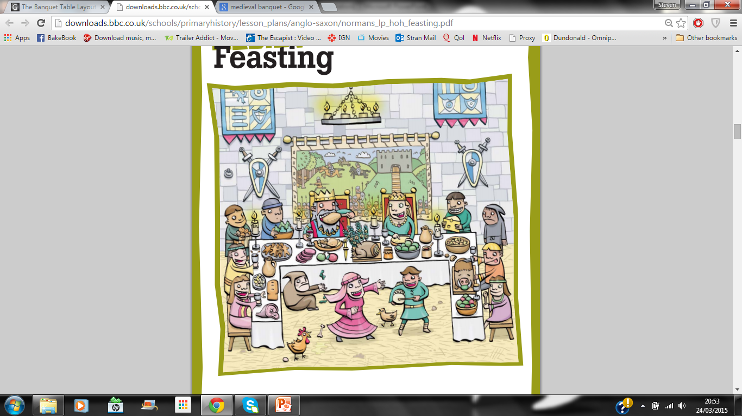
Banquets

Slide 2
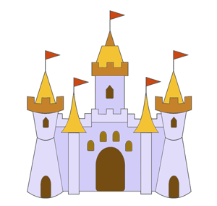
Banqueting – where and when?
Banquets would be held in the great hall of the castle.
Special guests would be seated at the high table with the Lords and Ladies.
There were special feasts for special days of the year like Christmas and New Year.
And other events including birthdays and weddings.

Slide 3
The banquet hall and table
The banquet hall would be the biggest room in the castle.
It would be brightly decorated and filled with people.
There would be music, dancing and other forms of entertainment.
The tables would be decorate with centrepieces such as a swan or boars head.

Slide 4
High Table
Side Boards
Side Boards

Slide 5
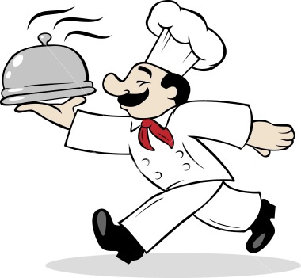
The menu
There could be up to 6 courses.
The richer and more important you were the better the menu.
Important people would eat lots of meat.
Less important people would eat lots of vegetables.

Slide 6
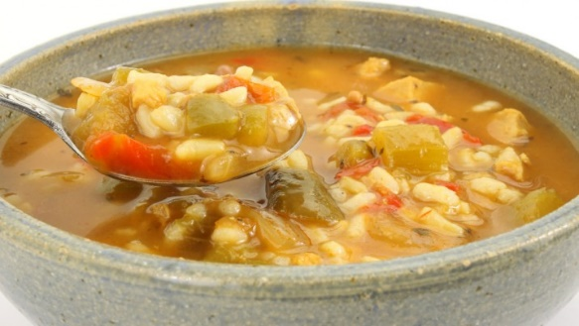
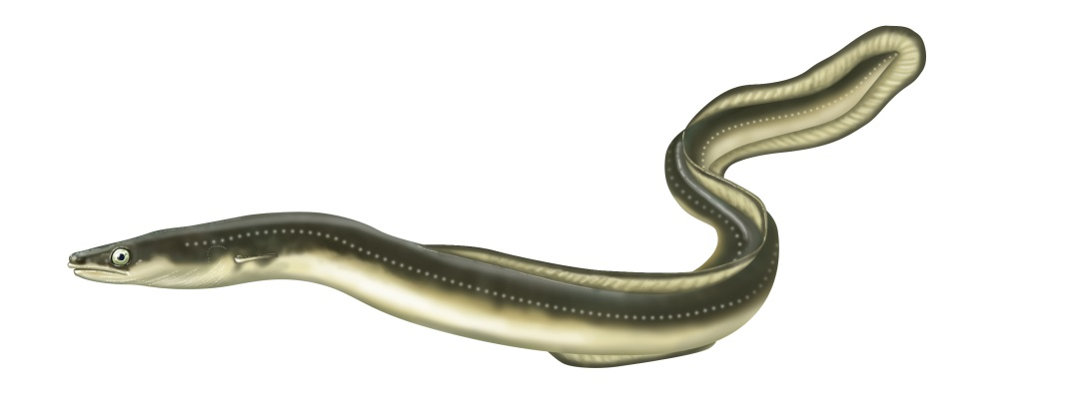
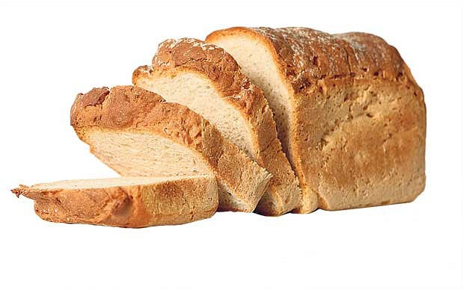
First Course
Pottage – a thick mushy soup.
Eel Broth – eels boiled in water and vinegar.
Bread

Slide 7
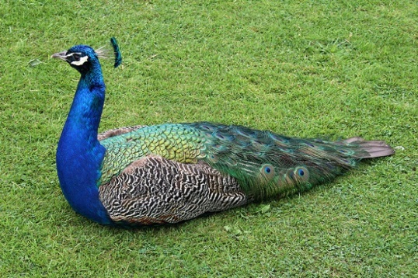
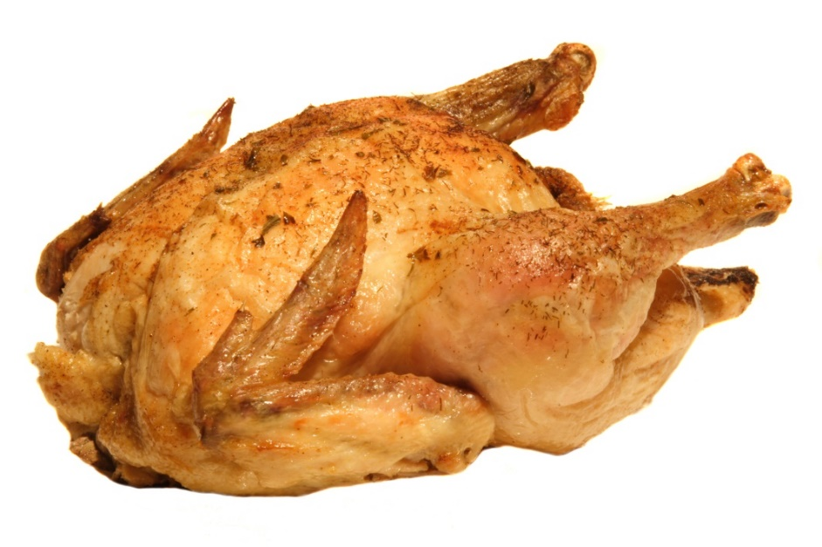
Second Course
Stuffed Peacock – a peacock stuffed with lots of different birds.
Capoun – chicken stuffed with eggs and pork.

Slide 8
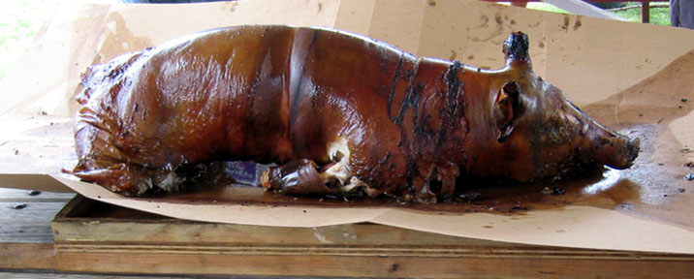
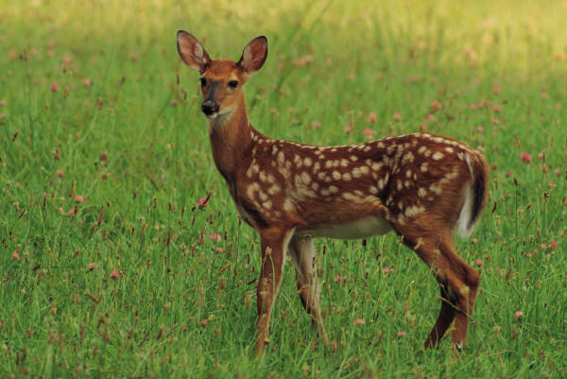
Third Course
Roasted Boar
Roast Venison

Slide 9
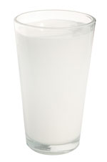
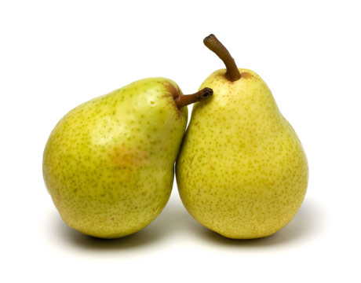
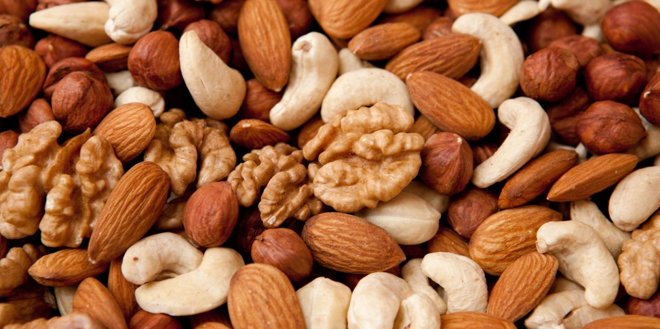
Fourth and Fifth course
Sugared Milk
Pears cooked in red wine.
Nuts

