Slide 1
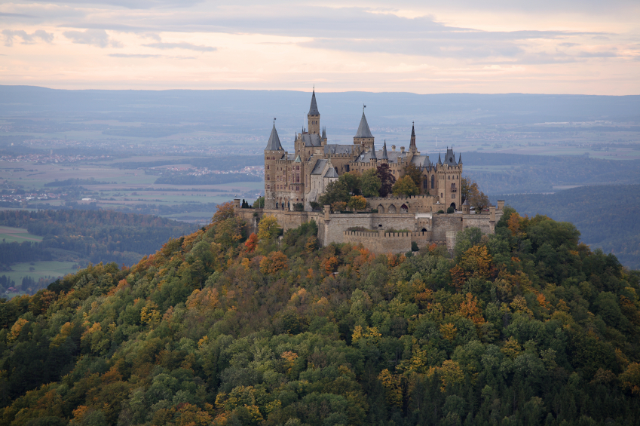
Inside a Castle

Slide 2
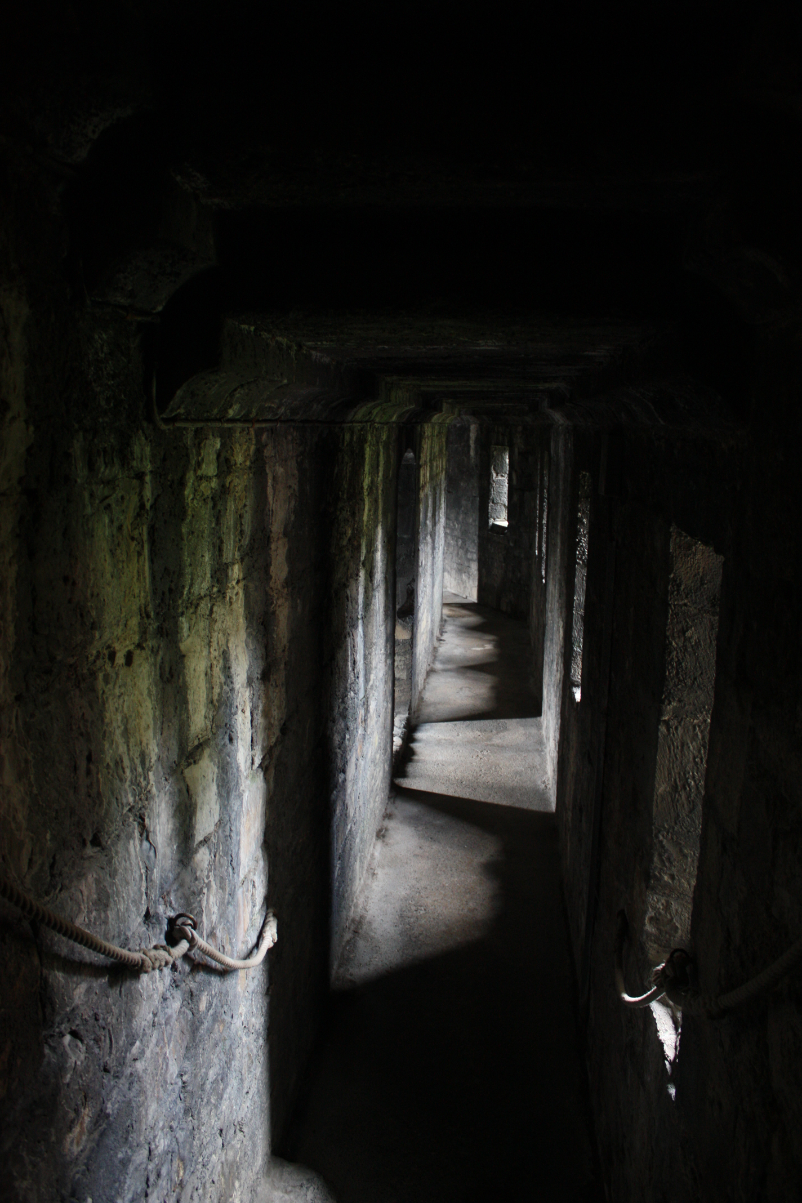
Cold, damp and poorly lit.
Castles looked cool on the outside but really they were cold, damp and poorly lit. The only heating was provided by fireplaces in each room. Castles had to be lit by torches because they were very dark inside.

Slide 3
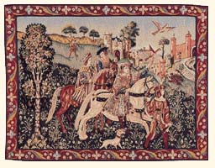
Tapestries
People tended to spend much time outdoors to get away from the dampness of the castle. Tapestries were hung on the wall to help brighten up the halls and keep in heat.

Slide 4
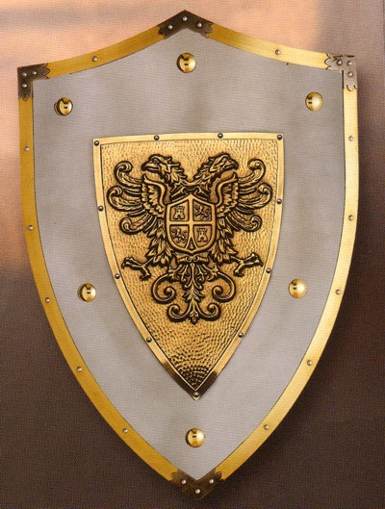
Shields
They used to display some of their shields as well.

Slide 5
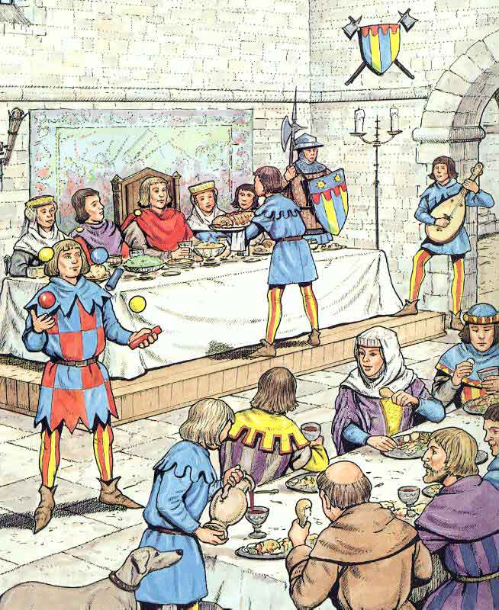
The Great Hall
The main furniture in the great hall was wooden benches and large tables made by laying wood planks across other benches. At night, the table was taken down to make room for the servants who slept on the floor. The floors were covered year round with reeds, bones and scraps of food. When the room began to smell, the servants added more reeds and sprinkled spices to help get rid of the odour. Once a year, the servants replaced the old reeds with new ones and the whole process started again.

Slide 6
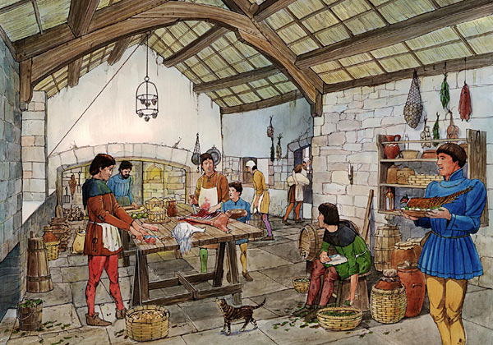
The Kitchen
The King’s kitchen staff decorated most of the food before they served it. Sometimes when meat was served, the servants put the fur or feathers back on the meat to make it look alive! On the other hand, because there was no refrigeration, the food spoiled quickly. Sometimes when the food was spoiled, they just dumped extra gravy on it and served it anyway! One of the only ways to preserve and season food was to salt all of the meat.

Slide 7
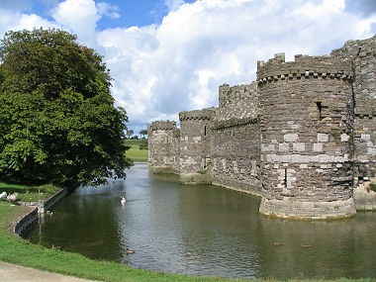
No Bathroom
Bathrooms had no modern plumbing but waste disposal presented no problem. The servants dumped it in the moat! Bathrooms in castles often emptied right into the most as well. Since people in medieval times believed that washing too much could make you sick, bathing became a once-a-month activity. Most didn’t even bother with soap because the soaps were so strong that they could burn holes through cloth. The royal family preferred dirt to holes, so wash days were few and far between.

Slide 8
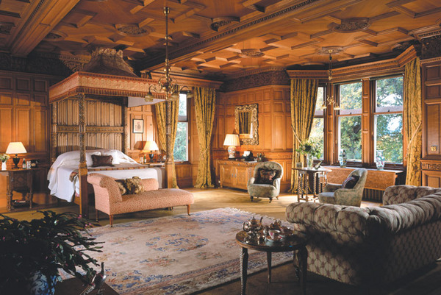
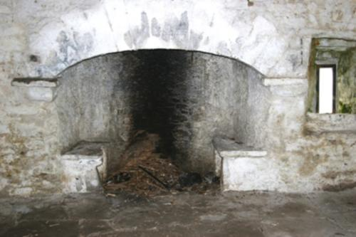
Bedrooms
The castle owners had a proper bedroom, with a bed and wall tapestries. The servants and most of the other castle staff had to sleep in crowded places together in any space that they could find. Probably rolled up in a blanket on the floor, huddled near to a fire for warmth.

Slide 9
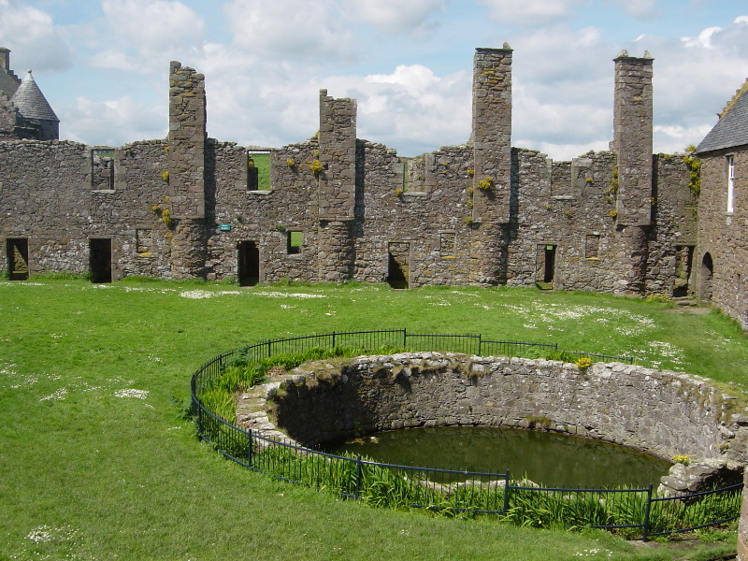
The Well
Castles had very basic facilities. Water did not come from a tap. It had to be collected from a well or a fresh water stream.

Slide 10
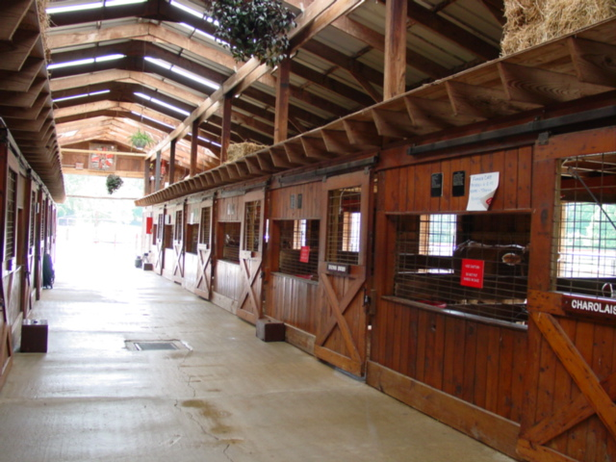
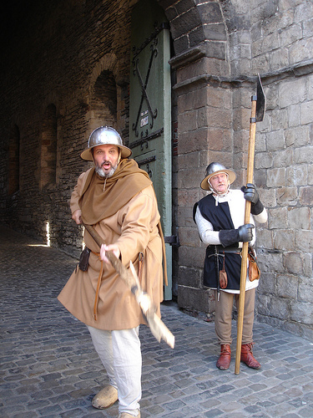
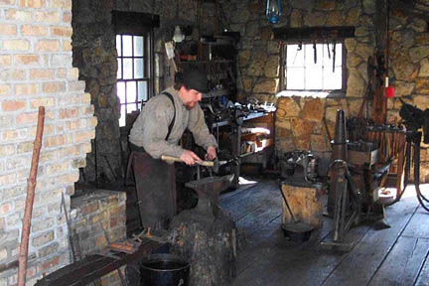
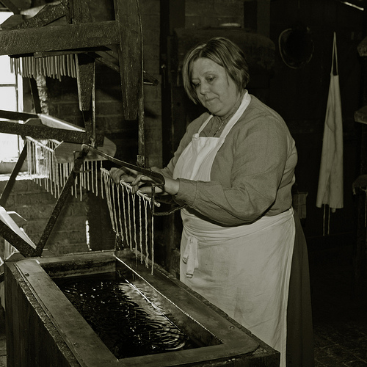
A Busy and Exciting Place
Castles must have been noisy and smelly places. Livestock roamed inside the stable. Blacksmiths clanged out ironwork in the forges. The soldiers practiced their fighting skills and children played when school lessons were complete.
Everything you needed was inside the castle walls. There was always work to be done and the castle was maintained by local craftsmen. Stables, carpenters, saddlers, blacksmiths, armourers, shoe smiths, cooks, candle makers, launderers and tailors all worked inside the castle.

Slide 11
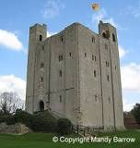
Keep
At the heart of the castle is its tower, known as the keep. The number of floors within the keep depended on its size and the wealth of its owner. All keeps contained a large room known as the Great Hall. The enclosed area between the inside of the wall and the keep.

