Slide 1
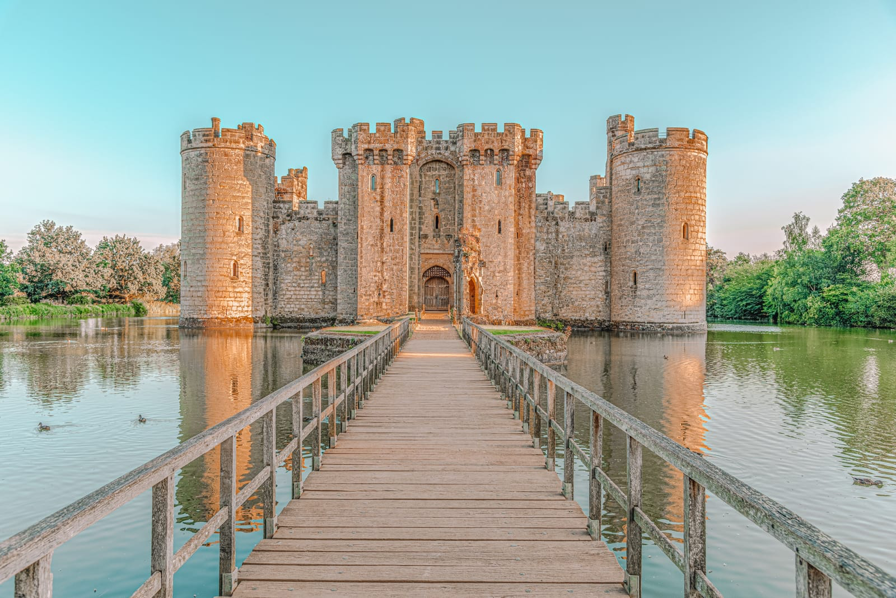
Parts of a Castle

Slide 2
Moat
Moats were of supreme importance. A medieval castle moat was basically a deep and wide ditch that surrounded the castle and served as a reliable protection against enemy assaults. The moat was usually filled with water which was one of the reasons why most castles were built near a water source such as a river or a stream. The depth of a medieval castle moat was usually around 30 feet and it measured around 12 feet in width. Moats made it difficult for enemies to enter the castle.
Fun Fact:
Bathroom waste was poured into the
moat water!

Slide 3
Drawbridge
The Drawbridge was an important medieval castle part which was a movable bridge at the entrance of a castle above the moat. Since the medieval castles were defended by the moats, it was common to remove or destroy the drawbridge in the event of an attack. A Drawbridge could be removed either by ropes, pulleys and or chains. Sometimes simple manpower was used to remove them.

Slide 4
Curtain Wall
Medieval castle walls were central to a castles defence and the width and type varied from castle to castle. It was common to build medieval castle walls of width ranging from 8 feet to 20 feet. At the top of the medieval castle walls were crenellation or parapets which served to defend the castle from above. There were also openings between the medieval castle walls and parapets which were used to throw stones and boiling liquid on the invading armies.

Slide 5
Gatehouse
The medieval castle gatehouse was built at the entrance of a castle and acted as a minor fortification. It enclosed the gateway for the castle and usually also consisted of chambers for important guests.

Slide 6
Portcullis
A strong gate made of metal bars with points at the bottom that hangs above the entrance to a castle. In the past, it was brought down to the ground in order to close the entrance against enemies.

Slide 7
Towers
In the defence of a medieval castle, towers played a central role. The main difference between a medieval castle tower and medieval castle turret was that the latter was constructed on the top of a wall while the former projected from the ground. Towers were mainly built of stone and included battlements and arrow loops for defence.

Slide 8
Turrets
A turret was a small tower that was constructed at the edge of a medieval castle wall. Its main purpose, like most other components of medieval castle parts, was defence. During the middle medieval times, turrets were usually square shaped but during the late medieval times, circular shaped turrets became more popular because they provided a better line of sight for the archers defending the castle.

Slide 9
Battlements
The medieval castle battlements were of central importance in the defence of a castle. A medieval castle battlement consisted of a rampart which was built at the top of a castle walls and towers. There were specially designed gaps in the ramparts which served to release arrows, stones, or other missiles at the invading armies.

Slide 10
Murder Holes
In the medieval castle parts, murder holes were also of primary defence value. A medieval castle murder hole was a large hole in the ceiling of the gateway of the castle and was used to throw various objects such as stones, tar, or boiling liquids on the invaders. Murder holes could also be built in the platforms similar to a balcony protruding from the outside walls of a castle.

Slide 11
Arrow Slits
Arrow-loops or arrow-slits were an inevitable part of medieval castle battlements and thus its defence. A medieval castle arrow-loop was a narrow opening in the medieval castle walls and towers and was used to launch arrows at the invading enemy. Arrow-loops were found in various forms although the most popular form was that of a cross.

Slide 12
Keep
At the heart of the castle is its tower, known as the keep. The number of floors within the keep depended on its size and the wealth of its owner. All keeps contained a large room known as the Great Hall. The enclosed area between the inside of the wall and the keep.

