Slide 1
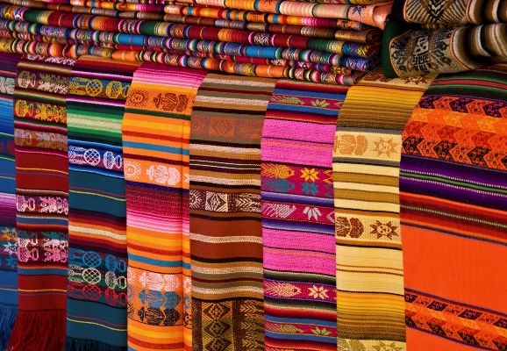
Northern Ireland v
Mexico

Slide 2
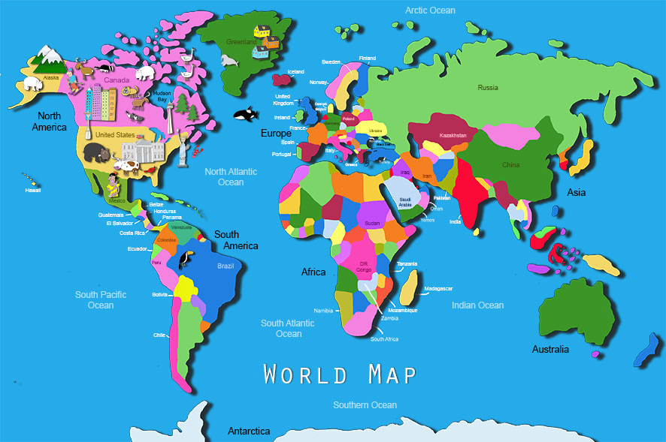

Slide 3
Facts about Mexico
They speak Spanish.
Mexico is a land of extremes, with high mountains and deep canyons in the centre of the country, sweeping deserts in the north, and dense rain forests in the south and east.
Located between the Equator and the Arctic Circle, it is a refuge for animals fleeing extreme cold in the north and intense heat in the south.
The rain forests and coastal wetlands of eastern Mexico are home to thousands of tropical plant species and animals like jaguars.
Mexico's ancient societies built great cities and huge pyramids, created remarkable works of art, and even studied the stars and planets to determine when to plant crops and hold ceremonies.

Slide 4
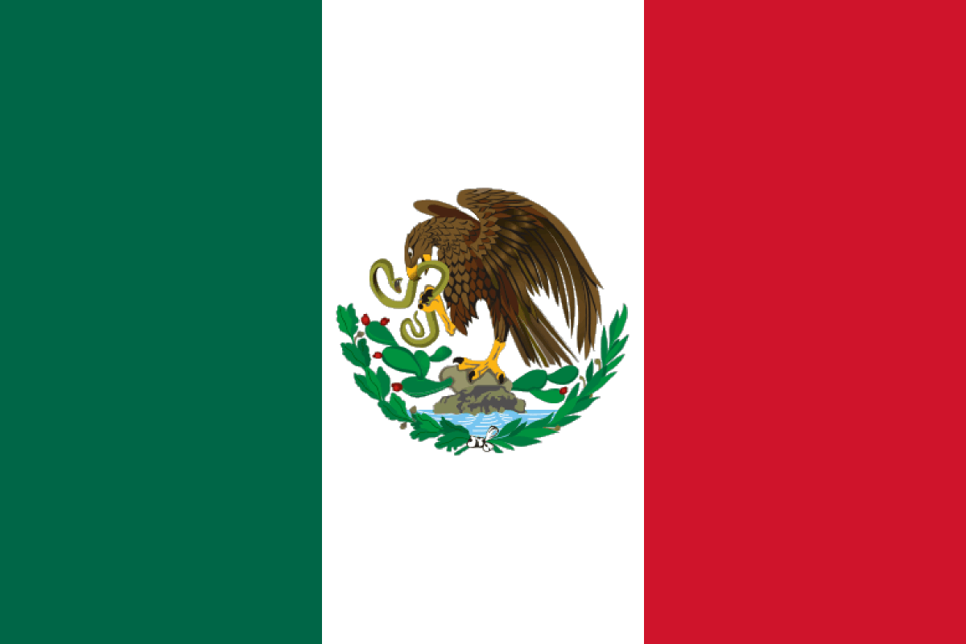
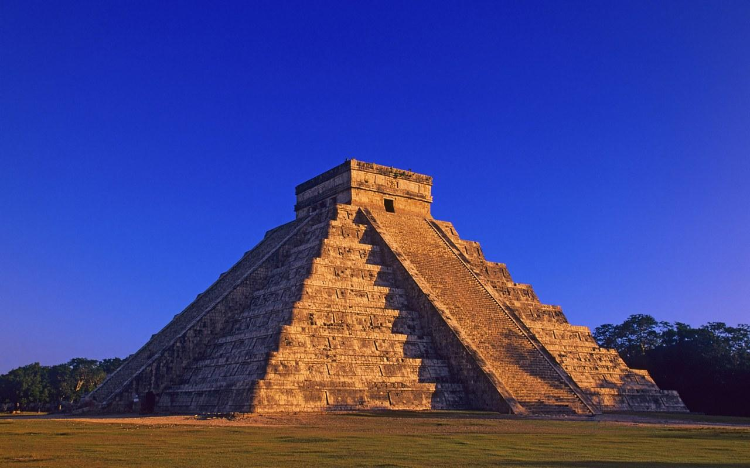
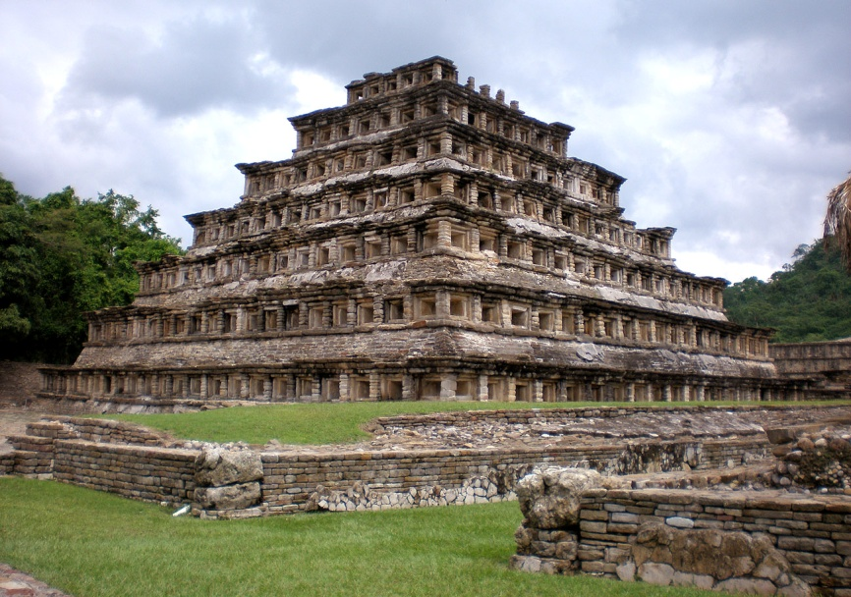
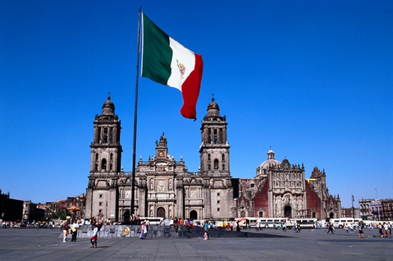

Slide 5
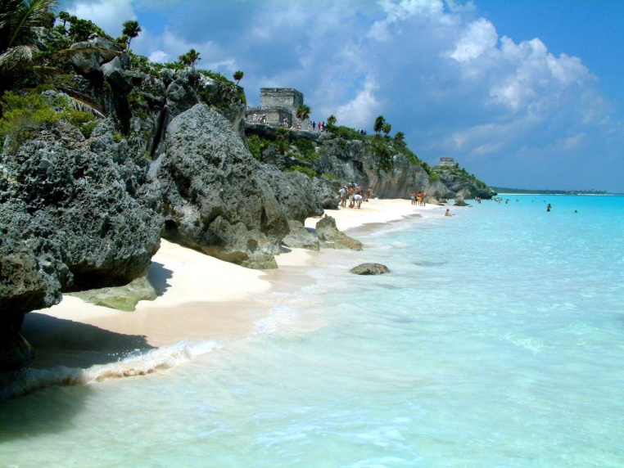
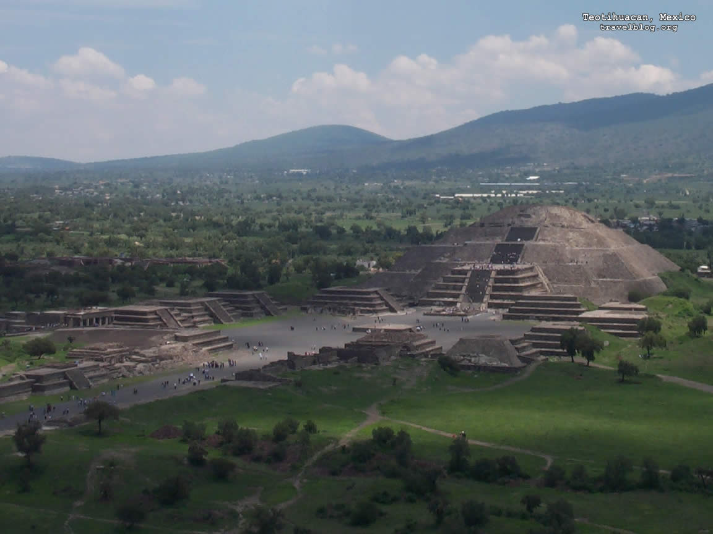
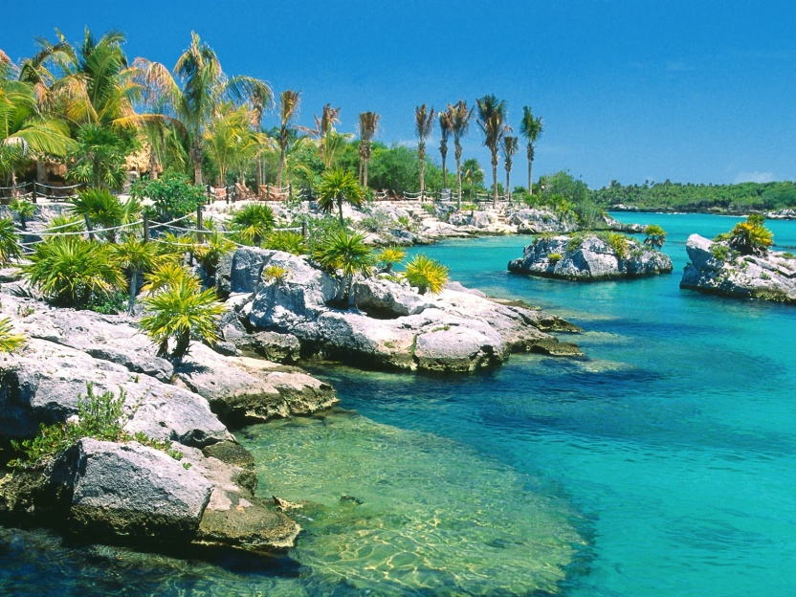

Slide 6
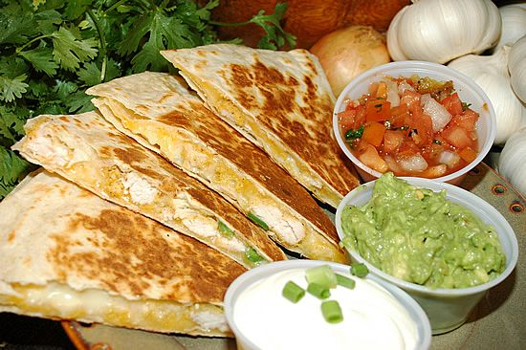
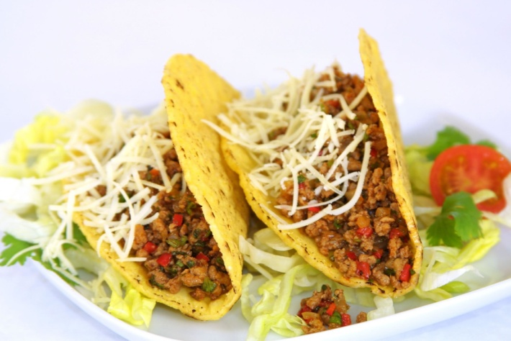
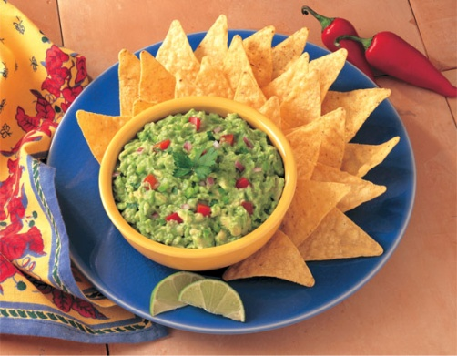

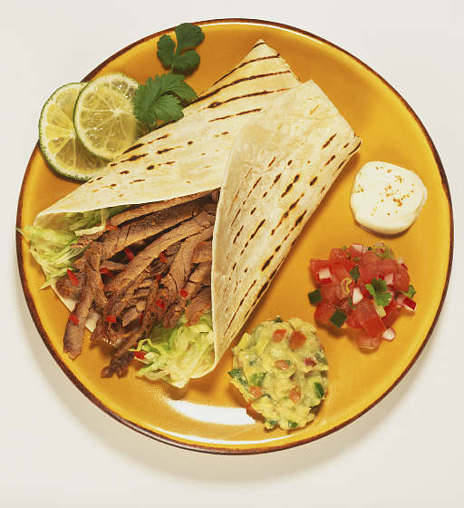
Mexican Food

Slide 7
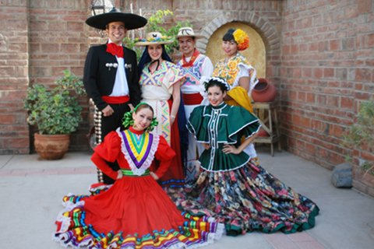
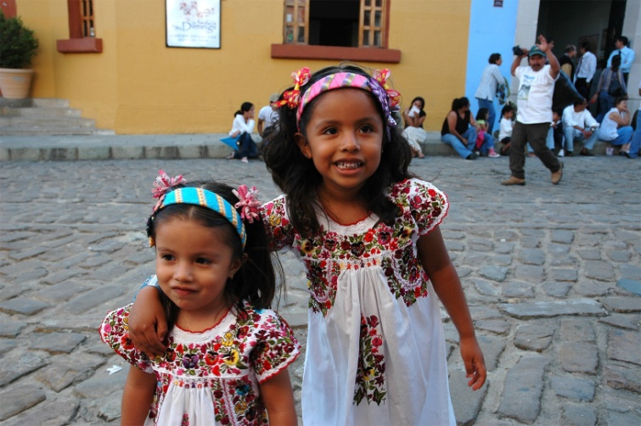
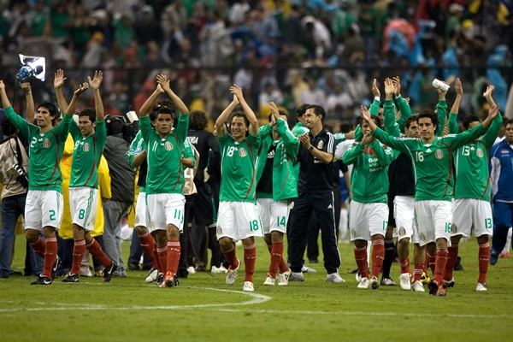
Mexican people

