Slide 1
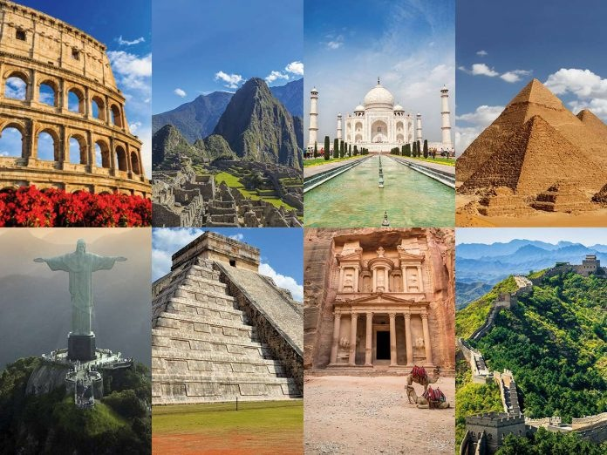
Wonders of the World

Slide 2
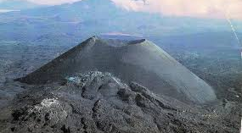
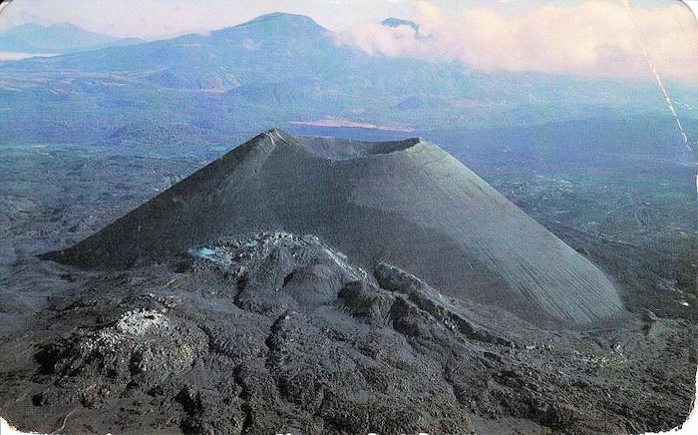
Paricutin Volcano

Slide 3
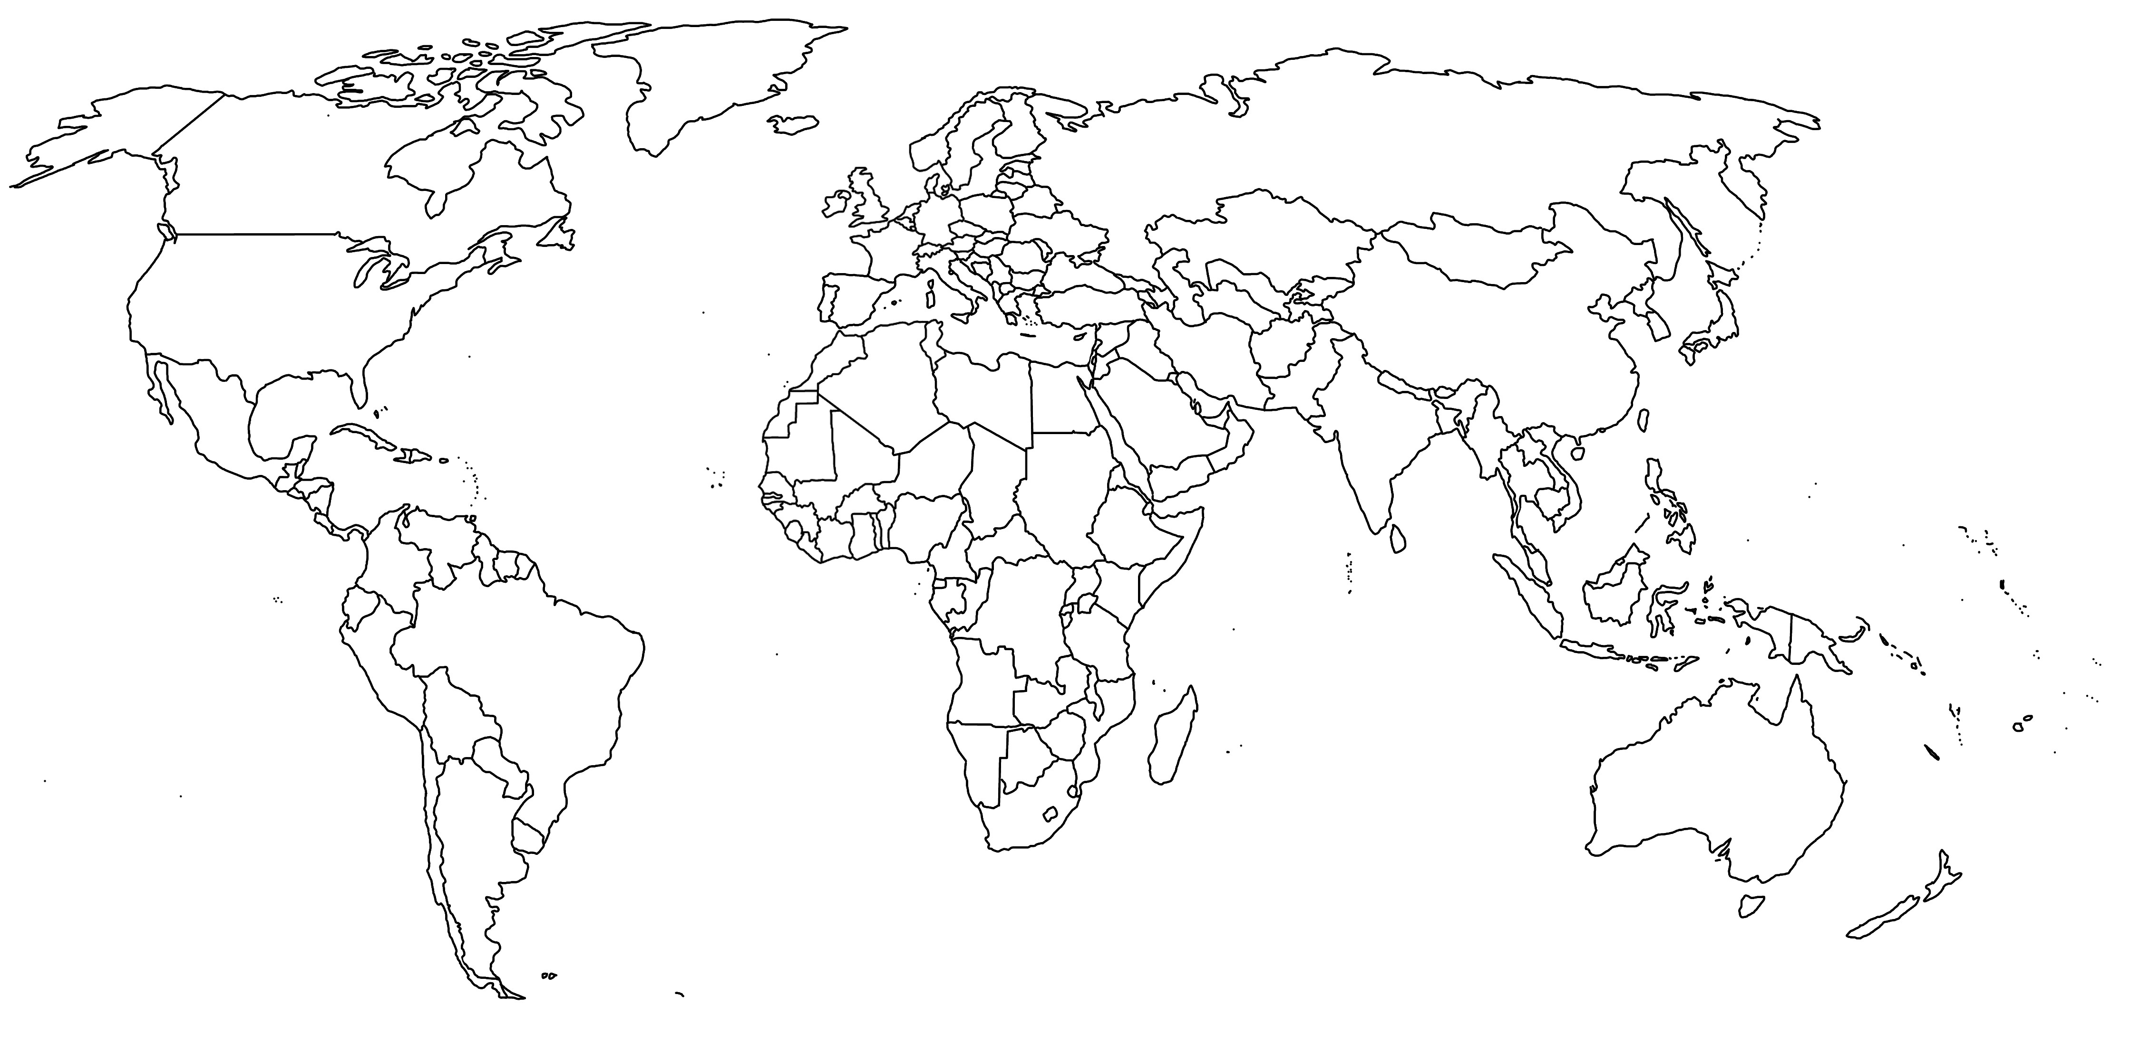
Northern Ireland
Mexico

Slide 4
The Paricutin Volcano is in the state of Michoacán in Mexico. This volcano is actually one of the Seven Natural Wonders of the World. It is known as a cinder cone volcano; this steep conical shape was created by debris. One of the most special things about this Natural Wonder of the World is that humans have been around to witness its activity from the beginning to its extinction.

Slide 5
Two weeks before the quick growth of Paricutin, the villagers in the area reported loud rumblings in the ground as well as feeling an earthquake sensation. Dionisio Pulido and his wife were the first people to see the volcanic eruption in February 1943 in their cornfield. Imagine having a volcano in your back garden!

Slide 6
Paricutin Volcano Facts
The Paricutin Volcano is part of the Ring of Fire. The Ring of Fire is an area of high earthquake and volcanic activity. This happens in the Pacific Ocean.
This particular volcano grew very quickly. It started off as small eruptions of ash and stones. These small eruptions grew into eruptions the height of a five story building in only a week!
It continued to grow and grow and in a year the volcano had reached 336 meters. The final height that the volcano reached by the end of its life was 424 meters.

Slide 7
The Paricutin Volcano continued to erupt for eight years until 1952. The volcano has remained silent since then. It is believed to be a monogenetic volcano and that means that when it is finished erupting it will never explode again.
The volcano was named after the village where it is located.
Did you know that when the lava from a volcano cools and hardens, the hard rock that it forms is called basalt?

Slide 8
The residents of the village had to evacuate their homes because of the explosions and soon the area became unsafe for them to live there anymore. By 1944, the village had disappeared as it was completely covered by lava with only the top part of San Juan Parangaricutiro church still visible.
You can climb the volcano and it is an amazing thing to do! It is definitely a bit scary but experiencing one of the Seven Natural Wonders of the World would be unforgettable!

