Slide 1
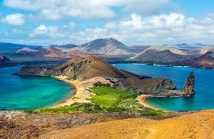
Galapagos Island Animals

Slide 2
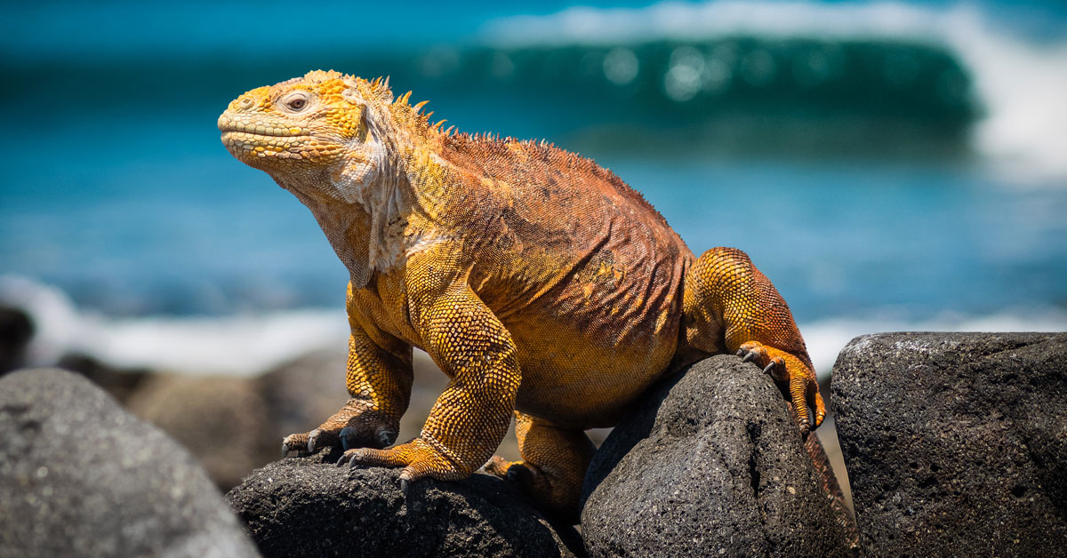
Land Iguana
Land iguanas are very long. They can grow more than 90 cm in length. They are yellow in colour. They have scaly skin with spikes on their backs and claws to attack predators. Land iguanas live in the dry areas of the Galapagos Islands. In the morning, they like to be out in the hot sun. At night, they sleep in burrows under the ground. They eat plants and shrubs, such as spiny opuntia cacti, as well as fallen fruits and cactus pads. Land iguanas can live for more than 50 years.

Slide 3
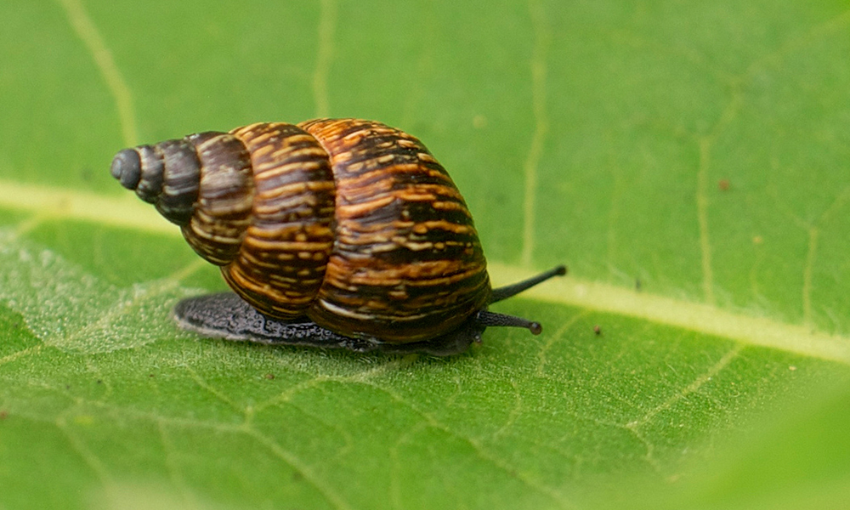
Land Snails
One of the tiniest animals on the Galapagos Islands is the land snail. They like to live in high up places, for example, on mountains and where there is a lot of different plants for them to eat. They like to hide under lava rocks and inside tree bark. They are only 25 mm in length and have a shell to protect them against birds and beetles.

Slide 4
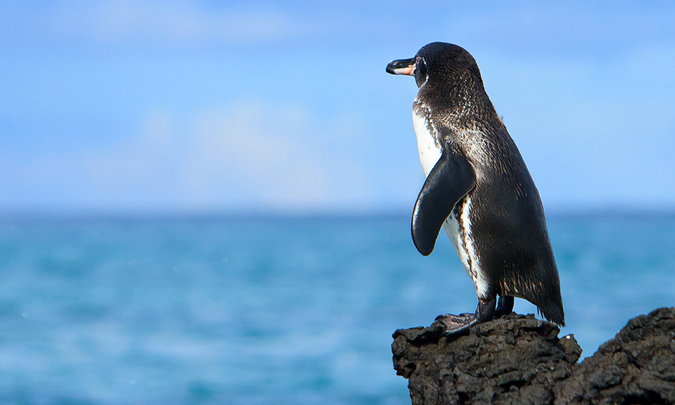
Galapagos Penguin
The Galapagos penguin is one of the smallest penguins in the world. They live in caves and cracks in the coastal lava. They are very good at swimming and hunt for anchovies and sardines to eat. They can grow to be 55 cm tall and can live until they are 20 years old. On land, snakes, owls and hawks can attack them and in the sea, sharks and seals can attack them. They have waterproof feathers and flippers. Their bill is strong to crack open or tear food.

Slide 5
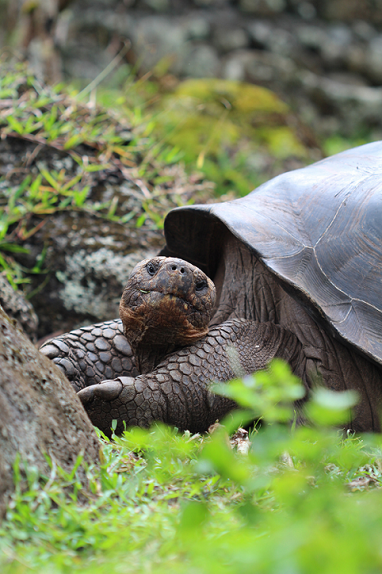
Giant Tortoise
The giant tortoise tends to live on the large, humid islands of the Galapagos where there is a lot of vegetation to eat. They spend 16 hours per day resting and the rest of their time eating grasses, fruits and cactus pads. They also enjoy bathing in water to keep cool. Rats, pigs and dogs can attack tortoises. They have a large dome shaped shell to help protect them. The giant tortoise can grow to be 1.8 m in size, 400 kg in weight and live to be over 100 years old.

