Slide 1
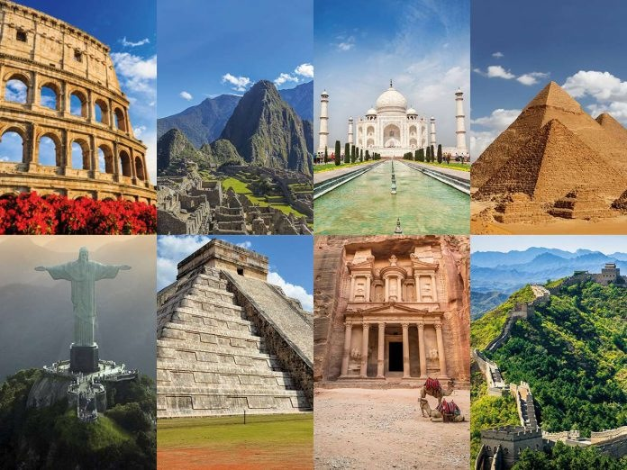
Wonders of the World

Slide 2
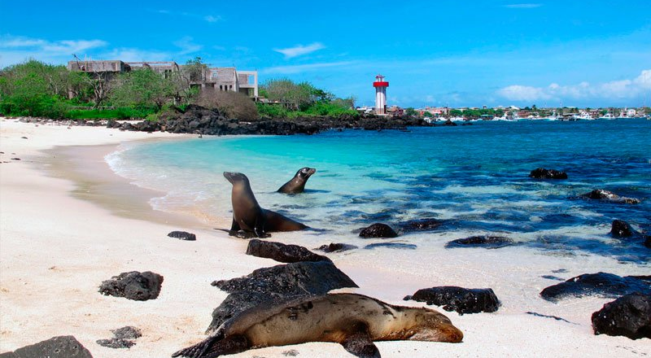
Galapagos Islands

Slide 3
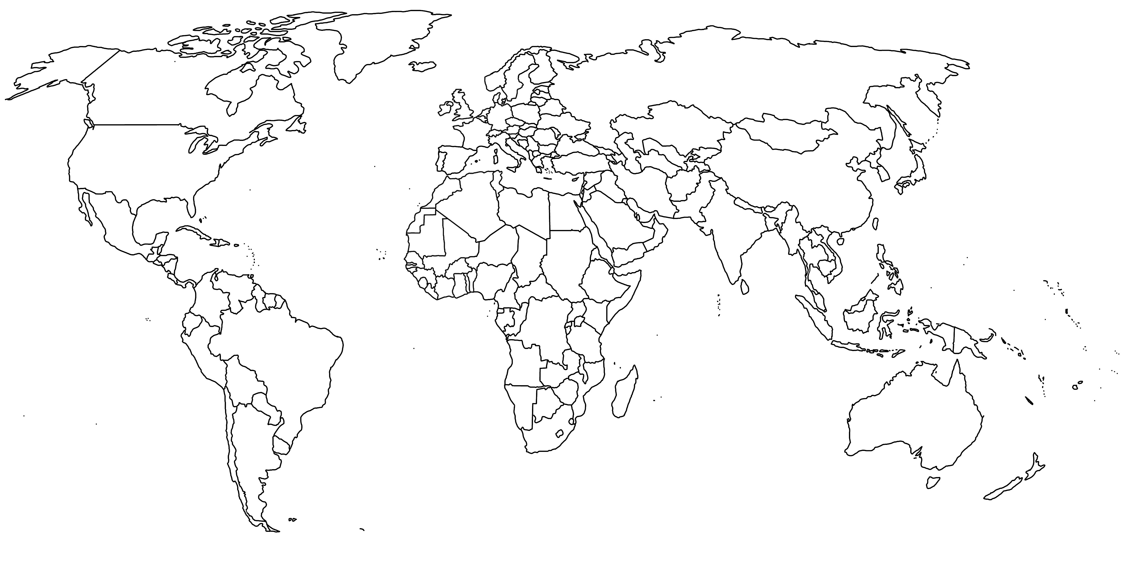
Northern Ireland
South
America
(Ecuador)

Slide 4
History of the Galapagos Islands
The Galapagos form an archipelago, which means a large group of islands, of 18 major islands of lots of smaller islands.
The islands came out of the deep dark depths of the ocean about four million years ago after volcanic activity on the ocean floor.
In 1535 these amazing islands were discovered by Panamanian bishop Fray Tomas de Berlanga while he was sailing away to Lima, Peru.
Many years later, Abraham Ortelius named them Galapagos because of the saddle-shapped shell of the giant tortoises that live there. In Spanish, ‘galapagos’ means ‘saddle’.
After that absolutely nothing happened. For hundreds of years the islands stayed abandoned, except for pirates of course, whalers and buccaneers who used them as hideouts. In 1832, Ecuador claimed the islands and the 1959 declared them a national park.

Slide 5
What are the Galapagos Islands?
The Galapagos Islands are a volcanic archipelago which belongs to Ecuador, which is nearly 900km miles west of its mainland.
The Galapagos go right across the equator line and are in the Pacific Ocean.
There are 18 main islands, 3 smaller islands and 107 islets or rocks. The largest of the islands is Isabela.
Only five of the islands have people living on them; Baltra, Santa Cruz, San Cristobal, Isabela and Floreana.

Slide 6
What lived on the island before humans came?
There are absolutely humongous tortoises on the islands and can you guess how they arrived there? Well they actually floated on the ocean currents.
Iguanas and other small animals possibly latched onto tree trunks or other natural rafts and followed the currents as well.
There are seven species of lava lizards but good luck finding a frog or other amphibian here… they don’t exist!
You also won’t find any mammals as they certainly wouldn’t be able to take the scorching heat from the journey or the long periods where animals have to go without food.
There is a cute little fellow called the Galpapgos Penguin and he’s one of the smallest penguins in the world. He or she is the only animals to cross the equator into the Northern Hemisphere. They would be cool to see.
You also get sea lions as well as whales and dolphins. Sally Lightfoot crabs are everywhere! They scuttle along the rocky shores.
There are 13 species of gorgeous finches. They are called Darwin’s finches and they played a big role in Charles Darwin’s theory of evolution.

