Slide 1
The Victoria Falls, Africa
Let’s take a look

Slide 2
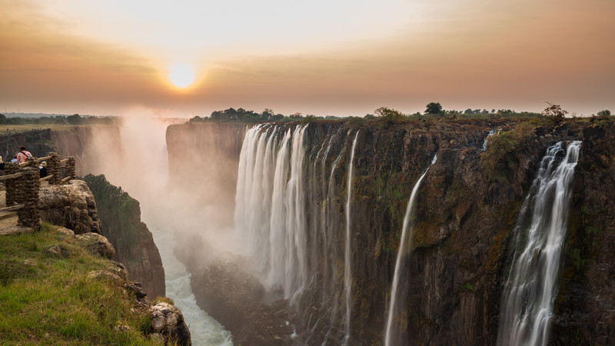

Slide 3
Victoria Falls is part of the Zambezi River in Zambia, Africa.
The Zambezi River is the fourth longest river in the world.
Victoria Falls is 108 metres high!
Spray from the waterfall can be seen from many miles away and the roar of the water can be heard even before it can be seen.

Slide 4
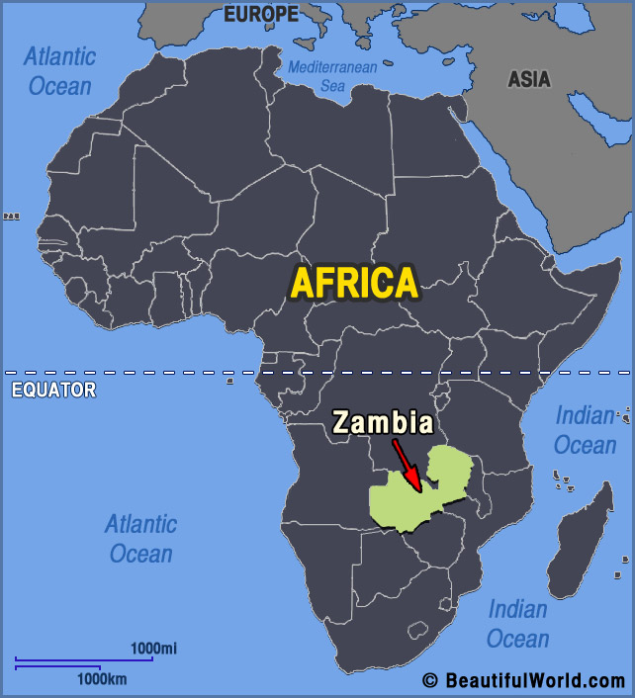

Slide 5
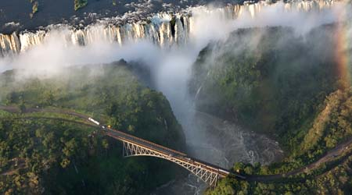
An explorer called David Livingstone named Victoria Falls after Queen Victoria.
The local people called the falls
Mosi-oa-Tunya, which means ‘The Smoke that Thunders.’
The bridge allows people to travel by train, by automobile and on foot.

Slide 6
Click to see some of the animals you would find near Victoria Falls…
Can you name them all?

Slide 7
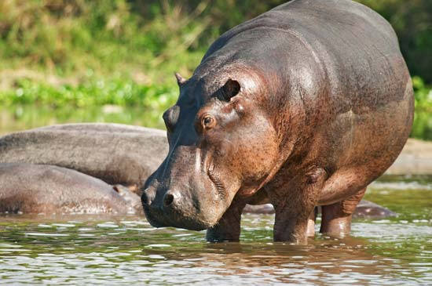
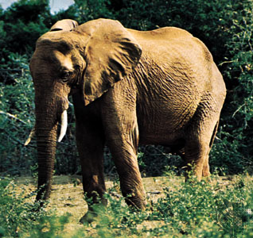
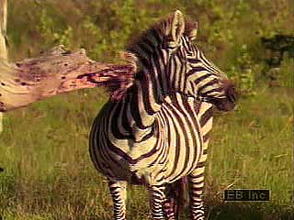
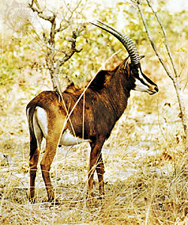
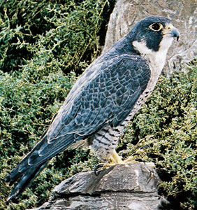
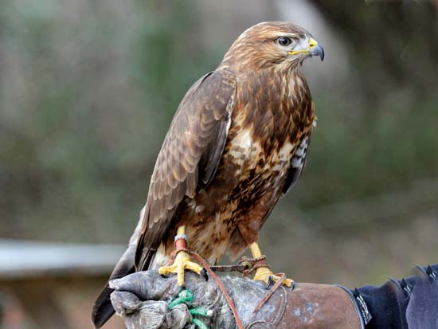
Elephants
Hippos
Zebras
Eagles
Antelope
Buzzards

