Slide 1
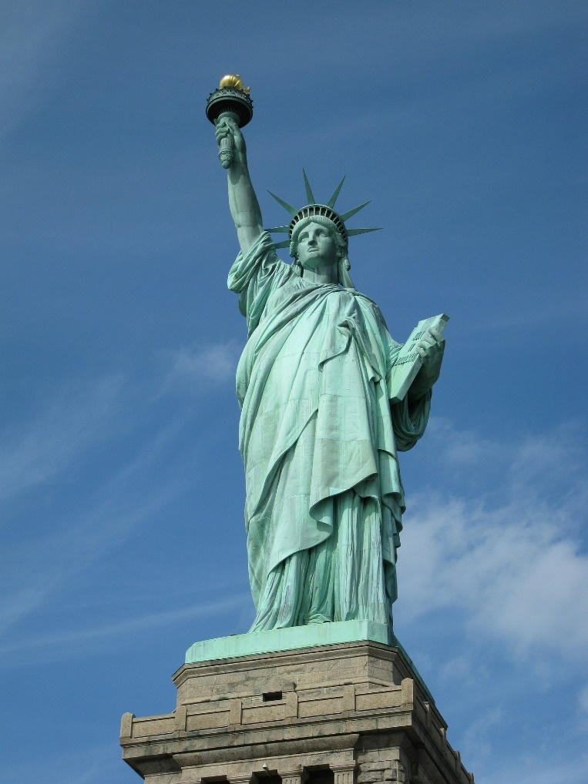
Famous Landmarks
Statue of Liberty, USA

Slide 2
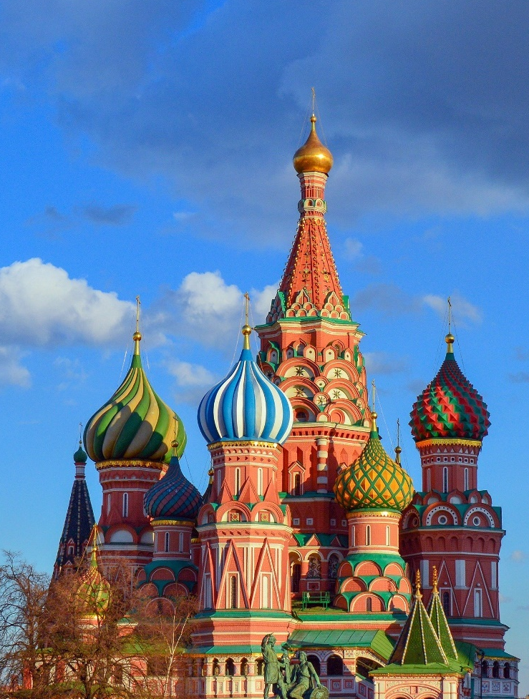
Famous Landmarks
St Basil’s Cathedral, Russia

Slide 3
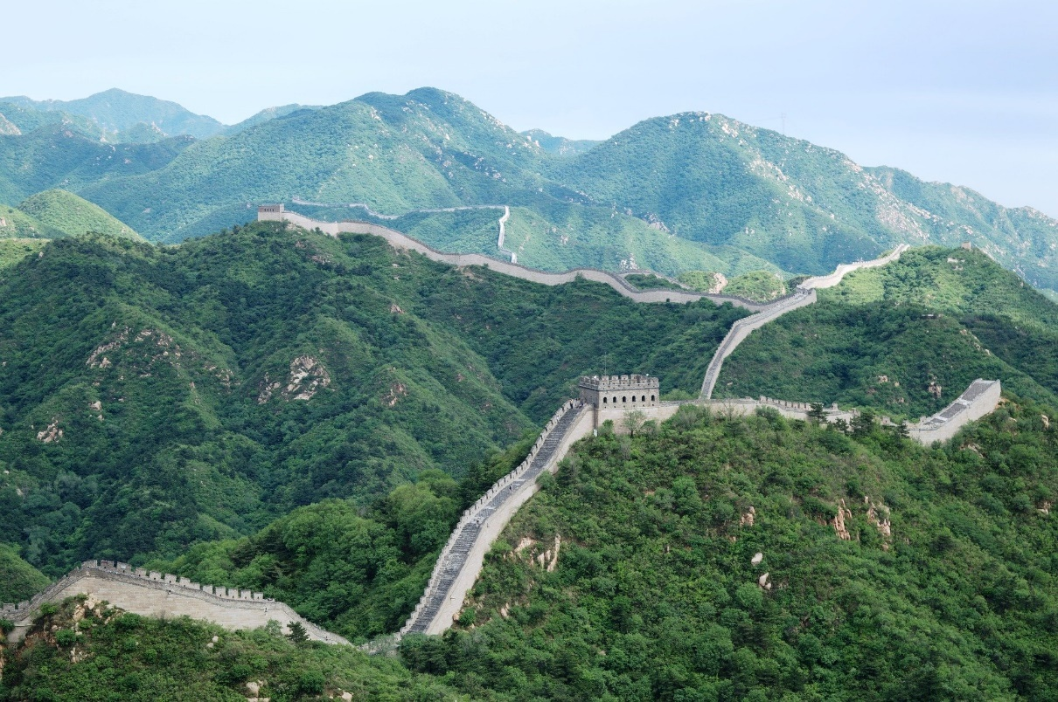
Famous Landmarks
The Great Wall, China

Slide 4
The Sahara Desert
Now let's look at landmarks in Africa!
A desert is a place that has less than 25cm of rain a year. Deserts don’t have to be hot – there are deserts in very cold places too. The Sahara Desert is in northern Africa. It is the largest hot desert in the world and stretches across 11 different countries.

Slide 5
Maasai Mara
This is the Maasai Mara in Kenya. It is named after the Maasai, a group of people who have lived in the region for many hundreds of years. Here is Ubercorn with some Funky Facts.

Slide 6
Victoria Falls
Victoria Falls is on the Zambezi river, along the border of two countries, Zambia and Zimbabwe. It is one of the world’s largest waterfalls. The noise of the water is so loud that it can be heard from almost 40 kilometres away! This is why the falls are known locally as ‘Mosi-oa-Tunya’ which
means ‘the smoke that thunders’.

Slide 7
Landmarks Quiz
1. What is a landmark?
a. A patch of dirt on some land.
b. Something that stands out in an area.
c. A sign on a map.

Slide 8
Landmarks Quiz
2. Which of these is not a country in Africa?
a. Egypt
b. Zambia
c. England

Slide 9
Landmarks Quiz
3. What is the name of the desert we have learnt about?
a. The Sahara Desert
b. The Landmark Desert
c. The Africa Desert

